Slide 1
Gastric and Peritoneal Lavage
Prepared by-
Dr. Sonam Bhatt
Assistant Professor
Vet. Medicine)

Slide 2
Gastric lavage, also commonly called stomach pumping or gastric irrigation
It is the process of cleaning out the contents of the stomach
Gastric lavage procedures are often performed an emergency situation

Slide 3
Indications
Eliminating poisons from the stomach
When the body temperature rises above 40 °C, gastric lavage with iced saline also can be an aggressive cooling measure in a medical emergency

Slide 4
Requirements
White tape
• Mouth gag
• Sterile lubricant
• Gauze
• Orogastric tube
• Warm lavage fluid (e.g., tap water) in a bucket
• Drench or stomach pump
• Sedatives

Slide 5
• Endotracheal tube & anesthesia machine
• IV catheter supplies
• Activated charcoal pre-drawn in 60 ml syringes ready for administration (Dose: 1-5g/kg of charcoal)

Slide 6
Procedure
Pass the stomach tube or nasogastric tube via the mouth or nose down into the stomach
The placement of the tube in the stomach must be confirmed by pH testing a small amount of aspirated stomach contents, or x-ray
sequential administration and removal of small volumes of liquid

Slide 7
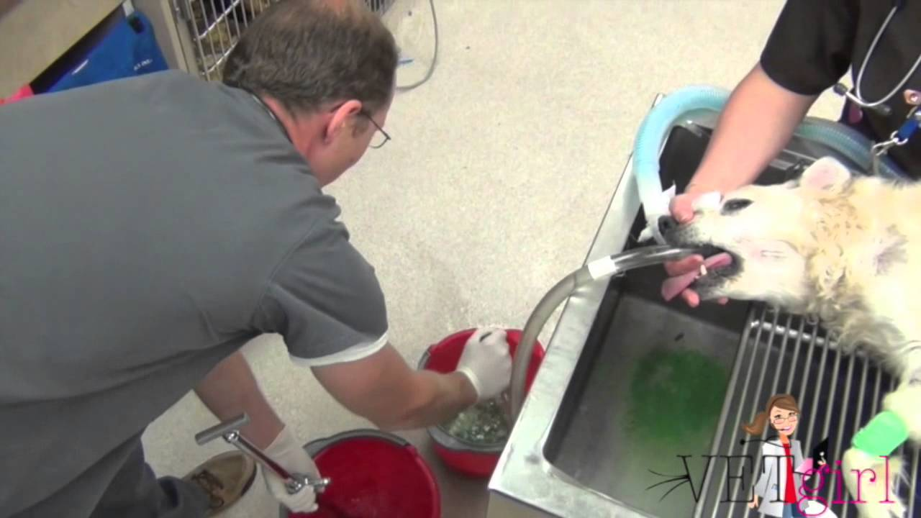

Slide 8
Peritoneal lavage
When lavage is performed in peritoneal cavity, it is called as peritoneal lavage

Slide 9
Indications
In case of peritonitis for diagnosis & treatment

Slide 10
Procedure
The dog will be intravenously anesthetised
A vertical incision of the skin will be made one third of the distance from the umbilicus to the pubic symphysis
The linea alba is then divided
The peritoneum is picked up to prevent bowel perforation

Slide 11
The peritoneum is then entered
A catheter will be inserted towards the pelvis and an attempt at aspiration of material using a syringe will be made
If no blood is aspirated, warm saline is infused.
After a few minutes this is drained and then sent for analysis

Slide 12
