Slide 1
BVSC & AH
(General Pathology)
INFLAMMATION
DEFINITION, CAUSE & TYPES
Dr. Sanjiv Kumar
Assistant Professor,
Deptt. of Pathology, BVC, Patna

Slide 2
Definition: The reaction of living, vascularized tissues to injury.
Complex reaction in the vascularized connective tissue
The goal is to dilute, destroy, or wall off the injurious agent
5 Cardinal Signs of inflammation
1) Heat (Calor)
2) Redness (Rubor)
3) Swelling (Tumor)
4) Pain (Dolor)
5) Loss of Function (Functio laesa)
First four by Cornelius Celsus
Fifth one by Rudolph Virchow.

Slide 3
Remember
1) Inflammation is a good thing
2) However, inflammation can be bad
3) Predictable series of events, multiple participants
4) Only occurs in living tissues
5) Defensive mechanism, innate immunity
6) A response evoked by initiating stimulus
7) Fairly stereotyped response regardless of initiating stimulus
8) The reactive components come mostly from the blood
9) Highly redundant, many mediators
10) Sets up healing & specific immunity

Slide 4
Initiating stimuli of Inflammation
Infections (bacterial, viral, fungal, parasitic)
Microbial or other toxins; xenobiotics
Trauma (blunt or penetrating)
Physical or chemical agents (thermal, irradiation, caustics)
Tissue necrosis
Foreign bodies
Immune (hypersensitivity reactions)
Nutritional imbalance

Slide 5
Terminology of Inflammation
Inflammation of an organ or tissue is designated by adding suffix 'itis', after its name in Latin or Greek.
The term acute diffuse serofibrinous peritonitis indicates an acute inflammation of the entire peritoneum characterized by serofibrinous exudate.
The term chronic diffuse suppurative interstitial hepatitis signifies chronic inflammation of the interstitial tissue of the liver characterized by pus formation.

Slide 6
Classification of Inflammatory Response
Severity: how bad is it?
Duration: how long has it been going on?
Distribution: how widespread/is there a pattern?
Type of exudate

Slide 7
Severity of Inflammation
Minimal
Mild
Moderate
Severe

Slide 8
Duration of Inflammation gradual transformation from Peracute to acute, acute to subacute & subacute to chronic
Peracute | Acute | Subacute | Chronic
Min to hours after initiation Hallmarks - Edema (pus filled) - Hyperemia (red) - Minimal cellular infiltration - Example: hives, urticaria | hours to 3-5 days after initiation Hallmarks - Edema Extensive vascular engorgement Fibrin exudation then neutrophils - Lymphatic dilation leading to swollen regional lymph nodes - 5 cardinal signs are very evident | several (3-5) to many (7-14) days Hallmarks - Minimal edema (pus reabsorbed) - Decreased vascular changes - Change of infiltrating leukocytes from neutrophils to lymphocytes, macrophages, & plasma cells | 7-14 days until resolution or death Hallmarks - Angiogenesis - Fibroplasia Regeneration Inflammatory cells are predominantly macrophages - Possible formation of epitheloid cells & multinucleate giant cells - Also infiltration of lymphocytes & plasma cells

Slide 9
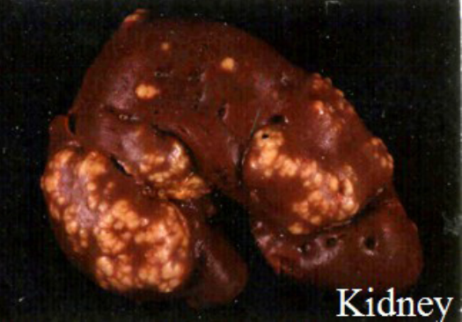
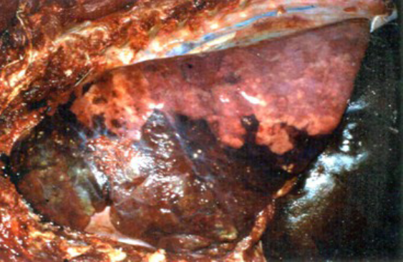
Distribution of Inflammation
Focal
Single Lesion (White Infarct)
- Size not indicated (mm to many cm diameter)
- Discrete (easily recognizable)
Multifocal
Multifocal lesions
Scattered to numerous focal lesions
Locally Extensive
- Used when a large region of an organ is diffusely involved
- i.e. an entire lobe of an organ or confluent anterioventral
portions of lungs in bronchopneumonia
- ex. Lobar pneumonia

Slide 10
Segmental
Inflamed segment of intestine - Primarily used in the intestine.
Diffuse
- All the tissue or organ is involved
- Severity may vary across the tissue, but entire organ is involved.

Slide 11
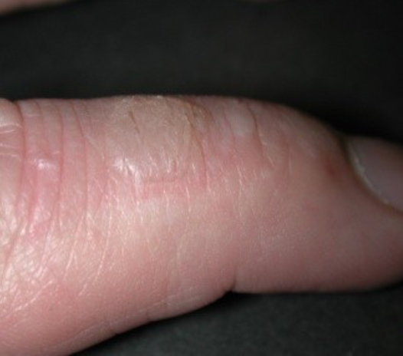
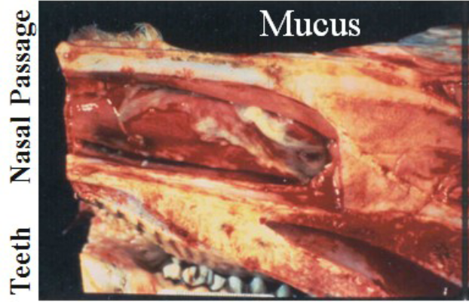
Types of Exudates
Acute
• Serous
Protein-rich fluid exudate by moderately severe irritants.
From plasma or secreted by serous mesothelial cells
stains pink with eosin;
rubbing nature and second-degree burns also form blisters on the skin. Certain viruses (foot-and-mouth, vascular stomatitis)
▪ Catarrhal/ Mucous
Inflammation of a mucosal surface which is predominantly characterized by hypersecretion of mucus
Mucus is a clear, transparent, glistening slimy material containing water and mucin.
Mucus stains blue with haematoxylin.
Irritants that are mild in nature, such as formalin, phenol, detergents, irritating foods in the digestive tract, inhaled dust, cold air, bacterial and viral infections of low virulence in respiratory tract.

Slide 12
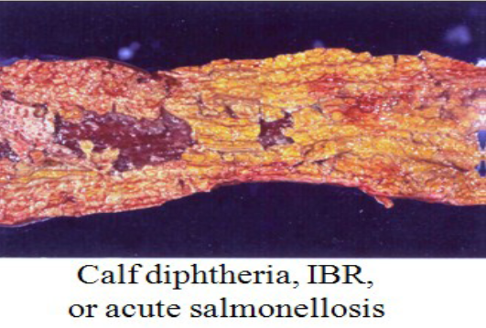
Fibrinous
Protein-rich exudate with adequate vascular permeability such that fibrinogen escapes the vessels and polymerizes in the tissue or on a surface to form fibrin
more violent type of injury.
Stains dirty pink with eosin.
Gross appearance of fibrin : White to yellow, easily broken down, usually adherent mat of exudate on a serous or mucosal surface.
Infectious feline enteritis, malignant catarrhal fever, Corynebacterium diphtheriae, various salmonella, or Fusobacterium necrophorum
Masses of fibrin on epithelial surface may either form a pseudomembrane (croupous membrane) when it is easily peeled away, or a diphtheritic membrane when it is quite firmly attached.
If the necrotic, denuded epithelial cells are also included in the mass, it is a 'true membrane', otherwise, without epithelial cells it is called a 'false membrane'.
Calf diphtheria, and intestinal tract in swine fever.

Slide 13
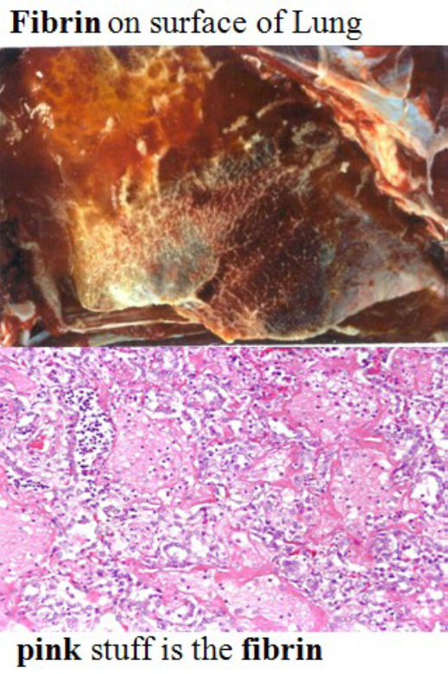

Slide 14
Suppurative (purulent)
Neutrophils are the principle component of pus, along with dead cell, serum, etc.
Any irritant causing positive chemotaxis and necrosis will produce suppuration.
Usually associated with acute inflammation, but may be seen in subacute to chronic inflammation.
The main causes of suppurative inflammation are:
1. Pyogenic bacteria: Ex. staphylococci, streptococci, and members of the Coli group.
2. Specific organisms like C. pyogenes, P. mallei, A. bovis, etc.
3. Chemicals - turpentine, mercuric chloride, croton oil etc.
Streptococci and staphylococci produce white or yellow pus.
Corynebacteria, particularly in cattle, produce greenish pus;
bluegreen colour comes from the pigment-forming pyocyaneus bacillus.
Canine pus is thin and watery due to extremely proteolytic neutrophilic enzymes.
Bovine pus is rather viscid.
Avian pus has a dry, caseous consistency due to the presence of antienzymes.

Slide 15
Term
Abscesses are localized accumulations of pus & are frequently surrounded by a connective tissue capsule.
Cellulitis (phlegmon) is a diffusely spreading suppurative inflammation of connective tissue caused by streptococci, and has red raised margins.
Empyema – accumulation of pus in a natural cavity.
Sinus: It is a tract in the tissues communicating with an epithelial surface, discharging pus from an abscess.
Fistula is a tract that connects two epithelial surfaces - skin and mucous membrane, for the discharge of pus from an abscess.
Boil (furuncle): This is a small suppurative inflammation in the skin that involves a hair follicle or a sebaceous gland, and is caused by Staphylococcus aureus.
Pustule: It is a circumscribed cavity in the epidermis containing pus.

Slide 16
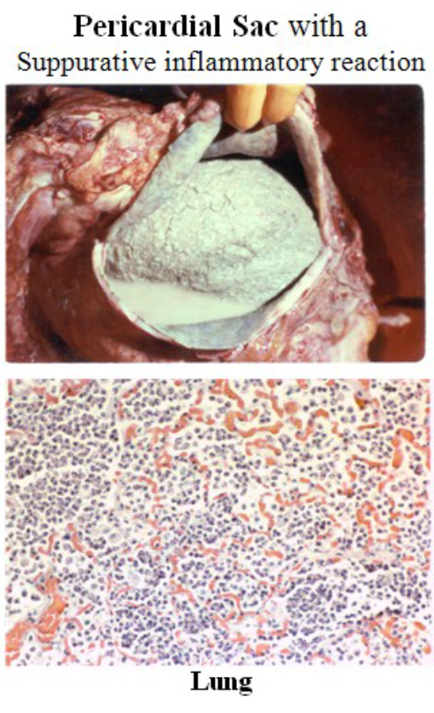

Slide 17
Hemorrhagic
Hemorrhagic exudate refers to an inflammatory process in which hemorrhage is the primary sign
Vascular damage allows the Red Blood Cells to leak into the injured area

Slide 18
Subacute
Lymphocytic (lymphoplasmacytic)
Characterized by a nearly pure infiltrating population of lymphocytes &/or plasma cells
often no gross lesions
Seen most commonly with immune mediated disease & some viral diseases
Immune mediated diseases: interface dermatitis
Viral diseases: lymphocytic thyroiditis, ovine lymphocytic intersttial pneumonia
Ex. German Shorthair Pointer with lupus erythematosis& pemphigus

Slide 19
Chronic
Granulomatous / Also called ―histiocytic inflammation
- Characterized by macrophage infiltration
-These can further differentiate into epithelioid cells & merge to form multinucleate giant cells
-Lymphocytes & plasma cells are nearly always present too.
- Granulomas are localized accumulations of macrophages and epithelioid cells usually centered around the causative agent or necrotic debris or a caseous center
- Usually accompanied by fibrosis around or within the reaction
- Characteristic of persistent infectious organisms such as Mycobacterium spp., fungi, parasites & protozoa also indigestible foreign material
Tumor: starts in one cell, that cell then proliferates uncontrollably (cancerous)
Granuloma: contains lots of cells, but proliferation is NOT uncontrollable (not cancerous)

Slide 21
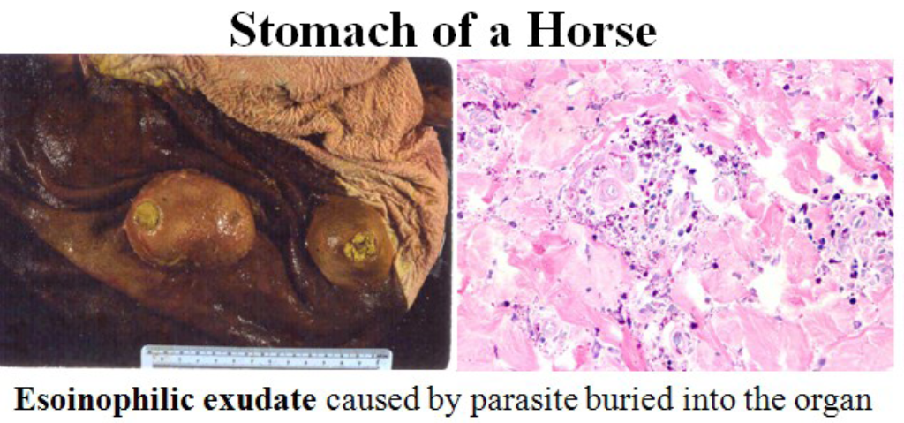
Eosinophilic
- Characterized by infiltration of eosinophils
- Usually associated with parasitism or allergic disease & some fungi (pithium)
- Eosinophils give exudate a lime green tint

Slide 22
Combination of Types
––To describe combination of exudate, the least important component of the exudate is placed first.
For example, the term serofibrinous would mean that fibrin is the main component.
The term mucopurulent would mean more pus in the exudate than mucus.
- fibrinosuppurative
– pyogranulomatous

Slide 23
THANK YOU

