Slide 1
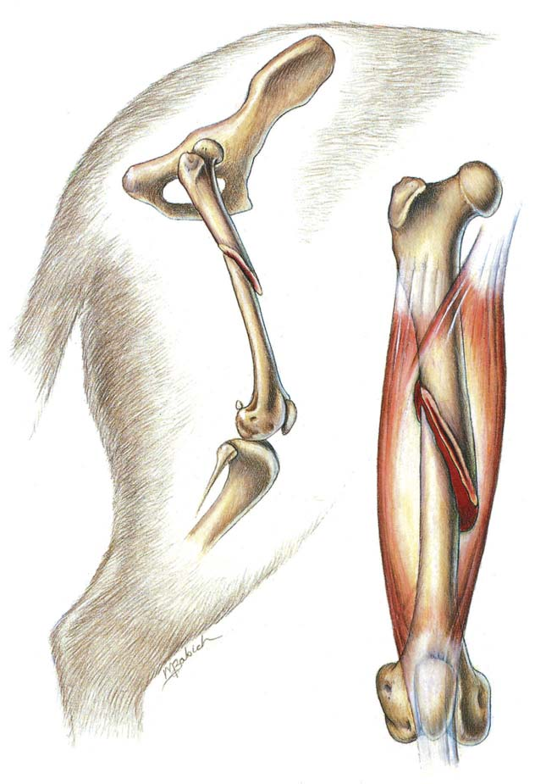
FRACTURE - III
.
Dr. Archana Kumari
Asstt. Professor cum Junior Scientist
Veterinary Surgery and Radiology
BVC, BASU, Patna

Slide 2
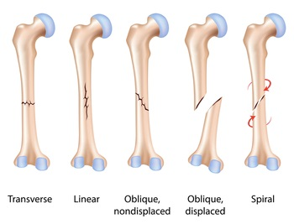
On the Basis of direction Fracture Line
Transverse: The fracture line runs transverse to the long axis of bone.
Oblique: The fracture line runs oblique to the long axis of the bone. Such type of fracture is caused by bending with axial compression
Spiral: The fracture line spirals along the long axis of the bone. Such type of fracture is caused by torsion, twisting or rotational forces e.g. in humerus

Slide 3
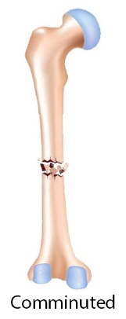
Cont.
Longitudinal: A fracture extending in longitudinal direction e.g. split pastern.
Comminuted: In comminuted fractures, at least three fracture lines inter connect each other at one point
Multiple: In multiple fractures, the bone is broken in to three or more segments. The fracture lines of not interconnect each other
Avulsion: A fragment of bone at the site of muscle insertion is detached due to its forceful contraction

Slide 4
On the Basis of Stability of Fracture Fragments
Stable fracture: The fractured fragments more or less interlock after reduction.
Unstable fracture: The fractured fragments are unstable after reduction.

Slide 5
On the Basis of Anatomical Location of Fracture
Diaphyseal fracture: Fracture that occur in the diaphysis of a long bone.
Metaphyseal fracture (Proximal or Distal): A fracture where within the metaphysis of a long bone
Epiphyseal fracture (Proximal or Distal): These are fractures of epiphysis.
Fracture of epiphyseal plate: fracture of cartilaginous epiphyseal plate in an immature animals. Based on shape of fracture line it is classified as
Salter Harris type I : displacement of epiphysis from the metaphysis at the growth plate
Salter Harris type II : separation of small piece of metaphyseal bone along with epiphysis from the metaphysis at the growth plate
Salter Harris type III : fracture of epiphysis and a part of the growth plate , but metaphysis is unaffected
Salter Harris type IV : fracture through the epiphysis, growth plate and metaphysis
Salter Harris type V : impaction of epiphyseal plate with the metaphysis driven into the epiphysis

Slide 6
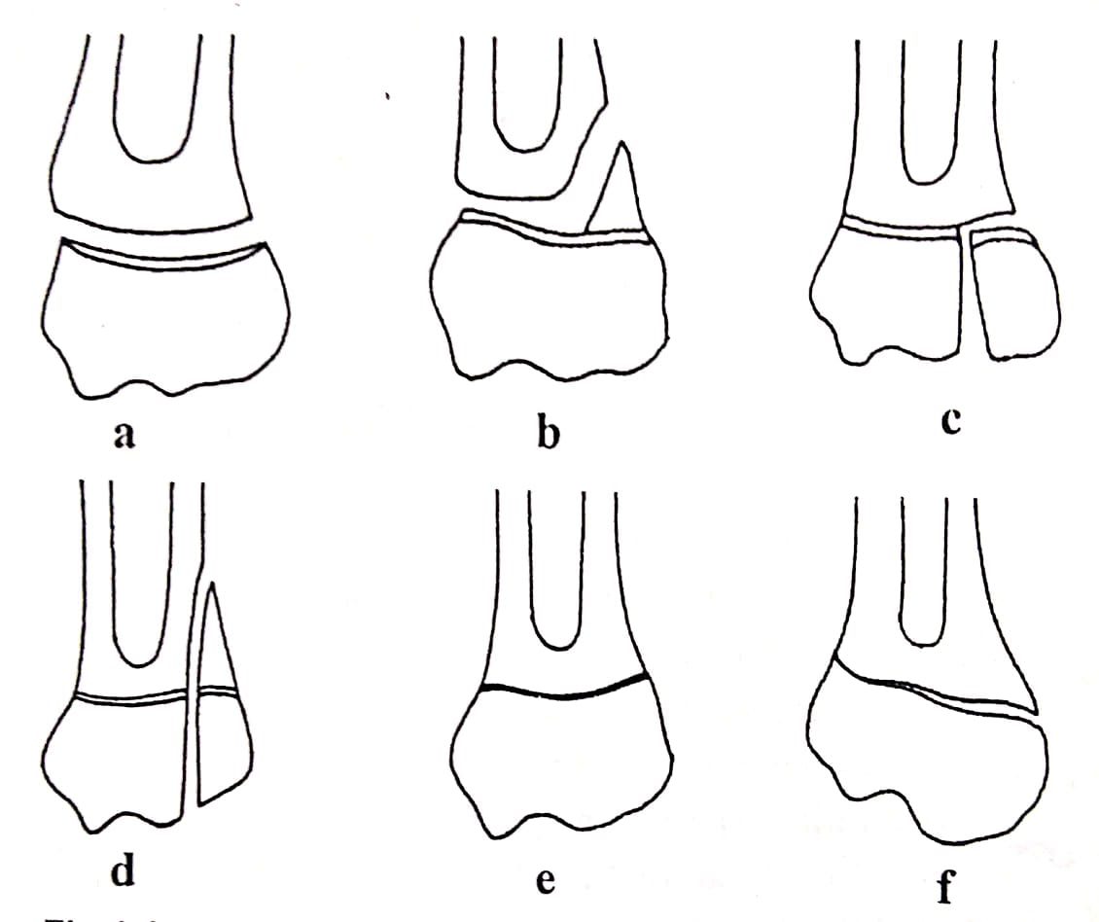
Fracture of epiphyseal plate: fracture of cartilaginous epiphyseal plate in an immature animals. Based on shape of fracture line it is classified as
Salter Harris type I : displacement of epiphysis from the metaphysis at the growth plate
Salter Harris type II : separation of small piece of metaphyseal bone along with epiphysis from the metaphysis at the growth plate
Salter Harris type III : fracture of epiphysis and a part of the growth plate , but metaphysis is unaffected
Salter Harris type IV : fracture through the epiphysis, growth plate and metaphysis
Salter Harris type V : impaction of epiphyseal plate with the metaphysis driven into the epiphysis
a – Salter Harris Type I,
b- Salter Harris Type II,
c- Salter Harris Type III,
d - Salter Harris Type IV
e & f - Salter Harris Type V

Slide 7
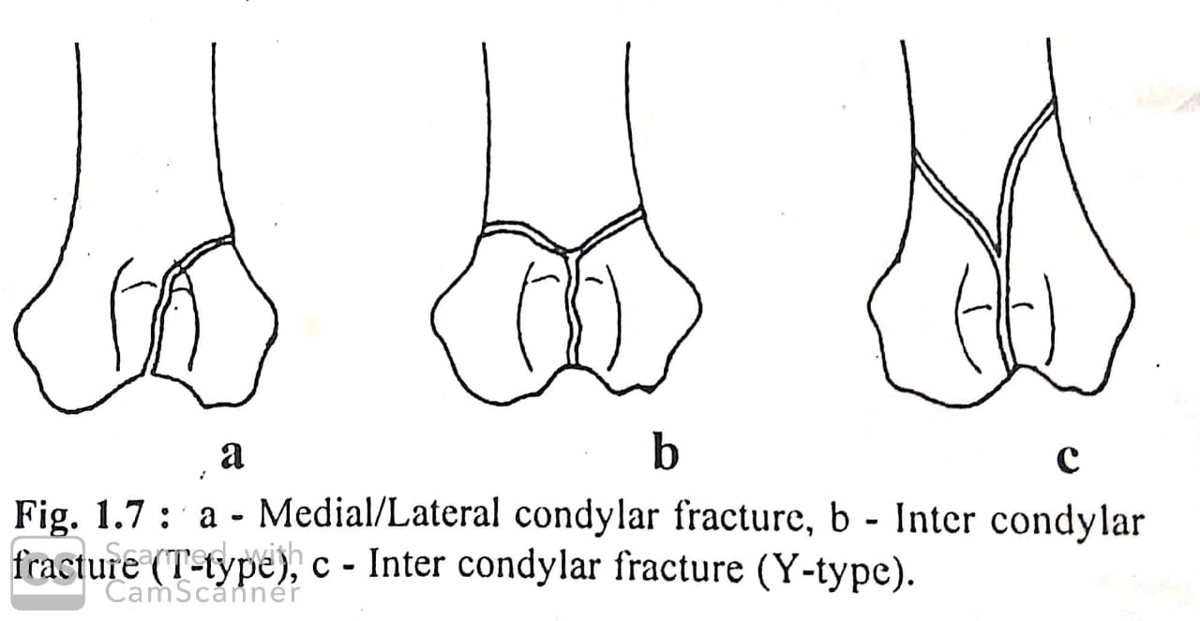
Cont.
Condylar fracture: Fracture of the condyle either medial or lateral or both
Supracondylar fracture: Fracture when both the condyles are fractured off the shaft as a unit
Supracondylar-intercondylar fracture: The fracture when both the condyles are fractured from the shaft and also from each other (‘T’ shape and ‘Y’ shape).
Articular fracture (Intracapsular): Fracture of subchondral bone and articular cartilage.
Periarticular fracture (Extra capsular fracture): A fracture near a joint but not entering within the joint capsule.
Trans-cervical fracture: Fracture through neck of femur.

Slide 8
Fracture dislocation: When a fracture of a bone results into joint instability leading to subluxation or luxation of the joint. It is termed as fracture dislocation.
The term ‘Monteggia fracture’ is specifically referred to fracture of the olecranon process and dislocation of the elbow joint
Colle’s fracture: Fracture of distal end of radius e.g. abduction of paw is noticed in Colle’s fracture.
Down in the hip: Fracture of the external angle of hip.

