Slide 1
Internal immobilization of fracture

Slide 2
HUMERAL FRACTURE
HUMERAL DIAPHYSEAL FRACTURES
SUPRACONDYLAR FRACTURES

Slide 3
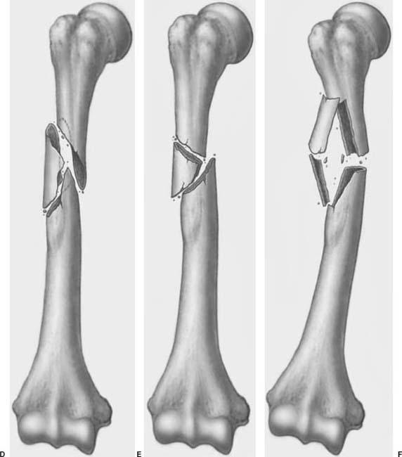
HUMERAL DIAPHYSEAL FRACTURE
It results in disruption of continuity of diaphyseal cortical bone
Cause : high velocity injuries e.g. Motor vehicle accidents, gunshot injuries, blunt trauma
Radial nerve injury may occur with fractures involving the distal humerus
HUMERAL DIAPHYSEAL FRACTURES

Slide 4
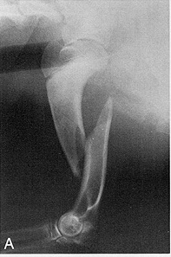
DIAGNOSIS
History
Physical examination : Non weight bearing, varying degree of limb swelling, pain and crepitus on manipulation, animal drag the limb while walking
Diagnostic Imaging : General anaesthesia is required for proper positioning of animal to obtain best quality radiographs
Craniocaudal view
Lateral view

Slide 5
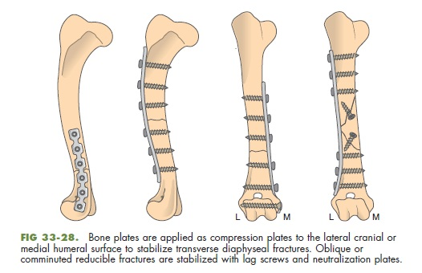
SURGICAL TREATMENT
Pre-operative management :- Before surgery, a spica splint can be applied to increase patient comfort and protect soft tissue from further injury induced by bone fragments
Operative management :-
Intramedullary pinning
Orthopaedic wire
Interlocking nails
IM pins plus external skeletal fixation
Bone plates

Slide 6
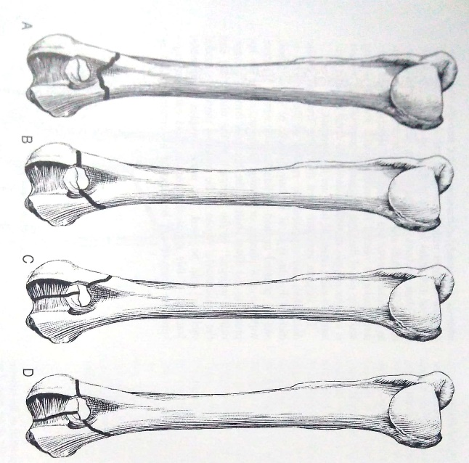
SUPRACONDYLAR FRACTURES
These are usually transverse or short oblique fractures
Comminuted fracture with multiple small fragments can also be noticed
Transverse or short oblique fractures require rotational and bending support
Comminuted fracture require axial, rotational and bending support
SUPRACONDYLAR FRACTURES

Slide 7
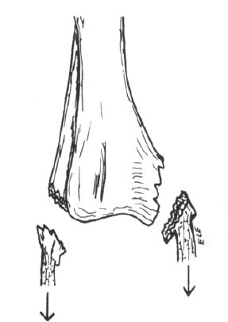
RADIAL AND ULNAR FRACTURE
Most often seen in young animals and is frequently comminuted
Can occur anywhere in the shaft of bone
Metaphyseal & Epiphyseal fractures are common in young animals
Avulsion fracture of radius

Slide 8
DIAGNOSIS
History
Physical examination :
Palpation of limb reveals swelling ,
Pain and crepitation
Reluctant to move the limb
Diagnostic imaging :craniocaudal and lateral radiographs of affected radius and ulna are required to assess the extent of bone and soft tissue injury

Slide 9
SURGICAL TREATMENT
If the fracture is at the distal third of the radius, full limb cast upto the elbow joint provide satisfactory result
Internal fixation alongwith some form of external support is usually effective
Transfixation can be used except in cases of proximal radial fracture
For mid shaft fractures, transfixation along with modified Thomas splint provides satisfactory result
Both conventional and compression plating can be used for repair of Radial fracture

Slide 10
Femoral fractures
FEMORAL DIAPHYSEAL AND SUPRACONDYLAR FRACTURES
FEMORAL METAPHYSEAL AND ARTICULAR FRACTURES

Slide 11
.
High velocity injuries are the most common type of trauma that causes femoral fractures
Most injuries result from Motor vehicle accidents, gunshot injuries, blunt trauma
Coxofemoral luxation may occur concurrently with femur fractures
Observation of pelvic girdle symmetry and gental rectal palpation help determine the presence of pelvic fracture

Slide 12
DIAGNOSIS
History
Physical examination :
Non weight bearing lameness,
Swelling over scapula,
crepitation on palpation
Diagnostic imaging : Radiographs of femur should include
Lateral view
Caudocranial view

Slide 13
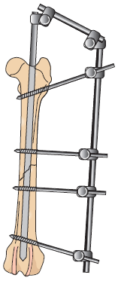
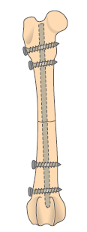
Surgical techniques
For femoral diaphyseal fracture
Application of intramedullary pins
Placement of interlocking nails
Application of external skeletal fixation
Application of bone plates and screws
A
B
C
D

Slide 14
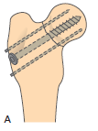
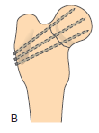
For metaphyseal fractures
Stabilization of femoral neck fracture with cancellous lag screw
B. Stabilization of femoral neck fracture with triangulated krischner wires

Slide 15
For intertrochanteric fractures
Stabilization of a Unicondylar fracture with a lag screw
Stabilization of a Bicondylar fracture with a lag screw & Steinmann pin
A
B

Slide 16
Complications of fracture and repair
A fracture and its repair may lead to number of complication which the course of healing of injured area
Use of various immobilization devices may cause pressure sores, atrophy of muscles and joint stiffness
Main complications related to fracture healing are :-
Malunion
Delayed union ,
Non union
Avascular necrosis
Shortening of bones
Infection

Slide 17
CONT.
Nerve injury : Radial, Obtrutor, Suprascapular and Peroneal Nerves are more prone to injury
Injury to blood vessels : damage to the major blood vessels may occur due to direct trauma
Injury to viscera :
In fracture of ribs, injury to lungs, heart, diaphragm, spleen and liver may occur
In pelvic fracture , urinary bladder and rectum are more prone to injury

Slide 18
Failure of implants
Excessive wear and tear of plaster cast,
Bending of splints
Bending and loosening of plates, screws and intramedullary pins

Slide 19
Malunion (Angular deformity)
Healing of the bone fragments in a abnormal position.
The causes of malunion are:
Faulty reduction.
Inadequate immobilization.
Failure of fixation of the fracture.

Slide 20
Delayed union / Non-union
Delayed union is prolongation of fracture healing.
Non union is cessation of fracture healing.
The cause are:
More gap between the fractured fragments.
Loss of blood supply
Damage to the surrounding soft tissues
Compound fracture or Infection
Incomplete fixation
Overstripping of periosteum
Functional disuse.
Early weight bearing.

Slide 21
Cont.
Radiographic Signs of Delayed Union
Both fractured ends are far apart.
Presence of very little callus.
Radiographic Signs of Non-union
No callus formation.
Sclerosis of bone ends.
Gap between the bone fragments.
Medullary canal is completely closed in each fragment.

