Slide 1
Neurotransmission
Dr. Rashmi Rekha Kumari
Asstt. Prof, Deptt. Of Pharmacology & Toxicology,BVC,Patna-14

Slide 2
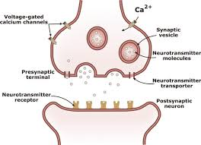
Steps involved:
1. Axonal conduction
2. Junctional Transmission
The conduction refers to passage of impulse along an axon or muscle fiber
Transmission refers to passage of impulse across the synaptic or neuroeffector junction.
Except Local anaesthetic very few drug modify the axonal conduction

Slide 3
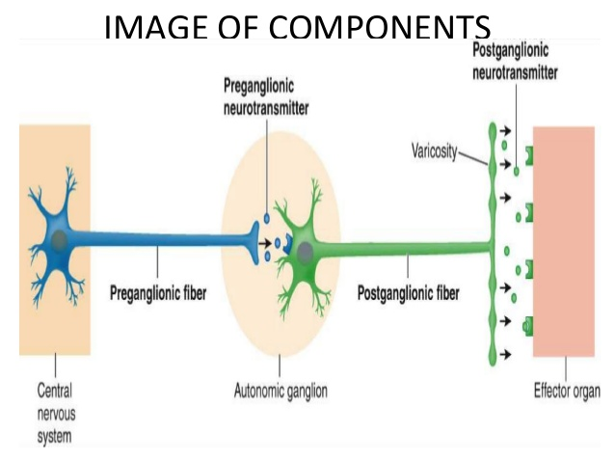
Neurohumoral transmission
Neurohumoral transmission implies that nerves transmit their message( in the form of Action Potential) across synapses and neuroeffector junctions by the release of humoral (chemical) messengers.
Most of the autonomic drugs used clinically exert primary pharmacological activities by altering some essential step in neurohumoral transmission.

Slide 4
Historical Aspects
Lewandowasky (1898) and Langley (1901)Independently observed the similarity between the effect of stimulation of sympathetic nerve and injection of extract of adrenal medulla
T R Elliot (1905) extended these studies and postulated that sympathetic nerve terminal release minute amounts of epinephrine like substance in immediate vicinity of effector cell- A chemical step in process of transmission.
Langley(1905) suggested that effector cell have excitatory and inhibitory “Receptive substances” and response to epinephrine depends which type of receptive substance is present.

Slide 5
Dixon(1907) concluded from his studies on effect of muscarine that vagus nerve liberate a muscarine like substance that acted as chemical transmitter of its impulse.
In the same year Reid and Hunt described the action of Ach and other cholin ester.
Dale(1914) thoroughly investigated the pharmacological properties of Ach along with other esters of choline and distinguished its nicotine like and muscarine like actions.
In 1921, cannon and Uridil (1921) reported that stimulation of sympathetic hepatic nerve

Slide 6
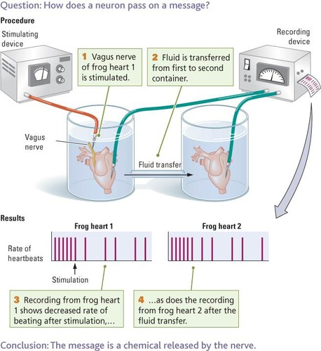
Historical Aspect continued…
1921, Otto Loewi : He provided the first direct evidence for the chemical mediation of nerve impulses by peripheral release of specific chemical agents. He named the chemical agent as Vagusstoff: Loewi and Navratil(1926) presented evidence to identify it as Ach.
1946, Von Euler : He showed that the sympathetic transmitter is noradrenaline.

Slide 7
Criteria/Evidence For Being a Neurohumoural Transmitter
Following criteria should be met before a chemical can be accepted as neurotransmitter –
It should be present in the presynaptic neuron (usually along with the enzymes synthesizing it).
It should be released in the medium following nerve stimulation.(Recovery of compound from the perfusate of innervated structure during the period of nerve stimulation but not( or in a very less amount) in the absence of nerve stimulation.
Demonstration that its application should produce responses identical to those produced by nerve stimulation.
Its effects should be antagonized or potentiated by other substances which similarly alter effects of nerve stimulation.

Slide 8
Events Involved in Neurotransmission
1. Axonal Conduction
2. Junctional transmission
Storage and the release of transmitters
Combination of transmitter with postjunctional receptor and production of post junctional potential
Initiation of post junctional activity
Destruction/ Dissipation of transmitter

Slide 9
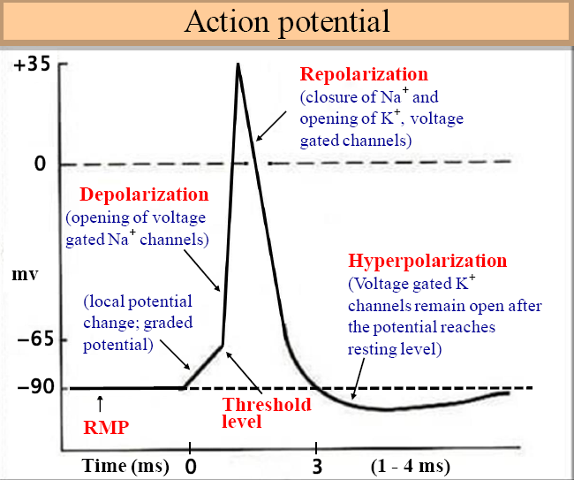
Axonal Conduction
Axonal conduction: Refers to the passage of an impulse along the nerve fiber.
An Action Potential or nerve impulse reflects a reversal of polarisation state present at rest (negative- inside and positive-outside) and is the result of permeability change that occur at the axonal surface as an impulse is propagated along the nerve fiber.

Slide 10
Investigative work of Hodking and Huxley(1952) formed the basis of current concept of axonal conduction.
At rest, interior of the typical mammalian axon is approximately 70mV negative to the exterior
Resting potential is a diffusion potential based on fortyfold higher concentration of potassium in the axoplasm as compared with extracellular and very high permeability of this ion through axonal membrane in resting condition

Slide 11
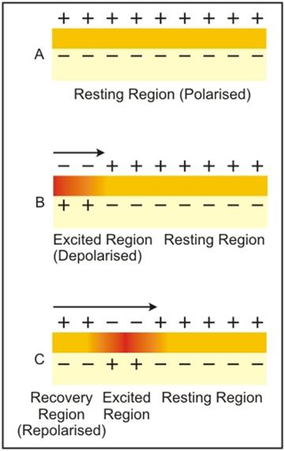
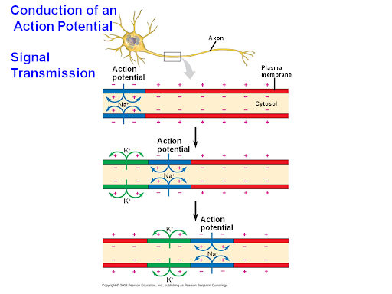
Axonal Conduction
Source: Google Image

Slide 12
Na and cl ion are present in higher concentration in the extracellular fluid than in the axoplasm, but axonal membrane at rest is considerably less permeable to these ion; hence their contribution to resting potential is less.
These ion gradient is maintained by active transporter Na/K ATPase activated by Na at the inner and K at the outer surface of the membrane.
In response to depolarisation at threshold level, an action potential or nerve impulse is generated at the local region of membrane.

Slide 13
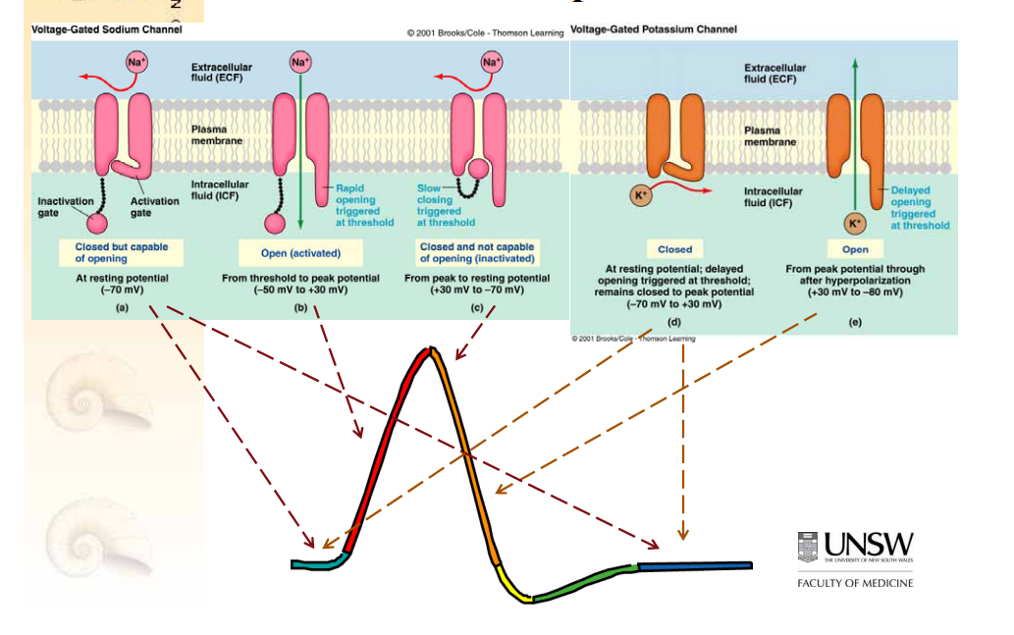
Source: Google Image

Slide 14
The transmembrane ionic currents produce local circuit current around the axon.
As a result of such localised changes in the membrane potential, adjacent resting channel in the axon are activated, and excitation of adjacent portion of axonal membrane occur.
Although localised permeability changes associated with an action potential are extremely short-lived, They elicit similar alteration in membrane function in immediately quiescent areas of the axon.
Thus the action potential is self-propagating and in this manner action potential is propagated along the axonal fiber.

Slide 15
In myelin fiber, permeability changes occurs only at node of ranvier thus causing a rapidly progressive type of jumping and salutatory conduction
Axonal conduction is insensitive to most drugs
The puffer fish poison tetradotoxins, shell fish poison saxitoxin, selectively block axonal conduction
Batrachotoxins, secreted by south American frog; produces paralysis through a selective increase in permeability of Na channel to Na, which induce a persistant depolarisation.

Slide 16
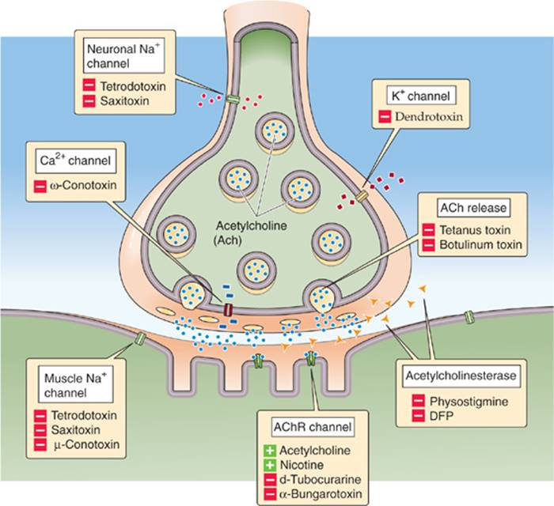
Source: Google Image

Slide 17
Thank You

