Slide 1
Tetracyclines …………………………………………………………………………………………………………………………………………………………………………………………………………………………………………… Chemotherapy (VPT-411) (Lecture-14)
Dr. Kumari Anjana
Asstt. Professor
Deptt. of Veterinary Pharmacology & Toxicology
Bihar Veterinary College, Bihar Animal Sciences University, Patna

Slide 2
Content of the chapter
Tetracyclines
Introduction,
History
Source
chemistry,
classification
spectrum of activity
MOA
Applications
Side effects

Slide 3
Introduction
Group of natural and semisynthetic antibiotics having nucleus of four partially unsaturated cyclohexane rings.
All are obtained from soil actinomycetes and have nearly similar antimicrobial activity.
All are crystalline yellow powder.
Slightly water soluble but their hydrochloride salts are more soluble and are used (except doxycycline).
It contrasted from penicillin G and streptomycin in being orally active and broad spectrum antibiotic.

Slide 4
History
Tetracycline antibiotics were produced by systemic screening of soil microorganisms.
The first member of the group was chlortetracycline.
Derived from soil actinomycetes Streptomyces aureofaciens introduced in 1948 under the name aureomycin (because of the golden colour of S. Aureofacience colonies producing it).
This was followed by oxytetracycline.

Slide 5
Removal of chlorine atom from chlortetracycline produced semisynthetic tetracycline introduced in 1952.
Further discovery led to other semi-synthetic tetracycline's like
Methacycline,
Doxycycline, and
Rolitetracycline.
Doxycycline and minocycline are newer tetracyclines with
high lipid solubility and longer duration of action.

Slide 6
Chemistry
Tetracyclines are close congeners of polycyclic
naphthacenecarboxamide.
They are a family of four ringed amphoteric compounds that differ by specific substitutions at different points on the rings.
As a group, tetracyclines are acidic and hygroscopic compounds, which in aqueous solution form salts with both acids and bases.

Slide 7
They characteristically fluoresce when exposed to ultraviolet light.
Hydrochloride salts of tetracyclines are mostly used in clinics, except for doxycycline that is marketed as hyclate.
Tetracyclines form insoluble chelate with divalent and trivalent cations like Ca++, Mg++, and Al+++.

Slide 8
Tetracyclines are stable as powders but their aqueous solutions are not stable.
Therefore for parenteral injection, they are formulated in
propylene glycol or polyvinyl pyrrolidine and stabilizers are added to increase stability and prolong elimination half-life.
Physical and chemical properties of tetracyclines permit them to be formulated as injections, boluses, capsules, powders, feed additives, and ointments for veterinary use.

Slide 9
Classification
Based on sources
Natural:
Chlortetracycline (streptomyces aureofaciens),
Oxytetracycline (S. rimosus),
Demethylchlortetracycline/demeclocycline
(a mutant strain of S. aureofaciens).
Semisynthetic: Tetracycline, methacycline, rolitetracycline, lymecycline, doxycycline and minocycline.

Slide 10
Based on duration of action
Short acting: Tetracycline,
Oxytetracycline and Chlortetracycline.
Intermediate: Demeclocycline and
Methacycline.
Long acting: Doxycycline and
Minocycline
(highly protein bound and slowly excreted).

Slide 11
Mechanism of action
The tetracyclines are primarily bacteriostatic; inhibit protein synthesis by binding to 30S ribosomes in susceptible organism.
Subsequent to such binding, attachment of aminoacyl-t-RNA to the mRNA-ribosome complex is interfered.
As a result, the peptide chain fails to grow.
The sensitive organisms have an energy dependent active transport process which concentrates tetracyclines intracellularly.

Slide 12
In gram-negative bacteria tetracyclines diffuse through porin channels.
The more lipid-soluble members (doxycycline, minocycline) enter by passive diffusion also (this is partly responsible for their higher potency).
Two factors are responsible for the selective toxicity of tetracyclines for the microbes:
The carrier involved in active transport of tetracyclines is absent in the host cell.
Moreover, protein synthesizing apparatus of host cell is less sensitive to tetracyclines.

Slide 13
Antibacterial spectrum
Tetracyclines are broad spectrum antibiotics and practically inhibit all types of pathogenic microorganism except mycobacteria, fungi and viruses.
Some strains of E. coli, Klebsiella, proteus, Psedomonas aeroginosa and Corynebacterium spp. are frequently resistant to tetracyclines.
Therapeutically effective level in serum is 0.5 to 4 µg / ml of serum.

Slide 14
Tetracyclines are active against:
both aerobic and anaerobic Gram +ve and Gram -ve bacteria,
Mycoplasma,
Rickettsiae,
Chlamidia and
some protozoa like Babesia,
Theileria,
Anaplasma,
Coccidia
Entamoeba.

Slide 15
Pharmacokinetics
Tetacyclines are administered orally (mainly to small animals), parenterally (mostly IM and IV) and also topically.
Absorption:
Oral administration in carnivores the drugs are absorbed rapidly from GIT reaching peak plasma concentration within 2-4 hr which persists for 6-8 hr.
Milk and milk products, calcium, magnesium, iron or iron preparations and antacids interfere with the absorption of the tetracyclines in the GI tract due to chelation.

Slide 16
The absorption of doxycycline and minocycline is complete and highest in undergo enterohepatic cycling.
Tetracycline should not be administered orally to ruminants as they are poorly absorbed and cause disruption of ruminal microflora.
In veterinary medicine, specially buffered tetracycline solutions (to avoid irritation) are most commonly administered by IM and sometimes by IV routes.

Slide 17
IM dosage gives peak blood levels after 2 hr and maintained for 12-24 hr.
Chlorteracycline should not be administered IM because of severe tissue irritation and damage.
The long acting tetracycline are produced by delaying their absorption from IM sites by using a special carrier or increasing magnesium content.
Oily preparations, used for SC administration in poultry should not be administered parenterally to mammals.

Slide 18
Distribution:
Tetracyclines are widely and extensively distributed to almost all the body tissues and fluids, particularly after parenteral administration.
These drugs undergo chelation with calcium and are deposited irreversibly in growing bones and teeth in young animals.
Doxycycline and minocycline readily penetrate tissues and also CSF.
protein binding varies from 30% (oxytetracycline) to 90% (doxycycline).

Slide 19
Metabolism :
Tetracyclines undergo limited metabolism in domestic animals except doxycycline and minocycline (partly).
Excretion:
They are chiefly excreted by kidney via Glomerular filtration and also excreted unchanged in faeces directly or through bile.
Most tetracyclines will accumulate if renal function is impaired and increases nephrotoxicity.
Doxycycline is an exception as it is largely excreted through the GI tract.
They are also secreted in milk.
Their minimum therapeutic level is 0.5 to 1 µg per ml serum.

Slide 20
Dosage
Tetracycline and oxytertracycline:
Dog & cat: 20 mg/kg orally at 12 hr intervals;
7-10 mg/kg/day IM or IV once day.
Oxytertracycline:
Calf, foal, lamb & pig: 10-20 mg/kg orally at 12 hr intervals; Horse,foal, cattle, calf sheep, lamb & pig: 5-10 mg/kg IM or IV once a day.
Doxycycline:
small animals: 5-10 mg/kg orally once a day;
5 mg/kg IM or IV once a day.
Rolitetracycline:
Cattle: 2 mg/kg IV once a day.

Slide 21
Withdrawal periods
Oxytetracycline:
cattle & pig: 22 days;
poultry: 5days;
Oxytetracycline (long acting):
cattle-28 days;
Chlortetracycline: cattle: 10 days; pig: 7 days;
Oxytetracyclines are not to be used in lactating cows.

Slide 22
Clinical uses
Tetracyclines are used in local infections viz.
Mastitis (local + parenteral),
Coliform-salmonella enteritis,
Bronchopneumonia in all species,
Urinary tract infections,
Metritis,
Pyodermatitis,
Amoebiasis,
Balantidosis,
Leptospirosis,
Cystitis in small animals and
Specific disease actinomycosis
Actinobacilosis,
Keratoconjuntivitis,
Brucellosis,
Chlamydiosis,
Babesiosis,
Anaplasmosis,
Theileriasis,

Slide 23
Rickettsiosis (especially chlortetracycline),
Nocardiosis (especially minocycline),
Ehrlichosis (especially doxycycline),
Haermobartoneliosis,
Pasteurellosis (transit fever, HS, fowl cholera)
Bacterial diseases of poultry (blue comb in turkey,CRD contagious catarrh), to check secondary bacterial infection in viral infections.

Slide 24
Adverse Reactions and Toxicity
Alteration in microflora in rumen or intestines oral use leads to digestive disturbances and ruminal stasis,
decrease in synthesis and availability of vitamin B and K particularly in monogastric animals.
Superinfections by fungi, yeasts and resistant bacteria may cause severe or fatal diarrhea (horse) following oral or parenteral administration.

Slide 25
Tetracyclines are deposited in growing teeth and bones and should not be used in growing animals because they cause yellowish and later brownish discoloration of teeth and suppress bone growth.
Tetracycline should not be used with immunization programme (as they cause immunosuppression).

Slide 26
Intramammary infusion of chlortetracycline is contraindicated in dry cows (Cause severe tissue irritation and subsequent fibrosis) and if infused. Cows fail to lactate after parturition (due to teat and udder tissue damage).
Intraarticular injection of tetracyclines are contraindicated (cause severe irritation and inflammation).

Slide 27
If administered by rapid IV injection, hypotension and acute collapse may occur in cattle and horses due to chelation of blood Ca⁺⁺ and this can be avoided by slow infusion of the drug or pretreatment with IV calcium gluconate.
Tetracyclines in high doses produce hepatotoxicity particularly in pregnant animals or those having renal abnormality.
All tetracyclines in high doses are potentially nephrotoxic (due to decrease in host protein synthesis and anti-anabolic effect) except doxycycline and are contraindicated in renal insufficiency.

Slide 28
Phototoxic dermatitis is most common with demeclocycline and doxycycline in man which is rare in animals.
Hypersensitivity is rare.
In human ingestion of outdated tetracyclines produces a syndrome characterized by aminoaciduria, glycosuria, polyuria and polydypsia due to proximal convoluted tubular damage (Fanconi syndrome).
Demeclocycline induces diuresis (ADH antagonism).

Slide 29
Precautions
Contraindicated in
Pregnant,
Lactating and
Young animals.
Must be cautiously used in animals with renal and hepatic dysfunctions.
Injectable tetracyclines should never be mixed with penicillin (precipitation inactivation occurs).

Slide 30
Summary
Tetracycline antibiotics were produced by systemic screening of soil microorganisms.
They characteristically fluoresce when exposed to ultraviolet light.
The tetracyclines are primarily bacteriostatic; inhibit protein synthesis by binding to 30S ribosomes in susceptible organism.
Yellowish and later brownish discoloration of teeth and suppress bone growth.

Slide 31
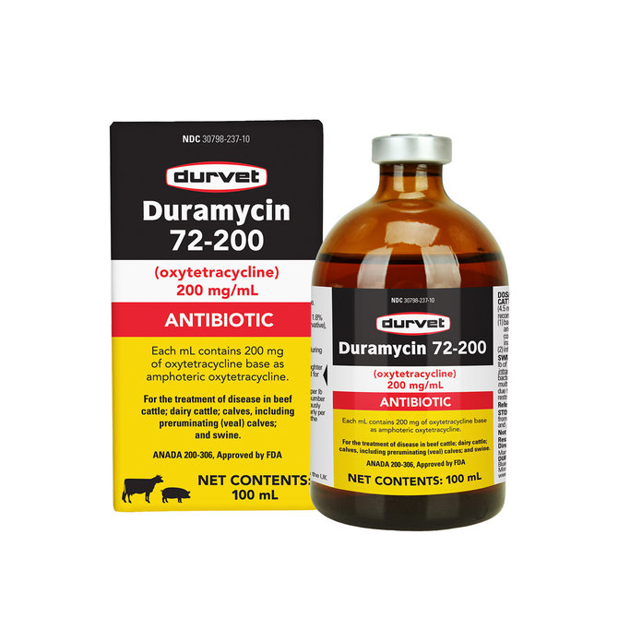
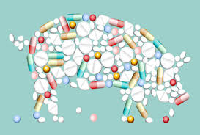
Thank You

