Slide 1
Fluoroquinolones …………………………………………………………………………………………………………………………………………………………………………………………………………………………………………… Chemotherapy (VPT-411) (Lecture-17)
Dr. Kumari Anjana
Asstt. Professor
Deptt. of Veterinary Pharmacology & Toxicology
Bihar Veterinary College, Bihar Animal Sciences University, Patna

Slide 2
Content of the chapter
Fluoroquinolones
Introduction,
Source
chemistry,
classification
spectrum of activity
MOA
Applications
Side effects

Slide 3
Introduction
In 1962 nalidixic acid was discovered by George lesher during synthesis of chloroquine and was named as quinolone.
Earlier quinolones were useful only for treatment of UTI.
Fluoroquinolones are quinolone antimicrobials having one or more fluorine substitutions.
Fluorinated derivatives achieve bactericidal levels in blood and tissues so they have improved antibacterial spectrum.

Slide 4
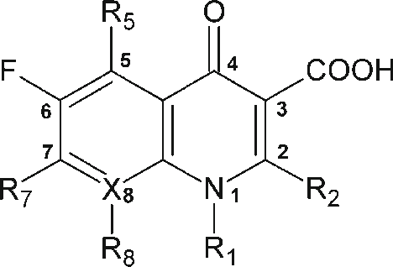
Structure Activity Relationship
Carboxyl group at position 3 Antibacterial
& ketone at position 4 activity
The Fluorine at position 6 differentiates the quinolones from fluoroquinolones and accounts for the improved gram –ve and gram+ve activity increased potency and increased entry into bacteria.
At position 1, addition of cyclopropyl ( enerofloxacin, ciprofloxacin) , an ethyl and fluorophenyl improve the spectrum of activity against gram + ve bacteria gram –ve bacteria.
Fig: Fluoroquinolones
Source : Google image

Slide 5
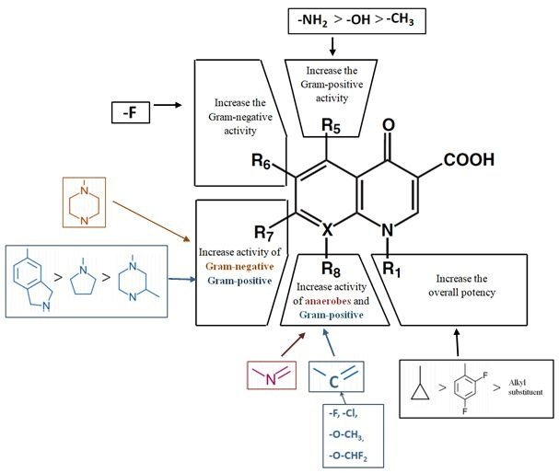
Addition of piperazine at position 7, (ciprofloxacine and enrofloxacine) improves spectrum of activity to include pseudomonas group, among other gram –ve bacteria.
Newer generation of quinolones have a bicyclic substitution at position 7, insteade of piperazine. This increases the activity to include wider range of bacteria.
A substitution at 8 position on the ring enhances the bactericidal effect and improves the spectrum of activity to include more gram positive bacteria and anaerobes (Moxifloxacin, pradofloxacin).
Source : Google image

Slide 6
Classification
First generation : Nalidixic acid, oxolinic acid, cinoxacin, resoxacin, Piromidic acid and Flumequine.
Second generation: Ciprofloxacin, ofloxacin, enrofloxacin, norfloxacin, difloxacin, danofloxacin, and flumequine
Third generation: Pefloxacin, marbofloxacin, Sarafloxacin

Slide 7
First generation
Original quinolones.
Nalidixic acid, oxolinic acid, cinoxacin, and resoxacin.
These are primarily active against Gram negative bacteria specially coliforms but not against Pseudomonas.
Their use is restricted only for the treatment of urinary and GI tract infections because of their --
CNS toxicity,
low potency,
moderate blood and tissue levels,
limited spectrum and
high incidence of bacterial resistance.

Slide 8
Second generation
Fluoroquinolones.
Ciprofloxacin, enrofloxacin, norfloxacin, difloxacin, ofloxacin, danofloxacin, marbofloxacin and flumequine.
Additional of one or fluorine atoms and other substitutions in the quinolone molecule yield fluoroquinolones with—
enhanced antibacterial potency,
expended spectrum,
better tissue penetrability,
reduced toxicity and
retard development of bacterial resistance.

Slide 9
Spectrum of Activity
Fluoroquinoles are highly active against a broad range of an aerobic Gram negative and Gram positive bacteria.
The most susceptible ones are the aerobic Gram negative bacilli (MIC < 0.1 µg/ml), especially the Enterobacteriaceae and Neisseria.
They are also effective against several intracellular pathogens (Brucella spp) and have significant activity against Mycoplasma and Chlamydia spp.
Some are also active against Mycobacteria (ciprofloxacin, ofloxacin).

Slide 10
Microbiological features
Their notable microbiological features are:
high potency and rapid bactericidal activity particularly against Gram negative infections including Pseudomonas,
no activity against anaerobes,
low incidence of resistance
MBCs are close to MICs.
Relatively long post-antibiotic effect on Enterobacteriaceae, Pseudomonas and Staph.
active against beta lactam and aminoglycoside resistant bacteria
less activity at acidic pH

Slide 11
Pharmacological features
Broad spectrum of activity
Can be used in majority of domesticated species of animals.
Can be administered by variety of routes
Have wide margin of safety
Large volume of distribution
Concentration dependent effect
Biphasic effect
Post-antibiotic effect
Efficacy at low therapeutic doses

Slide 12
Mechanism of action
The FQs inhibit the enzyme bacterial DNA gyrase
which nicks double-stranded DNA,
introduces negative supercoils and
then reseals the nicked ends.
This is necessary to prevent excessive positive supercoiling of the strands when they separate to permit replication or transcription.
The DNA gyrase consists of two A and two B subunits:
The A subunit carries out nicking of DNA,
B subunit introduces negative supercoils and
then A subunit reseals the strands.

Slide 13
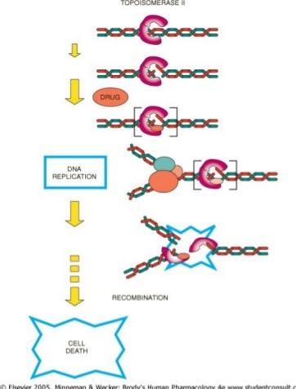
FQs bind to A subunit with high affinity and interfere with its strand cutting and resealing function.
Recent evidence indicates that in gram-positive bacteria the major target of FQ action is a similar enzyme topoisomerase IV which nicks and separates daughter DNA strands after DNA replication.
Greater affinity for topoisomerase IV may confer higher potency against gram-positive bacteria.
Source : Google image

Slide 14
The bactericidal action probably results from digestion of DNA by exonucleases whose production is signalled by the damaged DNA.
In place of DNA gyrase or topoisomerase IV, the mammalian cells possess an enzyme topoisomerase II (that also removes positive supercoils) which has very low affinity for FQs— hence the low toxicity to host cells.

Slide 15
General dispositional characteristics of Fluoroquinoles
Variable but good oral absorption
Complete parenteral absorption
Good tissue distribution
Volume of distribution 2-4 L / kg.
Renal excretion by glomerular filtration and tubular secretion
Hepatic metabolism via oxidation and glucuronidation
Eenterohepatic recycling
Terminal phase half-life of 2-4 hrs.

Slide 16
Pharmacokinetics
Quinolones are commonly administered orally, IM, SC, IV and also topically.
Oral bioavailability in Monogastric animal is about 80% (food delays absorption) for most quinolones but in adult ruminant it is low.
FQs have high tissue penetrability and wide distribution to the tissues and fluids .
Some members also cross the blood-brain barrier and attain high concentration in CSF (pefloxacin).

Slide 17
Some are eliminated unchanged (ofloxacin) and some are metabolized in liver and the metabolites (sometimes active ;enrofloxacin to ciprofloxacin) undergoes glucronidation and are mainly excreted by kidneys, both by glomerular filtration and tubular secretion.
In some cases (ciprofloxacin, pefloxacin) the parent drug as well as metabolites are mainly eliminated in bile.
Quinolones also appear in milk when administered to lactating animals. Nitrofurantion (bacteriostatic) interferes with efficacy of quinolones (bactericidal).

Slide 18
Clinical uses
FQs have broad spectrum of activity, oral as well as parenteral efficacy, high tissue penetrability and good tolerability.
FQs are extensively used for blind therapy.
They should not be used for minor infections or where Gram positive organisms are primarily suspected.
In severe infections, the treatment should be started parenterally.
They are particularly good for deep seated infections and for intracellular pathogens.

Slide 19
They are used in Gram negative septicaemias;
Respiratory tract,
GI tract,
Urinary tract,
Skin and eye infection,
Meningoencephalitis,
Bacterial prostitis,
Osteomyelitis,
Arthritis,
Mastitis.
In human, some members are also used in the treatment of typhoid (ciprofloxacin; drug of choice) and tuberculosis.

Slide 20
Doses of fluoroquinolones
Norfloxacin: Dog & cat; 10-20 mg/kg, orally twice a day.
Ciprofloxacin: dog 5-15 mg/kg, orally twice a days.
Enrofloxacin; Dog & cat: 5 mg/kg orally, once a day, 2.5 mg /kg SC.
Cattle, calves & pig: 2.5-5 mg /kg IM or SC once in a day.
Marbofloxacin: Cat & Dog: 2.5 -5 mg/kg orally once in a day.
Orbifloxacin: Cat & dog: 2.5- 7.5 mg/kg orally once in a day.

Slide 21
Toxicity of quinolones
GI disturbances (vomiting, diarrhea etc.) neurotoxicity (convulsions, GABA antagonism) at high doses. Causes.
Fluoroquinolones are relatively safer than older quinolones.
FQs cause arthopathic toxicity (erosion of cartilage in weight bearing joint).
Dogs are the most susceptible species (mainly in pups/growing dogs), but also occurs in young foals.

Slide 22
Summary
Fluoroquinolones are quinolone antimicrobials having one or more fluorine substitutions.
Effective against several intracellular pathogens.
Less activity at acidic pH.
The FQs inhibit the enzyme bacterial DNA gyrase.
FQs cause arthopathic toxicity (erosion of cartilage in weight bearing joint).

Slide 23
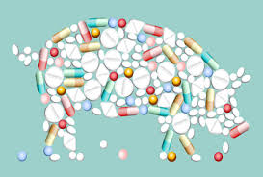
Thank You

