Slide 1
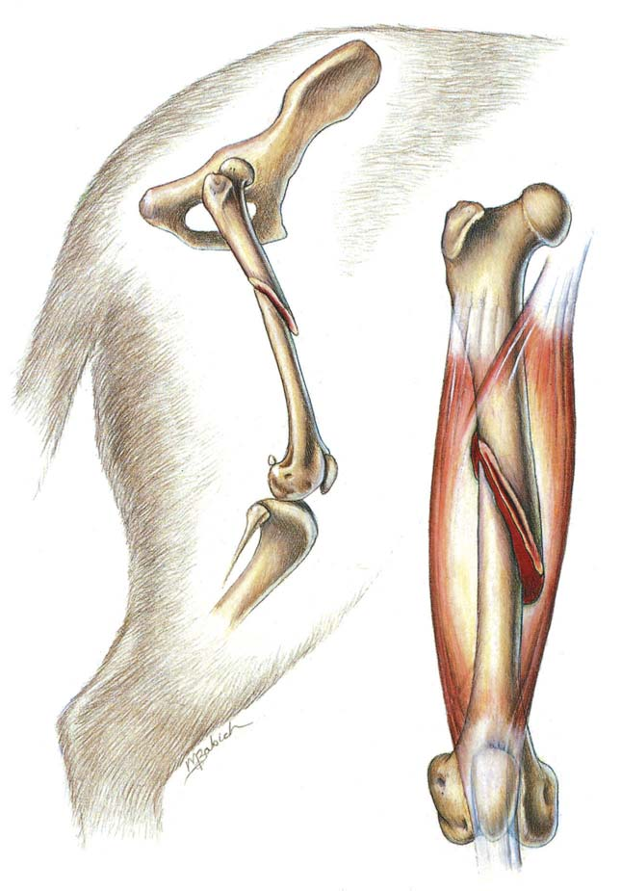
FRACTURE - II
.
Dr. Archana Kumari
Asstt. Professor cum Junior Scientist
Veterinary Surgery and Radiology
BVC, BASU, Patna

Slide 2
FRACTURE
Dessolution in the continuity of bone with or without displacement of fractured fragments is knows as fracture.
Breach in the continuity of bone with or without displacement of fractured fragments associated with soft tissue damage of varying degree.
A fracture is a break in the continuity of hard tissues.

Slide 3
Etiology
Extrinsic cause
Intrinsic cause
Indirect trauma
Direct trauma
Muscular contraction
Pathological fracture

Slide 4
INDIRECT TRAUMA
Bending force
Tensional force
Shearing force
Compressive force

Slide 5
Pathological fracture
Bone tumors and cyst
Osteoporosis
Hyperparathyroidism
Localized bone infection
Osteoporosis caused by prolonged fixation

Slide 6
CLASSIFICATION
On the basis of Communication of Fractured Site to the Environment
On the Basis of Extent of Bone Damage
On the Basis of Number of Fractured Fragments
On the Basis of Type of Bone Involved
On the Basis of Displacement of the Fractured Fragments

Slide 7
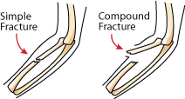
On the Basis of Communication of Fractured Site to the Environment
a. Simple fracture: does not communicate with the environment .
b. Compound fracture: communicates with the environment and more prone to infection.
c. Complicated fracture: A closed fracture with considerable injury & accompanied by the opening of a joint or vascular cavity.

Slide 8
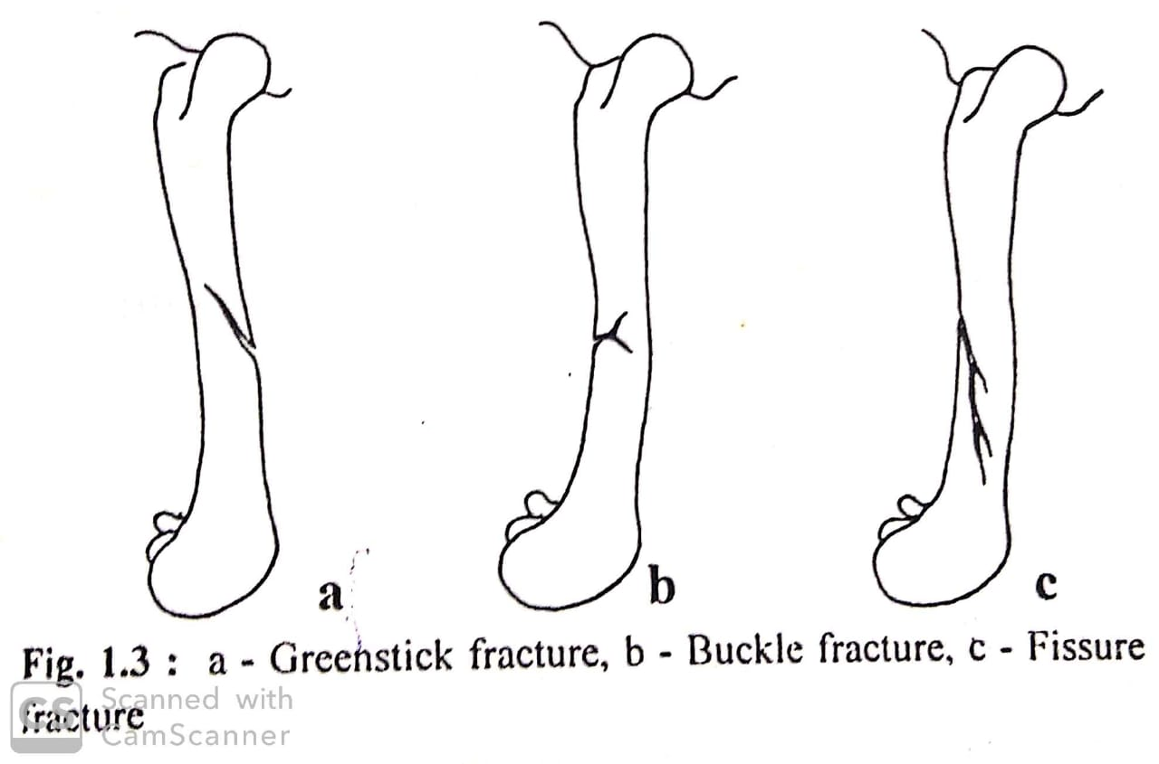
On the basis of fracture line
Incomplete fracture : continuity of bone has not completely lost
Green stick fracture: usually seen in immature bones under bending stress. The cortex under tensile stress (Convex) fractures completely, while the cortex under compression stress remains intact
Buckle fracture: seen on compressive side of bone usually seen in nutritional bone disease
Fissure fracture: crack /fissure in one cortex of bone with intact periosteum, due to direct trauma

Slide 9
.
Fissure fracture: The fissure formed in one cortex of the bone and the periosteum remains intact. The fissure line may be longitudinal, transverse or oblique.
Partial or splintered fracture: When splinters of bone are separated from the main bone i.e. by fire arms.
Sub-periosteal (intra-periosteal) fracture: A fracture of the cortical bone without rupture of the periosteum.
Deferred fracture: In which separation of fragments occur only after a varying period after incident due to subsequent violence, strain or concussion e.g. broken back in horse

Slide 10
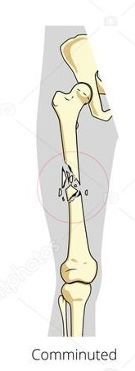
On the Basis of Number of Fractured Fragments
Single: When the bone is broken at one place only
Double: When there are two fracture in same bone
Multiple/comminuted: When the bone is broken into more than two pieces.
Single
Double

Slide 11
On the Basis of Type of Bone Involved
Cortical bone fracture: Fracture of diaphysis of long bone.
Cancellous bone fracture: Fracture of skull bone or extremities of long bones.

Slide 12
On the Basis of Displacement of the Fractured Fragments
Impacted fracture:
the cortical end of the fracture is forced of impacted into the cancellous bone.
Seen at the junction of diaphysis and metaphysis of a long bone.
Compression fracture: Cancellous bone collapse and compresses upon itself. Such fractures are seen in vertebral bodies
Distracted fracture: Bone fragments are separated the to sufficient muscle pull. e.g. fracture of olecranon.
Depression fracture: The fragments are depressed and produce a cavity e.g. fracture of skull bone.
Overriding fracture : A fracture in which the fragments lie side by side, causing shortening of limb

