Slide 1
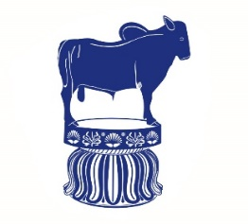
GENERAL CHEMOTHERAPY General Consideration Part II …………………………………………………………………………………………………………………………………………………………………………………………………………………………………………… Chemotherapy (VPT-411) (Lecture-3)
Dr. Kumari Anjana
Asstt. Professor
Deptt. of Veterinary Pharmacology & Toxicology
Bihar Veterinary College, Bihar Animal Sciences University, Patna

Slide 2
Content of the chapter
History
The period of empirical use
Ehrlich’s phase (1890-1935)
The modern era of chemotherapy

Slide 3
History
The history of chemotherapy may be divided into 3 phases:
The period of empirical use
Ehrlich’s phase of drugs and organometllic compounds (1890-1935)
The modern era of chemotherapy

Slide 4
Pre Ehrlich periods/The period of empirical use
In this period some compounds were used empirically to treat different diseases. Sometimes adverse effects were also monitored due to empirical use of the compounds.
‘Mouldy curd’ by Chinese on boils,
Chaulmoogra oil by Hindus in leprosy,
Chenopodium by Aztecs for intestinal worms,
Mercury by Paracelsus (16th century) for syphilis
Cinchona bark (17th century) for fevers.

Slide 5
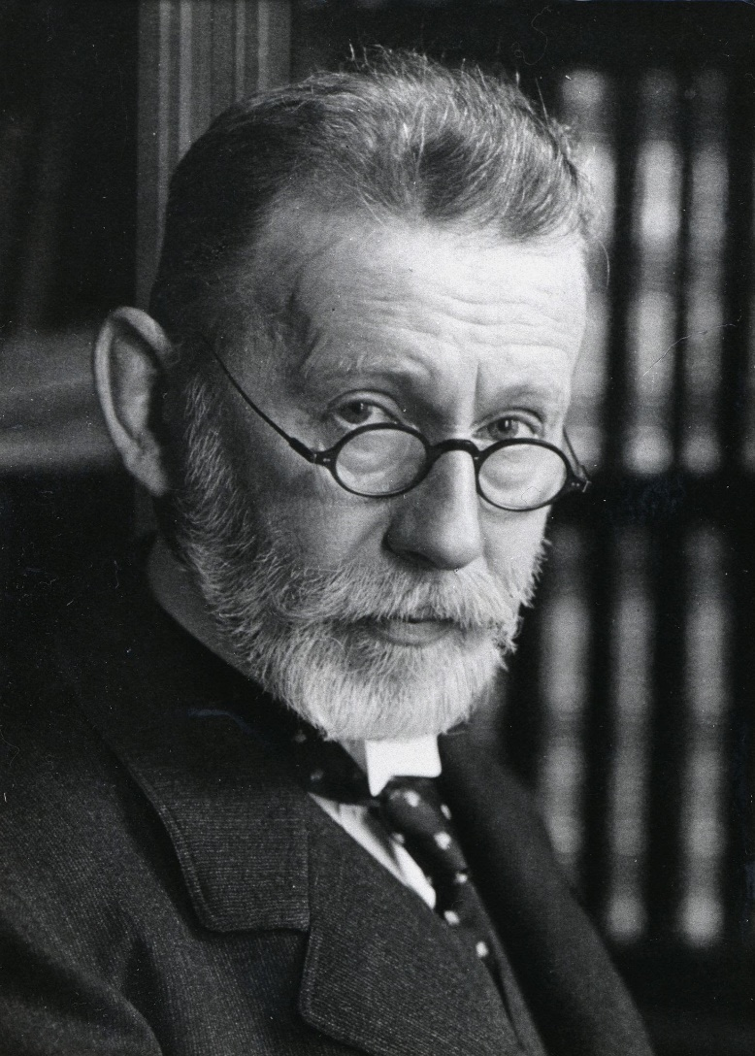
Ehrlich’s phase of dyes and organometallic compounds (1890-1935)
Discovery of microbes in the later half of 19th century and that they are the cause of many diseases.
Ehrlich toyed with the idea that if certain dyes could selectively stain microbes, they could also be selectively toxic to these organisms, and tried methylene blue, trypan red etc.
Fig: Paul Ehrlich
Source : Google image

Slide 6
Ehrlich called such compounds "Magic bullets".
For the therapeutic utility of compounds he introduced the term "chemotherapeutic Index", a ratio of maximum tolerated dose of a drug to its minimum curative dose.
Further, the term chemotherapeutic index was replaced by therapeutic index, a ratio of LD50 to ED50.
Ehrlich expressed an idea that cell membrane contains chemical groups or 'receptor' which with essential materials like oxygen and caused their up take by cells.

Slide 7
He told that chemicals contain two groups-one group attach to the cell receptor (haptophore) and another group which caused specific pharmacological effect or toxic effect (toxophore).
It is his idea that a drug can produce curative or toxic effect depending upon its affinity for the parasite or host.
Therefore, a compound which has high affinity for the host tissue (organotropic) may be toxic.
Where as, if the compound has high affinity for parasite (parasitotropic) may be curative.
Based on the above hypothesis, Ehrlich introduced arsephenamine, the first really effective chemotherapeutic agent in man, for the treatment of syphilis.

Slide 8
Developed
Arsenicals-Atoxyl for sleeping-sickness,
Arsphenamine in 1906 and
Neoarsphenamine in 1909 for syphilis.
Father of chemotherapy
He coined the term ‘chemotherapy’ because he used drugs of known chemical structure and showed that selective attenuation of infecting parasite was a practical proposition.
Awarded Nobel Prize in 1908 in medicine.

Slide 9
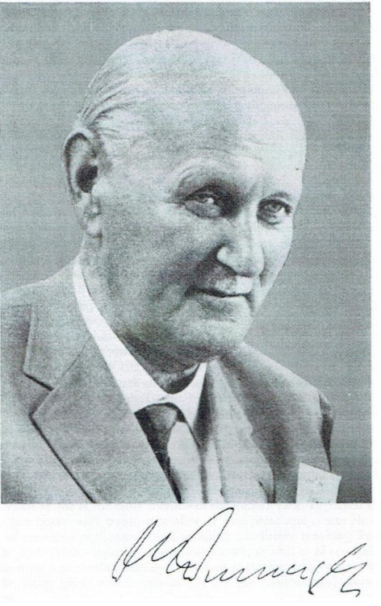
The modern era of chemotherapy
Domagk, Mietsch and co-workers in 1935 by demonstrating the therapeutic effect of prontosil, a sulfonamide dye, in pyogenic infection.
It was soon realized that the active moiety was paraamino benzene sulfonamide, and dye part was not essential.
Sulfapyridine (M&B 693)-first sulfonamide to be marketed in 1938.
Fig: Domagk
Source : Google image

Slide 10
Nitti, Bovet and Fuller are also known as trefuel brothers, pointed that prontosil produce its therapeutic efficacy to its conversion into sulfanilamide in the body.
Since then a variety of sulphonamides have been synthesized.
Though, sulfonamide was prepared by Gelmo in 1908, but years passed before its therapeutic value was discovered.

Slide 11
Antibiosis : The phenomenon of antibiosis was demonstrated by Pasteur and Jobert in 1877 : growth of anthrax bacilli in urine was inhibited by air born bacteria.
Babes in 1885, using culture media, established that one bacterium could elaborate a substance that would stop the growth of another.
Emmerich and Low in 1889, while working on the organism pseudomonas aeruginosa discovered that extract of this organism in high dilution could destroy a variety of pathogenic cocci as well as diphtheria, cholera, typhoid and plague organisms.

Slide 12
Sir Alexander Fleming (1929) while working on Staphylococcal varients found that a diffusible substance was elaborated by penicillium mould which could destroy staphylococcus on the culture plate.
He named this substance penicillin but could not purify it.
Chain and Florey followed up this observation in 1939 which culminated in the clinical use of penicillin in 1941.
Because of the great potential of this discovery in treating war wounds, commercial manufacture of penicillin soon started.

Slide 13
1940s Waksman and his colleagues undertook a systematic search of Actinomycetes as source of antibiotics and discovered streptomycin in 1944.
In 1944, streptomycin was reported by Schatz, Bugie and Waksman from Steptomyces griseus waksman defined 'antibiotic' as a chemical substance produced by micro-organisms having property of inhibiting the growth or destroying other micro-organisms in high dilution.
The streptomycin was found effective against many gram-negative micro organisms and Mycobacterium tuberculosis.

Slide 14
Actinomycetes - treasure-house of antibiotics.
Tetracyclines, chloramphenicol, erythromycin and many other followed.
Domagk,
Fleming-chain-Florey Noble prize
Waksman

Slide 15
Thank You

