Slide 1
Milk By-Products (Part-1)
By-
Dr. SUSHMA KUMARI
ASST.PROF., DEPT. OF LPT, BVC, PATNA

Slide 2
Milk by-products
By- products of commercial value are obtained during the manufacture of main product from milk.
Main product by-product
Cream skim milk
Butter butter milk
Ghee ghee residue
Channa/paneer whey
Cheese/ casein whey
Curd lassi

Slide 3
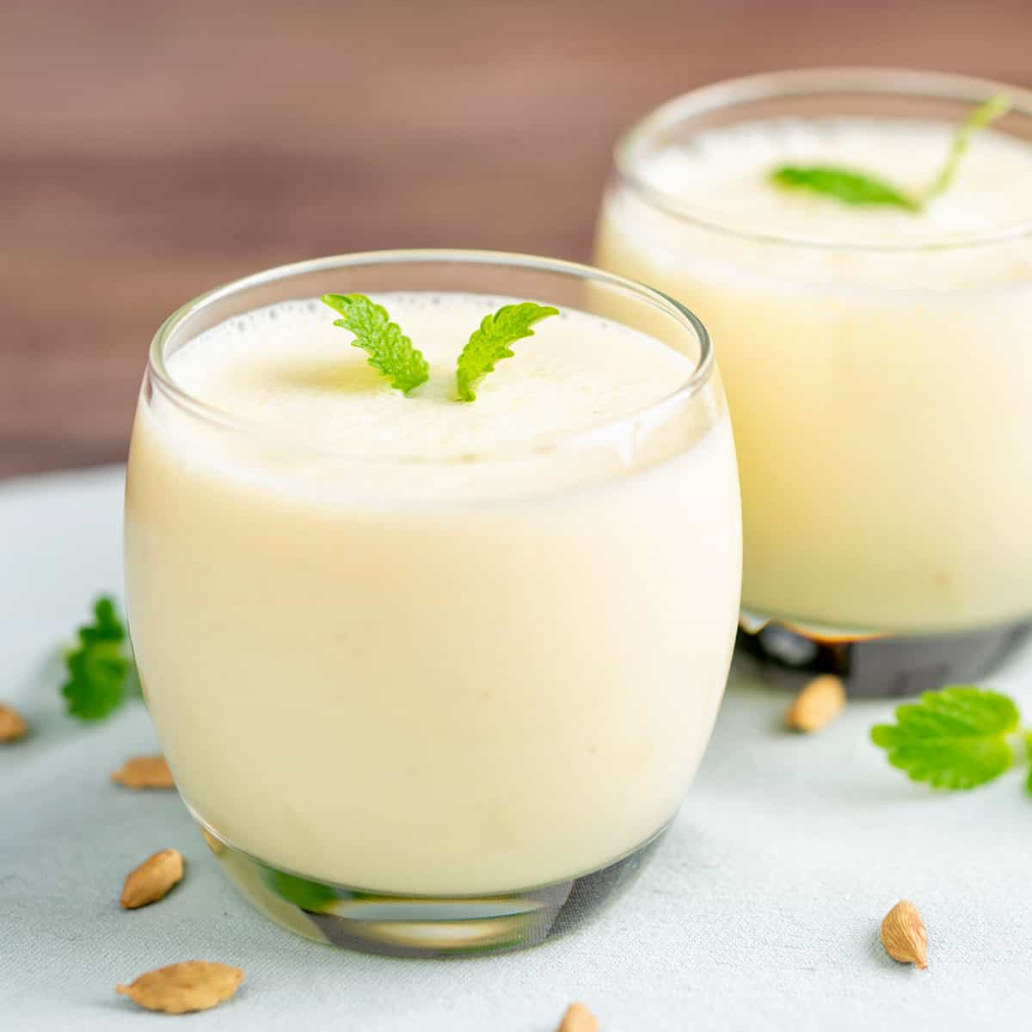
MATHA

Slide 4
Utilization of milk by-products
By-product Principle of utilization Uses
Skim milk pasteurization flavoured milk
do- sterilization do-
do- drying skim milk powder
do- coagulation cottage cheese
bakers’ cheese
gammelost cheese
sapsago cheese
casein (edible)

Slide 5
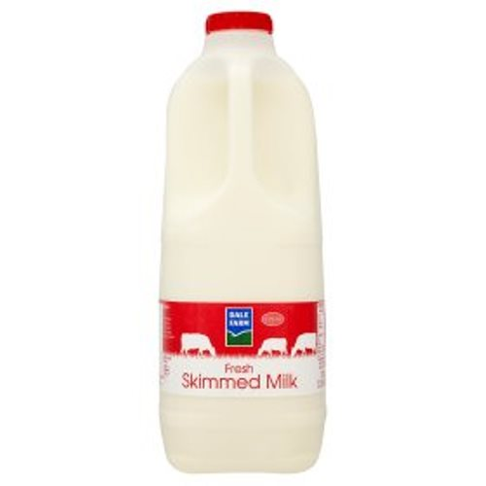
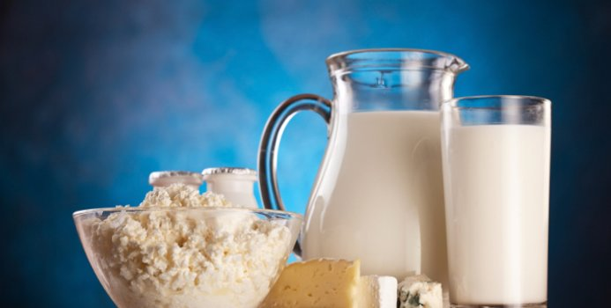
SKIM MILK

Slide 6
By-product Principle of utilization Uses
Whey fermentation wheyvit
(whey beverage)
do- coagulation ricotta cheese
Mysost cheese
Primost cheese
lassi icing& seasoning beverage
Ghee residue processing toffee,
sweets (ladoo)
biscuits etc.

Slide 7
THANKS

