Slide 2
Butter
Butter is fat concentrate obtained by churning cream, gathering the fat into a compact mass and then working it.
Classification of butter-
Pasteurized cream butter
Ripened cream butter
Unripened cream butter
Salted butter
Plain butter etc.

Slide 3
Chemical composition of butter
Fat – 80%
Moisture-16.5 %
Salt-2.5%
Curd- 1%
Nutritive value of butter-
Butter is rich source of fat and fat soluble vitamins.

Slide 4
Method of preparation
Milk cream
Pasteurization/ vacreation
Cooling (5-10 C)
Ageing (5-10C for 4 hrs to 16 hrs)
Churning ( at 9-11C separation of fat and serum within 30-60 min,pea size butter granule occur)
Washing
Salting and Working
Packaging and storage

Slide 5
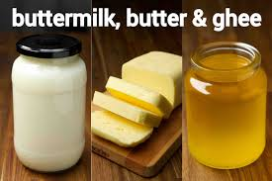

Slide 6
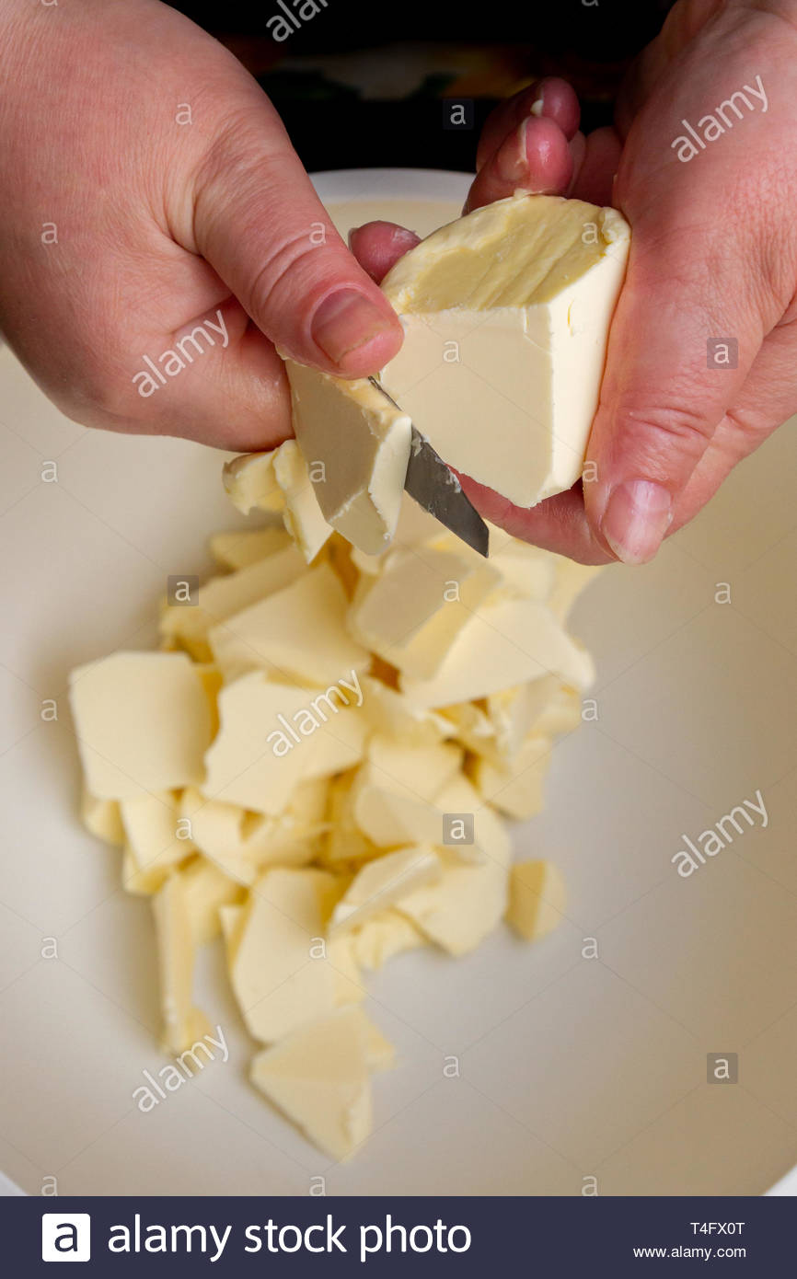
Butter

Slide 7
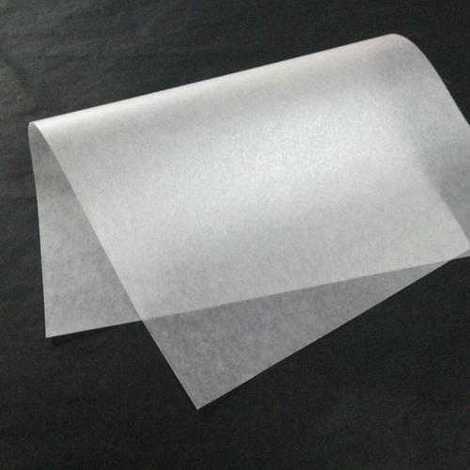
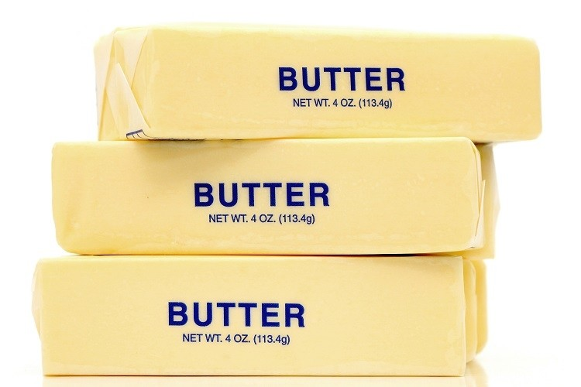
Butter Packaging

Slide 8
Over run- The weight of butter obtained from a given lot of cream exceeds the amount of fat in the cream. that amount of butter which exceeds the fat present in cream is called overrun.
overrun is caused by presence of moisture, curd , salt etc in butter.
It is a source of profit to the butter maker and also help to check the efficiency of factory operation.

Slide 9
THANKS

