Slide 1
Dr Alok Kumar
Assistant Professor Cum Jn Scientist
Dept. VGO, BVC, BASU

Slide 2
Methods of semen collection
Collection from vagina (Spoon/Sponge method)
Massage technique
Artificial vagina method
Electroejaculation method
Digital manipulation method

Slide 3
Vaginal method ( Spoon or Sponge technique)
The simplest and earliest method of semen collection was from vagina.
Bull is allowed to mount the cow/dummy in naturally and the semen is collected from vagina by means of a spoon or Sponge or syringe with a long nozzle.

Slide 4
Disadvantages of spoon method
Unsatisfactory semen quality
Selectively small volume of semen is mixed with large volume of vaginal mucus.
To avoid this female out of oestrus can be used.
Later, Breeder’s bag and urethral fistular methods of semen collection were used.
Non-scientific method.
Danger of contamination and disease transmission.
Keeping quality of the semen will be very poor.

Slide 5
Ampullary Massage technique
Here semen is collected by massaging the ampullae and seminal vesicle through the rectum.
This method was reported as early as 1925 by Case and late well described by Miller and Evans (1934).
Procedure
Before starting semen collection by massage method ensure that the bull has not ejaculated either by natural service or by some other method for two to three days to ensure that ampulla is full of spermatozoa.
Secure the bull in a suitable stanchion & The preputial hair should be clipped

Slide 6
Ampullary Massage technique
By tapping the preputial sheath stimulate the urination and empty the bladder
Properly wash the preputial sheath with warm water and carefully dry it with a clean towel
Perform back-racking
The operator can carefully massage the seminal vesicle, prostate, cowper’s gland to stimulate some secretion of seminal fluid to rinse the bull’s urethra.
The seminal vesicles are gently massaged for few times with fingers by backward and downward strokes towards urethra and a cloudy fluid is expelled.

Slide 7
Ampullary Massage technique
Then the ampullae is massaged one by one by gentle, slow and rhythmic manner.
The ampullae is squeezed/stripped by pressing over floor of the pelvis and the pelvic urethra may be massaged.
The massage can be done for 5 minutes. After the massage of the ampullae the S-curve of the penis should be straightened to allow the escape of semen.
An assistant holding a glass funnel fitted to a collection vial directly beneath the bull’s sheath can collect the semen during massaging.
The quantity of fluid collected from seminal vesicle ranged from .5 to 21 ml and ampullae ranged from .5 to 23 ml.

Slide 8
Ampullary Massage technique
Advantages
Semen can be collected from bulls, which are physically incapable of mounting due to less libido, lameness or fracture .
To collect semen from bulls that are refusing to artificial vagina.
To collect from bulls those are incapable of erection.
Disadvantages
Chances of contamination by urine or sand.
Seminal vesicles secretion leads to unbalanced semen components than ejaculated semen.
Poor concentration and poor keeping quality.
Requires skill on the past of operator or training on the past of bull.
Excessive massage will cause inflammation of the organs.

Slide 9
Electroejaculator method
Electrical stimulation of ampullae and seminal vesicle is also a method of collecting semen from bulls.
This method was used by Gunn in 1936 for rams.
Later it was modified by Rowson and Murdock, Marden, Dzuik for collection of semen in bulls.
Thibault et al. (1948) successfully used this for bulls.

Slide 10
Electroejaculator method
Procedure
The animal is restrained in a trevis
The preputial hairs may be clipped, washed and dried
Teasing or sexually stimulating the bull before applying electro ejaculate may help to inform the quality and quantity of semen
After cleaning the rectum the glove hand with the electrodes is inserted and passed forward upto 30 cm and the electrodes can be pressed down on the floor of the rectum directly over the two ampullae between the two diverting seminal vesicles

Slide 11
Electroejaculator method
An alternate current is passed starting at 5 voltage and return back to zero every 5 to 10 seconds.
This is gradually increased up to 15 volts. Generally the erection and ejaculation occurs at 10-15 volts when 0.5 to 1 ampere current is flowing.
The semen is collected in a clean sterile glass with a glass funnel.
The first portion generally consists of merely the watery secretion of the accessory glands and can be discarded.
The portion is usually containing semen is collected and used.

Slide 12
Electroejaculator method
Advantages
Semen can be collected from males that refuse to donate semen in artificial vagina, lowered sex libido or when injuries or deformities make this impossible.
Helps to collect the semen from bulls that are not able to mount
Bulls that are recumbent but having good pedigree can be collected by this method
Disadvantages
The technique may be painful to bulls. It can not be practiced frequently, since frequent use of this method may affect the health status of the bulls.
The quality of semen collected by electro ejaculation cannot be compared with semen obtained by AV method because the non accessory sex gland secretion.
The semen collected by this method is usually more in volume and less in sperm concentration. The contamination of semen will also be more.

Slide 13
Artificial vagina (AV) method
The AV provides the most satisfactory method of collecting semen from bulls.
This is the most widely used and preferred method for routine semen collection.
This method has several advantages over other methods and a normal, clear ejaculate can be collected.
Artificial vagina is very convenient and is more near to the natural service i.e. it contributes the threshold of warmth, pressure and friction simulating the normal characters of female reproductive passage.

Slide 14
Artificial vagina (AV) method
Limitations
Requires trained/skilled personnel for collection of semen.
Chances of injury by furious bulls
Development of artificial vagina
Russians (Kumorov and Nagev, 1932) designed the first artificial vagina.
The Cornell University workers developed Cornell Model
“Danish model” was developed in US
In tropical countries the “short model” was developed

Slide 15
Russian model of Artificial Vagina
Made of rigid rubber cylinder
60 cm long and 5.5 cm inner diameter.
The inner side of rubber cylinder was covered by a thin walled rubber liner, the ends was turned back over the outer cylinder to form water tight jacket
The jacket was filled with hot water enough to bring the inside of AV to also body temperature.

Slide 16
Danish model of artificial Vagina
Danish model is commonly used for semen collection in united states.
Length – 40.70 cm
Outer diameter – 6.25 cm
Inner diameter – 5.7 cm
The above mentioned dimensions may be lowered for smaller bulls in order to collect the ejaculate near the collecting receptacle

Slide 17
Cornell model of Artificial Vagina
Developed by scientists of Cornell university
Length – 71.20 cm
Outer diameter – 6.25 cm
Inner diameter – 5.7 cm
This model overcome the advantage of Danish model by covering the collecting receptacle and exposing to outside environment

Slide 18
Disadvantage of AV
Semen receptacle is exposed to light and ambient temperature
Damage of cold shock to spermatozoa during collection in cold weather.
Cornell model overcome the advantage of Danish model by covering the collecting receptacle and exposing to outside environment

Slide 19
Parts of Artificial Vagina
Rubber hose pipe or cylinder

Slide 20
Directors cone Director cone
Silicone conParts of Artificial Vagina e for bovine vagina

Slide 21
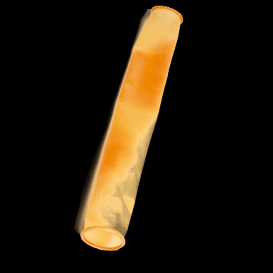
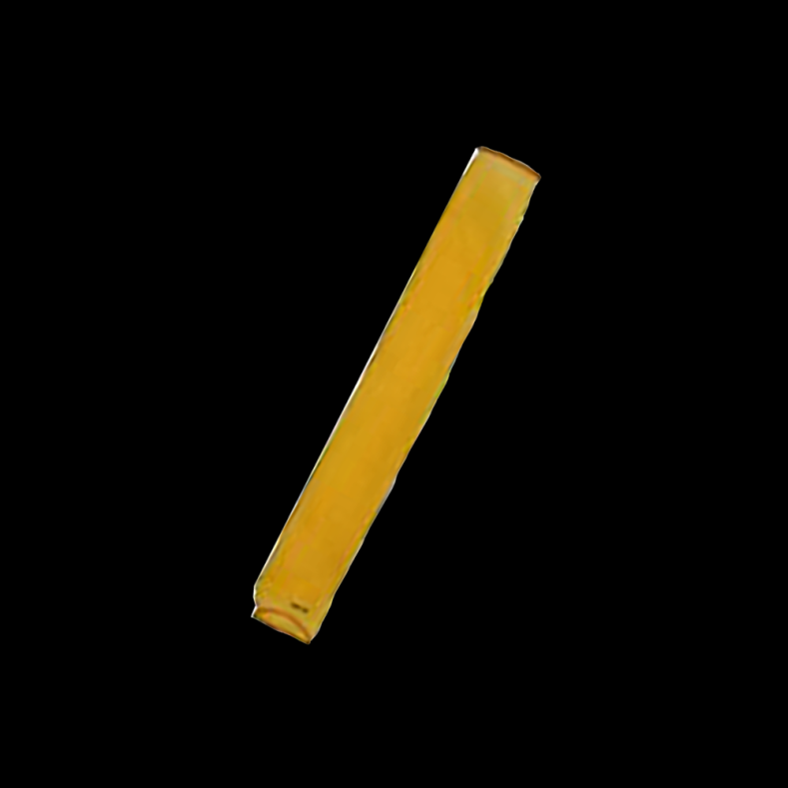
Inner liner Inner liner/ latex liner
Parts of Artificial Vagina
Rough latex liner
Rough neoprene liner
Smooth latex liner

Slide 22
Preparation of AV
The parts AV should be sterilized before it is used for semen collection to avoid the contamination and disease transmission.
After sterilization all parts should be dried and stored in a dust free cabinet or incubator.
The inner liner should be inserted into the AV and both the ends are turned back over the ends of the cylinder
Rubber bands may be attached on both the ends so as to form a jacket between the liner and rubber cylinder.

Slide 23
Preparation of AV
The director cone is fastened over one end of the AV and the glass semen collecting vial is attached to the smaller end of the cone.
After assembling AV, half the jacket is filled with warm water of about 65-70 ⁰ C is poured to get the final temperature of 42.5 to 45 ⁰ C inside the AV.
The remaining half of the jacket is filled with air. The temperature of AV may vary depending upon the season, time semen collection and air temperature. (Click here to view picture).
The insulation bag is used in colder or hotter environment to avoid cold/heat shock to the spermatozoa.

Slide 24
Preparation of AV
The insulation bag is applied to cover the director cone and collection vial. (Click here to view picture)
After assembling the AV, sterile lubricating jelly is applied for 3 to 5 inches of the interior of liner.
The temperature of the AV should be checked by the semen collector before taking it for semen collection. (Click here to view icture)
Excessive lubrication will cause the contamination over semen samples by carrying the jelly through the AV over the bull’s pelvis.

Slide 25
Lubricants
K.Y. Jelly
Sterile white Vaseline jelly
White mineral oil (Sterile)
Tragacanth gum (3 gm Tragacanth, 5 ml glycerine and 50 ml distilled water)

Slide 26
Preparation of bull
Semen collection is done in the early morning.
The scheduled bulls will be carried from their paddocks to washing area.
The animals should be washed to remove all the dirt.
The bulls should be tied with bull apron and the prepuce should be cleaned with normal saline
The bulls are allowed to watch the other bulls mounting which will stimulate the bull.
The forward and backward movement of dummy will also stimulate the bull.
The protrusion of penis from prepuce will indicate the bull is ready to mount.

Slide 27
Parts of Artificial Vagina
Protective felt cover for bovine vagina

Slide 28
Parts of Artificial Vagina
Collection tube
Reusable
Disposable

Slide 29
Parts of Artificial Vagina
Protective felt cover for collection tube

Slide 30
Semen collection
The teaser should be restrained in a trevis.
The dummy also used occasionally for semen collection
2 to 3 false mountings are given
The right handed operator can approach the bull from right side by holding the AV on his right hand
When the bull mounts and ready to make the thrust, the operator using the left hand drawn the penis from sheath and directs it into the AV which is held at an angle that it is in have with the testis.

Slide 31
Semen collection
During the entire process the testis itself should not be touched as it will leads to refusal to service.
The AV should be directed in such a way that the semen should be ejaculated in director cone or directly on collection vial
After collecting the semen the collection vial is disconnected immediately, closed with clean stopper / sterile aluminum, plastered with details of bulls, placed in a beaker containing water of about 34 ⁰ C and examined as soon as possible

