Slide 1
Milk Products (part-8)
By-
Dr. SUSHMA KUMARI
ASST.PROF., DEPT.OF LPT, BVC, PATNA

Slide 2
Kulfi
It is Indigenous frozen milk product.
Composition of kulfi-
Fat-7-8%
SNF- 37 %
Method off preparation-
Milk
Boiling
Addition of sugar (2:1)
Cooling
Addition of cream, nuts, flavours
Filling in conical/ triangular mould
Frozen( earthen vessel with mixture of ice: salt::1:1)

Slide 3
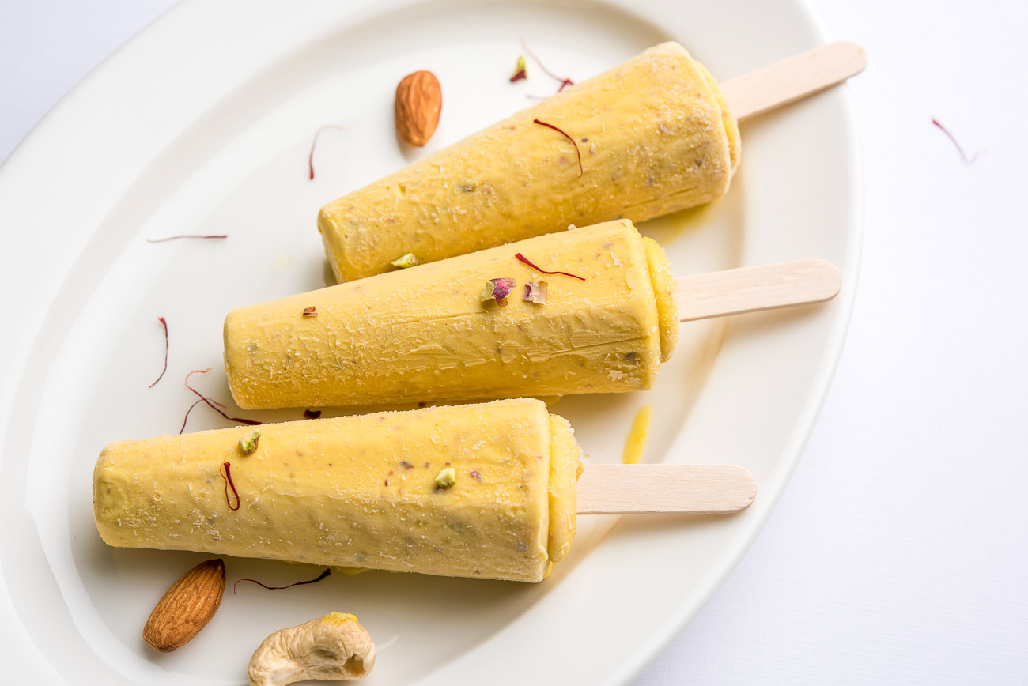
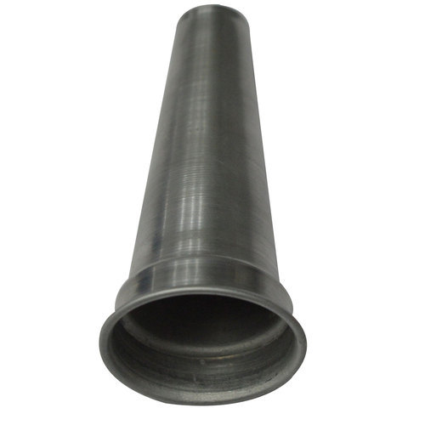
KULFI KULFI CONE

Slide 4
Ice cream
Ice cream is a frozen milk product made by freezing a pasteurized ice cream mix with agitation to incorporate air.
Composition of Ice cream mix-
Milk/milk powder +sugar + dextrose+ corn syrup+ water + flavour + stabilizer (0.3-0.5%) + emulsifier (0.3-0.5%)
Composition of Ice-cream-
Fat (12-20%) ,SNF (8-15%), Sugar ( 13-20%).
Stabilizer-used to prevent large ice crystal formation.
Common stabilizers used in ice cream, such as guar gum, carob bean gum and cellulose gum, function to reduce the degree of ice crystal growth by influencing viscosity and other rheological properties, thus limiting the mobility of water in the unfrozen aqueous portion.
Emulisifier- used to improve whipping quality o mix.
Emulsifiers commonly used in ice cream include mono-diglycerides (E471), lactic acid esters (E472b), propylene glycol esters (E477) and blends of these.

Slide 5
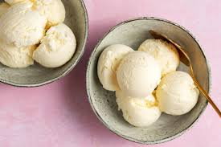
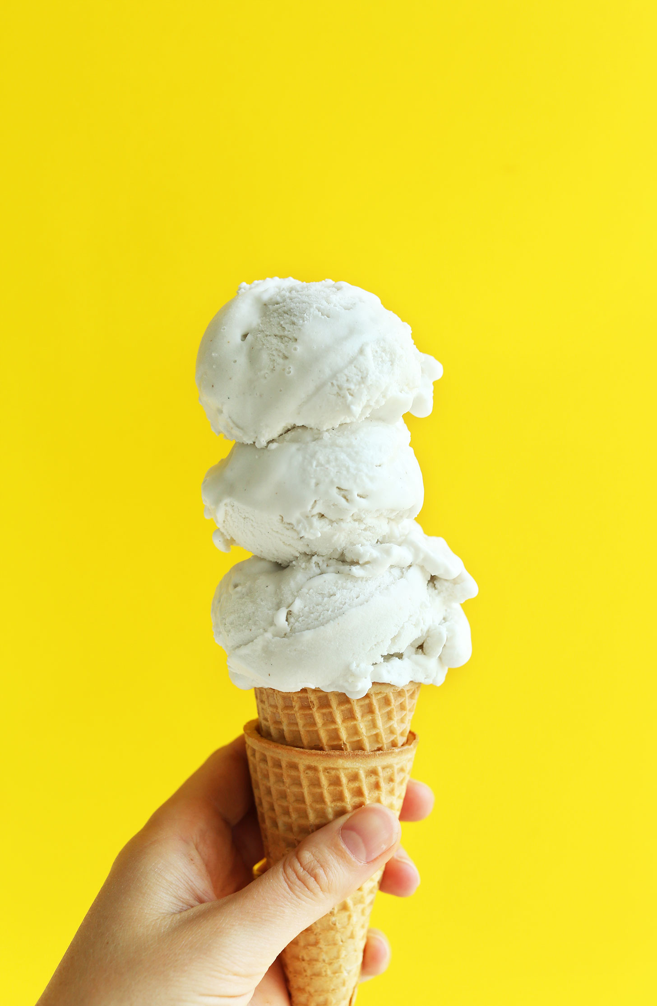
ICE CREAM

Slide 6
Method of preparation of ice cream-
Ice cream mix
Pasteurization
Homogenization ( 1st stage 2500psi,
2nd stage 500 psi)
Cooling the mix (below 5 C)
Aging the mix ( at 5 C for 3-4 hrs)
Freezing the mix (-4 C for 7 min)
Packaging of ice cream
Hardening and storage of ice cream (-23 C to -29 C)

Slide 7
%
Over run –is defined as the volume of ice cream obtained in excess of the volume of the mix . It is usually expressed as percent overrun.
vol of ice cream- vol of mix
% over run = ---------------------------------------------
vol of mix
Defects of ice cream-
Sour flavour, rancid flavour, sandy texture,
Slow melting (excess stabilizer), foamy melt down(excess emulsifier, excess overrun).

Slide 8
THANKS

