Slide 1
Pregnancy Diagnosis in Bovine
Dr.Chandrashekhar Azad
Department of Veterinary Gynaecology & Obstetrics
Bihar Animal Sciences University,Patna

Slide 2
Objective
Early pregnancy diagnosis is essential for successful breeding programme.
To differentiate the pregnancy and abnormal conditions of the uterus.
To detect the pregnant and non pregnant animal.

Slide 3
Methods of pregnancy Diagnosis
Sr. No. | Method | Cause | Species
1. | Managemental | Non return to oestrous | Cattle, Buffalo, Sheep,Goat,Sow
2. | Clinical | Rectal Palpation | Cattle, Buffalo, Sheep, Goat, Sow
 |  | Radiography | Canine Sheep, Goat
 |  | USG | All species
 |  | Abdominal palpation | Canine
 |  | Abdominal ballotment | Cattle, Buffalo, Sheep, Goat
 |  | Recto-abdominal | Sheep
3. | Lab Test method | Bacl 2,Cuboni Test | Cattle, Buffalo,Mare
4. | Lab method (Immunological) | Progestrone, Estrogen | All Species

Slide 4
External Examination
1.Visual examination
Fattening tendency of animal
Increase in bodyweight
Flanks become hollow and spine appears more prominent.
Cessation of estrus cycle after A.I and natural service.

Slide 5
2.Abdominal ballottement:
Abdominal ballottement of fetus can be done from 7 month onwards.
Press abdomen right side by closed first and release suddenly and apply the palm against the abdominal wall to feel the fetus which hits the palm.

Slide 6
Internal Examination (Per rectal palpation)
Advantage of P.D –
Provide immediate answer.
Non pregnant cow treated early.
Require minimum equipment and few person.
Common errors in rectal palpation
Failure to retract the uterus, abnormal uterine contents (pyometra and mucometra), incorrect service dates and Loss due to mishandling of uterus in early pregnancy diagnosis.

Slide 7
Changes observed during pregnancy by per rectal palpation.
Palpation at 35-40 days.
Uterus at pelvic floor.
Asymmetry of uterine horn and amount of fluid 30-80 ml.
Slipping of fetal membranes.
Horn diameter- 4-5 cm ( 3 fingers)
C.L on ipsilateral ovary

Slide 8
Palpation at 45-50 days
Asymmetry of uterine horn and amount of fluid 80-100 ml.
Pregnant horn diameter 5-6.5 cm( 4 fingers)
Slipping of fetal membrane
C.L on ipsilateral ovary

Slide 9
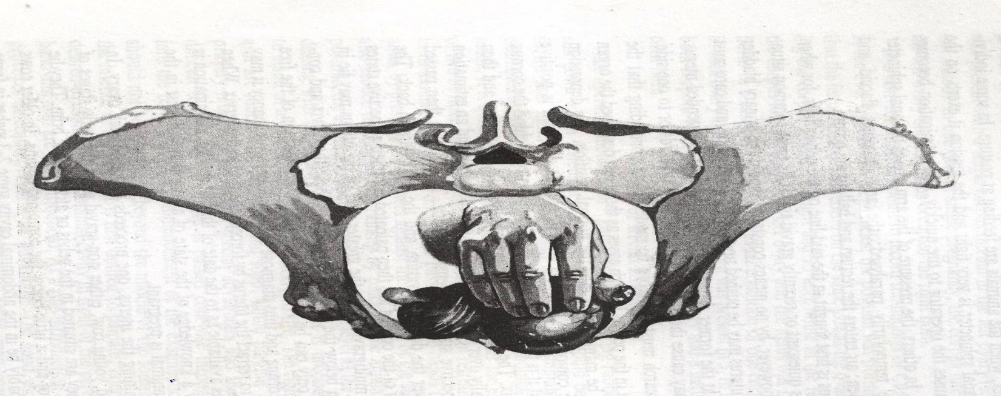
Palpation at 60 days
Uterus slightly over the pelvic brim.
Uterine horn feels like a balloon filled with water.
Fetus mouse size ( 5 cm long)
Pregnant uterus diam - 6.5 - 7.6 cm

Slide 10
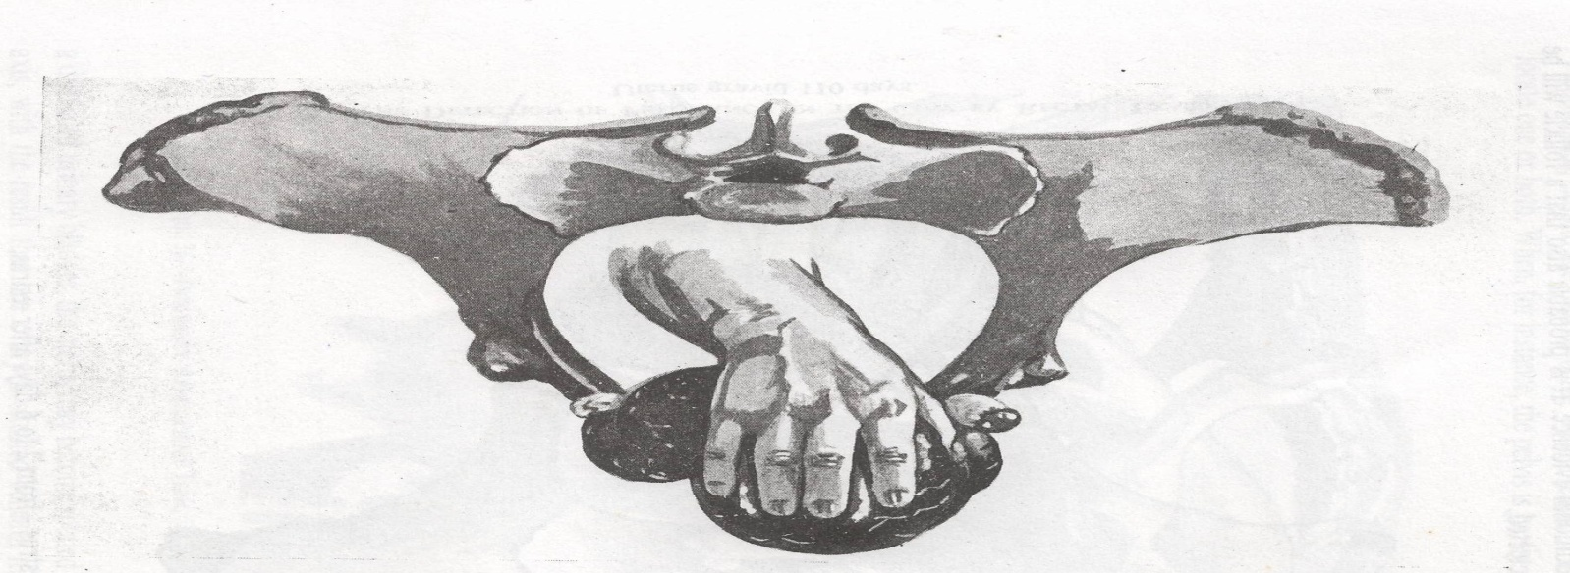
Palpation at 90 days
Pulled well over the pelvic brim.
Pregnant horn diameter 8 -10 cm.
Fetus 10-15 cm long.
Placentomes ( 1-2 cm) may be palpated
Pencil size middle uterine artery.
Fetal bump present.

Slide 11
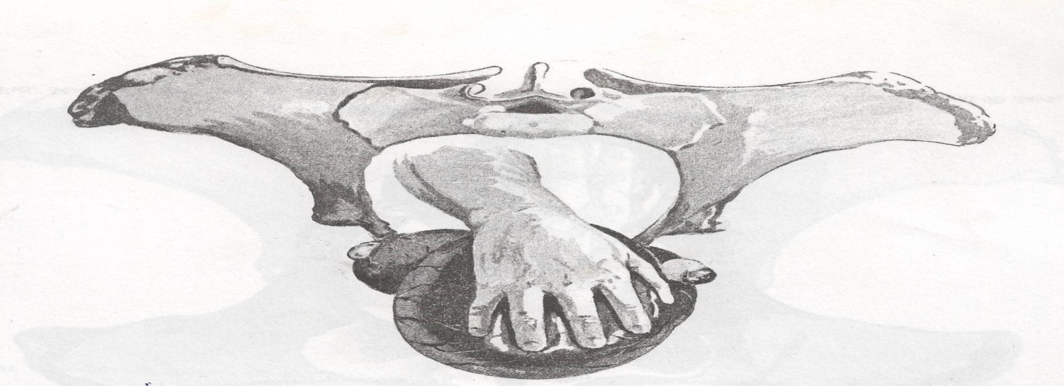
Palpation at 120 days
Cervix pulled toward pelvic brim.
Uterine horn diameter more than 18 cm.
Fetus size 25-30 cm long.
Small placentomes ( Cherry size)
Fremitus prominent.

Slide 12
Palpation at 150 days
Uterus at abdominal cavity.
Placentomes ( walnut sized)
Fetus size - 35-40 cm long
Fremitus more prominent.

Slide 13
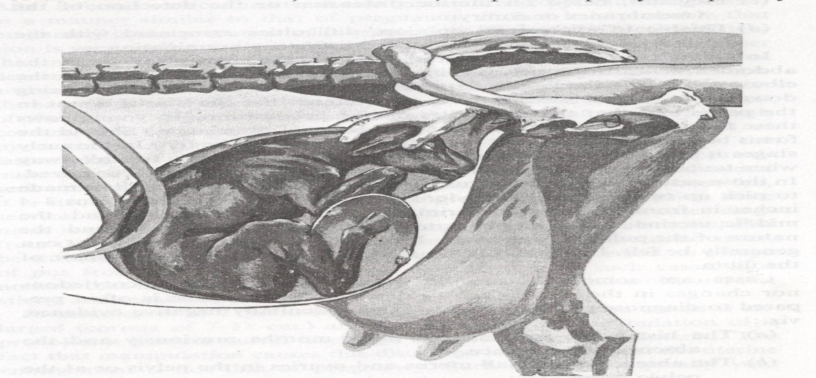
Palpation at 170-230days
Dorsal wall of uterus tight and difficult to palpate.
Placentomes difficult to palpate.
Cervix at pelvic brim.
Palpation at 230-280 days.
Fetal head and limbs palpate.
Fetal movement and reflexes can be felt.

Slide 14
Differential diagnosis
Filled urinary bladder trace from cervix whether enlarged mass is in continuation with the cervix.
Rumen feels like a doughy, flaccid mass whereas gravid uterus gives live feeling.
Metritis ( Thick uterine wall, no fluid feeling, Foul smelling discharge)
Mucometra – No presence of fetus, Cotyldones absent.

Slide 15
Pregnancy | Pyometra
Dissimilar horns | Similar horns except in cows where the uterine involution is not complete.
Uterine wall thin | Uterine wall thick.
Live fluid feeling | A thick fluid with no resilience.
Double slipping fetus, placentomes palpable depending | No such positive signs of pregnancy.
Normal pregnancy | Mummified fetus
Presence of fetal fluids , placentomes and live fetus. | Absence of fluid and placentomes and uterus tightly contracted over a semisolid to solid fetal mass.
Fremitus present. | Mostly absent

Slide 16
Thanks

