Slide 1
PROPERTIES OF AMINO ACIDS

Slide 2
A. PHYSICAL PROPERTIES
Solubility : Most of the amino acids are usually soluble in water and insoluble in organic solvents.
Melting point : Amino acids generally melt at higher temperatures, often above 200°C.
Taste : Amino acids may be sweet (Gly, Ala, Val), tasteless (Leu) or bitter (Arg, Ile), Monosodium glutamate (MSG; ajinomotto) is used as a flavouring agent in food industry.

Slide 3
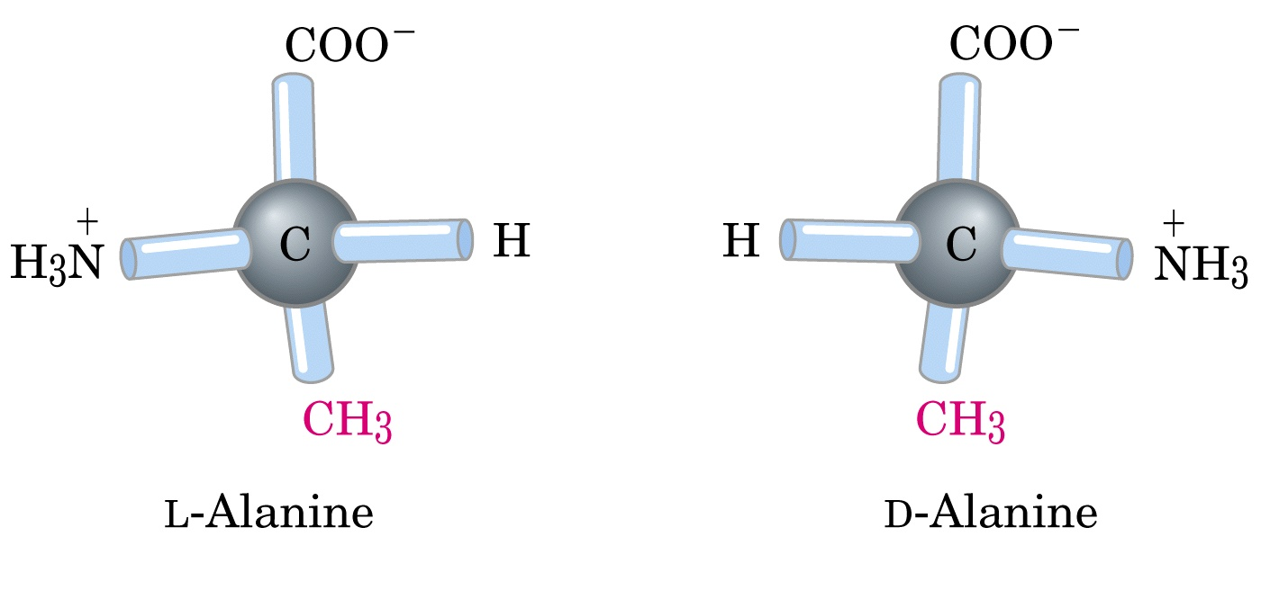
Optical properties: All amino acids except glycine possess optical isomers due to the presence of asymmentric carbon atom. Some amino acids have a second assymmentric carbon e.g. isoleucine, threonine.

Slide 4
Amino acids as ampholytes : amino acid contains both acidic(-COOH) and basic (-NH2) groups. They can donate a proton or accept a proton , hence amino acids are regarded as ampholytes

Slide 5
Zwitterion or dipolar ion:
In zwitterions of amino acids with uncharged side chain, the +ve and –ve Charges cancel one another
Amino acids in which the +ve and –ve charges are balanced is at its isoelectric point
The pH at which this balancing occurs is isoelectric pH
An amino acids is least soluble at its isoelectric pH
Increases solubility at lower pH as well as at higher pH

Slide 6
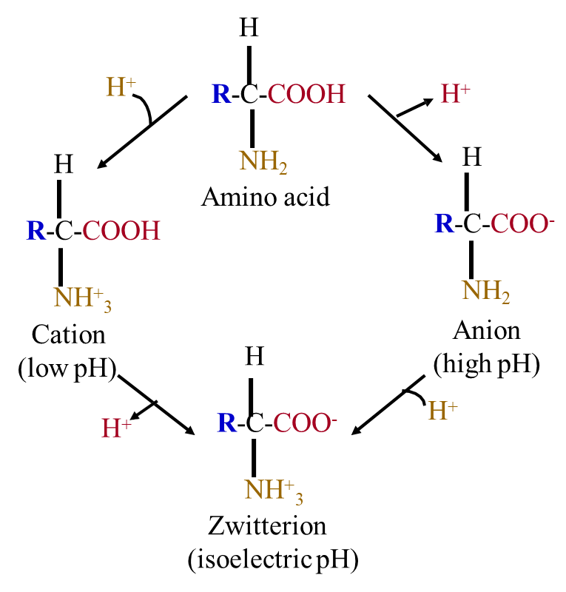
EXISTENCE OF AMINO ACID AS CATION, ANION AND ZWITTERION

Slide 7
Isoelectric pH (symbol pI):
the pH at which a molecule exists as a zwitter ion and carries no net charge making the molecule electrically neutral

Slide 8
B. CHEMICAL PROPERTIES
Reaction with ammonia:
The carboxyl group of dicarboxylic amino acids reacts with NH3 to form amide
The amino acid behave as bases and combines with acids (e.g. HCL) to form salts (-NH⁺₃Cl⁻)

Slide 9
Reaction with ninhydrin : The α- amino acids react with ninhydrin to form a purple, blue or pink colour complex (Ruhemann’s purple).
Amino acid + Ninhydrin ------> Keto acid + NH₃ + CO₂ + Hydrindantin Hydrindantin + NH₃ + Ninhydrin ------> Ruhemann’s purple
Ninhydrin’s reaction is effectively used for the quantitative deamination of amino acids and proteins. (Proline gives yellow colour with ninhydrin).

Slide 10
Colour reactions
Test | Observation | Specific group
Biuret | Violet/ purple | 2 peptide linkage
Ninhydrin | Blue | Α-Amino Acid
Xantoproteic | Orange | Aromatic amino acid
Millon’s | Red | Phenolic group
Hopkins-Cole | Violet ring | Indole ring
Sakaguchi | Intense red | Guanidio group
Sulphur | Black precipitate | -SH group
Pauly’s | Red | Imidazole
Folin-ciocalteau’s | - | Phenolic group

Slide 11
Beta amino acid
β amino acids, which have their amino group bonded to the β carbon rather than the α carbon as in the 20 standard biological amino acids.
The only commonly naturally occurring β amino acid is β-alanine; although it is used as a component of larger bioactive molecules, β-peptides in general do not appear in nature.
Only glycine lacks a β carbon, which means that β-glycine is not possible.

Slide 12
BETA ALANINE
Also known as 3-aminopropanoic acid,
It is a non-essential amino acid and is the only naturally occurring beta-amino acid.
Not to be confused with alanine, beta- alanine is classified as a non- proteinogenic amino acid as it is not used in the building of proteins
β-Alanine is the rate-limiting precursor of carnosine
Supplementation with β-alanine has been shown to increase the concentration of carnosine in muscles

Slide 13
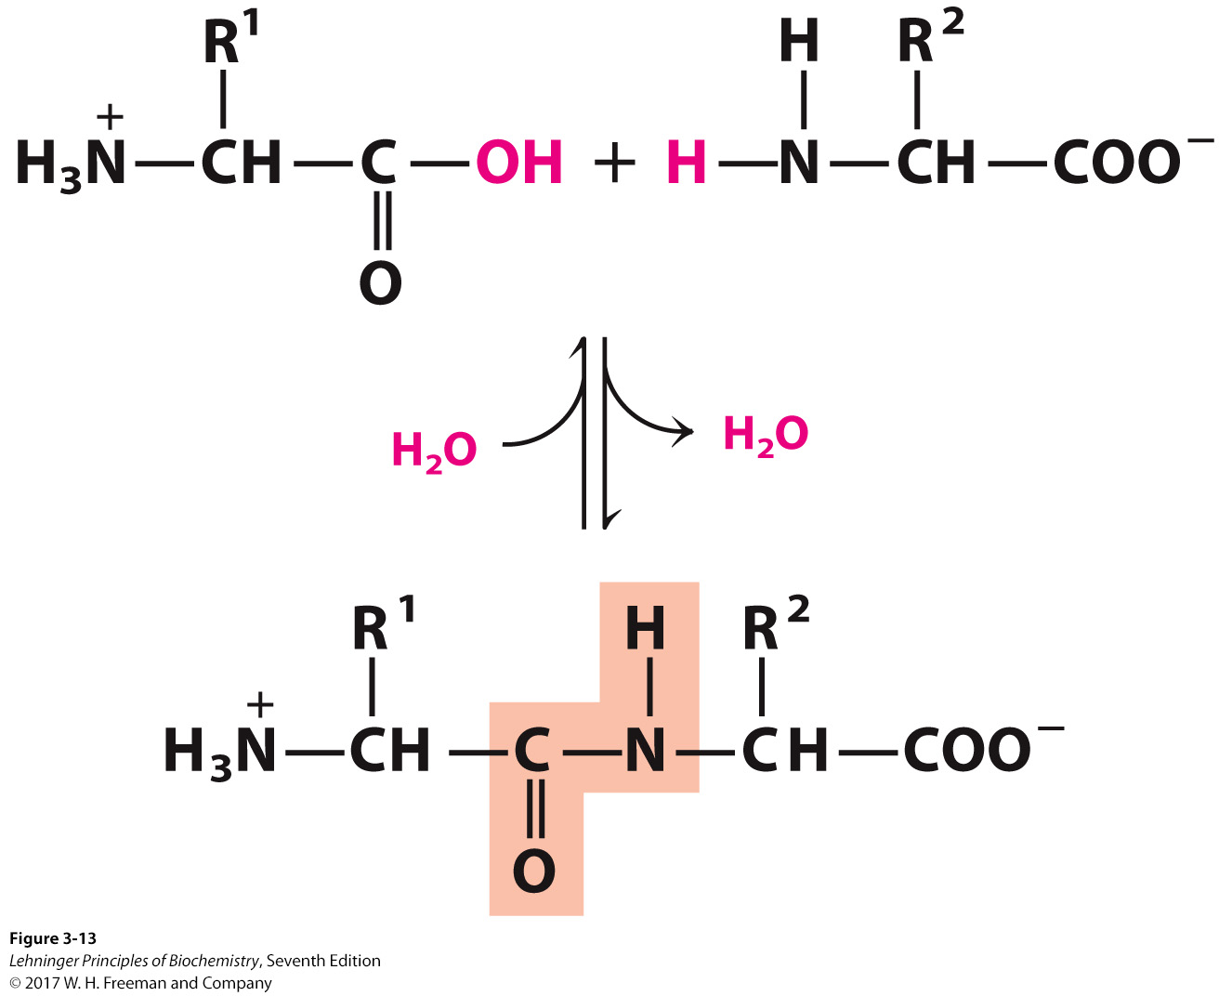
Amino Acids Polymerize to Form Peptides
Peptides are small condensation products of amino acids.
They are “small” compared with proteins (M_{w} < 10 kDa).
Notes:
FIGURE 3-13 Formation of a peptide bond by condensation. The α-amino group of one amino acid (with R² group) acts as a nucleophile to displace the hydroxyl group of another amino acid (with R¹ group), forming a peptide bond (shaded in yellow). Amino groups are good nucleophiles, but the hydroxyl group is a poor leaving group and is not readily displaced. At physiological pH, the reaction shown here does not occur to any appreciable extent.

Slide 14
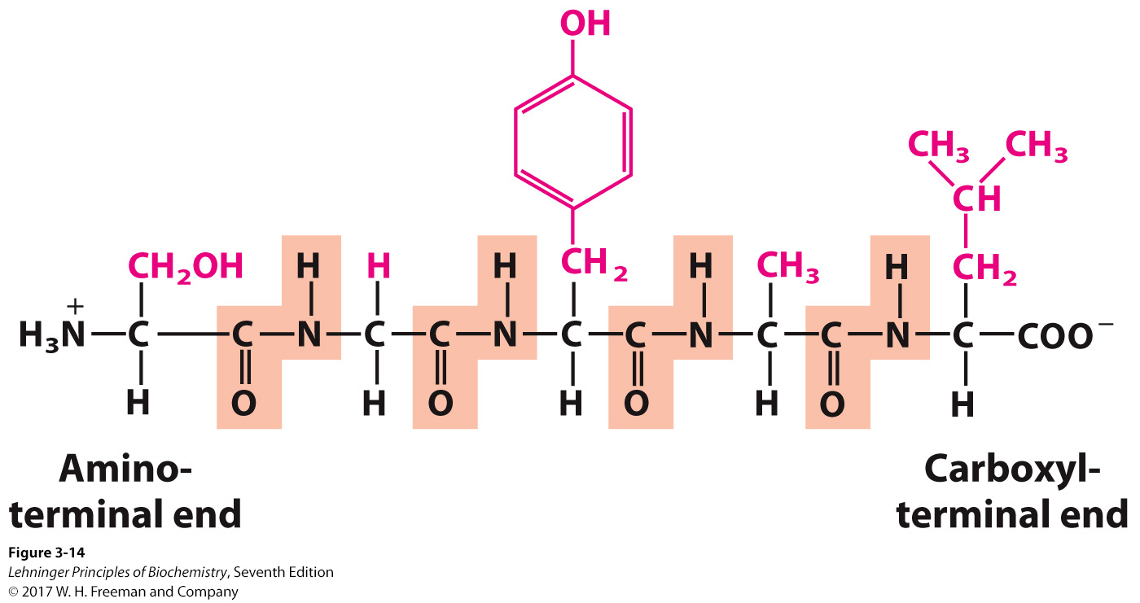
Peptide Ends Are Not the Same
Numbering (and naming) starts from the amino terminus (N-terminal).
AA₁ AA₂ AA₃ AA₄ AA₅
Notes:
FIGURE 3-14 The pentapeptide serylglycyltyrosylalanylleucine, Ser–Gly–Tyr–Ala–Leu, or SGYAL. Peptides are named beginning with the amino-terminal residue, which by convention is placed at the left. The peptide bonds are shaded in yellow; the R groups are in red.

Slide 15
Naming Peptides: Start at the N-terminal
Using full amino acid names:
serylglycyltyrosylalanylleucine
Using the three-letter code abbreviation:
Ser-Gly-Tyr-Ala-Leu
For longer peptides (like proteins) the one- letter code can be used:
SGYAL

Slide 16
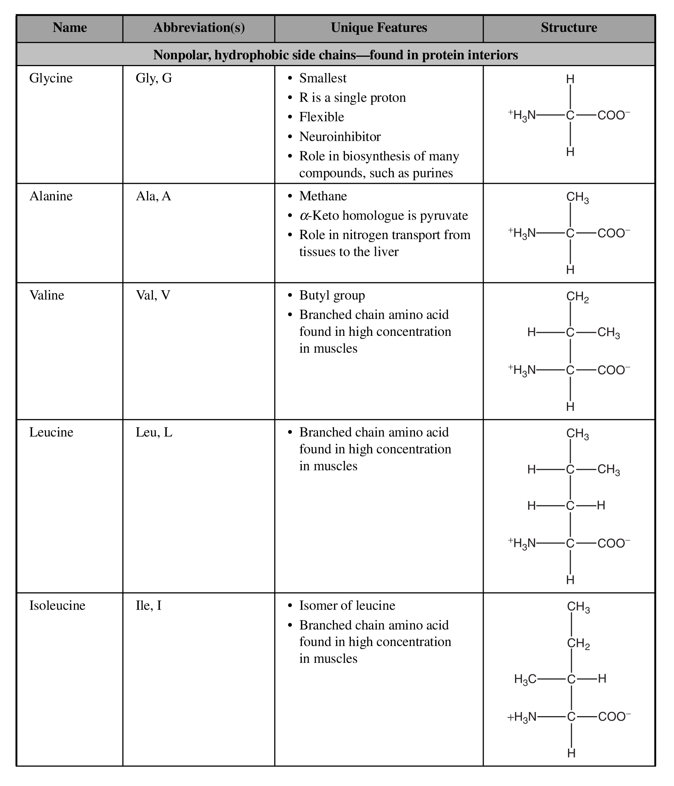

Slide 17
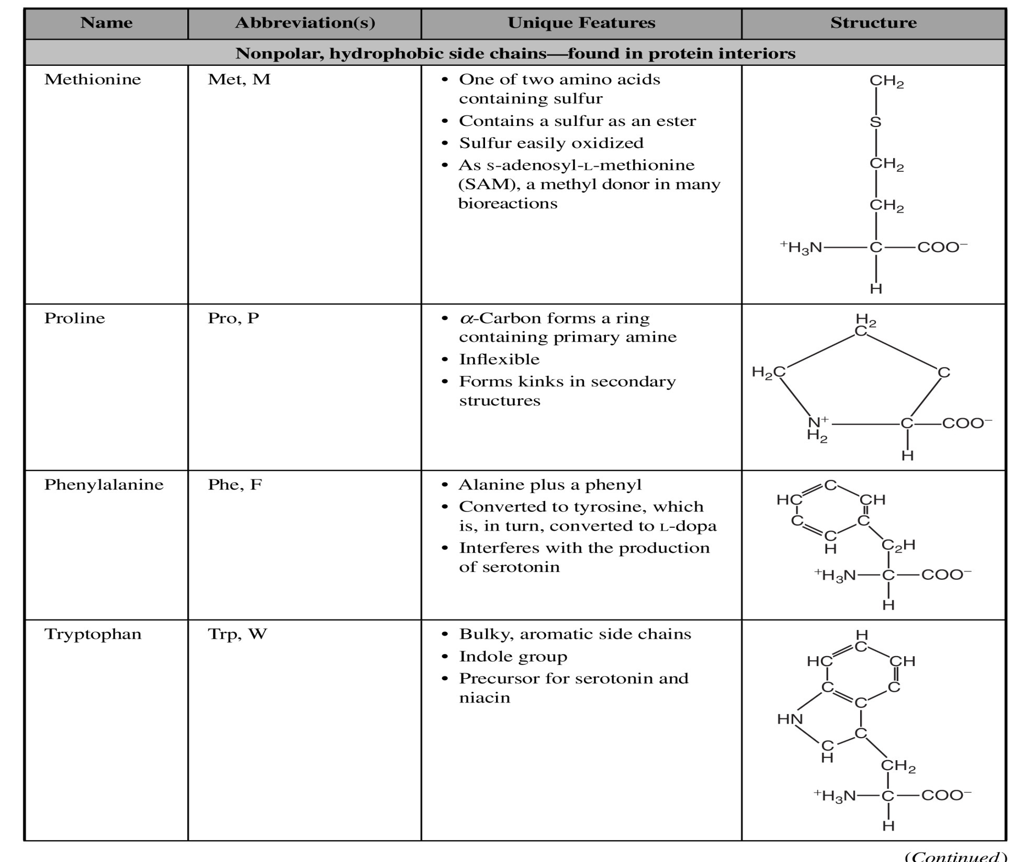

Slide 18
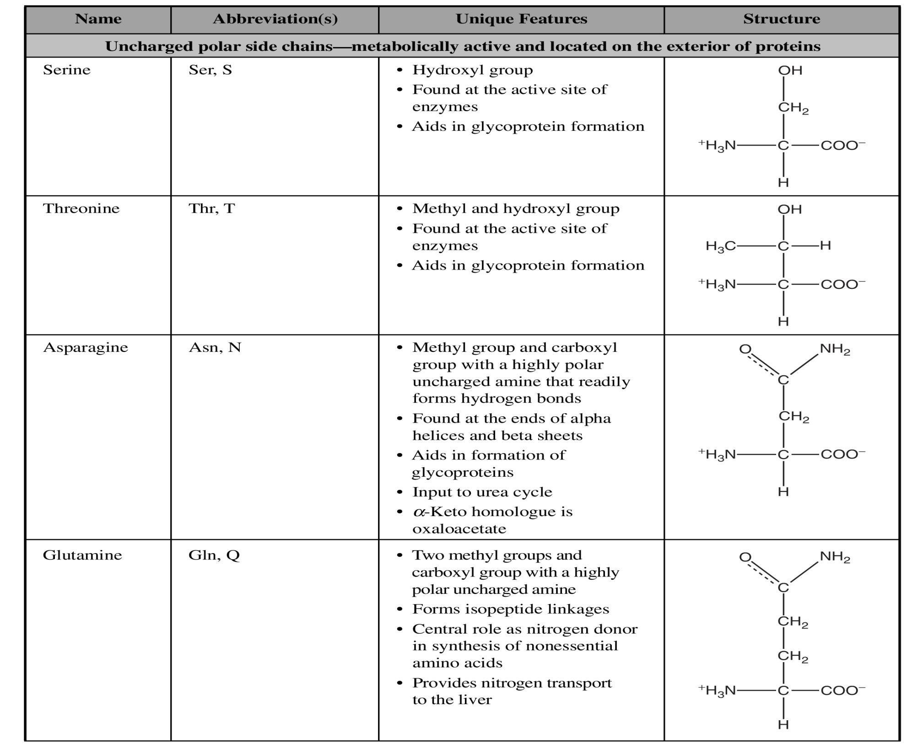

Slide 19
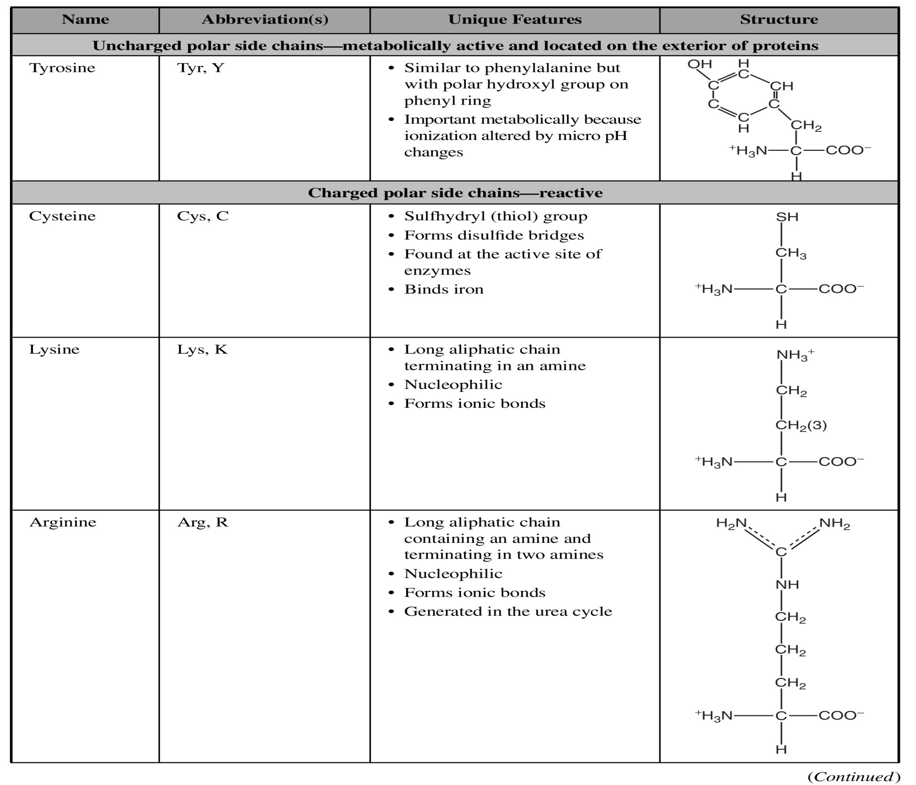

Slide 20
