Slide 1
Disturbances in Growth
Dr Deepak Kumar
Assistant Professor
Department of Veterinary Pathology
Bihar Veterinary College, Patna -14
Bihar Animal Sciences University Patna

Slide 2
Disturbances in Growth
The disturbances in growth cover a broader spectrum of changes from no growth to uncontrolled growth.
While uncontrolled growth (neoplasm) is dealt separately, the other forms of growth disturbances are considered in this chapter.
Cells may fail to develop or adapt to changing environment or physiological or pathological stimuli.

Slide 3
Disturbances in Growth
Aplasia - is the complete failure of an organ to develop.
Agenesis - is the complete absence of an organ or lack of specific cells within an organ (e.g., lack of germ cells in “Sertoli cell only syndrome”).
Hypoplasia - is the increase in the size of the tissue or an organ or a part of an organ due to quantitative increase in the number of cells.
Hyperplasia -is an increase in the number of cells in an organ or tissue that appear normal under a microscope.
Hypertrophy - is the increase in the size of the cells or the organ. The number of the cells doesnot increase.
Atrophy -decrease in size of a body part, cell, organ, or other tissue.
Metaplasia - is the reversible change in which one adult cell type is replaced by another adult cell type of the same germinal layer
Dysplasia - is any of various types of abnormal growth or development of cells.

Slide 4
Disturbances in Growth
The cells respond to altered physiological or pathological stimuli by adapting themselves.
These changes are reflected as atrophy, hyperplasia, hypertrophy, metaplasia and dysplasia besides aplasia and hypoplasia.
Following an injurious stimulus or to stress, the normal cell’s homeostatic state may respond with cellular injury resulting in either death or adaption.
Hence, the cellular adaptation to the increased demand is a state in between normal and stressed.

Slide 5
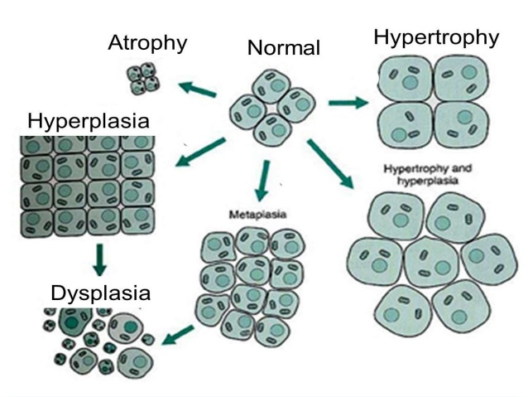
Disturbances in Growth

Slide 6
APLASIA/AGENESIS
Absence of any organ

Slide 7
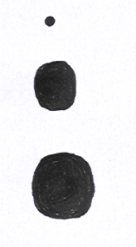
HYPOPLASIA
Failure of an organ/ tissue to attain its full size
Aplasia
Hypoplasia
Normal

Slide 8
HYPOPLASIA
Etiology
Congenital anomalies e.g. Hypoplasia of kidneys in calves
Inadequate innervations
Inadequate blood supply
Malnutrition
Infections e.g. cerebral hypoplasia in Bovine viral diarrhoea

Slide 9
HYPOPLASIA
Macroscopic features
Organ size, weight, volume reduced
Microscopic features
Reduced size of cells
Reduced number of cells
Connective tissue and fat is more

Slide 10
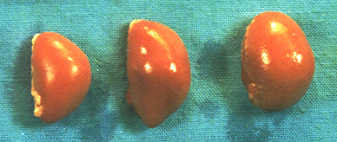
ATROPHY
Decrease in size of an organ that has reached their full size

Slide 11
ATROPHY
Etiology
Physiological e.g. senile atrophy
Pressure atrophy
Disuse atrophy e.g. Atrophy of immobilized legs
Endocrine atrophy e.g. Atrophy of testicles
Environmental pollution e.g. Atrophy of lymphoid organs
Inflammation/ fibrosis

Slide 12
ATROPHY
Macroscopic features
Size, weight, volume of organ decreased
Wrinkles in capsule of organ
Microscopic features
Size of cell is smaller
Cell number is less
Fat and connective tissue cells are more

