Slide 1
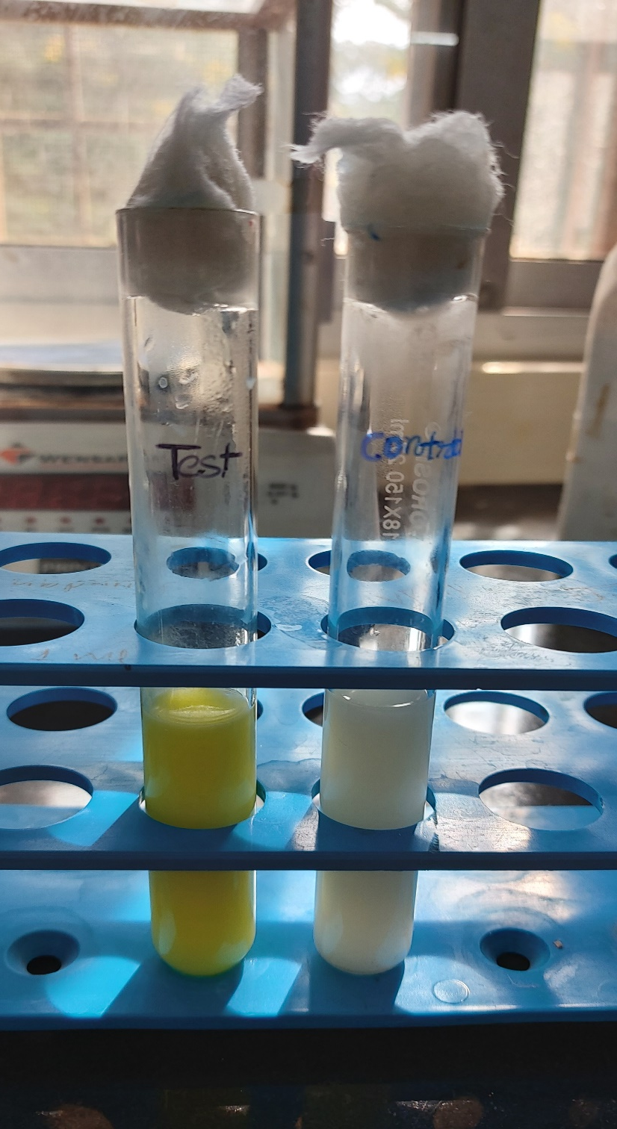
Alkaline Phosphatase Test
Practical No. 3

Slide 2
Principle
Pasteurization is an essential process in the production of milk which is safe and free from pathogens.
Alkaline Phosphatase is an enzyme which is naturally present in milk, but is destroyed at a temperature just near to the pasteurization temperature.
Alkaline Phosphatase test is used to indicate whether milk has been adequately pasteurised or whether it has been contaminated with raw milk after pasteurization.
Phenol (Forms a yellow coloured complex at alkaline pH 9.5)
(Alkaline phosphatase)
( disodium para-nitro phenyl phosphate)

Slide 3
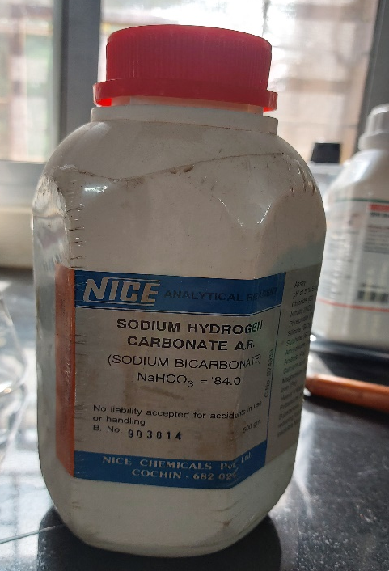
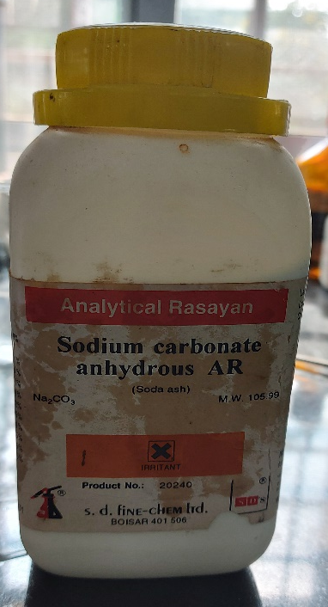
Materials Required
1. Test tubes with rubber stopper
2. Pipette
3. Water bath

Slide 4
Reagents
1. Sodium Carbonate-Bicarbonate Buffer –
(Dissolve 3.5 g of anhydrous sodium carbonate and 1.5 g of sodium bicarbonate in one litre of distilled water)
2. Substrate- Di-sodium p-nitrophenyle phosphate
3. Buffer Substrate solution–
(Dissolve 1.5 g of disodium p-nitrophenyl phosphate in one litre of sodium carbonate-bicarbonate buffer. This solution is stable if stored in a refrigerator at 4°C or less for one month but a colour control test should be carried out on such stored solutions)

Slide 5
Procedure
1. Take 10ml of buffer substrate solution in two test tubes
2. keep both test tube in water bath 37-38ºC
3. Take 5 ml from test sample and boil for few min in boiling water bath
4. Cool the boiled milk under running tap water (control)
5. Add 2ml of milk in one of the test tube containing buffer substrate
6. Add 2ml of control milk in one of the test tube containing buffer substrate
7. Close the tube with rubber stopper and mix thoroughly
7. Incubate the test tube at 37-38ºC and see within 30 minutes for the development of yellow color
8. Return these test tubes to the water bath and take the second reading after incubation of 90 min.
9. Compare the color development using color disc comparator and interpret result or use any other calorimetric method to detect the intensity of yellow development

Slide 6
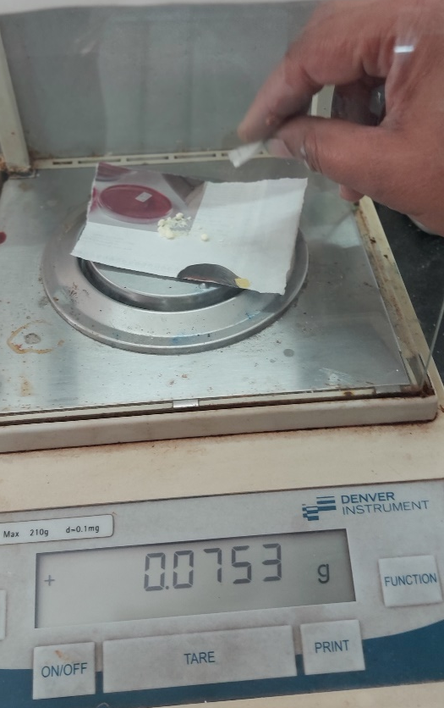
Procedure
1. Preparation of buffer solution

Slide 7
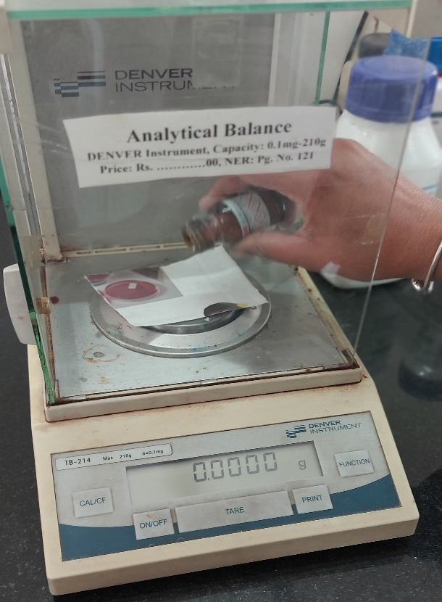
Procedure
2. Preparation of buffer substrate solution

Slide 8
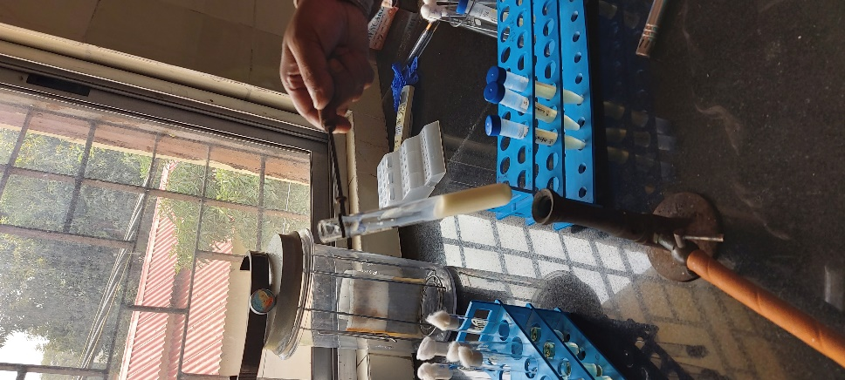
Procedure
3. Heating of milk sample for the destruction of alkaline phosphatase enzyme
Heating of milk sample: control

Slide 9
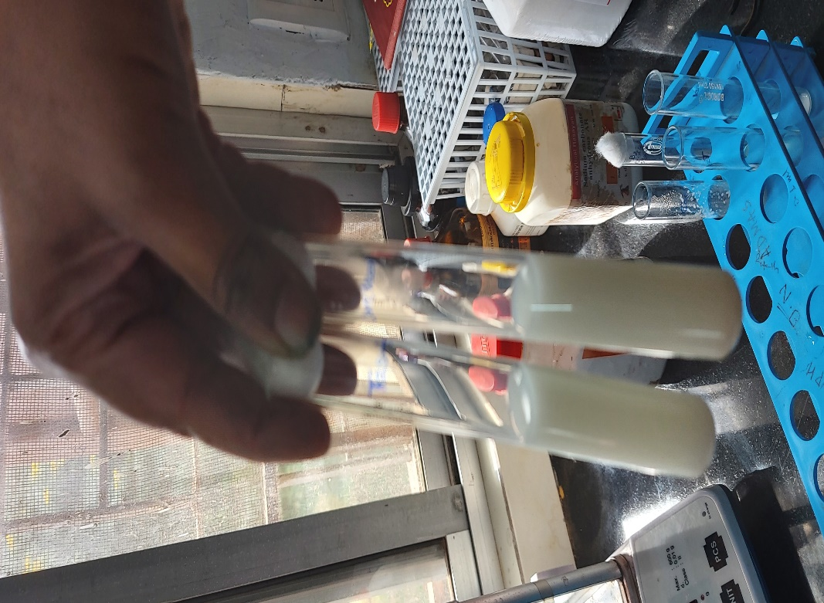
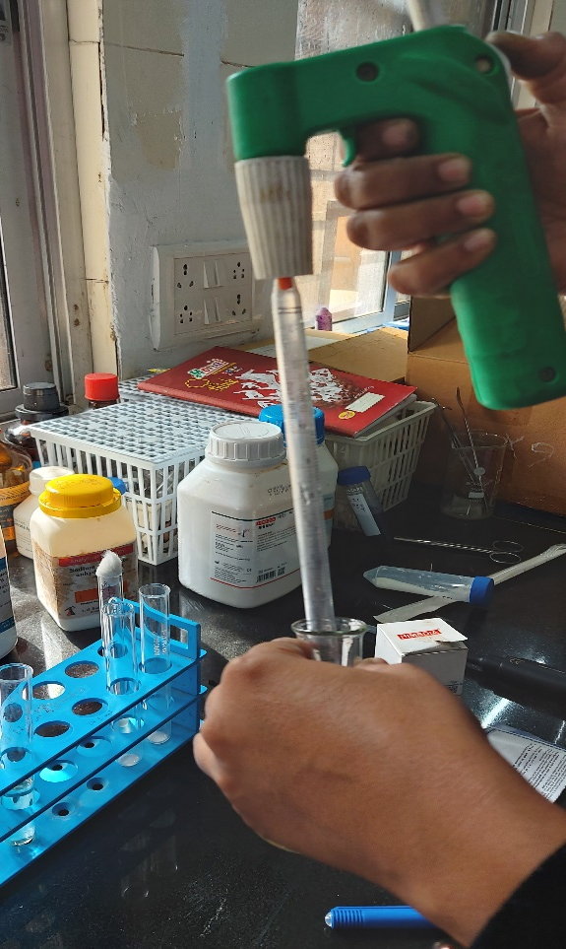
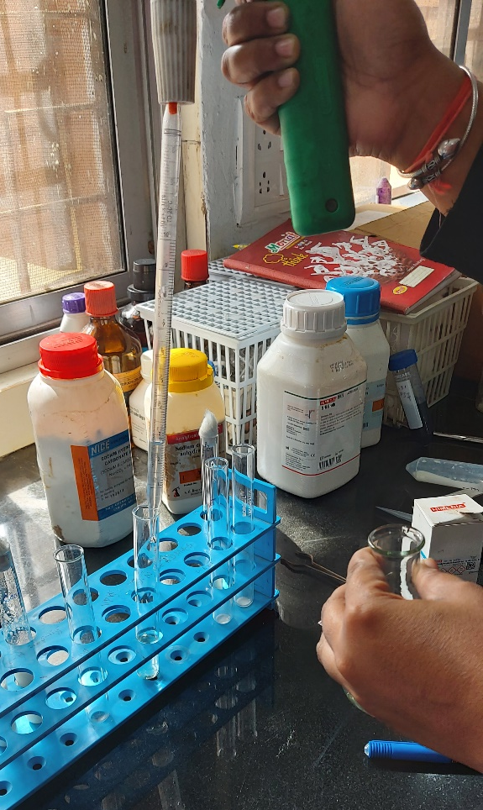
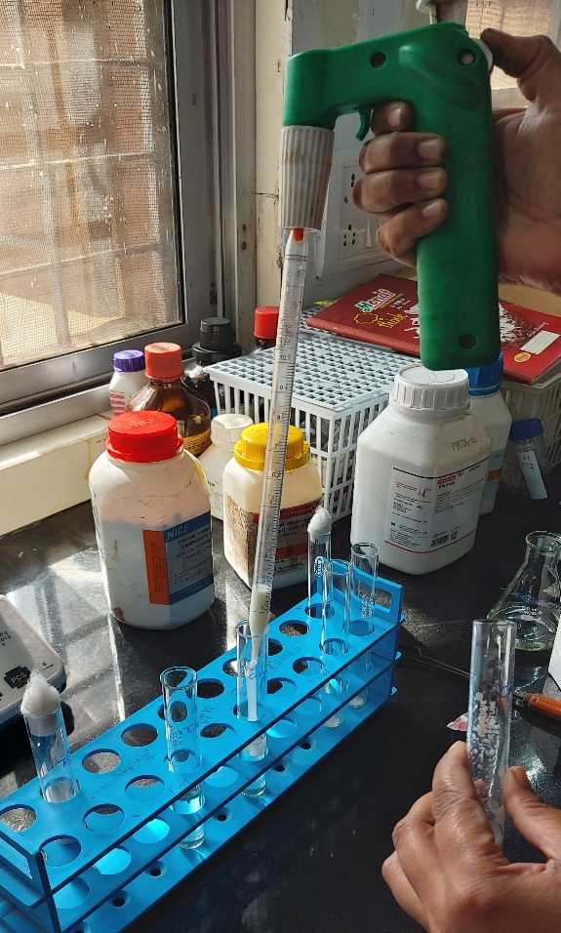
Procedure
4. Take 10ml of buffer substrate solution in two test tubes and add 2ml of milk samples in test tube containing buffer

Slide 10
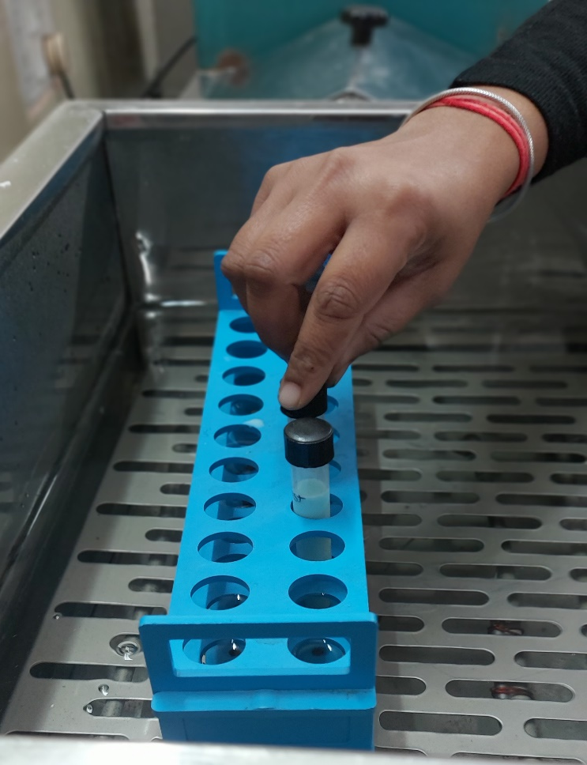
Procedure
5. Keep the samples in water bath at 37-38^{O}C

Slide 11
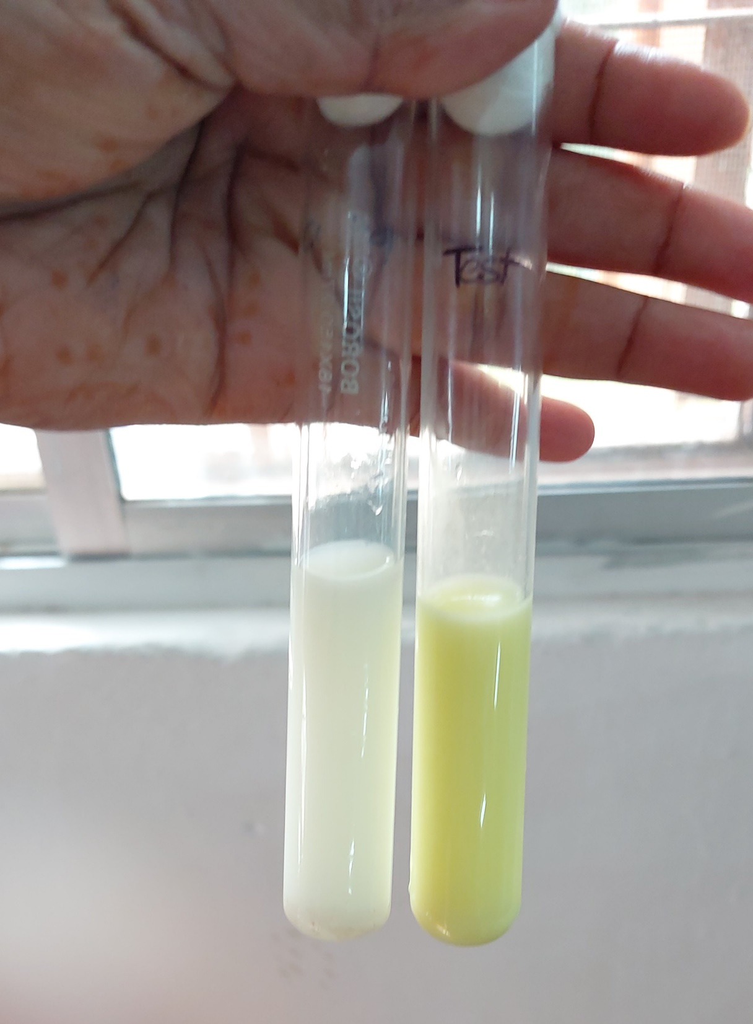
Observation
Development of yellow color in test samples
30 min. after incubation

Slide 12
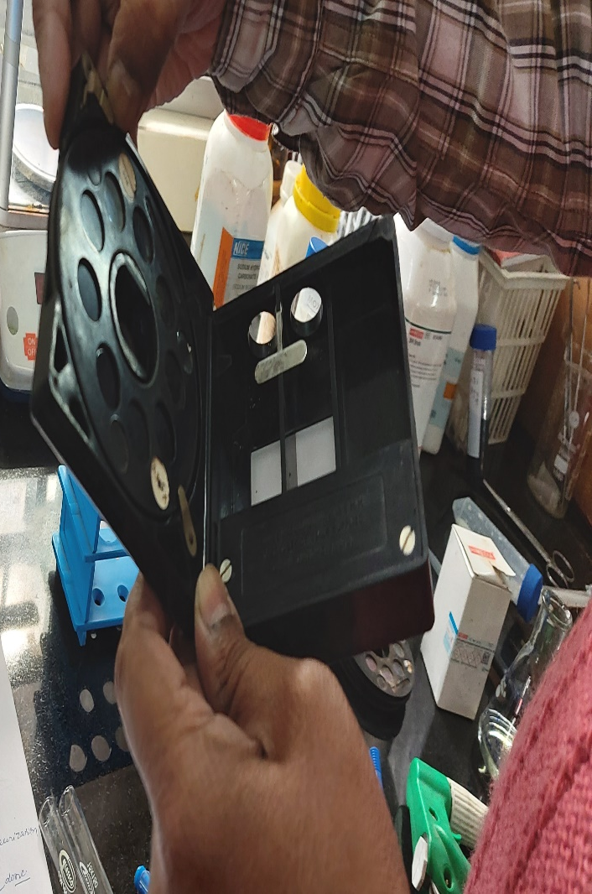
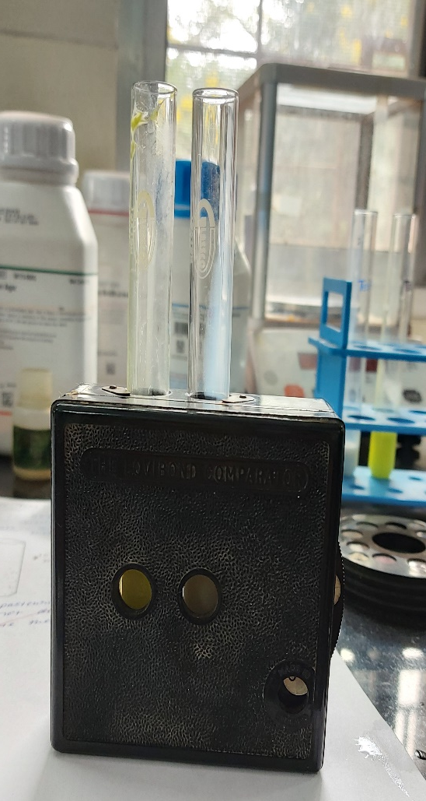

Slide 13
Interpretation
1. Disc reading
A. After 30 minutes of incubation
Observation ( hr.) | Interpretation
0 or traces | Properly pasteurized
6 | Doubtful
10 or over | Under pasteurized

Slide 14
Interpretation
1. Disc reading
A. After 2 hr. of incubation
Observation ( hr.) | Interpretation
0-10 | Properly pasteurized
10-18 | Slightly under pasteurized
18-42 | Under pasteurized
42 or over | Gross under heating of milk or raw milk

