Slide 1
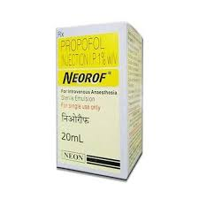
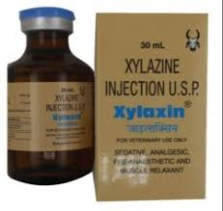
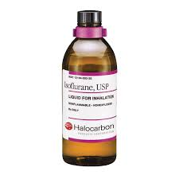
Anaesthesiology
Pre-anaesthetic agent and their classification
By
Dr. Rajesh Kumar
Assistant Professor
Department of Surgery

Slide 2
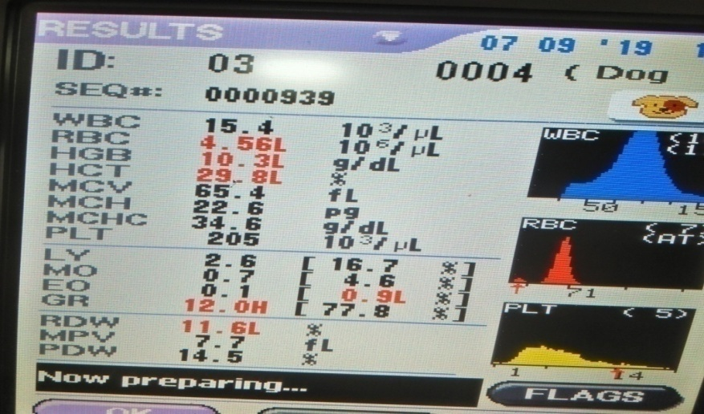
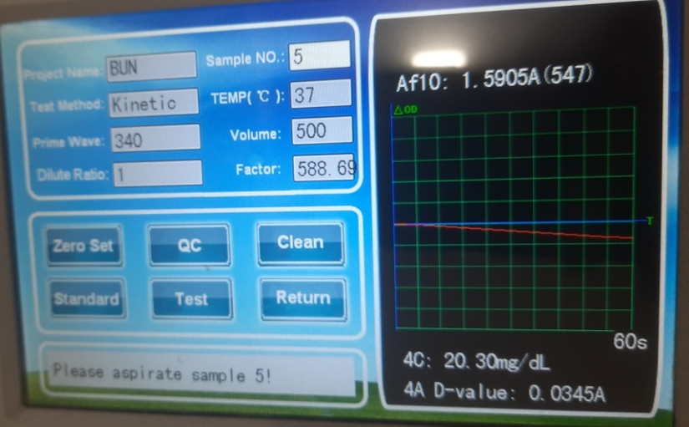
Pre Surgical Laboratory Test
At least Packed cell volume (PCV) and plasma protein (PP) concentrations should be evaluated

Slide 3
Hyper proteinemia can indicate haemo-concentration and dehydration
Drug responses can be affected by hypoproteinemia
It has been recommended that pre operative PCV be 27-30%
intra operative and post operative PCV be kept above 20%.

Slide 4
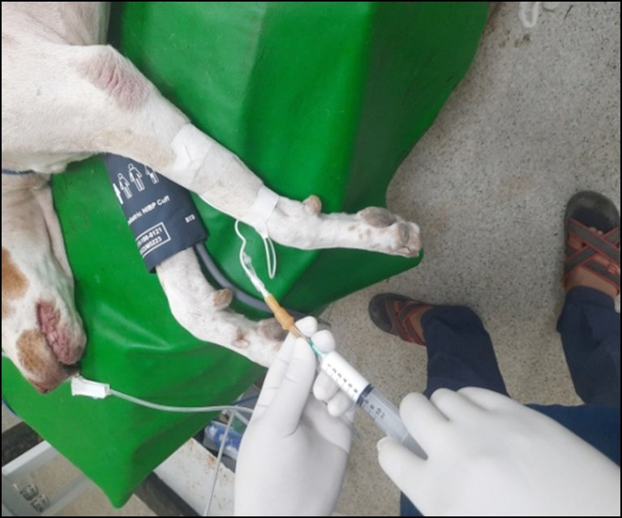
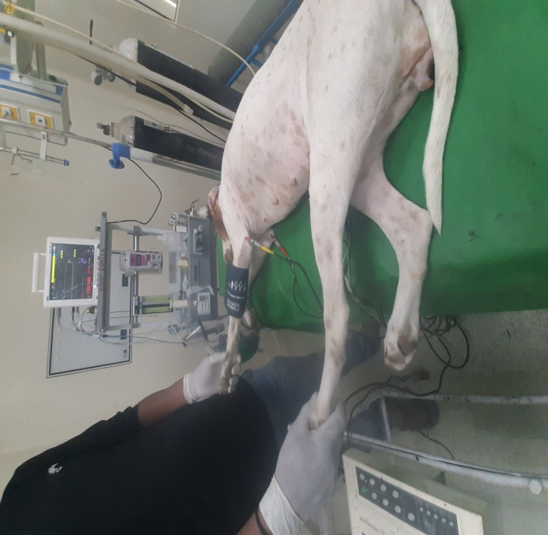
Anaesthesia
Selection of anesthetic agent:

Slide 5
Anaesthetic Risk
Potentiality to surviving anaesthesia and surgery
According to ASA physical status of animal classified into five classes (I to V)
Patient is a completely healthy
Patient has mild systemic disease
Patient has severe systemic disease that is not incapacitating.
Patient has incapacitating disease that is a constant threat to life.
A moribund patient who is not expected to live 24 hour with or without surgery.

Slide 6
Pre-anaesthetic agent:
Agent who are usually given to prepare the patient for administration of anesthetic agent.
Uses
To reduce the amount of general anaesthetic
To calm the patient so that anesthesia can be administrated without bright and struggling.
To reduce gastric and intestinal motility and prevent vomiting while the patient is under anesthesia.

Slide 7
Classification of pre anaesthetic agent :
(a)Anticholinergic agent
(b) Tranquilizers or neuroleptics.
(c) Sedative
(d) Opoid analgesic agent / Nacrotic.

Slide 8
Anticholinergic agent
Anticholinergic inhibit parasympathetic nerve impulses by selectivity blocking the binding of the neurotransmitter acetylcholine to its receptor in nerve cells.
Atropine Sulphate
Inhibits the muscarinic action of acetylcholine on structure inervated by post galglionic cholinergic nerve and on smooth muscle which respond to endogens, but not inverted

Slide 9
Effect of atropine sulphate
Cardiovascular system
Respiratory system
Other physiological function

Slide 10
Metabolism :
Dog excretes some part of atropine intact via kidney and remaining part undergoes hepatic metabolism.
Cat metabolizes the majority of the atropine in the liver
Doses:
Cattle = .04 to .06 mg/kg b.w. S/C or I/M
Dog /Cat = .04 mg I/M or S/C
Horse = .02 mg to .05 mg I/M or S/C
Sheep/Goat = .7mg/kg B.W. I/M or S/C
Contraindication Overdose

