Slide 1
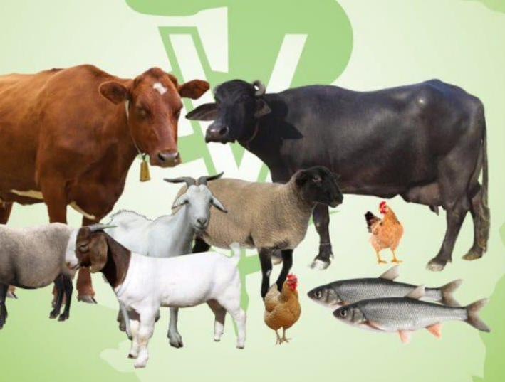
Induction of parturition
Dr Alok Kumar
Asst. Professor
VGO, BVC, BASU

Slide 2
Pre-term induction of parturition/calving
Indications:
Pasture availability
Availability of skilled labour
Reduced body weight and size - fetomaternal disproportion
Pathological condition - termination – alleviation of condition of dam

Slide 3
Period of induction
Induction should be carried out after 260 to 265 days to a apparently healthy cow.
In pathogenic condition, can be done at any stage
Induction before 95% of the breed’s normal gestation may lead to –
Birth of a small, weak calf
Poor chances of survival

Slide 4
Protocol of induction
Administration of corticosteroid –
Short, medium and long acting corticosteroids can be administered.
The effectiveness of the corticosteroid is believed to be dependent on the
Permeability of the ruminant placenta to the molecule.
In cows, corticosteroid can apparently be active for more than a month before full term.
At a normal therapeutic dose rate
(
S no. | Type of corticosteroid | Latent period (in days)
1 | Long acting | 11 - 18
2 | Medium acting | 5 - 11
3 | Short acting | 1 - 6

Slide 5
Conti……
Dexamethasone, Betamethasone and flumethasone produces reliable and predictable results
Most commonly used is Betamethasone at total dose 35 mg.
Short acting corticosteroid
less effective
RFM remains a consistent feature
Calf viability is more
Long acting corticosteroid
high perinatal mortality rate.
Corticosteroids are also immunosuppressive – combined with Broad spectrum antibiotics

Slide 6
Administration of Prostaglandins
PGF2α and the analogues have been successfully used from about 275 days of gestation with a latent period of 2 to 3 days.
Good results have been obtained by using a combination of corticosteroid and prostaglandin.
Experimental use of the progesterone receptor antagonist i.e. aglepristone demonstrated
Initiation of calving with cervical opening but impaired expulsion of the calves due to insufficient myometrial contractility.

Slide 7
Protocol 1 (250-260 days of gestation)
long-acting corticosteroid
Absence of calving for 8 days
short-acting corticosteroid or PGF2α
Protocol 2 ( after 270 days of gestation)
medium-acting corticosteroid
Absence of calving for 8 days
either a short-acting corticosteroid or PGF2α
After 275 days of gestation PGF2α or short- or medium-acting corticosteroids are effective on their own

Slide 8
BUFFALOES
Protocol A
(Gestation length less than 300 )
Dexamethasone 20 mg + PGF₂ Alpha 25 mg, i/m
Protocol B
(Gestation length more than 300 )
Dexamethasone 20 mg , i/m
Protocol C
(Gestation length 290-295)
Estrumate 750µg + Dexamethasone 40mg. IM

Slide 9
Protocol 3 (Clinical reports- pathological conditions in cows and buffaloes)
Intramuscular administration of following therapeutic agents:
synthetic prostaglandin (PGF2α) i.e. Cloprostenol Na @ 500 ug.
Valethamate bromide @ 48 mg.
Dexamethasone @40 mg.
Estradiol valerate @ 30mg.
Disadvantages of preterm induction of calving:
It is not always effective.
The birth weight of the calf is lower than it would have been at
term
There is also a high incidence of retained fetal membranes, up to
53% when ‘short-acting’ preparations are used

Slide 10
contin…….
Hartmann et al., 2013. observed that even inductions close to term pregnancy may still result in a high incidence of placental retention
Milk yield is initially affected, with a delay in reaching peak lactation, very little influence on the overall yield.
Subsequent fertility is fairly normal
. However Cows having RFM may have high
calving to conception interval
number of services per conception
There is a reduction in the quality and quantity of colostral immunoglobulins (mostly after use of slow-release corticosteroid preparations.
However calves passive immunity remains unaffected

Slide 11
Pre-term induction of foaling
Availability of skilled labours
Pathological condition of mare.
Preparation before induction
Examine degree of relaxation of SC ligament and cervix
Ionic composition of mammary secretion

Slide 12
Induction with oxytocin
Based on
Direct stimulatory on myometrium
Indirect stimulation of uteroplacental prostaglandin release.
Protocol
Ripened cervix with ½ finger dilation
I/M administration of 120 IU oxytocin – 360 to 600 kg mare.
Foaling within 15 to 60 minutes

Slide 13
Induction with Corticosteroids
Dexamethasone administration
Preferable for ponies and large saddle type mares
Protocol
100 mg/day for 4 days
Foaling after 6-7 days from start of treatment

Slide 14
Induction with prostaglandin
PGF_{2α}
1.5 to 2.5 mg every 12 hours
Fluprostenol
Period
322 and 367 days
Dose rate
250 μg to ponies
1000 μg to throughbred

Slide 15
Pre- term induction of farrowing
On average 5% to 7% of all piglets are stillborn
Interval between the birth of the first and last piglets is associated with the stillbirth rate.
Prolonged farrowing may results in an increase, probably 80% of the stillbirths
The stillbirth rate can be reduced by intensive care and attention during farrowing.
Major constrain is the difficulty in prediction of time of farrowing.
Solution – induction of farrowing of groups of sows at predetermined times facilitates availability of skilled

Slide 16
Pre- term induction of farrowing. Contin……..
Group farrowing
facilitates multiple suckling and allows crossfostering to take place.
(spl. In cases of MMA)
Groups of sows and litters can be managed on an ‘all in, all out’ principle, therefore more hygienic management can be practiced
Group farrowing facilitates group weaning.
It might increase the reproductive efficiency by reducing the farrowing interval by a few days.

Slide 17
Protocols
Intramuscular administration of natural PGF2α or a synthetic analogue i.e. Cloprostenol, on days 111 to 113 of gestation
Farrowing will occur on average 28 hours later.
Thus, if procedure followed at 8 or 10 AM - majority of sows will farrow during normal working hours.
Combination therapy with administration of 20 IU of oxytocin 24 hours post PG administration was tried with moderate effect
In recent times
Use of vulvar injections of a split-dose (50% of the label dose at a 6-hour interval) was recommended to obtain a higher proportion of responding sows.

Slide 18
Pre- term induction of Lambing
The indications for pre-term induction are limited because dystocia due
to fetomaternal disproportion is not as common as in cows.
However, lambing at day time with available skilled labor is important indication
Limitation
Shortening of gestation length by more than 7 to 10 days may lead to increased lamb mortality.
Protocol – 1. Administration of Corticosteroid –
corticosteroids such as dexamethasone, flumethasone, and betamethasone are given by a single I/M injection within 5 days of term, normal parturition occurs in 2 to 3 days.

Slide 19
Protocol – 2. Administration of 3β-hydroxysteroid dehydrogenase inhibitor.
Epostone administration via oral, I/V, or I/M route between days 136 and 142, birth of viable lambs occurred between 33 to 36 hours after application.
Protocol – 3. Administration of progesteron receptor antagonist.
I/M injection of RU 486, both on day 144 and 145 days of pregnancy, significantly advanced the birth of viable lambs.
Very recently
Two injections (on day 140 and 141) of aglepristone (5 or 10 mg/kg body weight)
Precisely controlled the lambing time without any adverse side effects in either mothers or lambs.

Slide 20
Pre- term induction of Kidding
Preterm induction of parturition in goats can be achieved by administration of
Luteolytic dose of natural prostaglandin F2α
Synthetic analogues Cloprostenol .
Parturition of 80% of the treated animals commenced 30 and 40 hours post treatment on day 145 of gestation.
Unlike cattle Dystocia and retention of the fetal membranes did not occur

Slide 21
Summary
Preterm induction of parturition in farm animal often required and can be practiced with precautions based on indications.
More research in this area with various protocols may facilitate better farm management with less chances of dystocia and perinatal deaths.

Slide 22
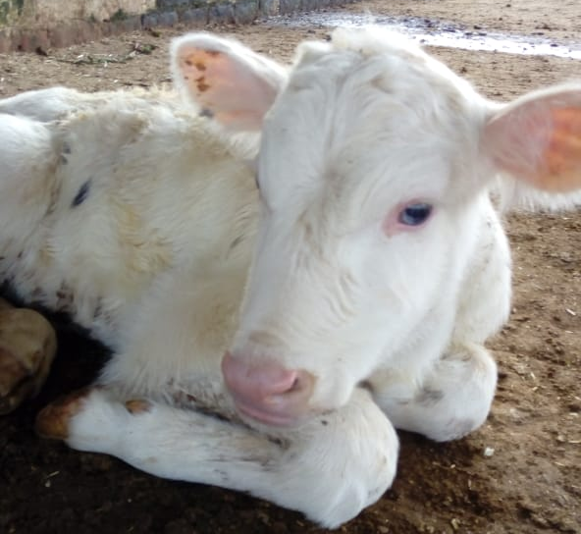
Thank you

