Slide 1
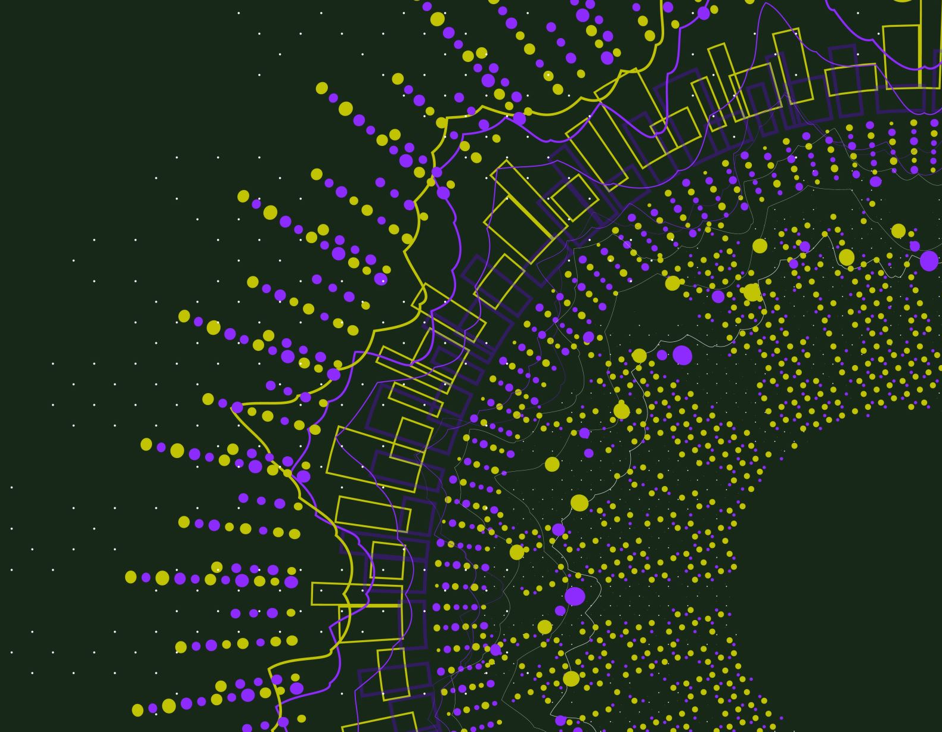
Properties of Proteins

Slide 2
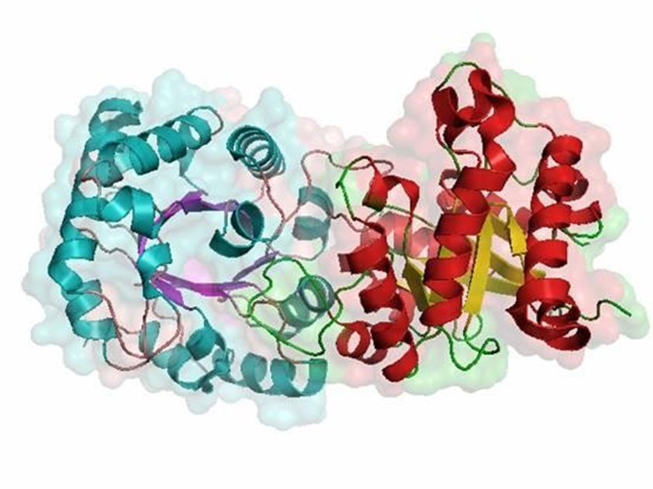
Physical Properties
Dissociation
Optical Activity
Solubility, Hydration and Swelling Power

Slide 3
Dissociation
Proteins, like amino acids, are amphoteric.
Depending on pH, they can exist as polyvalent (cations, anions or zwitter ions)
Most of the dissociable functional groups are derived from side chains
The total charge of protein, which is the absolute sum of all positive and negative charges, is differentiated from the so-called net charge which, depending on the pH, may be positive, zero or negative.
The net charge is zero and the total charge is maximal at the isoelectric point. Lowering or raising the pH tends to increase the net charge towards its maximum, while the total charge always becomes less than at the isolectric point
At its isoelectric point a protein is the least soluble and the most likely to precipitate (isoelectric-precipitation) and is at its maximal crystallization capacity

Slide 4
Optical Activity
The optical activity of proteins is due not only to asymmetry of amino acids but also to the chirality resulting from the arrangement of the peptide chain
Information on the conformation of proteins can be obtained from a recording of the optical rotatory dispersion (ORD) or the Circular Dichroism (CD) especially in the range of peptide bond absorption wavelength (190-200 nm)

Slide 5
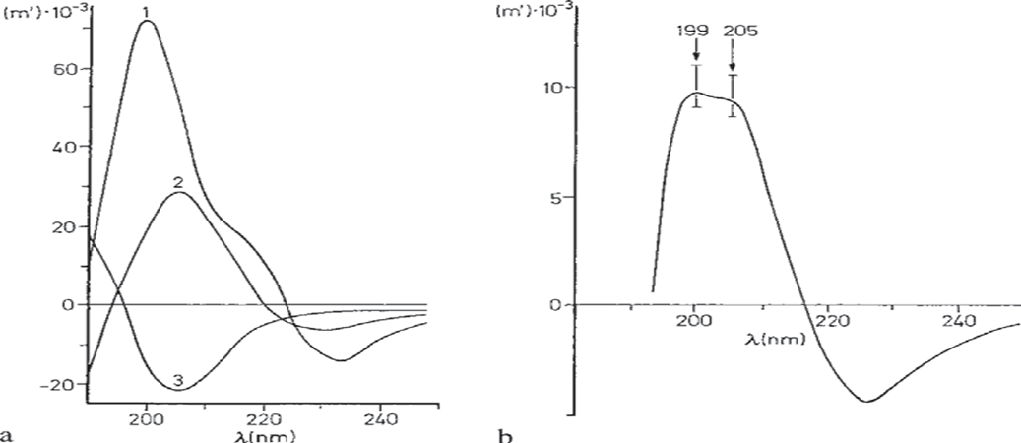
Cotton effect
The Cotton effect reveals quantitative information on secondary structure.
-α-Helix or β-structure gives a negative Cotton effect, with absorption maxima at 199 and 205 nm, respectively
While a randomly coiled conformation shifts the maximum to shorter wavelengths
Polylysine
α-helix (1)
β-sheet structure (2) and
random coiled (3).
Ribonuclease with 20% α-helix, 40% β-sheet structure and 40% random coiled region

Slide 6
Solubility, Hydration and Swelling Power
Protein solubility is variable and is affected by the number of polar and non-polar groups and their arrangement along the molecule
Generally, proteins are soluble only in strongly polar solvents such as water, glycerol or formic acid
In a less polar solvent such as ethanol, proteins are rarely soluble
The solubility in water is dependent on pH and on salt concentration
proteins are polar substances, they are hydrated in water
The swelling of insoluble proteins corresponds to the hydration of soluble proteins in that insertion of water between the peptide chains results in an increase in volume and other changes in the physical properties of the protein

Slide 7
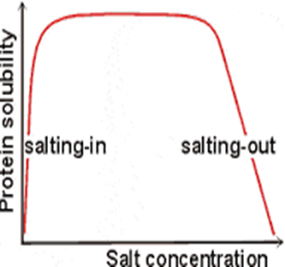
2 -fold action of salts on protein solubility
At low concentrations they increase the solubility (“salting in” effect) by suppressing the electrostatic protein-protein interaction (binding forces)
At higher salt concentration Protein solubility is decreased (“salting out” effect) due to the ion hydration tendency of the salts

Slide 8
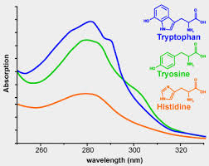
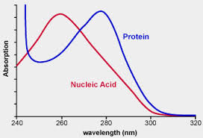
UV absorption
Trp, Tyr, Phe, and His have aromatic groups of resonance double bonds.
Proteins have a strong absorption at 280nm

Slide 9
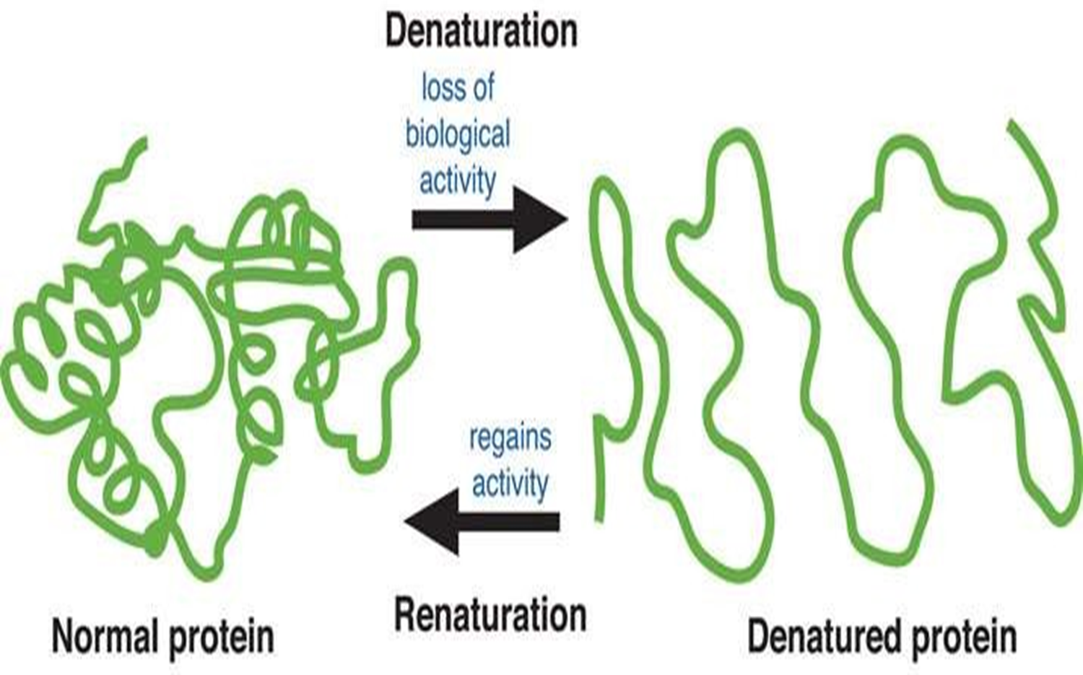
Chemical Properties
Denaturation of Protein
Native State
Denatured State
Usually most stable
Usually most soluble
Polar groups usually on the outside
Hydrophobic groups inside
Loss of native conformation
Altered secondary, tertiary or quaternary structure
Disruption of disulfide bonds (covalent) and non-covalent bonds (H-bond, ionic bond, hydrophobic interaction
Peptide bonds are not affected
Viscosity increases
Cannot be crystallized
More easily digested
Loses biological activity
Usually, irreversible

Slide 10
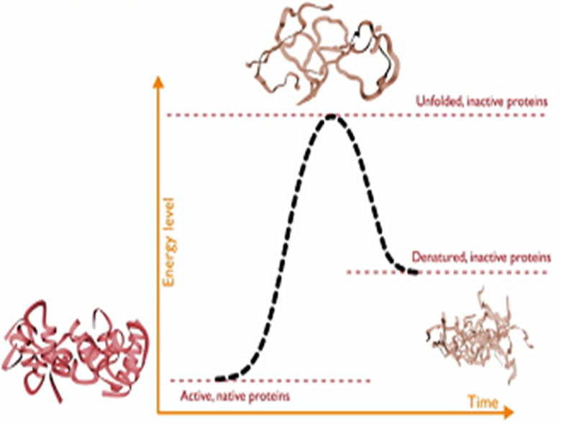
Denaturing agents
Physical Agent
1. Thermal treatment
High temperature destabilizes the non-covalent interactions holding the protein together causing it to eventually unfold
Freezing can also denature due to ice crystals and weakening of hydrophobic interactions

Slide 11
2. Hydrostatic pressure (5 000 to 10 000 atm)
Destabilize hydrophobic interactions; Water molecules can penetrate hydrophobic protein core
3. UV radiation
similar to high temperature treatment effect: higher kinetic energy increases the vibration of molecules thus disrupting H-bonds
4. X-rays
5. Violent shaking (H-bond disruption)

Slide 12
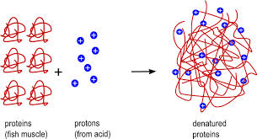
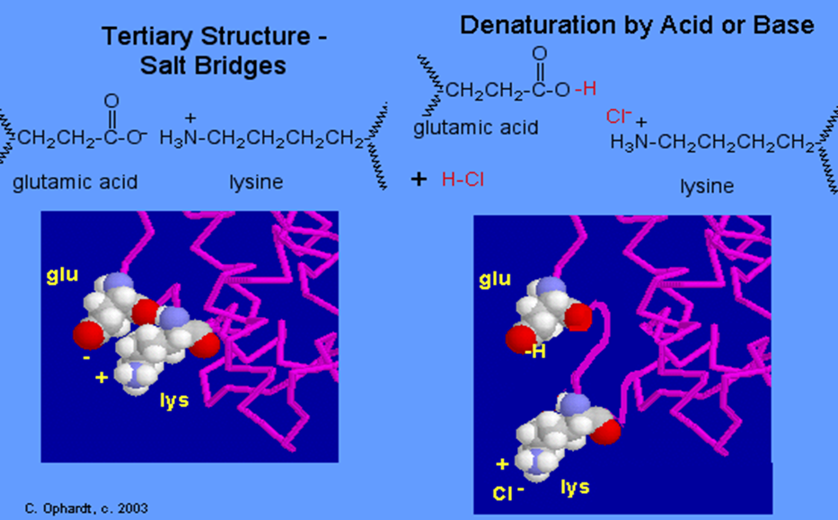
Chemical Agents
1. Acids and Alkalis
Breaks salt bridges

Slide 13
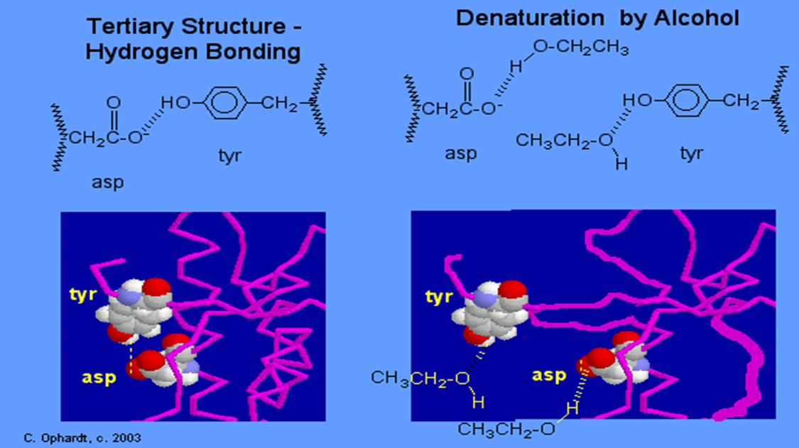
2. Organic solvents (ether, alcohol)
Organic solvents denature proteins by disrupting the side chain intramolecular hydrogen bonding

Slide 14
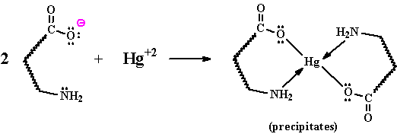
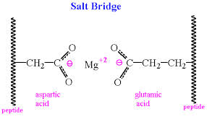
3. Salts of heavy metals (Pb+2, Cd+2 Hg+2…)
Disrupt ionic bonds
The reaction of a heavy metal salt with a protein usually leads to an insoluble metal protein salt

Slide 15
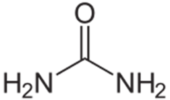
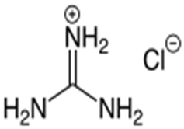
4. Chaotropic agents
chaotropic agent is a molecule in water solution that can disrupt the hydrogen bonding network between water molecules. This has an effect on the stability of the native state of other molecules in the solution such as proteins
Urea
Guanidinium chloride

Slide 16
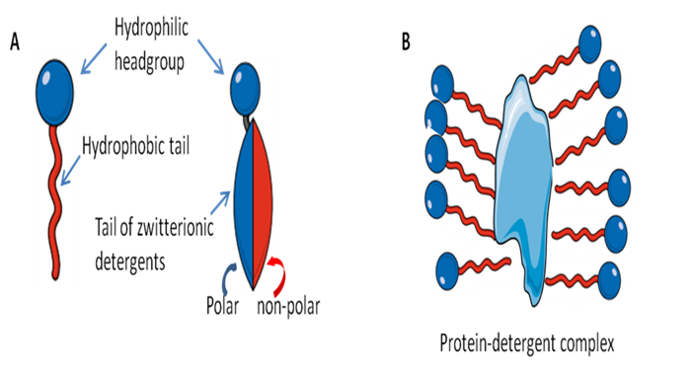
5. Detergents
Detergents are amphiphilic molecules which contain both hydrophobic and hydrophilic parts

Slide 17
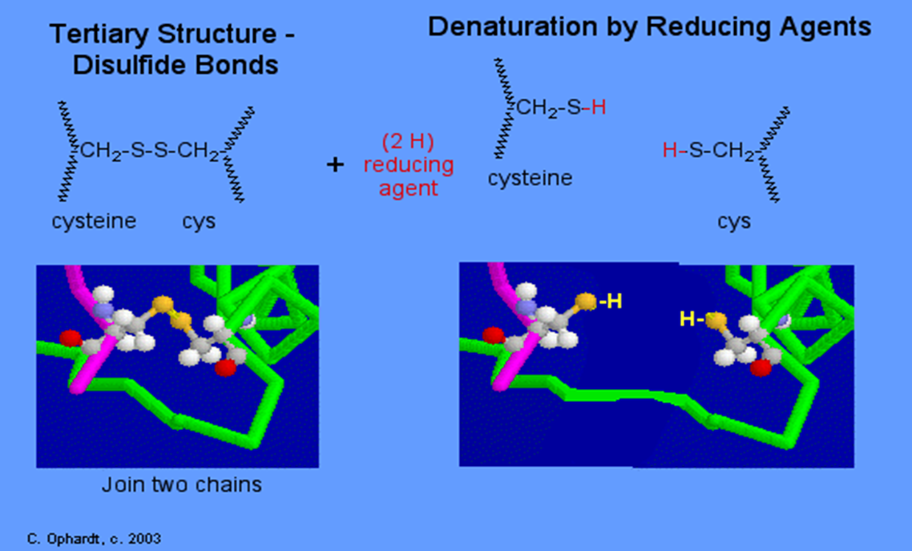
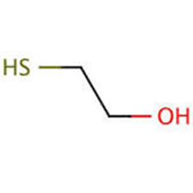
6. Reducing agents
Mercaptoethanol

Slide 18
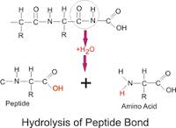
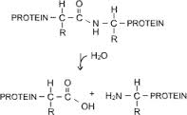
Hydrolysis
Proteins can be hydrolyzed (the peptide bond) by acid or enzymes to give peptides and free amino acids (e.g. soy sauce, fish sauce etc.)

Slide 19
Classification of Protein
Based on Biological function
Based on composition
Based on shape and solubility
Based on nutritional significance

Slide 20
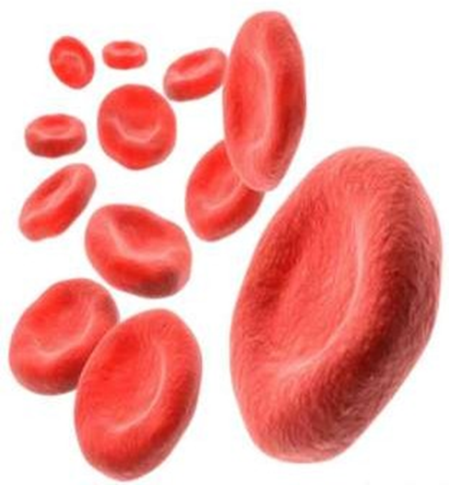
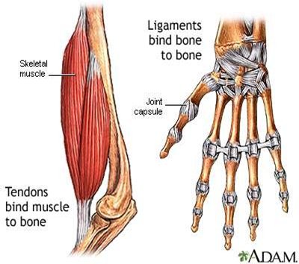
Biological function
1. Enzyme
2. Transport protein- help in transportation of life sustaining chemicals vital gases and nutrients. E.g. Haemoglobin
3. Storage Protein- stored inside the cells or tissue as reserved food and can be mobilized at the time of nutrient requirement to provide energy. E.g. Ferritin
4. Contractile/ Motile Protein- ability to contract to change the shape or to move about. E.g. Actin and myosin
5. Structural Protein
6. Regulatory Protein- many hormones, such as insulin, GH

Slide 21
Composition
SIMPLE PROTEINS- on hydrolysis yield only amino acids and no other major organic or inorganic hydrolysis products
Example:
-Egg (albumin), Serum (globulins), Wheat (Glutelin), Rice (Coryzenin)
CONJUGATED PROTEINS - on hydrolysis yield not only amino acids but also organic or inorganic components
The non-amino acid part of a conjugated protein is called prosthetic group

Slide 22
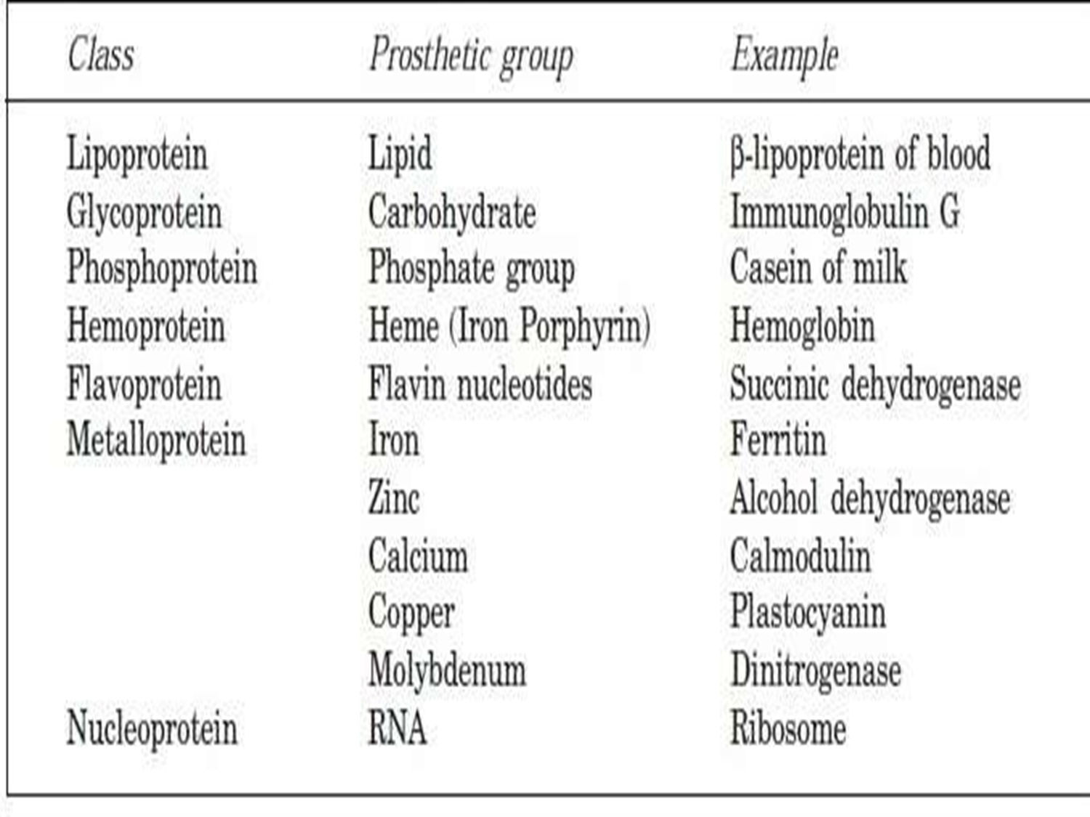

Slide 23
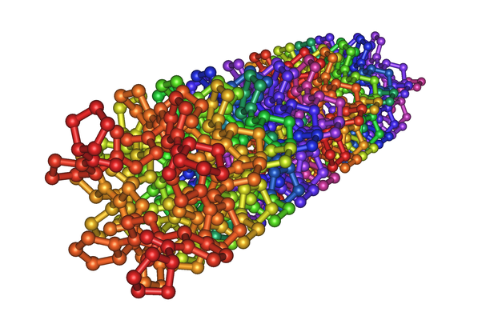
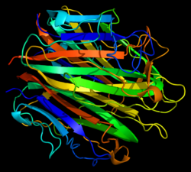
Shape and Solubility
FIBROUS PROTEINS
these proteins have a rod like structure. They are not soluble in water.
These are made up of polypeptide chain that are parallel to the axis & are held together by strong hydrogen and disulphide bonds.
They can be stretched & contracted like thread
Examples:
-Collagen, Keratin, Fibrinogen

Slide 24
GLOBULAR PROTEINS
these proteins more or less spherical in nature. Due to their distribution of amino acids (hydrophobic inside, hydrophilic outside)
they are very soluble in aqueous solution
E.g. Myoglobin, albumin, globu lin, casein, haemoglobin, all of the enzymes, and protein hormones

Slide 25
Difference
 | Fibrous | Globular
Shape | Long and Narrow | Round/Spherical
Purpose | Structural | Functional
Amino Acid Sequence | Repetitive | Irregular
Durability | Less sensitive to changes in pH, Temp etc | More sensitive
Solubility | Generally insoluble in water | Generally soluble in water

Slide 26
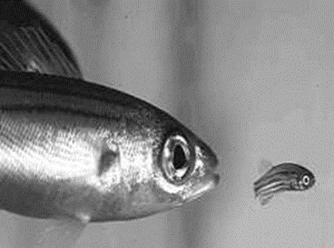
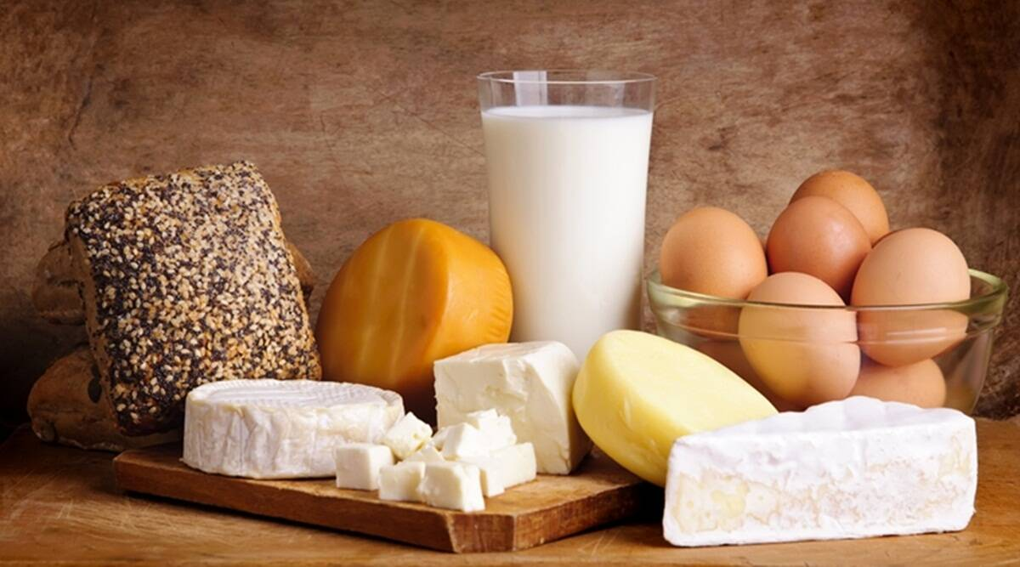
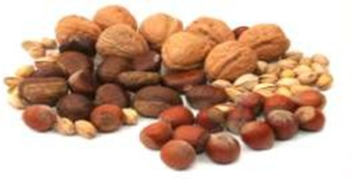
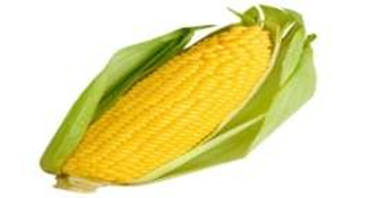
NUTRITIONAL
COMPLETE PROTEINS - contains an adequate amount of all of the essential amino acids that should be incorporated into a diet
must not lack even one essential amino acid in order to be considered complete
E.g. Animal Protein (meat, fish, egg, dairy products)
INCOMPLETE PROTEINS - that lacks one or more essential amino acids in correct proportions. These can also be referred to as partial proteins
E.g. Grains, Nuts, Beans, Seeds, Peas, Corn

