Slide 1
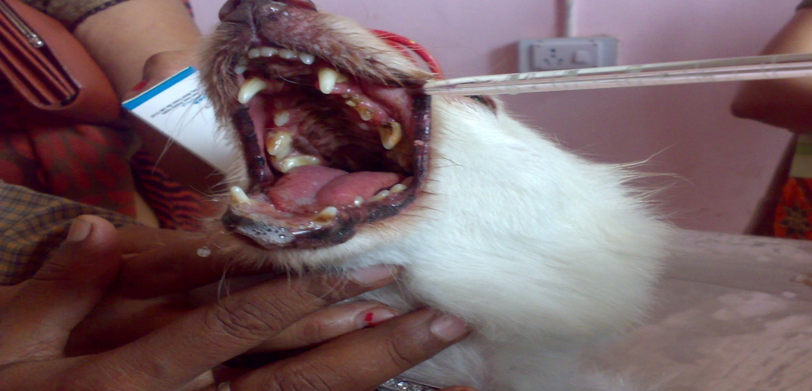
Rabies
Unit 6
Dr. Arvind Kumar Das
Assistant professor
Department of Veterinary Medicine
Bihar Veterinary College (BASU), Patna-800014.

Slide 2
Introduction
Synonym: Hydrophobia, Lyssa, Mad dog disease, Rage, Tollwut
The disease occurs as paralytic rabies, known as Derriengue
Acute viral disease causes acute encephalitis.
Rabies occurs in all warm blooded animals including human
Rabies is one of the most deadly zoonoses. Each year, it kills nearly 60,000 people worldwide, mostly children in developing countries
1 person die from rabies every 10 min in world.
Rabies 100% preventable.
>95% of human deaths caused by dog-mediated rabies

Slide 3
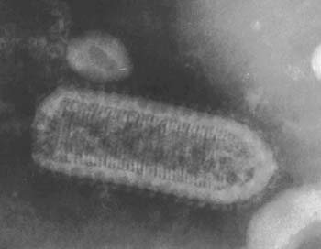
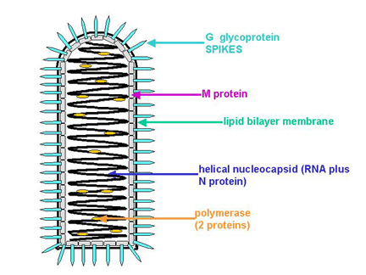
ETIOLOGY
Classification
Family Rhabdoviridae
Genus Lyssavirus (including Rabies virus)
Many viruses with broad host ranges
Vertebrates
Invertebrates
Plants
Features
Bullet-shaped with one flat end (75 x 180 nm), Enveloped having 10 nm spike like glycoprotein peplomers covering the surface.
Image, Curtsey with google

Slide 4
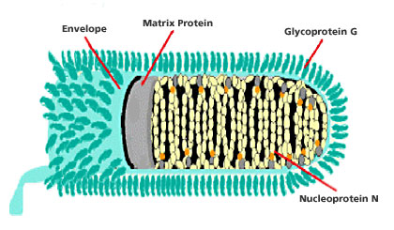
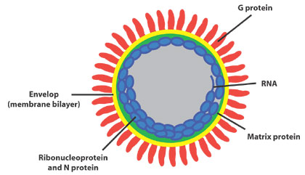
ETIOLOGY
There is a leader sequence (LDR) of approximately 50 nucleotides, followed by N, P, M, G, and L genes that encode 5 proteins. i.e. N-Nucleoprotein, P-Phosphoprotein; M-Matrix protein; G-Glycoprotein; L-large polymerase or transcriptase protein.
In the nature, 7 distinct genotypes of rabies virus circulating
Genotype 1 - classical rabies virus (CRV) strains, including field and laboratory – fixed strains
Rabies related viruses (RRVs) –
Genotype 2 - Lagos bat virus
Genotype 3 - Mokola virus
Genotype 4 - Duvenhage virus
Genotypes 5 and 6 - European bat Lyssavirus 1 and 2
Genotype 7 - Australian bat Lyssavirus (ABLV)
Image, Curtsey with google

Slide 5
Features of Virus
Rhabdovirus – lipid containing, single stranded non segmented nucleotide RNA of approximately 12 kb.
Sensitive to lipid solvents (Soap, ether, chloroform, acetone)
45-75% ethanol, iodine preparation and quaternary ammonium compounds
Relatively stable at pH between 5 & 10
Sensitive to pasteurization and UV light
The nucleic acid readily inactivated by β-propiolactone
Virus may persist up to 18 days at inoculation site
Virus travels along the nerves centripetally at a rate of roughly 3mm/hr
Once disease is established it is nearly always fatal
The virus can not live outside its host for more than a couple of seconds but has been found in animals as long as 48 hrs after death

Slide 6
Epidemiology
Widely distributed throughout the world .
In USA, Canada and Western Europe (rabies in dogs is controlled by vaccination), rabies is endemic in wild life – Skunks, Foxes, Racoons, bats
Cats are the most affected animal in USA
In Asia, Latin America and Africa, rabies is endemic in dogs and wild life
Vampire bats are important in the spread of rabies in cattle in South America
With the exception of Antarctica, rabies is endemic on all continents. Almost 95% of cases are reported in Asia and Africa.

Slide 7
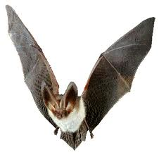
Rabies Transmission
Hosts:
All warm-blooded animals can be infected with varying susceptibility
High - wolves, coyotes, foxes, dogs
Intermediate - skunks, raccoons, bats
Low - opossums
Reptiles due to being cold blooded and birds don’t get rabies
Vampire bats can transmit virus for months
Insectivorous and frugivorous bats may also harbour and transmit virus
Young animals are more susceptible than adults
Domestic animals most likely to be diagnosed with rabies :
Dog > Cow > Horse/mule > sheep/goat
Rodents such as mice , rats, squirrels and chipmunks may be exposed to rabies virus but are rare source to transmit.
Virus occurs in saliva, nervous system, urine, lymph, milk
Image, Curtsey with google

Slide 8
Transmission
The virus is typically transmitted by bites wound or contact of infected saliva with mucous membranes (eyes, mouth, etc)
The virus cannot infiltrate intact skin
Saliva becomes non-infectious when it dries
People have been infected by aerosol in bat caves
Requires several weeks for infection to become apparent
Replication in muscle in myocytes and connective tissues at site of inoculation and shed into extracellular spaces.
Enters peripheral nervous system at neuromuscular junctions
Spreads up the peripheral nerves to the central nervous system
Entering peripheral or cranial nerves, progress to axons then enter spinal or cranial ganglia
Virus replicates rapidly in ganglion and spread throughout the CNS
Virus spread centrifugally by nerves throughout the body including the salivary glands
Encephalitis
Virus grows to high titers in the salivary glands
Negri bodies appear in neuron cell bodies

Slide 9
Symptoms
Dumb or the furious form
In dumb form the animals falls into a stupor and has a peculiar staring expression
Paralysis of the mastication muscles
In furious form animal goes into rages, biting and slashing at any moving objects or even inanimate objects
Champing of jaws, excessive salivation
Paralysis may follow either the furious or dumb form
Death occurs within 10 days of the 1st symptom

Slide 10
Symptoms
Animals (domestic)
Fearfulness
Aggression
Excessive drooling
Difficulty swallowing
Staggering
Seizures
Depression
Self-mutilation
Light sensitivity
Animals (wildlife)
Any of above
Unusual behavior
Nocturnal animal active during day
Lose fear of humans

Slide 11
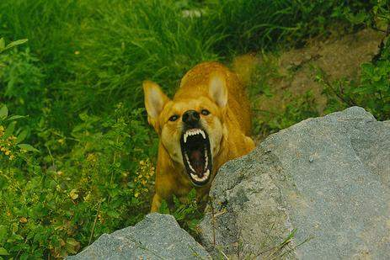
CLINICAL SIGNS
Dog: The incubation period in natural outbreak of dog rabies averages from 3-8 weeks. But it may be as short as 10 days to as long as one year.
The clinical features divided into three phases.
1) Prodromal phase: No externally visible signs are seen
2) Furious form: Mad dog syndrome, Animal bites, attack and show signs of aggression and madness, irritable, restless, nervous, deprived appetite, and often dangerous as it loses all fear of humans and bites at anything. By about 3rd day after the onset of illness the dog enters the furious stage which lasts for 3-7 days.
3) Paralytic form: Early paralysis of throat muscles. Animals shows head drooling, dropped lower jaw and salivary discharge, lasts in1-3 days.
Animals show only vague CNS signs, which intensify rapidly.
Image, Curtsey with google

Slide 12
CLINICAL SIGNS
Cattle
Paralytic form:
Knuckling of the hind fetlocks, sagging and swaying of the hindquarters while walking, often deviation or flaccidity of the tail to one side, are common signs.
Decreased sensation over the hindquarters
Drooling of saliva, tenesmus, pumping of anus and followed by recumbency in later stages.
Furious form:
Animal alert, hypersensitive, violently attack, loud and coarse bellowing, sexual excitement and collapses suddenly.
Cattle are very restless, excited and aggressive with salivation, abdominal pain, diarrhoea and rectal straining. Paralysis of hind quarters occurs followed by death in 3-6 days after the first signs of illness.

Slide 13
Sheep and Goats
Clinically similar to cattle. Sexual excitement, violent attack, vigorous wool pulling, sudden falling and salivation are characteristic.
Goats are commonly aggressive, and continuous bleating is common.
Horse
Muzzle tremors and pharyngeal paresis are common.
In addition to these abnormal postures, kicking, biting, colic, sudden onset of lameness in one limb followed by recumbency, high stepping gait, blindness, paddling, convulsions and terminally paralysis.
Pigs
Tendency to attack, twitching of the nose, rapid chewing movements, excessive salivation, walk backward and terminally paralysis.

Slide 14
Gross pathology
In majority of cases , CNS lesions are mild .
Leptomeningeal congestion and mild oedema.
The meninges may be cloudy .
In some case uneatable objects like straw, wood, leather pieces, rubber, etc may be found in the stomach of carnivores.
Histologic features
Typical changes are seen only when rabid animal is allowed to die on its own
The CNS lesions includes:
Perivascular cuffing with lymphocytes.
Vascular congestion and even perivascular haemorrhages

Slide 15
LESIONS
(A)GROSS: no lesion.
(B)MICROSCOPIC :
Necrosis of neuron with specific cytoplasmic inclusion body in affected nerve cell.
Encephalitis:It is characterised by 1)perivascular cuffing 2)neuronophagic nodules 3)Distraction of neurons.
Change in 1)Brain stem 2)hippocampus 3)proliferation of glial cell known as babes nodules.

Slide 16
Sample to be collected
Live animals : Saliva, corneal/ Conjunctival smear.
Dead animals
The whole carcass or the severed head of the animal suspected to have died of rabies.
Alternatively, the brain may be removed carefully and two portions, one in 50% glycerol saline and the other in Zenker’s fixative, sent for biological test and microscopy, respectively.
The brain tissue selected should include portions of hippocampus, cerebellum, cerebral cortex, and placed in 50% glycerol saline to preserve the virus.
No refrigeration is required.

Slide 17
DIAGNOSIS
It based on clinical sign , history ,symptoms,
FAT-fluorescent antibody test.
(This test is recommended by both WHO and OIE)
2. Seller’s stain – negri body seen in hippocampus.
3. Histological search of negri body.
4. Serological test of –
Immunoperoxidase test
ELISA
Rapid fluorescence focus inhibition test (RFFIT)
Virus neutralization test
Rapid rabies enzyme immuno diagnosis test (RREID) based on the use of antinucleocapsid lgG are highly useful
RT-PCR amplification technique is 1000 times more sensitive than other tests.
The virus can be detected in saliva and skin biopsy samples by RT-PCR..

Slide 18
TREATMENT
No specific treatment for rabies.
Dogs usually die after showing clinical signs.
The site of bite should be washed with water or soap. Sodium bicarbonate or caustic soda may be used.
Wound is treated with 2% quaternary ammonium compound or tincture iodine or 40-70% alcohol.
Wound may also be cauterized with carbolic acid or nitric acid.
Antirabies serum may be applied topically or infiltrated around the wound.
Treatment with antirabies serum is also effective. Dose recommended is 40 I.U. per kg body weight.
It should be given as early as possible after exposure and in any case within five days, after which it may not be beneficial.

Slide 19
Vaccination of Animals
Vaccine types: live or inactivated, according to the strain of rabies virus used
More recently a third generation of live veterinary rabies vaccine has been developed using recombinant technology. These vaccines are used either parentrally or orally.

Slide 20
Vaccination of Animals
Vaccine types: live or inactivated, according to the strain of rabies virus used
More recently a third generation of live veterinary rabies vaccine has been developed using recombinant technology. These vaccines are used either parentrally or orally.
Available for Humans, dogs, cats, ferrets, cattle and horses.
Oral rabies vaccine is offered to wildlife
Pre exposure vaccination- Pre exposure vaccination schedule for dogs starts at 12th week age – first dose,
28 days later – second dose,
one year later- third dose,
three years later- fourth dose.
Post exposure immunization : 0, 3, 7, 14, 21, 28 days after exposure.
Raksha rab –Indian immunological.
Rabigen :serum institute.

Slide 21
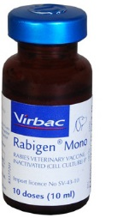
Rabigen
Composition Virus titre per dose(1ml) Inactivated VP12 Rabies virus strain > 1.0 I.U Aluminum hydroxide gel (as adjuvant) 10 % v/v Thiomersal IP (as preservative) 0.01 % w/v Indication- Active immunization of Dogs, Cats, Cattle and Horses, and in principle all mammal against Rabies. As a Post Exposure Prophylaxis
Image, Curtsey with google

Slide 22
Control (as per the WHO recommendations)
Notification of suspected cases, and destruction of dogs with clinical signs and dogs bitten by a suspected rabid animal.
Compulsory immunization of dogs
Sterilization and vaccination of stray dogs
Epidemiological Surveillance
Education of Public
Development of cost effective vaccine

Slide 23
World Rabies Day is a worldwide campaign against rabies. One person in the world dies from rabies every 10 MINUTES, equaling 60,000 each year! The disease is 100% fatal, but 100% preventable.
Image, Curtsey with google

Slide 24
Thank you

