Slide 1
SEXUAL BEHAVIOR
Dr Alok Kumar
Assistant Professor Cum Jn Scientist
Dept. VGO, BVC, BASU

Slide 2
SEXUAL BEHAVIOR
Importance of Sexual Behavior
Promote copulation
Assure sperm and oocyte meet
Goal is to achieve pregnancy and parturition

Slide 3
Factors Affecting Sexual Behaviors
Visual
Olfactory
Tactile
Environmental – management
Light
Nutrition
Hormonal

Slide 4
Endocrine control of male sexual behavior

Slide 5
Stages of Reproductive Behavior
• Pre-copulatory
• Copulatory
• Post-copulatory

Slide 6
Pre-copulatory Stage
Courtship
Species specific events
Sniffing of the vulva by male
Urination by the female
Flemen lip curl (exept BOAR)
Chin resting on female rump
Increased phonation
Male checks for female lordosis

Slide 7
Copulatory Behavior (cont.)
Varies among species
Short copulaters (1 - 3 seconds)
Bull
Ram
Sustained copulater (5 - 20 minutes)
Boar
Intermediate copulater(20 to 60 seconds)
Stallion

Slide 8
Pre-copulatory Stage
• Search for sexual partner
In female animals - limited to estrus
In primates can occur at any time
In male can occur at any time
Increased physical activity
Involves all of the senses
Visual (Sight)
Olfactory (Smell)
Phonation
Tactile

Slide 9
Precopulatory Stage (cont.)
Sexual arousal
Female
Lordosis
Presents hindquarters to male
Male
Erection
Penile protrusion

Slide 10
Copulatory Behaviour
Erection and protrusion of penis (exeptional)
Mounting and fixation
Intromission
Ejaculatory thrust and ejaculation

Slide 11
Erection and protrusion of penis (exceptional)
In most animals, Erection and protrusion of penis from prepuce, occurs before mounting
Exception - camel the full protrusion occur after mounting

Slide 12
Mounting and fixation
Mounting – Male fixes his fore legs around the hind quarter of female grasp her firmly which follows pelvic thrusts
In she camel the mounting occur in sitting position
In cat and Rabbit the male bite the scruff (behind the head or at the neck)

Slide 13
Intromission
Contraction of the abdominal muscle (rectus abdomenus) results in direct contact (apposition) of the pelvic region of male to the female external genitalia followed by penile insertion
Ejaculatory thrust and ejaculation
Involuntary, pulsatile release of semen in female reproductive tract

Slide 14
Post copulatory behaviour
Dismounting
Memory
Refractory Period/ Refractoriness
Dismounting – Retraction of penis into the prepuce

Slide 16
Refractory Period/Refractoriness
Most animals show sexual inactivity immediately after copulation
Ram and buck in exception usually lick the penis after ejaculation.
Cats smell the site of copulation.
The duration of this period is variable and modified by environmental stimuli (5 min to one hour )
This period is decreased by changing the female

Slide 17
Pre-Copulatory behavior in bull
Courtship
Grazing with cow
Guarding the cow
Liking cow vulva
Dribbling prostate secretion
Flehman’s reaction

Slide 18
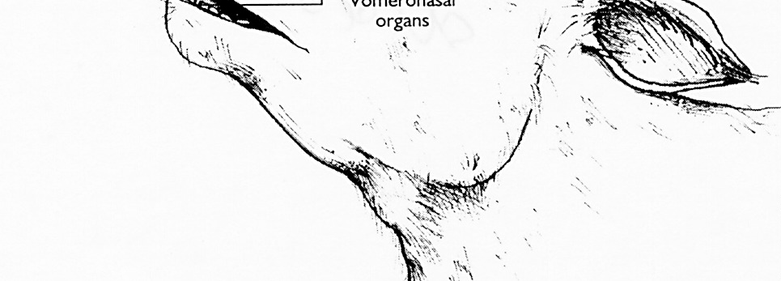
Flehmen’s reaction

Slide 19
Sexual behavior in bulls

Slide 20
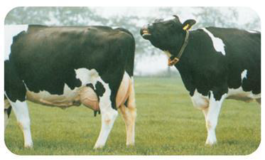
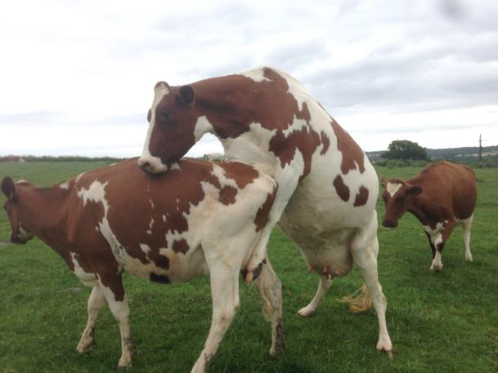
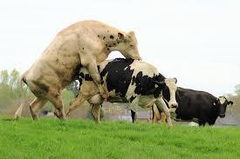
Sexual behavior in bulls

Slide 21
Ram sexual behavior
Social determine
Sniffing females genitals
Flehmen
Ritualize kicking
Urination

Slide 22
Buck sexual behavior
Kicking
•Vocalization
•Enurination
•Tail straight

Slide 23
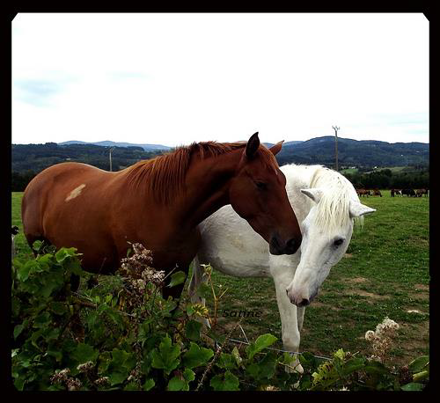
Stallion Sexual behavior
Biting and nuzzling
•Flehmen
•Vocalizations

Slide 24
Boar sexual behavior

Slide 25
The Dog: Sexual Behavior

Slide 26
Tom sexual behavior
Olfactory cue in female urine
Calling the female
Sniffing
Holding the queen neck
10 seconds
Lick its penis

