Slide 1
Semen Extension
Topics
Characteristics of a good semen extender
Constituents of semen extender
Type of semen extenders (Classification)

Slide 2
Semen Extender
Semen Extender or diluent is a chemical medium used for preservation, extension and protection of sperm cells against various shocks during processing, storage and transportation used for artificial insemination.
Characteristics of good extender
Isotonic (280- 310 m Osm) to seminal plasma
Buffering capacity (regulate pH)
Cold shock protection
Protection from cryo-damage/cryoinjury
Energy source (sperm metabolism)
Control microbial contamination

Slide 3
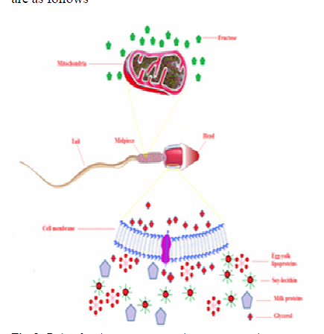
Various components used in semen extender
Egg yolk
It is non-penetrating cryoprotectant (Cold shock protection)
Contains
Phosphatidylcholine (lecithin)
Phosholipids
Lipid extracts
Lipoprotein fractions
Specific lipoproteins
Provides protection from cold shock

Slide 4
Egg yolk
20 percent Egg yolk is still used as a standard as it is cheap and readily available
Philips in 1939, was the first to report egg yolk use in the diluents
In egg yolk, Low Density Lipids (LDL) abundance is considered a main cryo-protective agent
The LDLs are composed of 17-60 nm spherical molecules
The LDL contains 11-17% proteins and 83-89% lipids
Egg yolk increased post thaw motility by solubilizing the cell membrane lipids and binds to the sperm
But such a high amount increased the risk of microbial contamination resulting in metritis and transboundary diseases

Slide 5
Semen
Seminal plasma
Spermatozoa
BSP Proteins (A₁, A₃, A₅)
LDL binds with 50-80 % BSP protein (stable complex)
Sperm Membrane+ BSP
LDL
Cholesterol efflux
membrane destablisation
capacitation and AR
Good for NI
Bad for cryopreservation

Slide 6
Milk sources
Lactose
Cannot diffuse across the cell plasma membrane, thus helps in creating osmotic pressure
Major protecting agent is casein micelle
Minor – Whey protein (α lactalbumin, β lactoglobulin) and lactose
Milk protein binds with 50-80 % BSP Proteins
Protein-protein interaction

Slide 7
Soy-lecithin
Replacement of animal protein source with plant protein sources
To avoid resulting diseases and keep the biosecurity from trans-boundary diseases
Lecithin (present in different cryoprotectants) protects the plasma membrane by restoring phospholipid that is lost due to heat and protects the cell viability
Soy-lecithin is a very good alternative to phospholipids present in egg yolk for semen cryopreservation
Commercially available - AndroMed, Biociphos

Slide 8
Various components used in semen extender
Ions for maintaining osmolarity
Zwitter ionic buffers
Amino acids
α-keto acids
Combination of salts and carbohydrates are added in extenders
Buffer
Hydroxymethyle aminomethane (Tris) and citric acid are very common used buffers in various types of diluents used for ruminant semen.
Tris containing egg yolk glycerol extender was developed in 1963

Slide 9
Antimicrobials
The most common contaminants are Gram positive bacteria along with E. coli and Salmonella spp
Cornel extender was the first standard diluent to have Penicillin G, Streptomycin and Polymixim-B
Penicillin and streptomycin are still used at the rate of one gram per liter
Energy source
Fructose

Slide 10
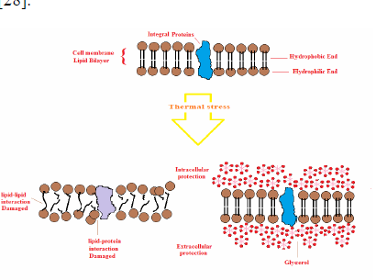
Glycerol
Glycerol is classified as a penetrating cryoprotectant and most common used for dilution of semen worldwide
Glycerol cryo-protective effect was accidentally found by Polge and co-workers in 1949
Glycerol as conventional cryoprotectant prevents the intracellular crystallization

Slide 11
Classification of semen extenders
Ambient temperature – 2.5x10⁶ motile spermatozoa
IVT (Illini variable temperature)
Coconut milk extender
Self carbonating extender e.g. (CUE) Conell university extender & Caprogen extender
2. Chilling/refrigeration temperature extender - 10x10⁶ motile sperm
EYC (egg yolk citrate)
EYP (egg yolk phosphate)
TRIS extender
Skimmed milk extender
Whole milk extender
D2 diluent
3. Cryopreservation Temp. - 196
Glycerolated EYC
Glycerolated EY TRIS

