Slide 1
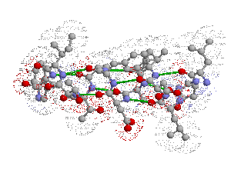
Structure of Protein

Slide 2
Protein
Proteins are major components of all cellular systems
Proteins consist of one or more linear polymers called polypeptides
Proteins are linear and never branched
Different AA’s are linked together via PEPTIDE bonds
The individual amino acids within a protein are known as RESIDUES
The smallest known Protein is just nine residues long - OXYTOCIN
The largest is over 35,000 residues - the structural protein TITIN

Slide 3
Protein
In the absence of stabilizing forces a minimum of 40 residues is needed to adopt a stable 3D structure in water.
Protein sequence can be determined by systematically removing the AA’s one at a time from the amino end - Edman degradation
Sequence the gene or cDNA for any protein and use the genetic code to determine the AA sequence

Slide 4
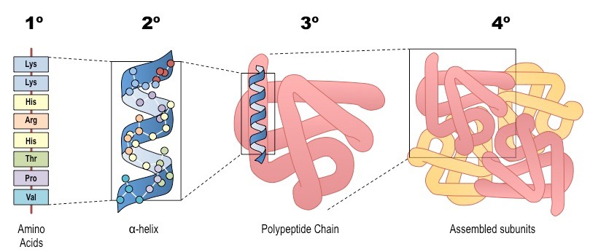
structural organization of proteins
Primary Structure
Secondary Structure
Tertiary Structure
Quaternary Structure
Important Forces determine structure
Covalent bond
Weak forces

Slide 5
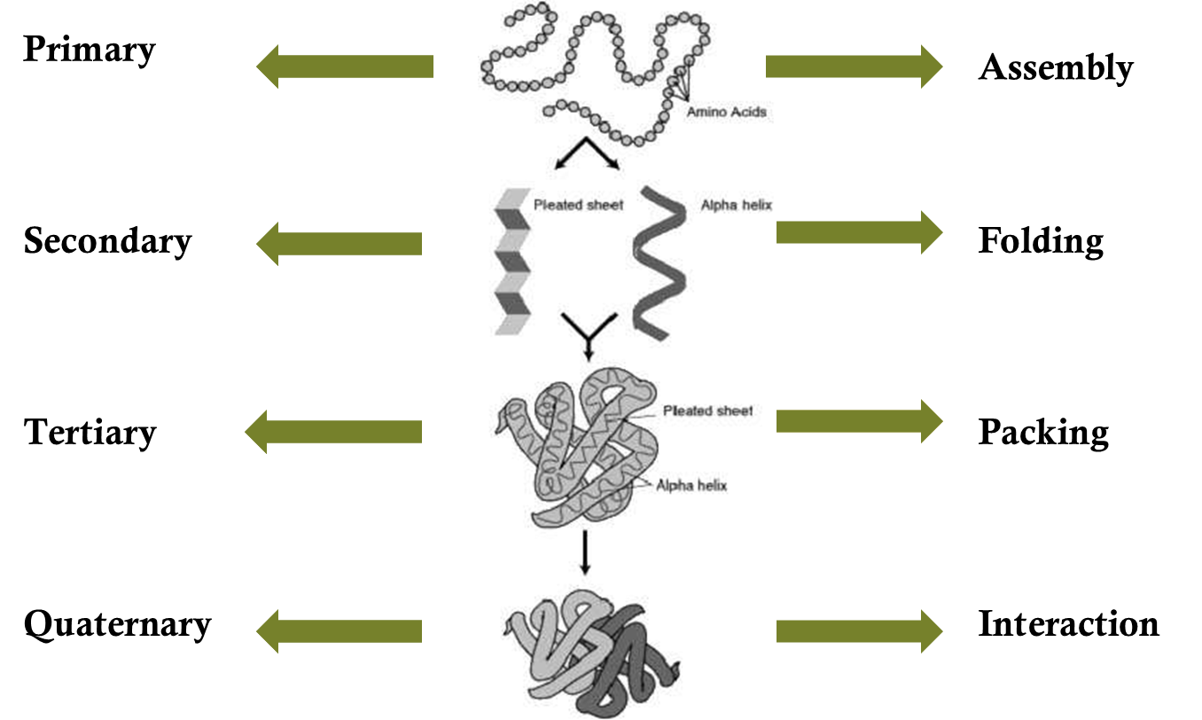
Structure organization

Slide 6
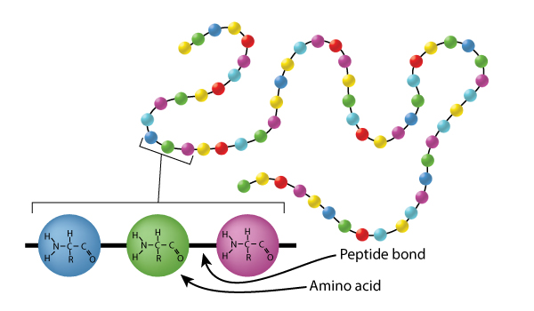
Primary Structure
The sequence of amino acids present in the polypeptide chain
Covalently linked by peptide bonds- Peptide bond
By convention, the primary structure of a protein starts from the amino- terminal (N) end and ends in the carboxyl-terminal (C) end
Largely responsible for its function

Slide 7
peptide bond has some double bond like character (40%) due to resonance C – N bond length of peptide is 10% shorter than that found in usual C – N
As a consequence of resonance, peptide bonds are almost planar

Slide 8
Cis conformation and Trans conformation
Trans conformation is normally present in the residues as Cis conformation leads to the steric clash
Cis conformation is possible for peptide bond next to the proline residue

Slide 9
IMPORTANCE OF PRIMARY STRUCTURE
To predict secondary and tertiary structures from sequence homologies with related proteins. (Structure prediction)
Many genetic diseases result from abnormal amino acid sequences
To understand the molecular mechanism of action of proteins
To trace evolutionary paths

Slide 10
METHODS OF Primary structure DETERMINATION
1. Amino Acid Composition
2. Degradation of protein into smaller fraction
3. Determination of amino acid sequence

Slide 11
Amino Acid Composition
unordered amino acid composition of a protein prior to attempting to find the ordered sequence
Knowledge of the frequency of certain amino acids may also be used to choose which protease to use for digestion of the protein
Misincorporation of low levels of non-standard amino acids
2 steps
Hydrolyse a known quantity of protein into its constituent amino acids- by acid or alkali treatment
Separate and quantify the amino acids- by chromatography

Slide 12
N-and C-terminal amino acid analysis
Reagents used which can label N-terminal amino acids
Sanger's reagent (1-fluoro-2,4-dinitrobenzene)
and dansyl derivatives such as dansyl chloride are used

Slide 13
Generation of small fragments
Urea or Guainidine hydrochloride- disrupts weak forces and dissociates the protein into polypeptide units
No of polypeptide chains than identified with dansyl chloride
Polypeptide is broken down
(i) Enzymatic cleavage- trypsin, chymotrypsin, pepsin etc
(ii) Chemical clevage- cyanogen bromide

Slide 14
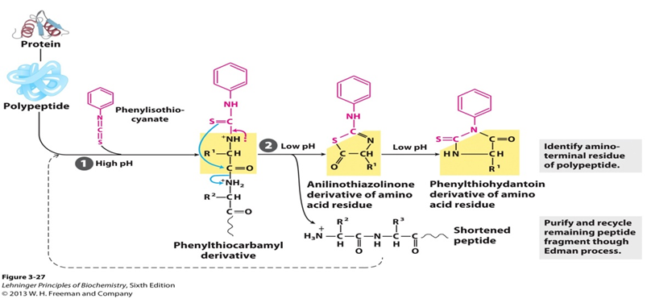
Amino acid sequence determination
Edman degradation-

Slide 15
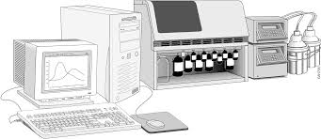
Sequentor
Protein or peptide is immobilized in the reaction vessel
Edman degradation is performed
Each cycle releases and derivatizes one amino acid from the protein or peptide's N-terminus
The released amino-acid derivative is then identified by HPLC
Process is done repetitively for the whole polypeptide

Slide 16
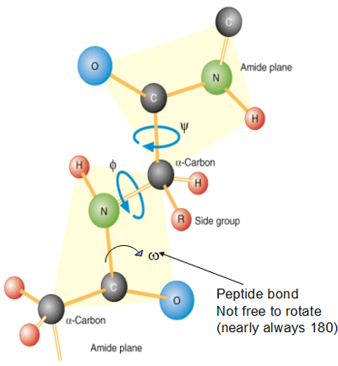
POLYPEPTIDE CHAIN CONFORMATIONS
The only reasonably free movements are rotations around the C α-N bond (measured as ϕ ) and the C α-C bond (measured as Ѱ).
The conformation of the backbone can therefore be described by the torsion angles (also called dihedral angles or rotation angles)
Two torsion angles in the polypeptide chain, also called Ramachandran angles

Slide 17
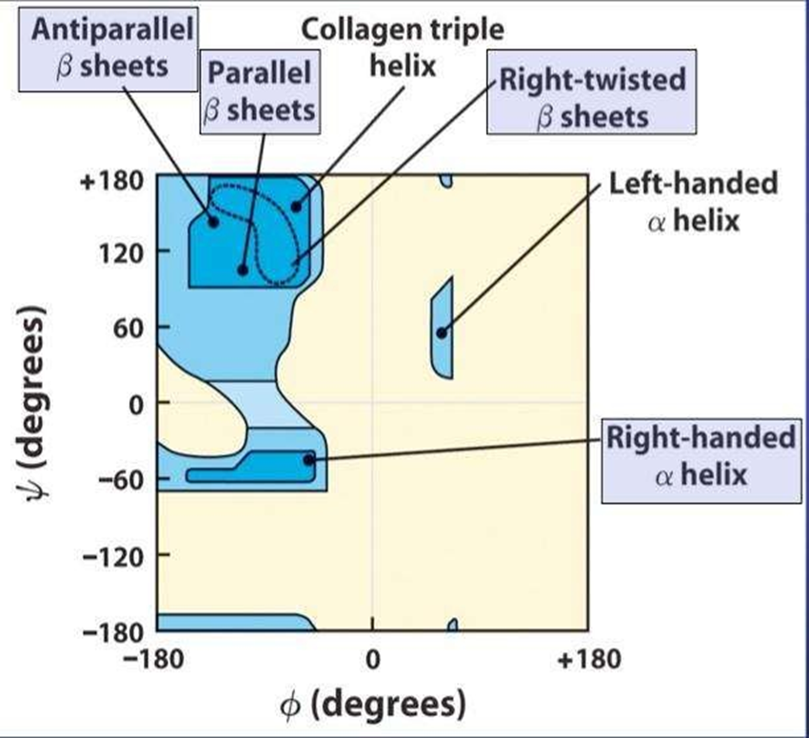
RAMACHANDRAN PLOT
To visualize the backbone of amino acid residues
Developed in 1963 by G. N. Ramachandran
Each dot on the Ramachandran plot shows the angles for amino acids.
The regions on the plot with highest density are most favorable combinations of phi-psi values and called “allowed” regions, also called “low – energy” regions.
Some values of φ and ψ are forbidden since the involved atoms will come too close to each other, resulting in a steric clash. Such regions are called “disallowed” regions

