Slide 1
VSR 411
Anaesthesiology
Introduction and basics of anaesthesia
By
Dr. Rajesh Kumar
Assistant Professor
Department of Surgery

Slide 2
Anaesthesia
Introduction –
Originated Greek word – an and aesthesis
Local or general loss of sensation to pain with or without the loss of consciousness, induced by an anesthetic.

Slide 3
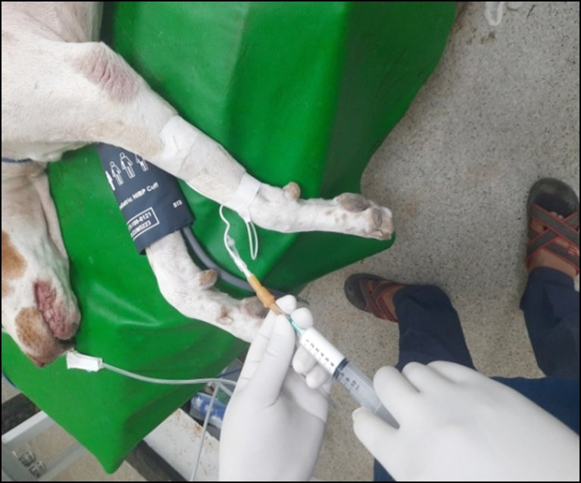
Terminology
Anesthesiology:
Anesthesiologist:

Slide 4
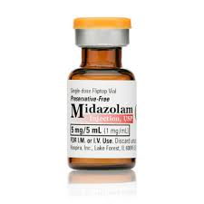
Anesthetic:
.
Analgesia:

Slide 5
Tranquilization:
Is a state of behavioral change in which the patient is awake, relaxed and indifferent to surrounding.
Sedation:
Is mild degree of CNS depression in which the patient is awake but calm and unaware of its surrounding.

Slide 6
Hypnosis:
Is an artificially induced sleep resulting from moderate depression of CNS.
Narcosis:
A condition of deep sleep or unconsciousness produced by a drug or other chemical substance. eg – Morphine, Meperidine.

Slide 7
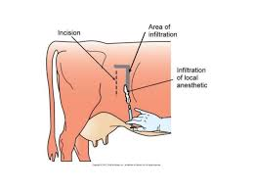
Local anesthesia:
Regional anesthesia:

Slide 8
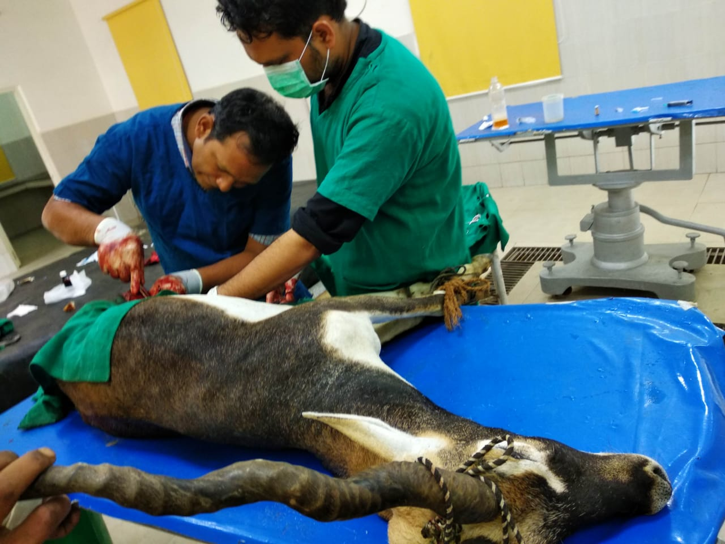
General anesthesia:
Surgical anesthesia:
Balanced anesthesia:

Slide 9
Basal anesthesia:
Is a state of light level of anesthesia produce of primary by pre anesthetic agent and serves as a basis for general anesthesia.
Neurolept analgesia:
Refer to a surgical pain relief using combination of neuroleptic agent and analgesic agents.

Slide 10
Induction of anesthesia:
The administration of drug or combination of drugs at the beginning of an anesthetic to produce state of anesthesia.
Dissociative anesthesia:
Loss of sensation of whole body, characterized by cataleptoid state in which eye remain open and swallowing reflex present.

Slide 11
Electro narcosis:
Acupuncture:

