Slide 1
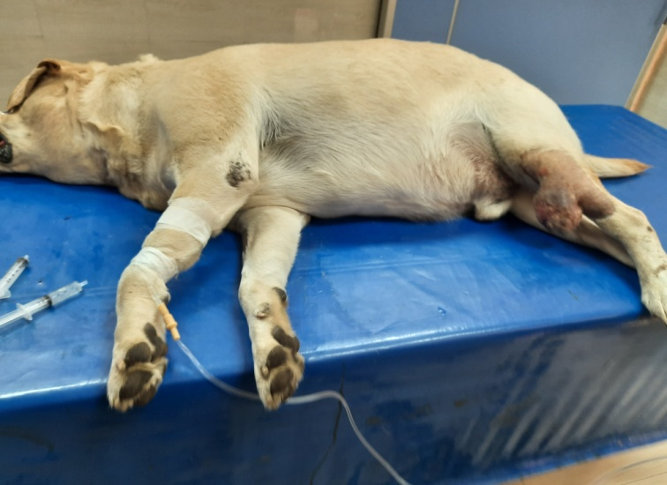
VSR 411
Anaesthesiology
Pre-anaesthetic consideration
By
Dr. Rajesh Kumar
Assistant Professor
Department of Surgery

Slide 2
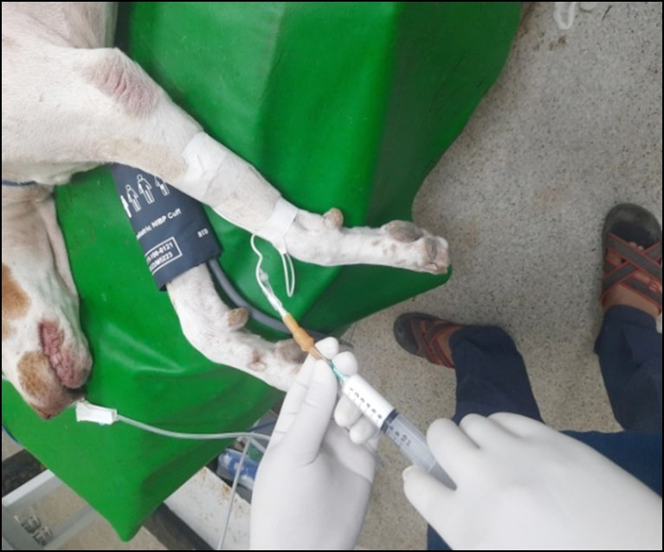
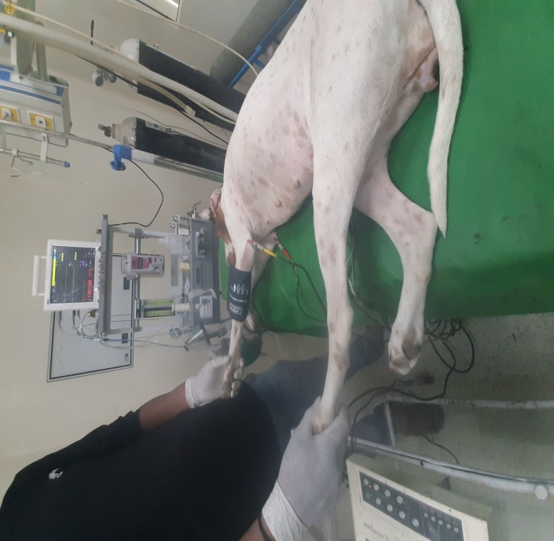
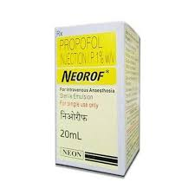
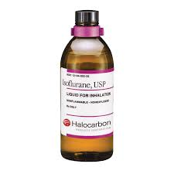
Anaesthesia
Selection of anesthetic agent:

Slide 3
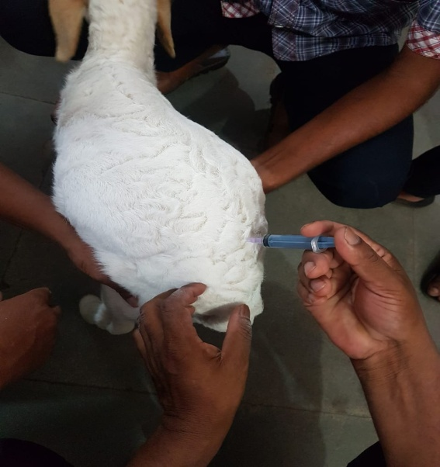
Pre-anaesthetic consideration
Careful pre-anesthetic evaluation is essential for selection of anaesthetic agents, monitoring requirement and other supportive measures
Depends on
Species Breeds

Slide 4
Age
Neonates metabolizes and excrete drugs less efficiency than adult
Geriatric patient have decreased anesthetic requirement and slowly metabolized and excrete injectable agent
Sex-
In male the basal metabolic rate is nearly 7% higher than female
History –
Duration and nature of illness determines the duration and type of anesthesia required

Slide 5
Size of patients
Smaller animal has higher metabolic rate
Recent feeding
Fasting of animal is recommended for 24-48 hrs in large animal 10 -12 hrs in small animal.
Activity and biological rhythum
Aggressive animals are at greater anesthetic risk

Slide 6
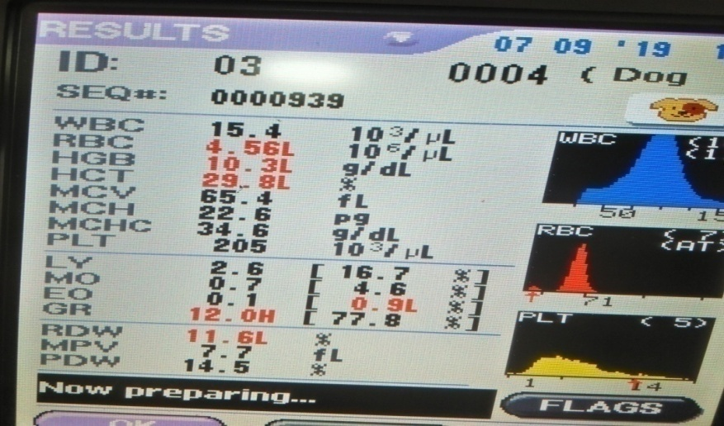
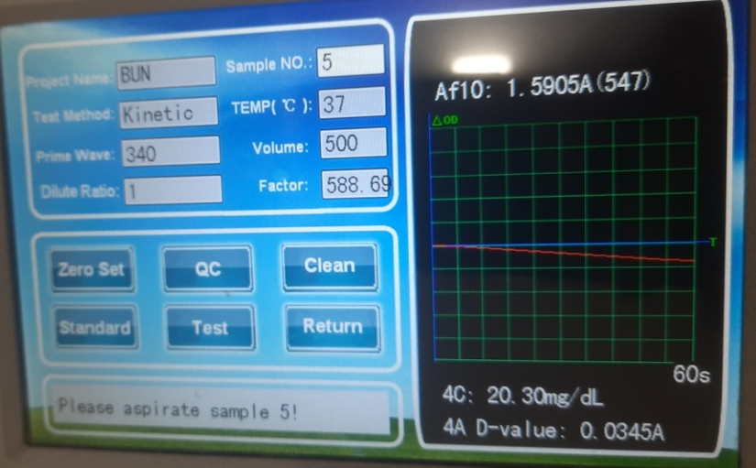
Pre Surgical Laboratory Test
At least Packed cell volume (PCV) and plasma protein (PP) concentrations should be evaluated

Slide 7
Hyper proteinemia can indicate haemo-concentration and dehydration
Drug responses can be affected by hypoproteinemia
It has been recommended that pre operative PCV be 27-30%
intra operative and post operative PCV be kept above 20%.

Slide 8
Anaesthetic Risk
Potentiality to surviving anaesthesia and surgery
According to ASA physical status of animal classified into five classes (I to V)
Patient is a completely healthy
Patient has mild systemic disease
Patient has severe systemic disease that is not incapacitating.
Patient has incapacitating disease that is a constant threat to life.
A moribund patient who is not expected to live 24 hour with or without surgery.

Slide 9
Pre-anaesthetic agent:
Agent who are usually given to prepare the patient for administration of anesthetic agent.
Uses
To reduce the amount of general anaesthetic
To calm the patient so that anesthesia can be administrated without bright and struggling.
To reduce gastric and intestinal motility and prevent vomiting while the patient is under anesthesia.

