Slide 1
Vagus indigestion
Dr. Bipin Kumar, Assistant Professor
Department of Veterinary Medicine
Bihar Veterinary College, Patna
(Bihar Animal Sciences University, Patna)

Slide 2
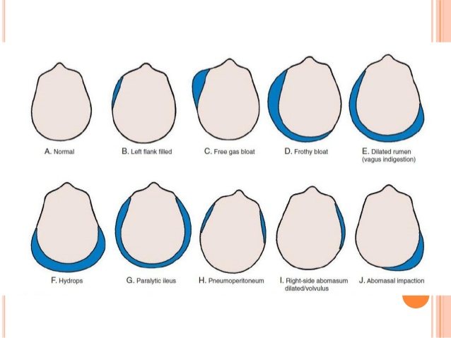

Slide 3
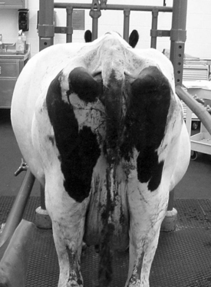
Functional disturbance of the ruminants fore stomachs. Not one specific disease, this is a syndrome which causes rumen distention.
Inappetance
Bradycardia
Hypermotility of rumen
Paple shaped abdomen
Scanty feces

Slide 4
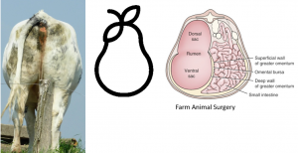
Etiology
Various diseases can cause vagal indigestion due to injury, inflammation, or pressure on the vagal nerve.
However, conditions resulting in mechanical obstruction of the cardia or reticulo omasal orifice

Slide 5
TYPES OF VAGAL INDIGESTION
Based on the site of the functional obstruction.
Type I is failure of eructation or free gas bloat,
Type II is a failure of omasal transport,
Type III is abomasal impaction,
Type IV is partial obstruction of the fore stomach.

Slide 6
TYPE I VAGAL INDIGESTION
FREE GAS BLOAT - Partial esophageal obstruction due to foreign body or extra esophageal obstruction due to lymphosarcoma, thyroid tumors, lung abscess.
FAILURE OF ERUCTATION - Inflammatory lesion adjacent to vagus nerve (localized peritonitis).
TYPE II VAGAL INDIGESTION
FAILURE OF OMASAL TRANSPORT due to
Abscesses
Lymphosarcoma,
Papilloma,
Squamous cell carcinoma,
Large infarct, adhesions,
Liver abscess exerting pressure of vagus.

Slide 7
TYPE III VAGAL INDIGESTION
ABOMASAL IMPACTION ,Lack of water access
PYLORIC STENOSIS/OBSTRUCTIONS
Traumatic reticulo peritonitis
Abscesses or adhesions
Foreign body
Vagal neuritis
TYPE IV VAGAL INDIGESTION
Most difficult type- uterus enlarges, abomasum pushed forward which interferes with normal motility. If going on for a long time it will progress into one of the other types.

Slide 8
PATHOPHYSIOLOGY
Lesion site will determine the clinical signs
Vagal neuritis or injury - due to traumatic reticuloperitonitis, space occupying lesions (tumors abscesses), or foreign body

Slide 9
CLINICAL SIGNS
Bradycardia- slow heart beat or pulse
Abdominal distention ,Anorexia, loss or decreased appetite
Ruminal tympany
An enlarged 'papple' –shaped abdomen
Scanty faeces with an increase in undigested particles or Absence of faeces (constipation)
Hyper motility of rumen
Inadequate response to treatment

Slide 10
Diagnosis
CLINICAL PATHOLOGY
Moderate neutrophilia and shift to the left
Increased plasma protein concentrations.This may be indicative of a chronic reticuloperitonitis.
Serum biochemistry , Metabolic hypochloremic, hypokalemic alkalosis.
Ruminal chloride concentrations .These are normally below 30 mmol/L and increased in posterior stenosis to levels above 40 mmol/L due to abomasal reflux .
Figure out what's in the rumen by palpation.
Increase in rumen fluid with abdominal impaction- hypochloremic, hypokalemic metabolic alkalosis.
Rectal palpation of rumen and other organs.

Slide 11
TREATMENT
TYPE I
Establish rumen fistula
Purported antifermentatives- turpentine
Type II
Ruminatorics and cathartics- GI evacuation
Ca gluconate i/v
Need surgical correction
Wont respond to symptomatic treatment
Needle biopsy of mass
Drain abscess
Pass a stomach tube

Slide 12
TYPE III
Vigorous thearpy- poor prognosis
Salvage- recommended
Oral cathartics, laxatives, metaclopramide
calcium gluconate
IV fluids
Last alternative- abomasotomy- not beneficial.
TYPE IV
Indigestion of advanced pregnancy- IV fluids
Decide what is more valuable- cow or calf.
If within 4-6 weeks of parturition- symptomatic treatment

Slide 13
ATROPINE TEST
Inj.Atropine sulphate 30 mg sc or 0.06mg/kg
A rise in heart rate of more than 20 beats/mt in 10 minutes is suggestive of Vagal Indigestion
DYE TEST –
To rule out Omasal Impaction in field condition
Mix charcoal or innocuous dye with 2 litres of 10 % salt solution and drench, after 5 mts abomasocentesis is done ,absence of charcoal or dye --- omasal impaction
Not Passing Dung….?? Rumen Impaction
Intestinal Obstruction
Intestinal Intussusceptions
Paralytic ileus

Slide 14
Thank you

