Slide 1
VASCULAR EVENTS OF
ACUTE INFLAMMATION
Dr. Sanjiv Kumar
Assistant Professor,
Deptt. of Pathology, BVC, Patna

Slide 2
Tissue Alterations In Acute Inflammation
These can be placed into two groups –
the vascular changes and
the cellular events.

Slide 3
VASCULAR CHANGES
Julius Cohnheim (1839-1884) was the first to describe vascular changes in 1877.
He spread the mesentery of a curarized frog (anaesthetized by curare) across the stage of a microscope and observed the flow of blood through the vessels, following the application of a drop of dilute acetic acid.
Based on his observations, the vascular changes are:

Slide 4
1. Changes in the Caliber of Blood Vessels
Momentary constriction:
Immediately upon application of the irritant, the arterioles are constricted.
(b) Vasodilation:
The momentary constriction of vessels is quickly followed by their dilation that involves first arterioles and then results in the opening of new capillary beds in the area.

Slide 5
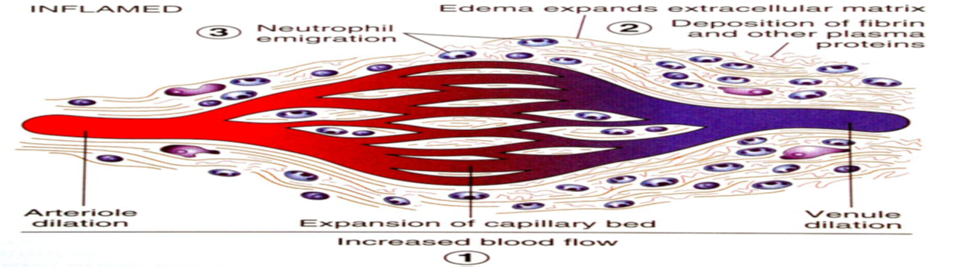
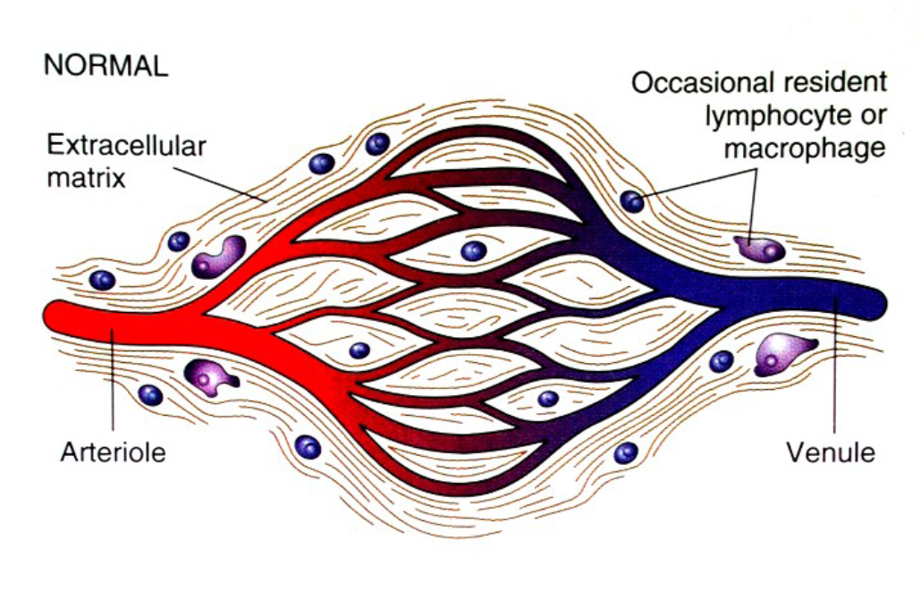

Slide 6
Vasodilatation

Slide 7
2. Changes in the Rate of Flow
The early vasodilation results in increased blood flow, but is soon followed by slowing of the circulation. This leads to:
A. Increased vascular permeability
B) Slowing of the circulation: Retardation is achieved in four ways:
(i) by increasing the capillary bed in the area.
(ii) by swelling of the endothelial cells lining the capillaries.
(iii) haemoconcentration
(iv) margination of the leukocytes.
v) Stasis: When the above factors markedly reduce the flow, blood barely moves through the vessels, and stasis is produced.

Slide 8
Increased vascular permeability (vascular leakage):
(i) A characteristic feature of acute inflammation is the striking increase in permeability of the vessels to proteins.
This net increase of extravascular fluid is called inflammatory oedema.

Slide 12
Mechanisms of Increased Vascular Permeability
The following mechanisms have been proposed.
(a) Formation of endothelial gaps in venules
(b) Endothelial cell retraction
(c) Direct endothelial injury
(d) Delayed prolonged leakage
(e) Leukocyte-dependent endothelial injury
(f) Increased transcytosis
(g) Leakage from new blood vessels

Slide 14
Estimation of Increased Vascular Permeability
Increased vascular permeability can be demonstrated or quantitated, experimentally, in several ways:
(1) dye technique (gross or macroscopic method), and
(2) colloidal carbon technique (microscopic method).

Slide 15
3. Changes in the Bloodstream
The main change consists of a redistribution of the cellular elements of the bloodstream. Normally in the bloodstream of a vessel, the axial stream is cellular and external to the axial stream is the plasmatic stream.
As the blood flow slows, the centripetal force of the bloodstream is overcome by the centrifugal force and the leukocytes fall out of the axial stream. This process of leukocyte adhesion at the periphery of vessels is called margination.
Afterwards, leukocytes tumble (roll over and over) slowly along the endothelial surface and adhere transiently called rolling.
Finally, leukocytes come to rest at some point where they adhere firmly called adhesion.
In time, the endothelium is virtually lined by white cells. This appearance is called pavementing.

Slide 16
4. Exudation of Plasma
Following increased vascular permeability, fluid part of the blood escapes into the inflamed area. This is known as exudation.
The accumulated plasma outside the vessel is known as an inflammatory exudate.

Slide 19

5. Emigration of Leukocytes
This is the process by which leukocytes come out of the blood vessels into the extravascular space.

Slide 20
6. Diapedesis of Erythrocytes
Red cells may also leave the intact blood vessels.
However, they have no power of movement and are pushed out of the vessel passively by the intravascular pressure following emigration of leukocytes. This is called diapedesis.
In severe injuries, red cells may also enter the tissue by rhexis (break) of the vessel wall.

Slide 21
THANK YOU

