Slide 1
CATHETERIZATION AND URINE COLLECTION IN DOGS
DR GYANDEV SINGH
ASSITANT PROFESSOR
DEPARTMENT OF VETERINARY SURGERY AND RADIOLOGY
Veterinary Clinical Complex

Slide 2
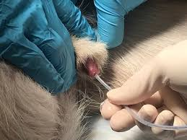
INTRODUCTION-
Urinary catheterization in dogs is a procedure done by veterinarian places a plastic tube [catheter]into the dogs penile urethra or vulva urethra.

Slide 3
INDICATION-
To collect urine for urinalysis.
To empty the urinary bladder.
To administer radiographic contrast media into the lower urinary tract.

Slide 4
Equipment -
Catheters
Sterile soft gauze swabs
Gloves
Lignocaine jelly
10 ml syringe

Slide 6
Patient preparation and positioning-
Gentle physical restraint
Sedation
Lateral recumbency
The prepuce should be cleaned with the antiseptic solution
The area around the prepuce can be maintained aseptically .

Slide 7
ANATOMICAL VIEW-

Slide 8
Procedure -
Position –lateral recumbency or standing position .
Prepration –sedation is generally not required .
exrude the penis from prepuce and wipe the
ureathral orifice.
-measure the approximate length of catheter.

Slide 9
Slide the catheter through the penile ureathra and stop insertion when urine fill the catheter and leaks from the end of catheter

Slide 10
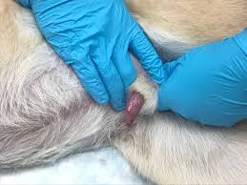
Once catheter is entered the bladder ,release the penis into the prepuce

Slide 11
If the catheter is to be indwelling-
For silicon foley ,water sufficient to fill ballon
Sterile intravenous fluid administration set and empty fluid bag or urine collection system with appropriate adapters for attachement to selected urinary catheter.

Slide 12
Containdication -
Pre-ureathral trauma
Large space occupying ureatheral mass or ureathral stricture.
Urine collected by catheterization is not suitable for for microbiology.

Slide 13
Uretheral cathetrization in bitch-
Bitches may require sedation or general anaesthesia.
Bitches positioned in dorsal recumbency
Clean the vulva with the antiseptic to remove any discharge and surface dirt.

Slide 14
Instrument ant technique -

Slide 15
Urine collection for sample handling -
For urinalysis-
approximately 5 ml is required.
sample should be collected into plain tube.
urine collected by cystocentesis because by catheterization
sample may by contaminated.

Slide 16
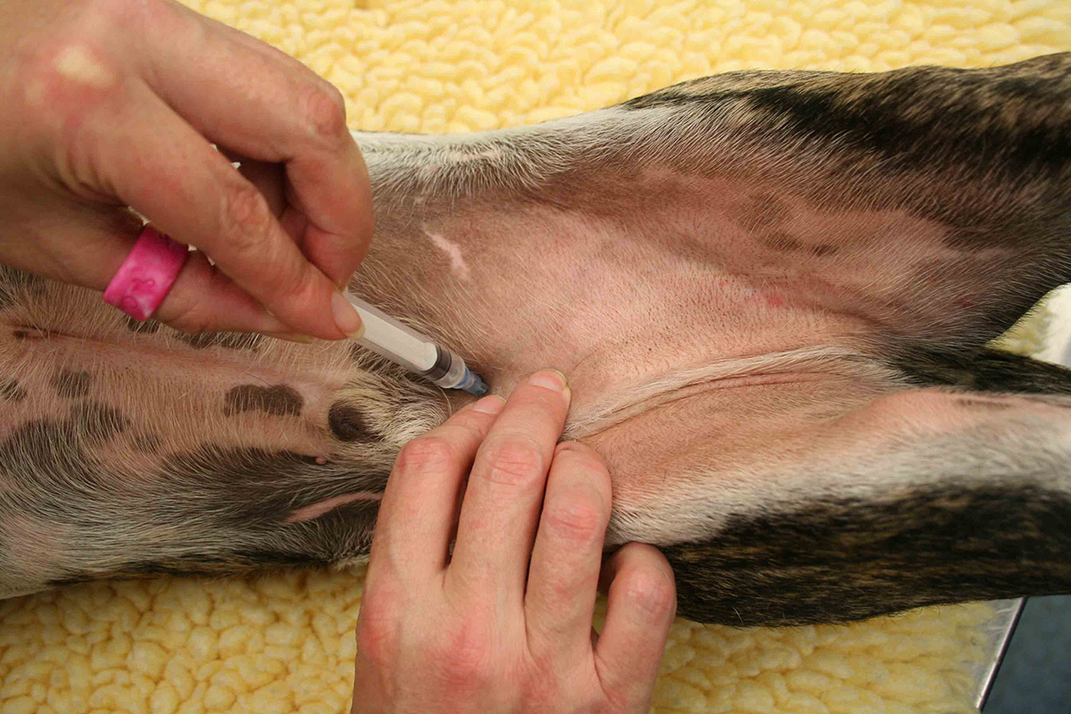
Process -

Slide 17
THANK YOU

