Slide 1
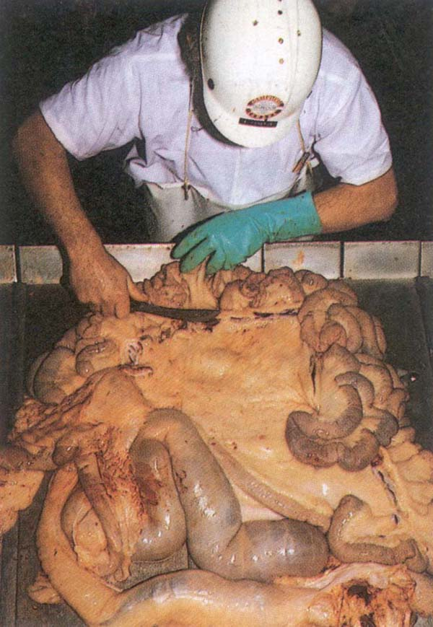
Lymph nodes examination of food animals

Slide 2
The Lymphatic System
Lymph is a medium:
Supply oxygen & nutritive matter are transferred from the blood to the body tissues
The means by which waste products from these tissues are removed
The presence of lymph around the tissue cells is maintained by a slow exudation of this fluid through the capillary walls & in to the surrounding tissue
Afferent lymphatics: Vessels conveying lymph to a lymph node
Efferent lymphatics: Discharge eventually in to larger lymph collecting vessels, the direction of the lymph flow in every case being towards the heart
Largest lymph collecting vessel is the thoracic duct
Lymph from posterior part of the body: lumbar & intestinal to thoracic duct & open in to the anterior venacava
Lymph from anterior part of the body: To tracheal lymph & towards jugular vein

Slide 3
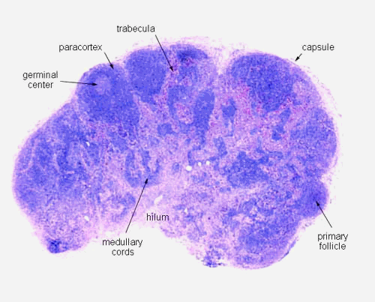
Lymph node: Introduction
Round masses of lymphoid tissue
Surrounded by a capsule of connective tissue
Found along the course of lymphatics
Consists of a reticulum of connective tissue fibers in the meshes of which are contained numerous small rounded cells-the lymphocytes

Slide 4
Lymph node: Introduction
The color of lymph nodes is variable: (white to greyish blue or almost black)
In ox: mesenteric LN of ox black in color
In Pigs: LN are lobulated & almost white
(exception: LN of head and neck which are reddish in color)
Consistency of LN: consistency is firm rather than soft
Generally oval in shape & somewhat compressed
Size: varies from pin head size to 10-20 cm or even more
In the horses: LN are small & grape like clusters
Larger in young animals than in the adults

Slide 5
Parts/Organ | Lymph node | Disease condition
Head | Parotid, submaxillary, retropharyngeal | FMD, stomatitis, rinderpest, actinomycosis, actinobacillosis, cysticercosis
Lungs | Bronchial, Mediastinal | Pleurisy, pneumonia, tuberculosis
Heart | Mediastinal | Traumatic/tubercular, pericarditis, peticheal haemorrhages on the epicardium and endocardium, cysticercosis, hydatidosis, flabbiness of heart
Liver | Portal & hepatic | Fatty changes, actinobacillosis, abscess, cirrhosis, hydatid cysts, fascioliasis
Oesophagus, stomach, intestine | Gastric & mesenteric | The serous surface for tuberculosis, actinobacillosis, penetration by any foreign body
Kidney | Renal
Spleen | Splenic | Tuberculosis, anthrax, infracts, haemorrhages,
Uterus | Iliac & renal | septic metritis, evidence of recent parturition or pregnancy
Udder | Supramammary | Abscess,septic metritis, tuberculosis
Testes | Superficial inguinal | Orchitis
Carcass | Prescapular, popliteal, renal, cervical, intercostal, xyphoid or sternal auxillary, prepectoral, external, internal iliac | Bruises, injuries, abdominal & thoracic cavities for tuberculosis, poorness, emaciation & state of nutrition

Slide 6
Haemal lymph node
Deep red or almost black in color
Oval in shape
Pea size
Absent afferent and efferent lymphatics
Accessory spleen: RBCs disintegration
Numerous in Sheep and OX
Absent in: Horse & Pigs
Cattle: along the course of aorta and Subcutaneous fat
Sheep: Beneath the peritoneum in sub-lumbar region
Being larger and more numerous in animals suffering from anemia &cachectic conditions
Lymph nodes absent in poultry

Slide 7
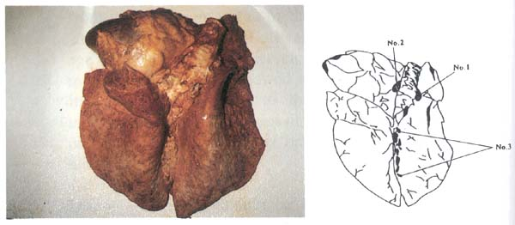
Lungs
Lymph nodes
Bronchial (tracheobronchial) and mediastinal: Incise
Lung inspection - Bronchial left (No. 1) and right (No. 2) and mediastinal (No. 3) lymph nodes are viewed and incised
Manual on meat inspection for developing countries
http://www.fao.org ›

Slide 8
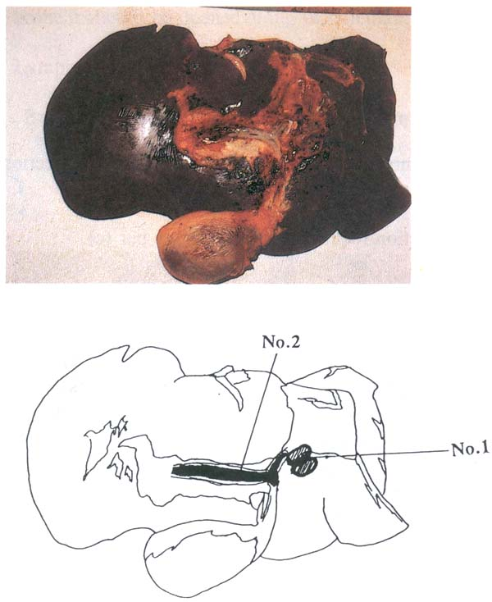
Liver
View and palpate entire surface(both sides)
View the gall bladder. For cattle over 6 weeks of age, incise as deemed appropriate to detect liver flukes. Open large bile ducts
For sheep, pigs and game, incise as deemed appropriate for parasite
Lymph nodes Portal (hepatic)
Liver inspection - Incised portal (hepatic) lymph nodes (No. 1) and opened large bile duct (No. 2).
Manual on meat inspection for developing countries
http://www.fao.org ›

Slide 9
Rumen, reticulum, omasum and abomasum
Viewing and incision of the mesenteric lymph nodes.
In this case an incision was performed to demonstrate the mesenteric lymph nodes chain.
Manual on meat inspection for developing countries
http://www.fao.org ›

