Slide 1
GENUS –STREPTOCOCCUS Dated-09/12/2020 2nd year professional course
Dr. Sudha Kumari
Assistant Professor
Department of Veterinary Microbiology
Bihar Animal Sciences University, Patna

Slide 2
Streptococcus
Streptococci
Streptos ( twisted or coiled )
Pathogenic and non-pathogenic species may be present on the skin and on the mucous membranes of the genital ,upper respiratory and digestive tracts.

Slide 3
Streptococcus is a genus of gram-positive coccus or spherical bacteria that belongs to the -
family -- Streptococcaceae,
Oder-- Lactobacillales,
phylum -- Firmicutes.
Cell division in streptococci occurs along a single axis, so as they grow, they tend to form pairs or chains that may appear bent or twisted.

Slide 4
Billroth-first saw—cocci chains in erysipelas & wound infections, called them streptococci.
Ogston- Isolatd,described pathogenicity, named as streptococcus pyogenes.

Slide 5
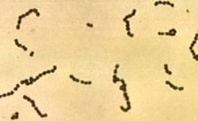

Slide 6
Some spe. of strep.
Strep. aureus
Streptococcus pyogenes
Streptococcus agalactiae
Strep. Dysgalactiae
Strep. Bovis
Strep. Suis
Strep. Porcine
Strep. uberis (bovine mastitis)
Strep. Zoo epidemicus
Strep. canis

Slide 7
Classification (Co2 requirement)/ heamolysin production
Alpha Produce greenish discolouration with partial hemolysis around the colonies.
Zone of lysis is small(1-2cm wide)with definite margins, unlysed RBC’scan be marked out microscopically within this zone-known as Viridians streptococci—viridis=green.
Normal commensals in throat---opportunistic infection Str.pneumoniae/pneumococcus is also an alpha hemolytic one.
eg. Streptococcus pneumoniae,.

Slide 8
Beta-produce sharply defined ,clear colourless zone of hemolysis,2-4cm wide, within which red cells are completely lysed.
hemolytic Streptococci”=beta hemolytic
Beta-hemolysis (β-hemolysis) is defined as the complete lysis of hemoglobin of red blood cells surrounding the colony on blood agar. eg. Streptococcus pyogenes
Gamma- Non haemolytic streptococci-produce no change in medium-so called “indifferent streptococci”---includes faecal(enterococci,strept.faecalis).
And related species-called enterococcus group.

Slide 9
Hemolytic classified on carbohydrate C antigen on the cell wall-Lancefields grp-20-A-V,without I&J.
Grp A-Strpt.pyogenes-into types-based on proteins-M,T,R—Griffith typing.
A blood agar plate displaying gamma hemolysis actually appears brownish as the normal reaction of the blood occurs due to the growth conditions used (37° C in the presence of CO2).
Eg. Group D Streptococci,

Slide 11
Lancefield classification (1928)
It is only Beta hemolytic streptococci.
This classification is done by precipitation test.
On this basis 20 groups are classified as:-
A-H and K-V
A-human type
B-cattle origin of stre. agalactae
C- Both of origin
D- in dairy products and intestinal tract of stre. faecalis
E- normal milk of porcine
F- in man
G- man and dog
K- man
L,M,N-dog

Slide 12
Classification basad on protein antigen-
M.T. R. –protein antigen
M-forms mucoid or matt like colonies and its presence is responsible
for virulence of the organisms.
T- found in somatic as well as capsule.
R- Responsible for agglutination.

Slide 13
Classification basad on the toxins and enzymes-
Streptococci two type of haemolysins
Streptolysin ‘O’ and ‘S’
Streptolysin ‘O’ is oxygen labile and ‘S’ is oxygen stable hemolysin.
O- antigenic
S- non antigenic.
After inoculation hemolysis occurs by the S- antigen.
This antibodies formed which is used for detection of strep.
In body and named as ASO –Test.
ASO- Anti Streptolysis O for streptococcus o infection.
In case of tonsillitis, pharyngitis, rheumatoid arthritis etc.

Slide 14
Morphology:
The individual cocci are spherical or ovoid, 0.5-1 µm in diameter and are arranged in chains and pairs of up to 50 cells or more but stre.salivarius forms the longest chain.
The length of chain vary widely with cultural conditions.
Streptococci are gram positive but they may become gram negative in ageing when bacteria die.
Streptococci are non-motile and non-spore forming.
Most species possess capsule.

Slide 15
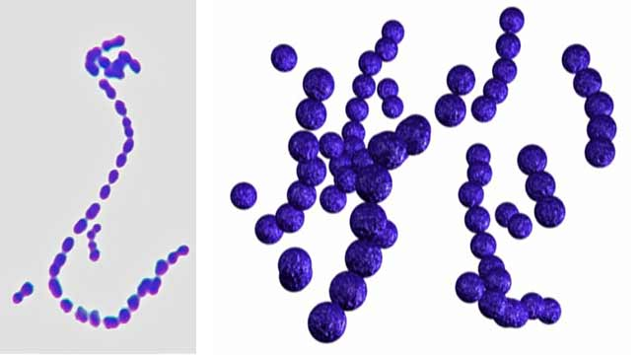

Slide 16
Cultural characters :
Aerobe & fac. anerobe-growing best at 37C—growth only in media with fermentable sugers, enriched blood /serum.
Blood agar—incubet-24hrs—colonies are small-circular, semi transparent, low convex discs with an area of clear hemolysis around them.
Colonies are glistening and look like dewdrops.
Growth and hemolysis are promoted by10% Co2.
Virulent strains—fresh isolation-matt colony/finely granular
Avirulent—glossy colonies
Capsulated—mucoid colonies

Slide 17
Rarely—non hemolytic grp A
In liquid medium(glucose/serum)—growth occurs as granular turbidity with a powdery deposit-no pellicle formed.

Slide 18
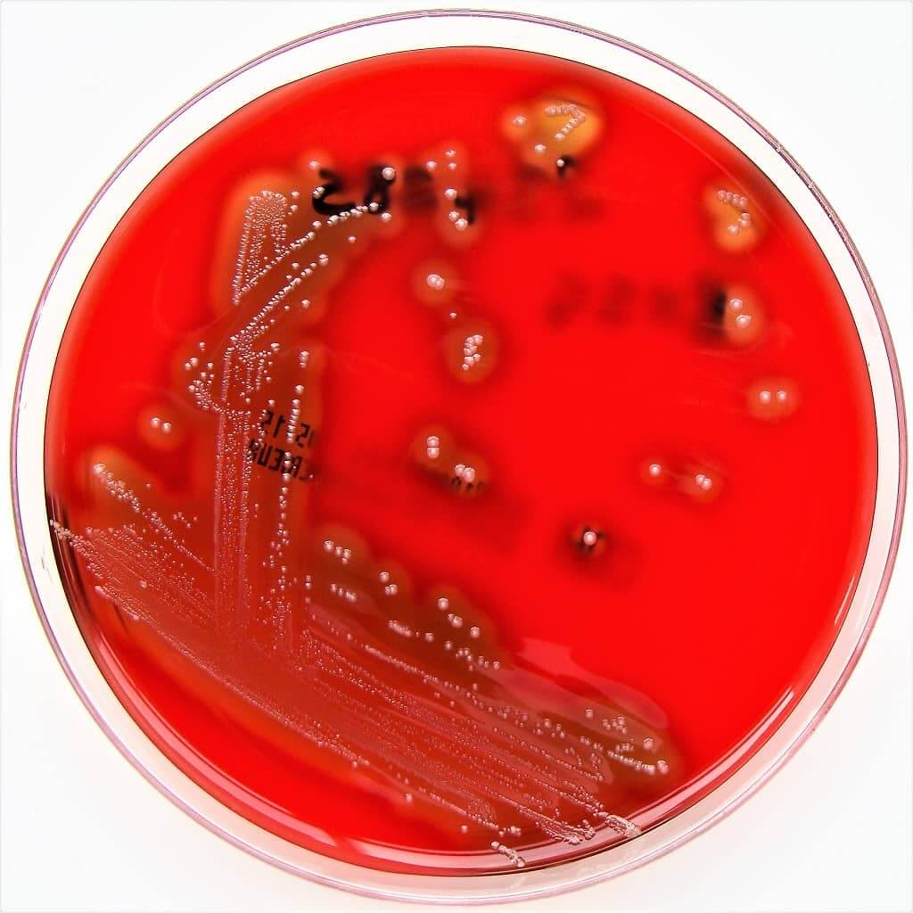
Streptococcus pyogenes

Slide 19
Toxins of Streptococcus
Haemolysins
Streptokinase
DNases A,B,C and D (streptodornase)
Hyaluronidase
Erythrogenic toxins (type A,B and C)
Proteinase

Slide 20
Symptoms :-
Common symptoms include facial pain, headache, and fever following previous upper respiratory viral illness.
First symptoms of streptococcus bacteria infections you will feel sudden fever.
Fever is one of the most common symptoms that you will get when you’re infected by Streptococcus.
The species cause acute and chronic pyogenic infection in animals, scarlet fever in man and strangles in horses.

Slide 21
Diagnosis of Streptococcus
Specimens:-
Pus(strangles),
Joint fluid (arthritis),
Milk (Mastitis),
Organs,
Blood (septicemia) etc.

Slide 22
Diagnosis con.
CAMP – Test one for separation of this mastitis group of organism
from other.
C- Christie
A- Atkins
M-Munch
P- Petersons test.
Producing camp factor.
For the three researchers who discovered the phenomenon.

Slide 23
CAMP test- is a test to identify group B beta hemolytic
Streptococci (str. agal.) based on their formation of a substance
that enlarges
the area of hemolysis formed by the beta hemolysin
elaborated from strep. aureus.
To detect the ability of an organism to produce the CAMP factor.
(It is a biochemical test used to differentiate streptococcus aglactiae
from other beta- hemolytic streptococci).

Slide 24
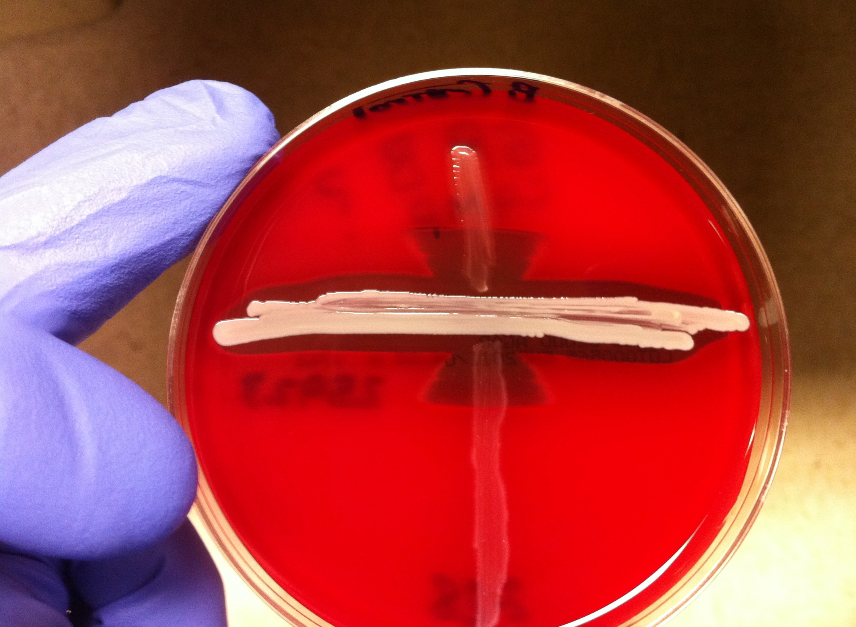

Slide 26
Procedure: -
Place a small amount of a bacterial colony (18 to 24 hours old) on a clean glass slide.
Add one to two drops of 3% hydrogen peroxide.
Positive: Rapid bubble formation
Negative: No bubble formation.

Slide 27
Slide catalase test results:
Hydrogen peroxide was added directly to the culture on a microscope slide.
A positive reaction produced by Staphylococcus aureus is indicated by bubbling; a negative reaction produced by Streptococcus pyogenes is indicated by lack of bubbling.

