Slide 1
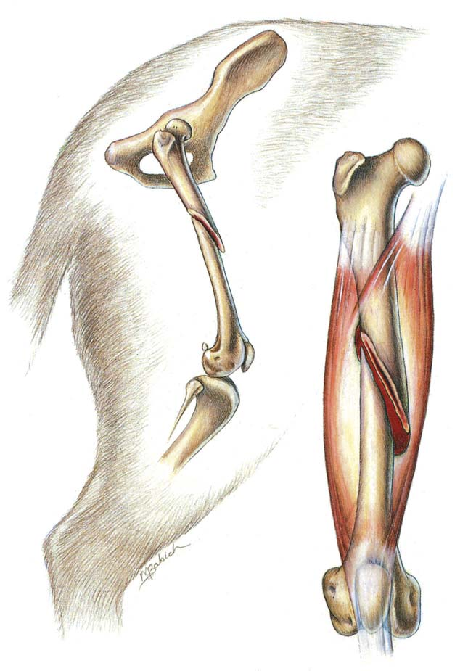
FRACTURE - I
.
Dr. Archana Kumari
Asstt. Professor cum Junior Scientist
Veterinary Surgery and Radiology
BVC, BASU, Patna

Slide 2
Development of Bone
Bone is a specialization connective tissue with mineralized collagenous framework providing skeletal support to the body.
acts as lever for muscles
gives form to soft tissues
protects the vital organs and
helps in the locomotion of the animals
also serves as a mineral bank.
Embryonic stage development of a bone takes place from the mesenchyme, a diffuse loose cellular tissue lying between ectoderm& endoderm of the embryo

Slide 3
Composition of bone
The bone is composed of three major components
bone cells,
organic matrix and
Minerals
The bone cells include
osteoblasts,
osteocytes
osteoclasts,
These cells are derived from undifferentiated mesenchymal cells (osteoprogenitor cells).

Slide 4
Mesenchymal cells also differentiate into:
Cartilage
Fascia
Ligament
Tendon

Slide 5
Cont.
An early stage of development, the skeletal structure appear as dense concentration of mesenchymal cells that tend to take shape of particular bones
These localized areas of bone formation are called Ossification Centres
Ossification may be heteroplastic endochondral or intramembranous depending on the environment in which the bone formation takes place.
A bone formed in tissue other than the skeleton is called a heteroplasic bone (exception : os penis of dog , os cordis of bovine & os phrenic of camel)

Slide 6
Types of bone
Based on the shape, bones can be classified as
long bones
short bones
flat bones
Long bones are present in limbs eg. Femur, humerus, tibia and radius etc.
Short bones are mainly seen in the joints-carpals and tarsals.
flat bones are present in skull, pelvis and ribs.

Slide 7
Types of bones
Based on the structure, bones can be classified as
cortical bone
compact bone
cancellous or spongy bone
Compact bone is found largely in the shafts or long bones that surround the marrow cavity.
Spongy bone is found in the vertebrae, flat bones and in the ends of long bones.

Slide 8
Intramembranous Ossification
Mesenchymal cells differentiate into osteoblasts
Osteoblasts begin to secrete intercellular substance of the bone
intercellular substance replaces amorphous fluid and encloses the osteoblasts and are called as osteocytes
Actively secreting osteoblasts, line the surface of newly formed spicules of the bone and continue to grow in a radial manner producing trabeculae
Branching and forming of different trabeculae result in scaffolding
The bone formed by the scaffolding trabeculae is termed as cancellous bone
The continued deposition of fresh bone lamellae on trabeculae & appositional bone growth forms the compact bone
The surface connective tissue becomes the periosteum

Slide 9
Endochondral Ossification
The process by which the bone is formed in a cartilaginous environment is called endochondral ossification
Mesenchymal cells differentiate into chondroblasts
Cartilage model increases in length and width by interstitial as well as appositional growth
It involves :-
proliferation
Maturation
Enlargement of chondrocytes

Slide 10
Cont.
The earliest chondrocytes of the centre matures,
Enlarge and secrete alkaline phosphatase into the intercellular substance and becomes calcified
A new vascular environment is created which with the invasion of perichondrium by blood vessels
it brings change in the behaviour of pluripotential cells of perichondrium
These cells differentiate into osteoblasts and a thin layer of bone is laid around the cartilage .
Membrane enclosing the cartilage model is called periosteum.

Slide 11
Cont.
formation of secondary ossification centre helps in the growth of bone
The young cartilage at each end of the model continues to grow and extend by interstitial growth to increase the length of the model
The cancellous bone in the central part is reabsorbed to form a medullary cavity and later on filled with myeloid tissue.

Slide 12
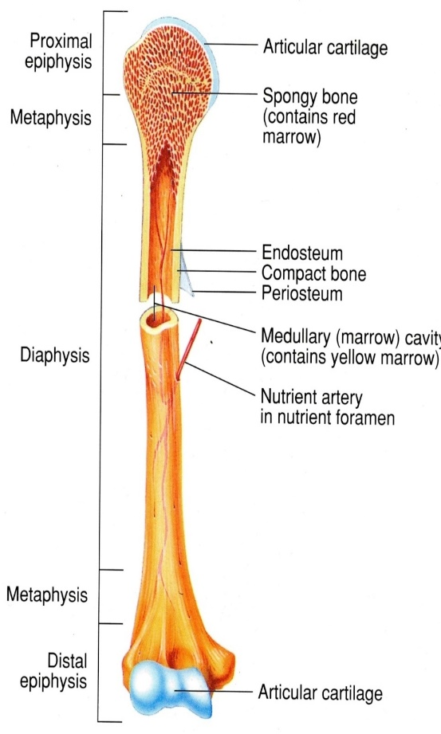
Anatomy Of Long Bone
Long bone is divided into three parts :
Epiphysis : present on both the ends of a bone and is composed of trabeculae
Metaphysis : composed of trabecular bone which contains haematopoietic elements
Diaphysis : hollow tube of cortical (compact) bone .its central cavity contains the medullary arterial supply

Slide 13
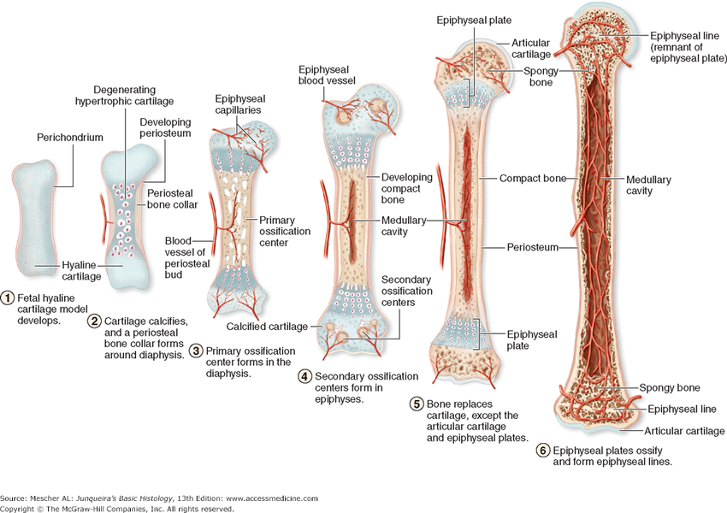
1

Slide 14
.
The entire surface of a long bone , except at the ends at which articular cartilage is present is covered by the periosteum.
The periosteum consist of an :
Outter fibrous layer
Inner osteogenic layer (cambium )

Slide 15
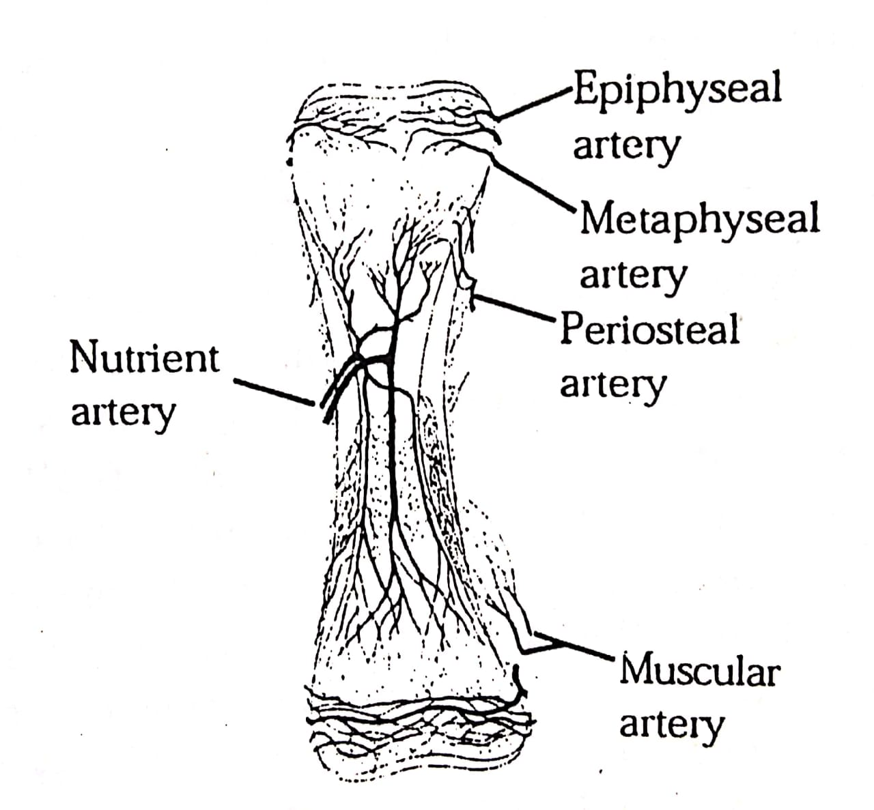
Blood supply
Divided into 3 main compartments:-
Afferent vascular system – arteries and arterioles carrying nutrients
Efferent vascular system – veins and veinules carrying waste products
Intermediate vascular system – capillaries linking afferent and efferent vascular system

