Slide 1
Techniques of fracture reduction
.
Dr. Archana Kumari
Asstt. Professor cum Junior Scientist
Veterinary Surgery and Radiology
BVC, BASU, Patna

Slide 2
PRINCIPALOF FRACTURE MANAGEMENT
4R
Recognition
Reduction
Retention
Rehabilitation

Slide 3
Methods of fracture reduction

Slide 4
.
The reduction of fracture can be done either by
CLOSED REDUCTION
OPEN REDUCTION

Slide 5
CLOSED REDUCTION
Reduction of fracture without incising the skin or exposing the bone through external manipulation is called as closed reduction.
Normally after a closed reduction, fracture is immobilized with external fixation techniques, though sometimes intramedullary or external skeletal fixation is done.

Slide 6
INDICATIONS
Fresh fractures in young animals, comprising only two pieces with little or no overriding of fragments.
Closed reduction is generally done where bone segments can be easily palpable with less muscular coverage (radius and ulna).

Slide 7
ADVANTAGES
Reduces the risk of infection.
Trauma to soft tissues from surgical exposure is avoided.
The cost of initial treatment is less.

Slide 8
TECHNIQUE
Under sedation, the animal is secured in lateral recumbency, by keeping the affected limb uppermost.
The test limb is held in lifted position for a few minutes, which helps in muscle relaxation and hence facilitate fracture reduction.
A rope or bandage is tied to the toe of the affected limb and straight traction is applied parallel to the long axis of the bone. This traction, counter traction and manipulation brings about reduction in some fresh cases with little overriding of fragments.
In case of oblique and overlapping segments toggling or angulation method is used

Slide 9
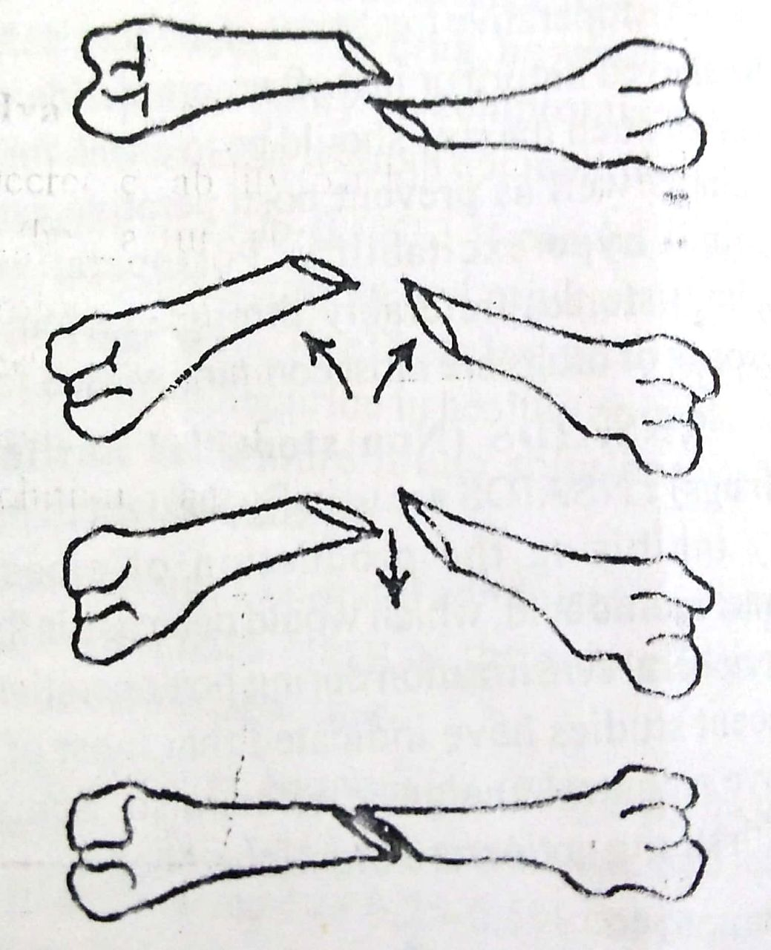
FRACTURE REDUCTION BY TOGGLING METHOD

Slide 10
DISADVANTAGES
Decreased ability to achieve anatomical realignment at the fracture site.
Prolonged anaesthesia if the first reduction is not perfect and the procedure must be repeated.
Development of fracture disease, if external fixation techniques

Slide 11
OPEN REDUCTION
Open reduction is achieved by exposing the fracture fragments through an incision
Open reduction is done primarily along with internal fixation, although at times external fixation is used.

Slide 12
INDICATIONS
Fractures with severe comminution
Severe overriding of fracture fragments.

Slide 13
TECHNIQUE
Under general anaesthesia, the fracture site is opened through a standard surgical approach.
Fracture fragments are exteriorized and reduction can be achieved, manually or with the help of bone clamps, by traction or toggling method.

Slide 14
.
ADVANTAGES :
Fracture fragments can be directly visualized
Manipulation is easy
Soft tissue interposition between the segments can be avoided.
DISADVANTAGES :
Additional tissue trauma due to surgical incision.
Chances of getting infection is also more.

