Slide 1
Internal immobilization of fracture

Slide 2
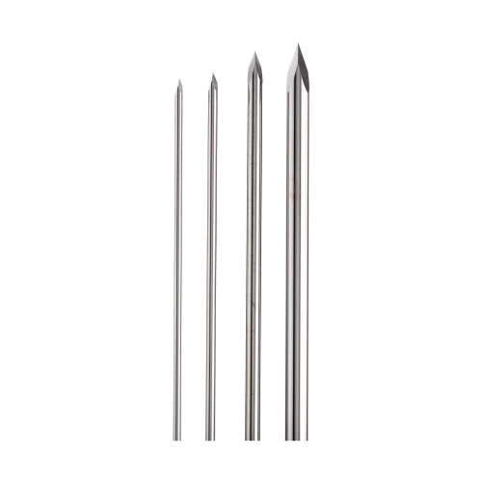
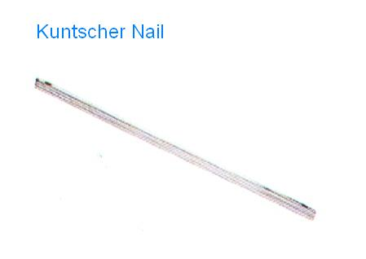
INTERNAL IMMOBILIZATION
Intramedullary pinning and nailing
Rush pins
Cross pinning
Wires
Screws
Transfixation
Hanging pin cast
Plate fixation
Steinmann pins

Slide 3
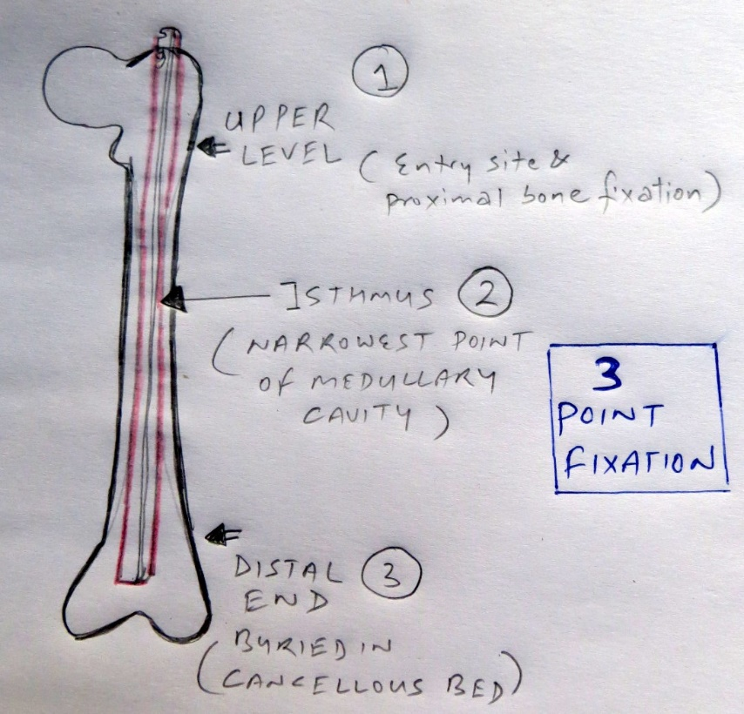
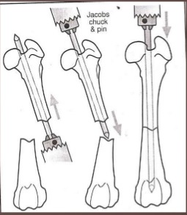
INTRAMEDULLARY PINNING AND NAILING
Sound and economical method of internal fixation
Steinmann pins, Kuntscher nail (K-nail) is used for repair of long bone fractures in large as well as in small animal
A pin should provide 3 point fixation

Slide 4
CONT.
Pin provides axial alignment and stability, but little rotational stability
A pin should cover approx. 60-70% of diameter of medullary cavity
Fracture of Radius, Tibia, Humerus and Femur can be repaired by this method
Success rate of this method in large animals depends upon the size and weight of animal
Two or more pins (stack pinning) can be used in adult animals especially in femur and humerus
Failure are related to mechanical factors such as
Pin migration
Bending
loosening

Slide 5
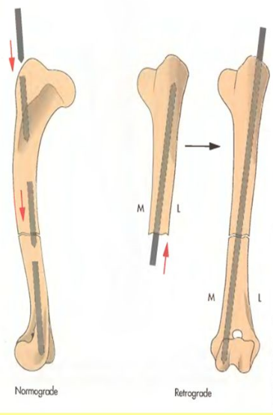
Cont.
Pin is inserted in the medullary cavity by using a simple hand driven chuck
Pin can be inserted via 2 routes :-
Retrograde : within the fracture site
Normograde : from one end of the bone
Normograde Retrograde

Slide 6
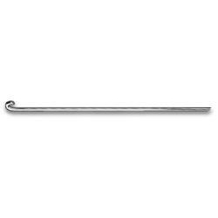
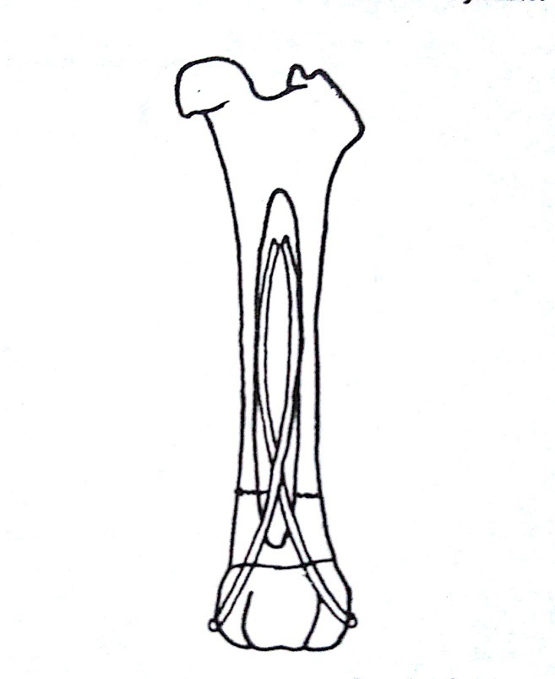
RUSH PIN
Used to treat fractures of the distal femur and supracondylar and diaphyseal fractures of tibia
A rush pin is tempered round intramedullary device
It has hooked end that is used to drive and seat the pin into the bone
Other end is tapered which bounces off the inner cortex as it is inserted into the medullary cavity of bone
Elastic bending nature of pins produces a spring like action to provide rigid fixation
Generally inserted from distal end of bone
Placement of rush pin

Slide 7
CROSS PINNING
Useful in compound subarticular fractures of long bones
Especially tibia, metacarpus and metatarsus
Can also be used to repair fracture of mandible

Slide 8
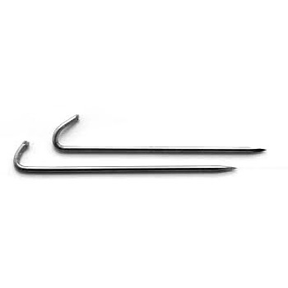
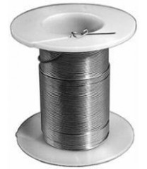
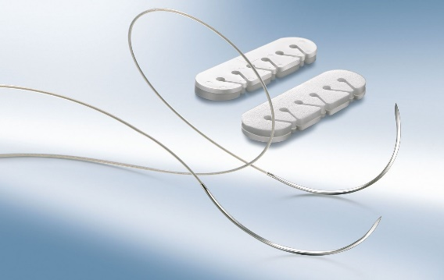
WIRES
In orthopaedic surgery different types of wire are used
The rigid kirschner wire,
The flexible orthopaedic wire
Suture wire.
kirschner wire
Orthopaedic wire
Suture wire

Slide 9
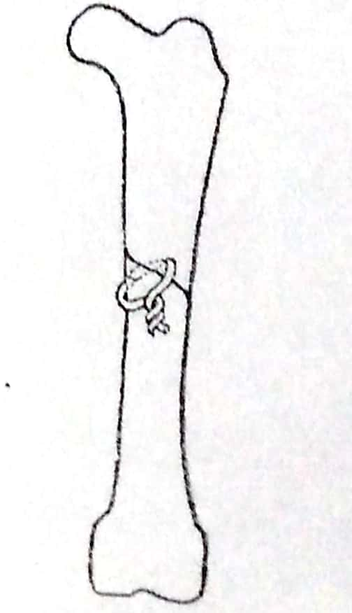
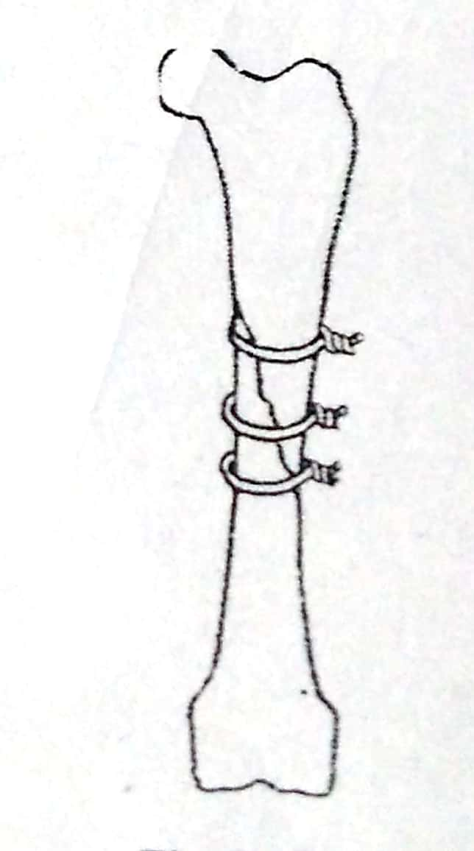
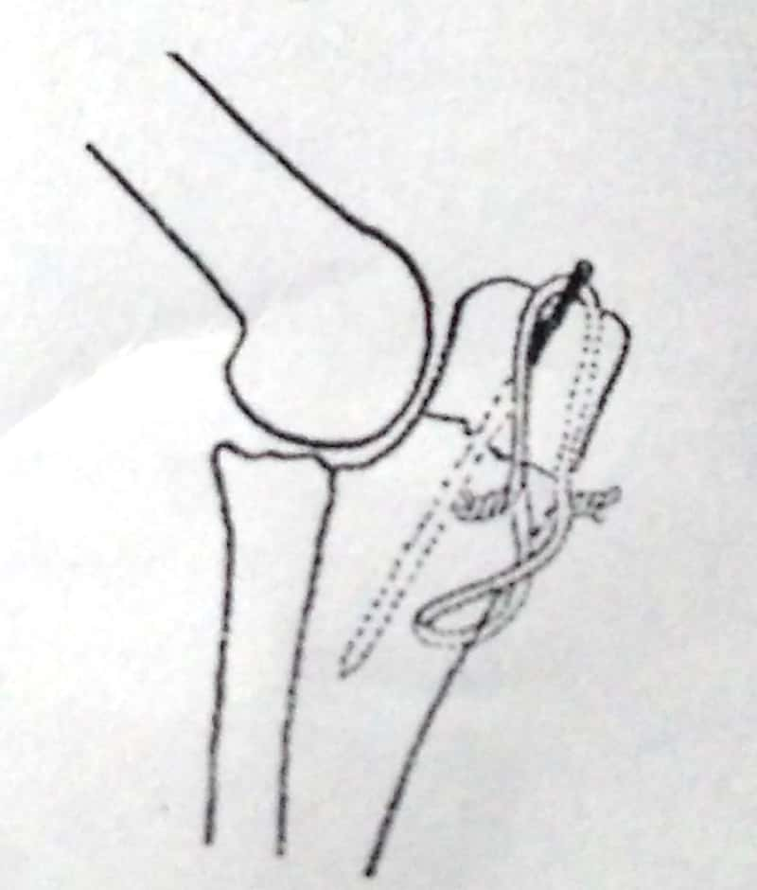
Orthopaedic wire
It is a monofilament soft and flexible wire.
Full circlage: The wire should be fixed perpendicular to the long axis of the bone and the knot must be twisted down snugly.
Hemicirclage: Hemiciriclage wiring is effective in reinforcing longitudinal cracks in the cortex & prevent rotation and overriding of oblique fracture fragments
Tension band wiring or figure of ‘8’ wiring : used in conjunction with Steinmann pins to achieve stable internal fixation by opposing the pull of muscular attachment on bone.
Kirschner wire: Kischner wires are used for temporary fixation of fragments, tension band osteosynthesis and intramedullary fixation in small bones.
Hemicirclage
Full circlage
Tension band wiring

Slide 10
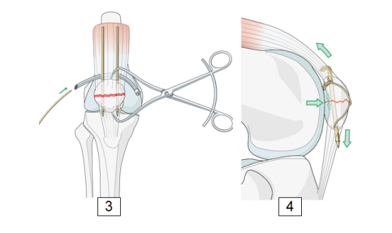

Slide 11
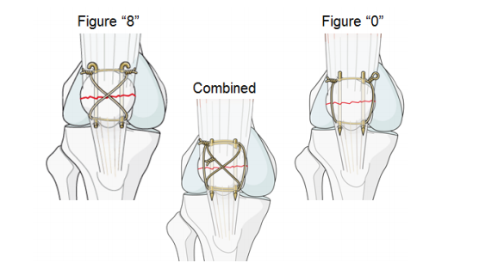
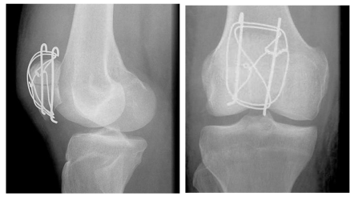

Slide 12
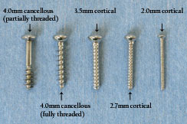
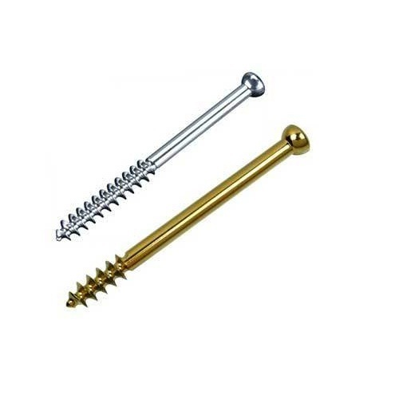
screws
Cortical
These screws are full threaded and used where cortical bone predominates
The inter-fragmentary compression is accomplished by drilling a long gliding hole (oversized hole) in the near cortex and a smaller threaded hole in the far cortex.
Cancellous
The screws are partially threaded used in cancellous bone e.g. fracture of the olecranon, slab, fractures of the metacarpus and metatarsus, condylar fractures and longitudinal fracture of the phalanx can be fixed with screw.
Oblique fracture of long bones can also be fixed by application of screw in combination with internal or external support.
Cortical Screws
Cancellous Screws

Slide 13
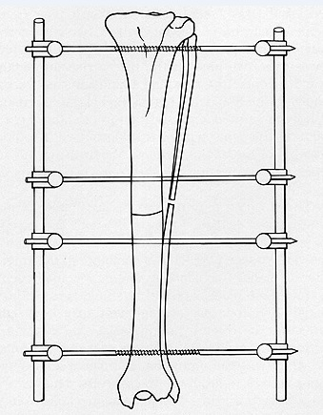
Transfixation
Most useful for treatment of diaphyseal fracture of the radius and tibia.
A minimum of two intramedullary pins in each fractured fragment are inserted transversely
The protruding ends of intramedullary pins are fixed in position by connecting external bars and protected with caps.
The pins are connected by one or more connecting bars.
The assembly should be removed only after complete union of fractured fragments
Transfixation pins

Slide 14
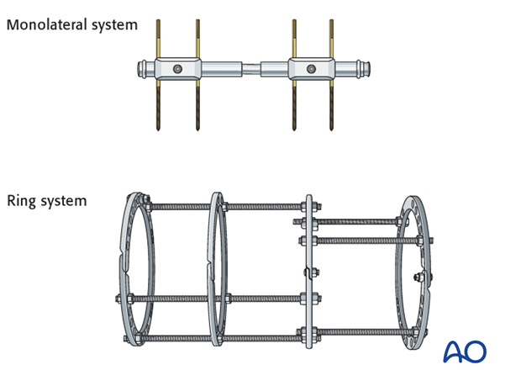
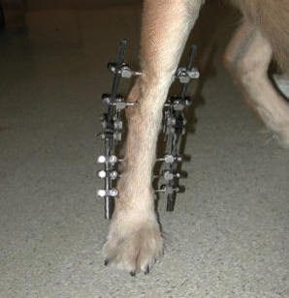
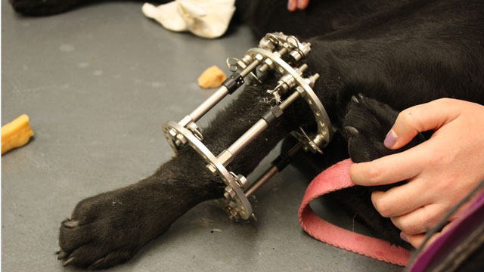

Slide 15
Complication:
Soft tissue infection,
Bone necrosis,
Periosteal reaction around the transverse pins.
Pathological fracture may occur at the point of insertion of transverse pins.

Slide 16
Hanging pin Cast
Only one pin is inserted tissue transversely through the proximal fragment .
This technique has the advantage of preventing rotation of the fractured bone & downward slipping of the plaster cast.

Slide 17
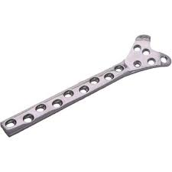
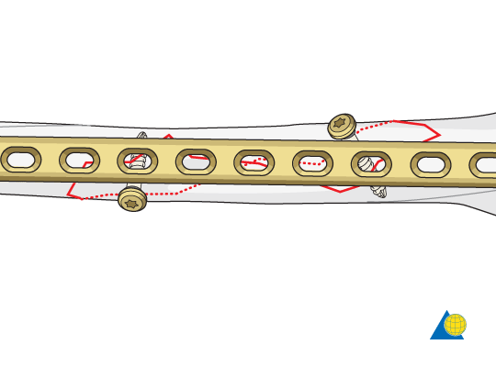
Plate fixation
Plate provide axial compression, counteract rotational forces,
can effectively immobilize oblique and comminuted fracture.
Plate classification: ( according to the function)
Compression plate: Static compression (a transverse or short oblique fracture can be best treated by compression plate
Neutralization Plate: Splinting and lag screw fixation (comminuted fracture are anatomically reconstructed).
Buttress Plate: Splinting or bridging a fracture area with buttress of the main fragments.
Buttress Plate
Neutralization Plate

Slide 18
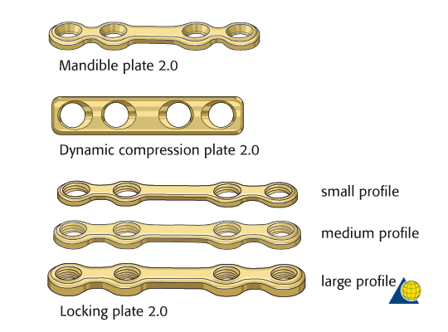
Dynamic compression plate (DCP)
DCP is used for compression and stabilization of a fracture.
Compression is achieved by tightening the screw inserted in a specially designed hole in the plate.
There are three sizes of DCP used in small animal surgery (2.7 mm, 3.5mm and 4.5 mm).
At least 3 cortical screw on each side of the fracture fragment should be used.

Slide 19
SCAPULAR FRACTURE
May occur through the body, spine, acromion, neck, supraglenoid tuberosity and glenoid cavity
Uncommon in dogs and cats bcoz large muscles surrounding scapula protect it from direct injury
Common concurrent injuries include :
Thoracic injuries
Pulmonary contusions
Rib fracture
Nerve injury

Slide 20
DIAGNOSIS
History
Physical examination :
Non weight bearing lameness,
Swelling over scapula,
crepitation on palpation
Diagnostic imaging : Radiographs of scapula should include
Lateral view
Caudocranial view

Slide 21
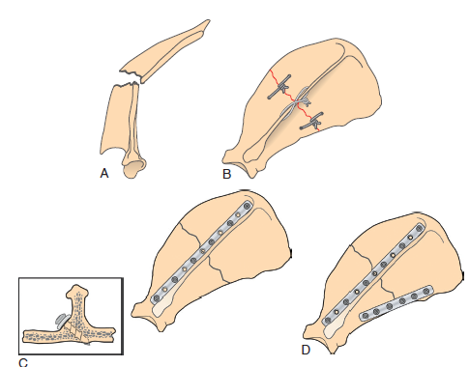
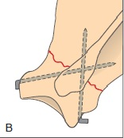
SURGICAL TREATMENT
Fixation systems applicable for scapular fracture includes
Plates and screws ,
Orthopaedic wires and
Kirschner wires
Use of Plating (B) and Orthopaedic wires (D) to repair transverse fracture
Use of crossed krischner wire

