Slide 1
GENERAL CHEMOTHERAPY General Consideration Part 1 …………………………………………………………………………………………………………………………………………………………………………………………………………………………………………… Chemotherapy (VPT-411) (Lecture-2)
Dr. Kumari Anjana
Asstt. Professor
Deptt. of Veterinary Pharmacology & Toxicology
Bihar Veterinary College, Bihar Animal Sciences University, Patna

Slide 2
Content of the chapter
Definition
Chemotherapy
Chemotherapeutic agents
Antibiotics
Antimicrobial Agents
Selective toxicity
Bacteriostatic activity
Bactericidal activity
Antibacterial spectrum
Potency of Chemotherapeutic agents
MIC
MIC90
MAC
PAE
Biphasic effect

Slide 3
Chemotherapy
It is treatment of systemic infection/ malignancy with specific drugs that have selective toxicity for the infecting organism/ malignant cell with no/ minimal effect on the host cells.

Slide 4
Chemotherapeutic agents
Chemotherapeutic agents are the drugs used in Chemotherapy to interfere with the functioning of foreign cells.
These include both antibiotics and synthetic antimicrobials.
It cover all antibacterial, antifungal, antiviral, antiprotozoal, anthelmintic and anti- neoplatic drugs.

Slide 5
Antibiotics
Antibiotics constitute a large portion of chemotherapeutic agent.
Antibiotics are substances produced by microorganism (fungi, Actinomycetes or bacteria), which selectively suppress the growth or kill other microorganism at very low concentration.

Slide 6
Antimicrobial Agents
Are term used to designate synthetic as well as naturally obtained drug that attenuate microorganism.

Slide 7
Selective toxicity
Selective toxicity is the ability of an antimicrobial agent to kill an invading microorganism without harming the cells of the host.

Slide 8
Bacteriostatic activity:
It is ability of an antibacterial agent to inhibit/suppress the growth and multiplication of bacteria.
Bactericidal activity:
It is ability of an antibacterial agent to cause the death of bacteria.

Slide 9
Antibacterial spectrum
Antibacterial spectrum refers to the range of pathogenic organisms against which an anti-microbial agent is active.
Broad spectrum anti-microbials: Effective against wide variety (Gram positive & Gram negative) of organism.
Narrow Spectrum anti-microbials: Active against a few or a limited group of bacteria.
Extended Spectrum anti-microbials: Is the term applied to anti-microbials that are effective against Gram positive bacteria and also against a significant number of Gram negative bacteria.

Slide 10
Potency
Potency may be defined as the antimicrobial activity per milligram of a chemotherapeutic agent.
Potency is usually expressed on the basis of MIC, MBC or MAC.

Slide 11
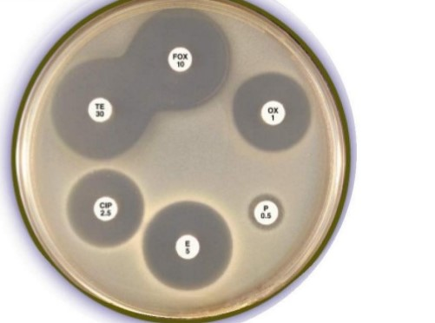
Minimum inhibitory concentration: MIC
Minimum inhibitory concentration is lowest concentration of an anti-microbial drug that prevents visible growth of bacteria.
Fig: Plate showing inhibition zone formation
Source : Google image

Slide 12
MIC90
It is the MIC necessary to inhibit 90 percent of the organisms tested.

Slide 13
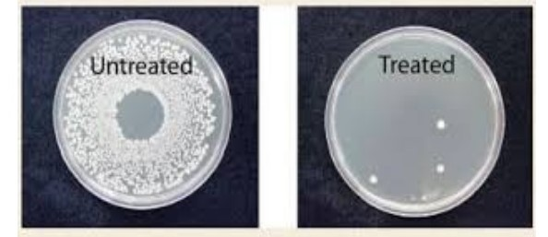
MBC
MBC: It is the lowest concentration of an anti-microbial drug that kills the 99.99 percent of bacteria.
Fig: Plate showing % inhibition of bacteria,
Source : Google image

Slide 14
Minimum antibiotic concentration MAC
Minimum antibiotic concentration :It is the concentration of an anti-microbial drug that reduces the growth of an organism in-vitro by a factor of 10.
MAC may be 1/4 or 1/10 of the MIC depending upon drug and the organism.

Slide 15
Post antibiotic effect (PAE)
After brief exposure with antibiotic, the organism is placed in an antibiotic free medium, it starts multiplying again after a lag period.
This lag period in growth resumption is known as ‘post antibiotic effect’ e.g. A long post antibiotic effect is noted with fluoroquinolones, aminoglycosides, β-lactam antibiotics.
Synergistic prolongation of post antibiotic effect has been demonstrated by combination of β-lactam with aminoglycosides.

Slide 16
Biphasic effect
It is a phenomena in which low doses of an antibacterial in vitro against certain bacteria (e.g. Staphylococci and streptococci) produce lysis of organism whereas high doses do not.
The Biphasic effect is associated with
Beta-lactam antibiotic, it is due to differential sensitivity of the penicillin binding proteins to high doses of Beta- lactams that inhibit the autolysins.

Slide 17
Concentration dependent inhibition
Inhibitory effect depends on the ratio of peak concentration to the MIC, the same daily dose produces better action when given as single dose than if it is divided into 2-3 portion.
e.g. aminoglycoside (rupture of cell membrane requires high concentration which leads to leakage of smaller ions).

Slide 18
Time dependent inhibition
Antimicrobial action depends upon the length of time the concentration remains above MIC, division of daily dose has better effect.
The dose should be shaped that the surviving organism starts multiplying and cidal action is exerted e.g. fluoroquinolones, cephalosporins.

Slide 19
Thank You

