Slide 1
GENERAL CHEMOTHERAPY General Consideration Part V …………………………………………………………………………………………………………………………………………………………………………………………………………………………………………… Chemotherapy (VPT-411) (Lecture-6)
Dr. Kumari Anjana
Asstt. Professor
Deptt. of Veterinary Pharmacology & Toxicology
Bihar Veterinary College, Bihar Animal Sciences University, Patna

Slide 2
Content of the chapter
Toxicity- Local irritancy & Systemic toxicity
Hypersensitivity reaction
Drug resistance
Superinfection
Nutritional Deficiencies
Masking of an infection

Slide 3
Local irritancy
Exerted at the site of administration.
Gastric irritation, pain and abscess formation at the site of i.m. injection, thrombophlebitis of the injected vein are the complications.
Practically all AMAs, especially erythromycin, tetracyclines, certain cephalosporins and chloramphenicol are irritants.

Slide 4
Systemic toxicity
High therapeutic index—doses up to 100-fold range may be given without apparent damage to host cells. These include penicillins, some cephalosporin's and erythromycin.
Lower therapeutic index—doses have to be individualized and toxicity watched for, e.g.:
Aminoglycosides : 8th cranial nerve and kidney toxicity.
Tetracyclines : liver and kidney damage, antianabolic effect.
Chloramphenicol : bone marrow depression.
Very low therapeutic index—use is highly restricted to conditions where no suitable alternative is available, e.g. : Polymyxin B : neurological and renal toxicity.
Vancomycin : hearing loss, kidney damage.
Amphotericin B : kidney, bone marrow and neurological

Slide 5
Hypersensitivity reactions
Practically all AMAs are capable of causing
hypersensitivity reactions.
These are unpredictable and unrelated to dose.
The whole range of reactions from rashes to anaphylactic shock can be produced.
The more commonly involved AMAs are—penicillins, cephalosporins, sulfonamides, fluoroquinolones.

Slide 6
Drug resistance
It refers to unresponsiveness of a microorganism to an AMA, and is akin to the phenomenon of tolerance seen in higher organisms.
Two type
Natural resistance
Acquired resistance

Slide 7
Natural resistance
Some microbes have always been resistant to certain AMAs.
They lack the metabolic process or the target site which is affected by the particular drug.
This is generally a group or species characteristic.
e.g. gram-negative bacilli are normallyunaffected by penicillin G,
M. tuberculosis is insensitive to tetracyclines.
No significant clinical problem.

Slide 8
Acquired resistance
It is the development of resistance by an organism (which was sensitive before) due to the use of an AMA over a period of time.
This can happen with any microbe and is a major clinical problem.
However, development of resistance is dependent on the microorganism as well as the drug.
Some bacteria are notorious for rapid acquisition of resistance, e.g. staphylococci, coliforms, tubercle bacilli.
Others like Strep. pyogenes and spirochetes have not developed significant resistance to penicillin.

Slide 9
Development of resistance
Resistance may be developed by
mutation
or
gene transfer

Slide 10
Mutation
Mutation is a stable and heritable genetic
change that occurs spontaneously and randomly
among microorganisms.
It is not induced by the AMA.
Any sensitive population of a microbe contains a few mutant cells which require higher concentration of the AMA for inhibition.
e.g. when a single anti-tubercular drug is used.

Slide 11
Mutation and resistance may be:
Single step: A single gene mutation may confer high
degree of resistance; emerges rapidly,
e.g. enterococci to streptomycin,
E. coli and Staphylococci to rifampin.
Multistep: A number of gene modifications are involved; sensitivity decreases gradually in a stepwise manner.
eg. Resistance to erythromycin, tetracycline and chloramphenicol is developed by many organisms.

Slide 12
Gene transfer
Gene transfer (infectious resistance) from one organism to another can occur by:
Conjugation
Transduction
Transformation

Slide 13
Conjugation
Sexual contact through the formation of a bridge or sex pilus is common among gram-negative bacilli of the same or another species.
This may involve chromosomal
or extrachromosomal (plasmid) DNA.
The gene carrying the ‘resistance’ or ‘R’ factor is transferred only if another ‘resistance transfer factor’ (RTF) is also present.

Slide 14
Contd…
It frequently occurs in the colon where a large variety of gram-negative bacilli come in close contact.
Even nonpathogenic organisms may transfer R factor to pathogenic organisms, which may become widespread by contamination of food or water.

Slide 15
Chloramphenicol resistance of typhoid bacilli,
streptomycin resistance of E. coli,
penicillin resistance of Haemophilus and gonococci.
Multidrug resistance has occurred by conjugation.
It is a very important mechanism of horizontal transmission of resistance.

Slide 16
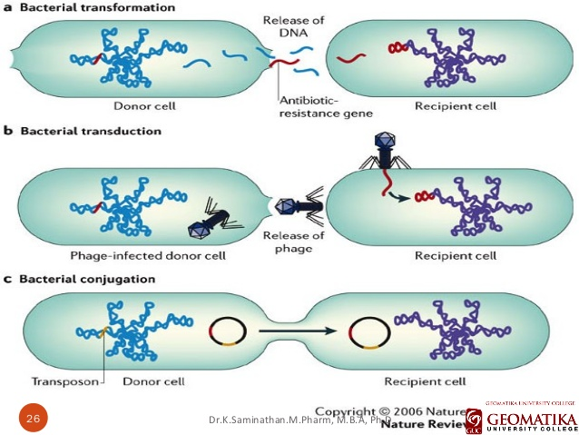
Fig: Transformation, Transduction and Conjugation
Source : Google image

Slide 17
Transduction
It is the transfer of gene carrying resistance through the agency of a bacteriophage.
The R factor is taken up by the phage and delivered to another bacterium which it infects.
Many Staph. aureus strains have acquired resistance by transduction.
Certain instances of penicillin, erythromycin and chloramphenicol resistance have been found to be phage mediated.

Slide 18
Transformation
A resistant bacterium may release the resistance carrying DNA into the medium and this may be imbibed by another sensitive organism—becoming unresponsive to the drug.
This mechanism is probably not clinically significant except isolated instances of pneumococcal resistance to penicillin G due to altered penicillin binding protein, and some other cases.

Slide 19
Resistant organisms
Resistant organisms can broadly be of the
following three types:
Drug tolerant
Drug destroying
Drug impermeable

Slide 20
Drug tolerant
Loss of affinity of target biomolecule of the microorganism for a particular AMA.
e.g., certain penicillin resistant pneumococcal strains have altered penicillin binding proteins.

Slide 21
Drug destroying
Resistant microorganism elaborate an enzyme which inactivate the drug.
Beta lactamase for β lactam antibiotics,
Acetyl transferase which inactivate chloramphenicol,
Kinases inactivates Aminoglycosides.

Slide 22
Drug impermeable
Many hydrophilic antibiotics gain access into the bacterial cell through specific channel formed by protein called porins or need specific transport mechanism.
These may be lost by the resistant strain.
Bacteria may acquire plasmid directed efflux protein in their cell membrane.

Slide 23
Cross resistance
Acquisition of resistance to one AMA conferring resistance to another AMA, to which the organism has not been exposed, is called cross resistance.
This is more commonly seen between chemically or mechanistically related drugs.
e.g. resistance to one sulfonamide means resistance to all others,
and resistance to one tetracycline means insensitivity to all others.

Slide 24
Complete cross resistance or Two way cross resistance
Neomycin Kanamycin
Partial cross resistance or One way cross resistance
Gentamicin Kanamycin Streptomycin

Slide 25
Prevention of drug resistance
No indiscriminate and inadequate or unduly prolonged use of AMAs should be made.
Prefer rapid acting and selective (narrow spectrum) AMA whenever possible.
Use combination of AMAs whenever prolonged therapy is undertaken, e.g. tuberculosis, SABE.
Infection by organism notorious for developing resistance, e.g. Staph aureus, E. coli, M. tuberculosis, Proteus etc must be treated extensively.

Slide 26
Superinfection (Superinfection)
This refers to the appearance of a new infection as a result of antimicrobial therapy.
Use of most AMAs causes some alteration in the normal microbial flora of the body.
The normal flora contributes to host defense by elaborating substances called bacteriocins which inhibit pathogenic organisms.

Slide 27
Nutritional deficiencies
Some of the B complex group of vitamins and vit. K synthesized by the intestinal flora is utilized by man.
Prolonged use of antimicrobials which alter
this flora may result in vitamin deficiencies.
Neomycin causes morphological abnormalities
in the intestinal mucosa—steatorrhoea and
malabsorption syndrome can occur.

Slide 28
Masking of an infection
A short course of an AMA may be sufficient to treat one infection but only briefly suppress another one contacted concurrently.
The other infection will be masked initially, only to manifest later in a severe form.
Eg: Tuberculosis masked by a short course of streptomycin given for trivial respiratory infection.

Slide 29
Thank You

