Slide 1
Milk By-Products (Part-2)
By-
Dr. SUSHMA KUMARI
ASST.PROF., DEPT. OF LPT, BVC, PATNA

Slide 2
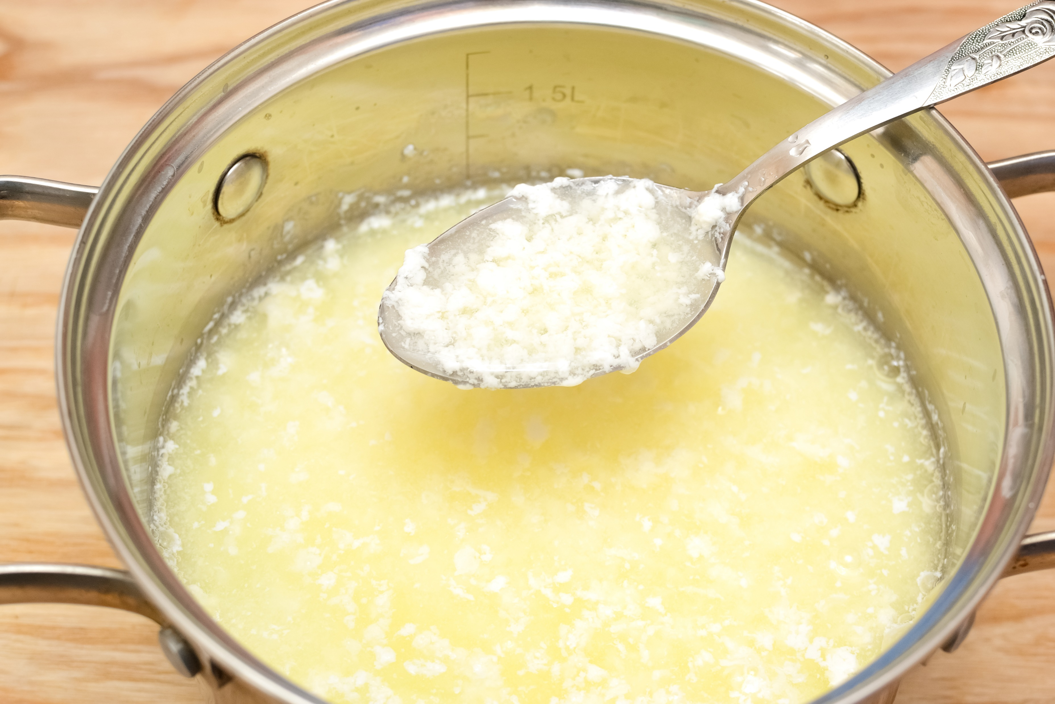
Whey

Slide 3
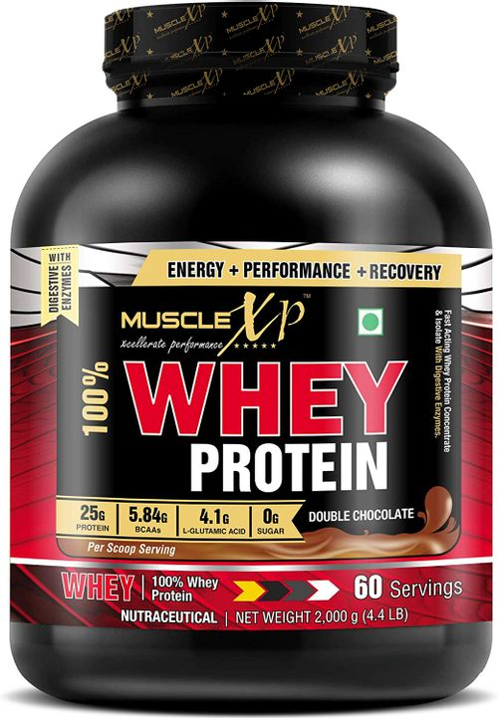
Whey

Slide 4
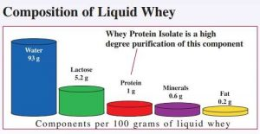
Composition of whey

Slide 5
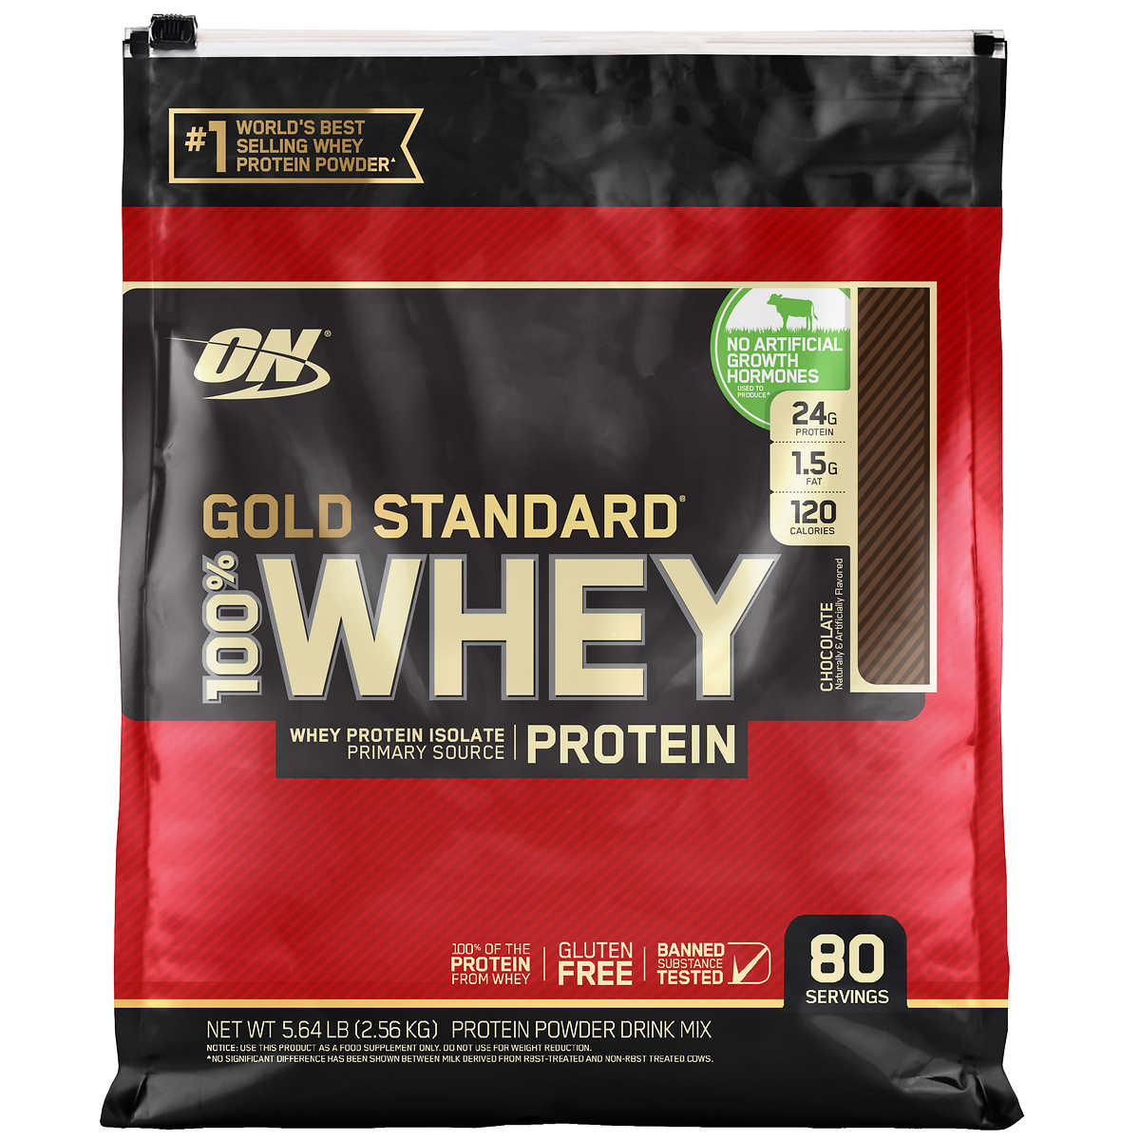
Utilization of Whey

Slide 6
Whey Powder

Slide 7
Ghee Residue

Slide 8
Ghee Residue

Slide 9
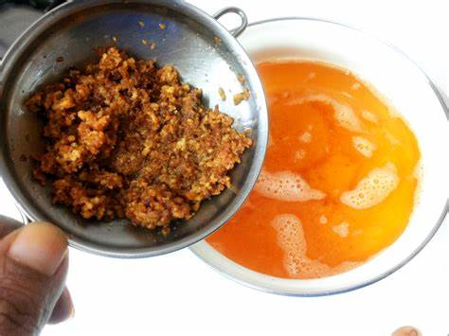
Ghee Residue

Slide 10
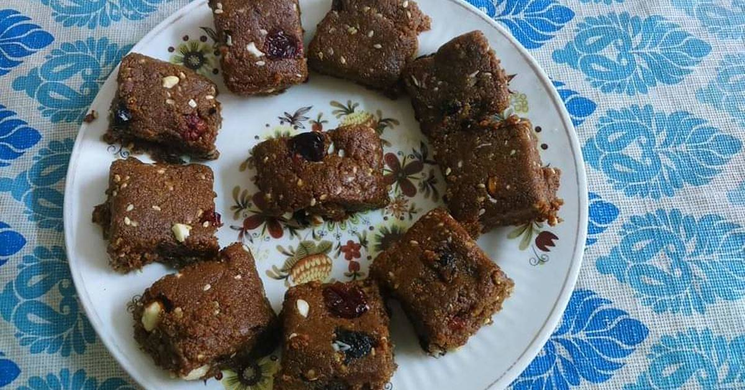
Uses of Ghee Residue

Slide 11
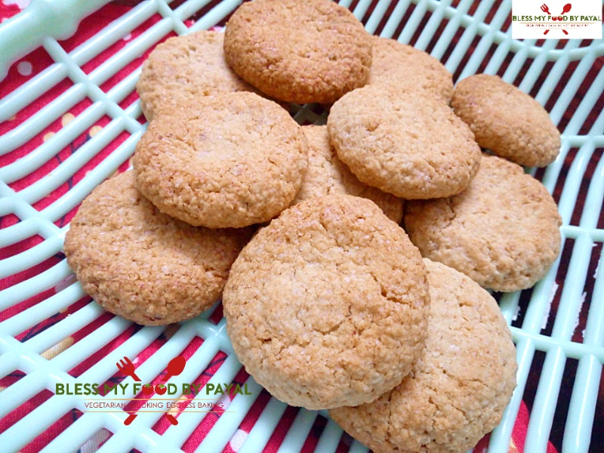
Ghee residue paratha and cookies

