Slide 1
MILK PRODUCTS (PART -9)
BY-
DR. SUSHMA KUMARI
ASST.PROF., DEPT. OF LPT, BVC, PATNA

Slide 2
Khoa
Prepared by partial dehydration of milk .
Milk fat > 20%
Total solid = 70-75%
Buffalo milk is preferred over cow milk because it gives higher yield with good quality khoa with soft and smooth body, granular texture.
Yield of khoa- ( 28 % moisture)
-Cow milk- 17-19 %
Boffalo milk- 21-23 %

Slide 3
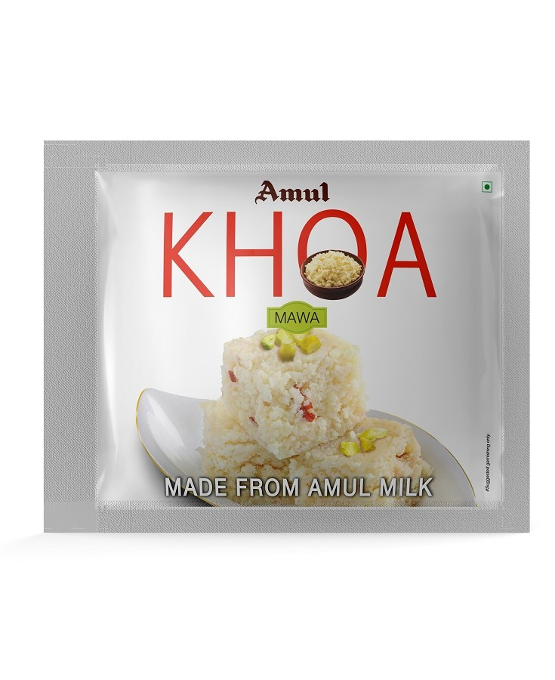
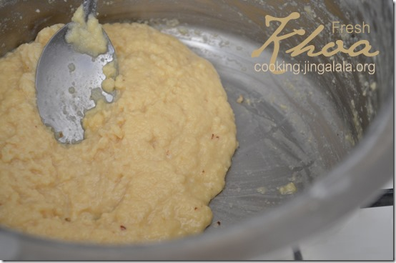
KHOA

Slide 4
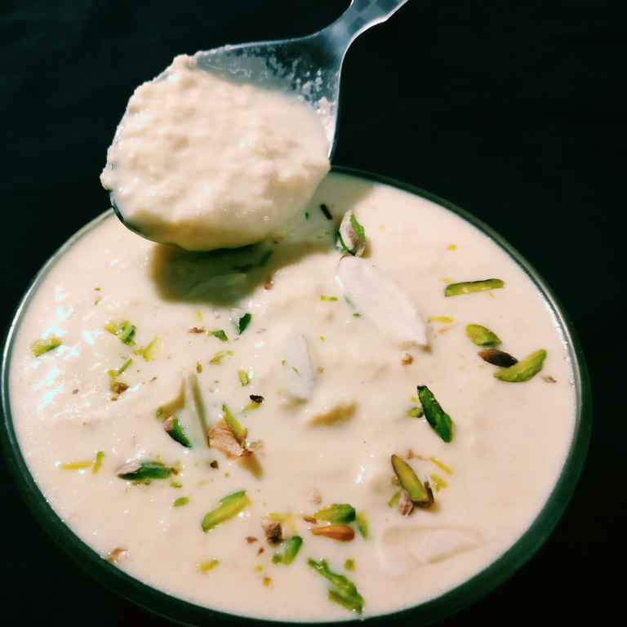
Khurchan

Slide 5
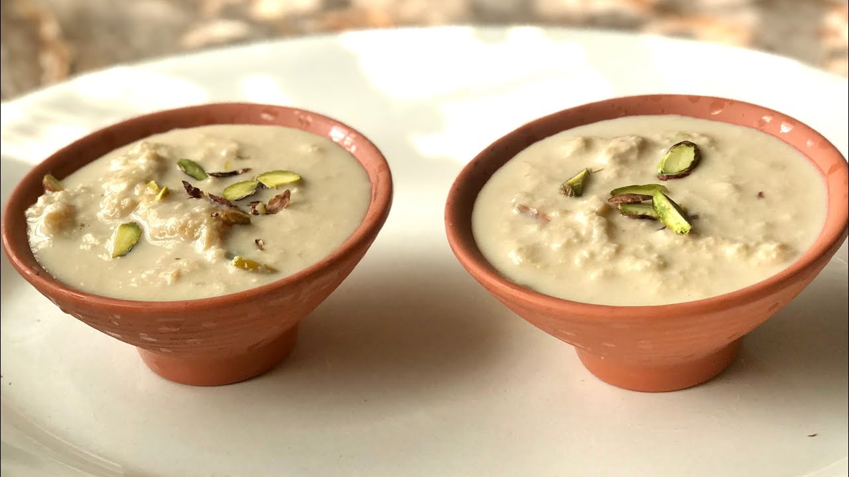
RABRI

Slide 6
Milk powder
Dried milk product.
Prepared by following methods-
1. Roller/ Drum dried method-
Milk is applied upon smooth surface of a continuously rotating steam heated metal drum or roller . The film of dried mil is continuously scraped off by a knife or scraper located opposite to th point of application of milk. The milk film is ground to obtain milk powder.
it is cheaper and has less solubility. Nearly 87 %.

Slide 7
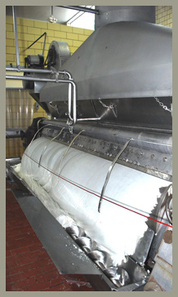
ROLLER DRIED WHOLE MILK POWDER

Slide 8
2. Spray dried method-
The basic principle of spray drying consist in atomizing the milk. Concentrated milk is sprayed into a large suitably designed drying chamber, where they mix with a current of hot air . The milk particles surrender their moisture instantaneously and dry to a fine powder, which is removed continuously.
costlier but solutibility more. Nearly 98%.

Slide 9
SPRAY DRYING OF WHOLE MILK POWDER

Slide 10
THANKS

