Slide 1
PELVIMETRY
Pelvimetry is the assessment of the dimensions & capacity of adult female pelvis in relation to the birth of a baby.
Pelvimetry was heavily used in leading the decision of natural, operative vaginal delivery or CS.

Slide 2
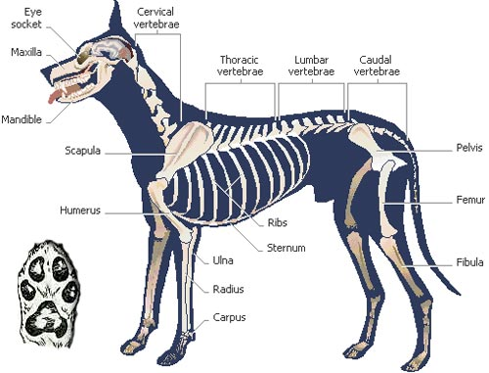
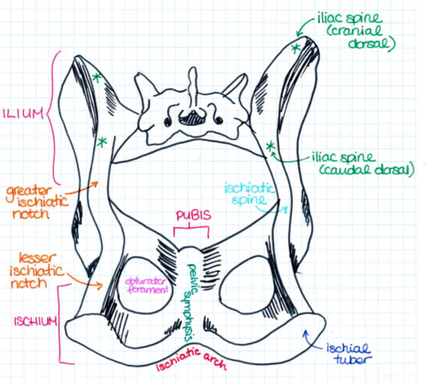
Pelvic anatomy

Slide 3
Types of Pelvimetry
External/indirect pelvimetry
Measures diameters of false pelvis
Little value, unreliable, no longer used
Internal/ direct pelvimetry
Radiographic pelvimetry

Slide 4
Calculation of external pelvimetry
Distance between two external angle of ilia = A
Distance between two ischial tuberocities = B
Height from hip joint to highest point of croup = C
Pelvic outlet diameter
Transverse diameter (x) = ¼ (A+B)
Superior/inferior diameter = ¾ C
Pelvic inlet diameters
Transverse diameter = 1.22X
Sacro-pubic diameter = 1.3Y

Slide 5
Internal/direct pelvimetry
Measurement of interior of pelvis through the rectum with a pelvimeter

Slide 6
Calculation - Internal/direct pelvimetry
Sacro-pubic/conjugate diameter = sacral promontory to cranial end of pubic symphysis
Superio-transverse diameter = diameter at the upper third of pelvic cavity
Inferio-transverse diameter = diameter between two psoas tubercle
Oblique sacro-iliac diameter = from sacro-iliac joint throgh the center of pelvic cavity to the psoas tubercle of opposite side
Ventral diameter = from cranial of pubic symphysis to the junction of 3rd and 4th sacral vertebrae.

Slide 7
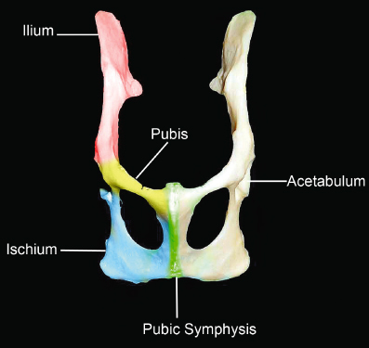
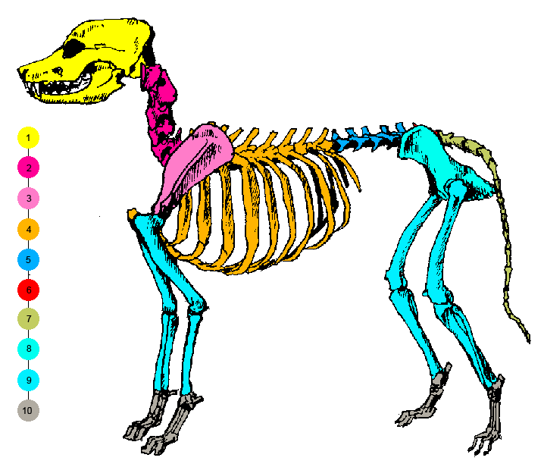
Maternal Pelvis

Slide 8
The Journey through the Passage..!!!
What is PASSAGE (pelvis) composed of..???
Inlet
Cavity
Outlet
Boundaries
Shape
Plane
Axis
Diameters

Slide 9
True Pelvis
Inlet
Cavity
Outlet
Obstetrical
Anatomical

Slide 10
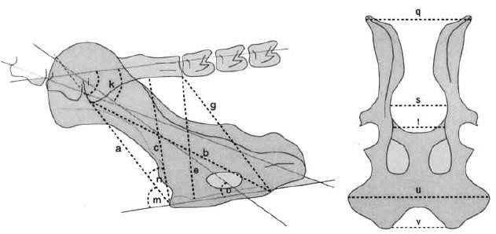
(a) conjugate vera, (b) conjugate diagonalis, (c) diameter verticalis, (e) sacral diameter, (g) sagittal diameter, (s) diameter transversa, (t) the inner distanischiadica, (v) the distance between the two medial tubera ischiadica

Slide 11
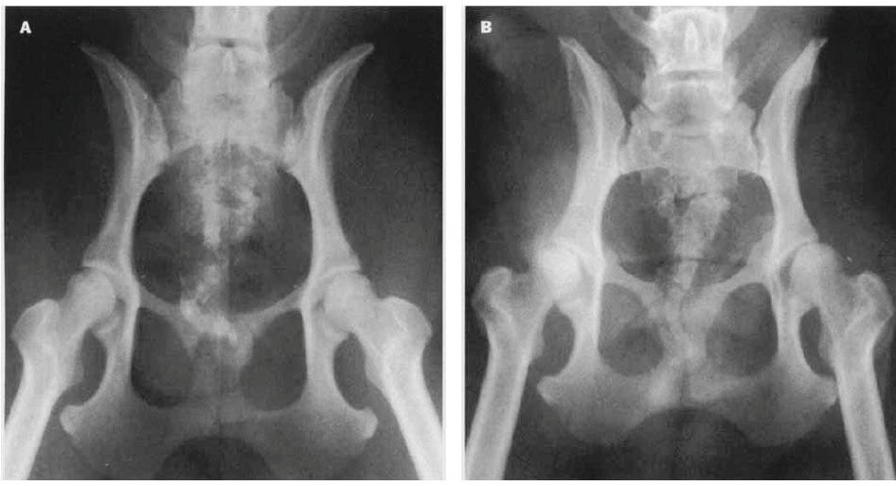
(A) normally shape (rounding),
(B) the dorsoventrally flattened pelvic inlet in the bitch with dystocia

Slide 12
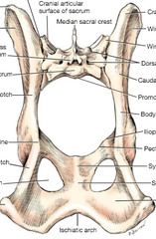
Pelvic inlet
Limited laterally and
ventrally by the arcuate
line of the ilium.
Dorsal boundary is the
promontory of the
sacrum.

Slide 13
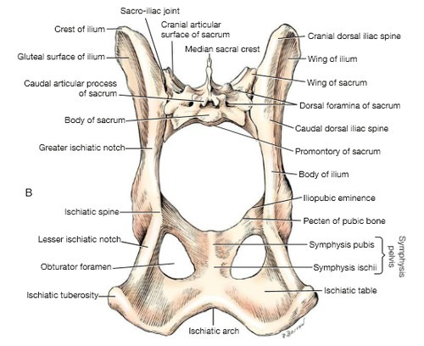
Pelvic outlet
Bounded ventrally by the
ischiatic arch
Mid-dorsally by the first caudal vertebra
Laterally
1. The superficial gluteal muscles
2. Muscles of the pelvic diaphragm
3. The sacrotuberous ligament. (More expandable.)

Slide 14
Diameters of Pelvis..!!!!

Slide 15
The vertical diameter is the vertical line from the cranial end of the pelvic symphysis to the vertebral column

Slide 16
The conjugate diameter extends from the cranial end of the pelvic symphysis to the promontory of the sacrum

Slide 17
Transverse diameters
Dorsal transverse diameter between the two ends of the sacral wings
Middle transverse diameter between the right and left psoas minor tubercles
Ventral transverse diameter between the two iliopubic eminences

