Slide 1
Semen evaluation
Provides information on the complex of sexual function
The semen is the normal discharge of the male at time of mating.
It is a suspension of spermatozoa in a fluid medium called seminal plasma.
Spermatozoa originates from the testes, primary sex glands and stored in the epididymis, constitute 10% of the total volume
Seminal plasma is a mixture of secretions from seminal vesicles, cowper’s gland, prostate gland, ampullae and epididymis.
Secretions of seminal vesicles form nearly 55% of the total volume of the bull semen
It takes about 60 days before spermatozoa appear in the ejaculated semen.

Slide 3
Care during semen handling
Hygiene of AV - clean and free from contaminants excessive petroleum jelly powder present on new liners and antiseptics and chemicals of any kind.
At the time of collection excessive dirt and debris should be kept
Immediately after collection the semen vial should be placed in a water bath at 37°C.
Overheating and rapid chilling of semen should be avoided as it affects the semen quality.
Too much agitation and shaking of semen should be avoided.
Exposure of semen to sunlight should be avoided ??????

Slide 4
Battery of tests
Macroscopic examination
Microscopic examination
Biochemical tests
Resistance to environment
Physical evaluation
Chemical Evaluation
Biological Test

Slide 5
Macroscopic examination
Volume
Remains fairly constant for each species.
Varies among individuals and between ejaculates within the same individual.
Volume increases
Increase in age and body size of animal
General reproductive health
Vigour and frequency of service.
Teasing and stewing of bulls are practiced to increase the volume of semen.
Semen volume increases up to 6-8 years of age.

Slide 6
Macroscopic examination
Decreased in semen volume
Young or old males
Reproductive / general illness
Males used excessively
Incomplete ejaculation or failure of ejaculation
Bilateral seminal vesiculitis

Slide 7
Macroscopic examination
Volume of semen in difference species
Species | Volume of Semen
 | Average (ml) | Range (ml)
Bull | 4 | 1-15
Stallion | 70 | 30-250
Ram and Buck | 1 | 0.7-3
Boar | 250 | 1.25-400
Dog | 10 | 1.25
Cat | 0.04 | 0.01-0.12
Fowl | 0.75 | 0.25-2.0
Elephants | - | 50-100

Slide 8
Macroscopic examination
2. Colour
Bull and buck semen - Milky white, creamy or opaque.
Buffalo semen is whitish when compared to bull semen.
In stallion, boar and dog - Pearly white to grey and translucent.
Yellow colour of semen is normal in some bulls (spl. indegenous)
Due to riboflavin content,secreted from ampulla or seminal vesicles
The highly concentrated semen will be creamy in colour and if there is only very few or no sperms then the colour will be watery.

Slide 9
Macroscopic examination
2. Abnormal Colour
S.no | Abnormal Colour | Etiology
1 | Brownish | Orchitis (Blood pigments)
2 | Dark red to pink blood | Hemorrhage in male reproductive tract
3 | Yellow green | Pseudomonas aerogenosa infection - pus This colour appears on keeping semen some time after collection
4 | Light brown | Contamination with dung
5 | Dull and dirty white | Increased number of spermatogenic cells
6 | Yellow | Presence of urine
7 | Chunk clots/Curdy appearance | Infection (Vesiculitis/Brucellosis)

Slide 10
Macroscopic examination
3. VISCOSITY AND DENSITY
Viscosity is assessed by using semen delivery pipettes. Viscosity increases with sperm concentration
The specific gravity of bull semen is 1.0361 There is a positive correlation between specific gravity and sperm cell concentration.
Colour Density | Grade
Creamy | DDDD
Milky | DDD
Thin milky | DD
Translucent & cloudy | D
Watery | O

Slide 11
Macroscopic examination
Certain pathological conditions of testis and accessory sex glands may affect the consistency of semen
Pathological condition | Consistency of semen
Epididymitis | Less milky semen
Catarrhal conditions of accessory sex glands | Thick viscous semen
Seminal vesiculitis | Purulent flocculi

Slide 12
MICROSCOPIC SEMEN EVALUATION
Mass Motility
The collective movement of sperms or their wave motion is called as mass activity
It is estimated by keeping a semen drop on a warm glass slide and examining under low power microscope with out putting coverslip.
Mass activity may be classified into five grade scale depending upon the wave motion and rate of sperm activity.
5 and 4th grade samples are acceptable. Others should be discarded.

Slide 13
MICROSCOPIC SEMEN EVALUATION
Mass motility
S.No. | Findings | Description | Grade
1 | Very vigorous forward motion, extremely rapid waves and eddies, about 90-100 % active sperms. | Excellent | 5
2 | Vigorous, progressive movement with rapid and abruptly forming waves and eddies, about 70-80% sperms are motile. | Good | 4
3 | Progressive rapid movement of sperm, slow moving waves and eddies, 50-60% sperms are motile. | Fair | 3
4 | Oscillatory or rotary movement, no waves and eddies, 30-40% progressively motile sperms. | Poor | 2
5 | Stationary bunting or weak rotary movements, 10-20% scattered progressive sperms. | Very poor | 1
6 | Immotile sperms. | All dead | 0

Slide 14
MICROSCOPIC SEMEN EVALUATION
2. INDIVIDUAL MOTILITY
Motility is the most common and extensively used tool for estimating the semen quality.
The movement of individual sperm - the individual motility.
To assess the individual motility diluted semen (diluted with physiological saline or 3% sodium citrate or Tris buffer or Tris-egg yolk extender) is kept on a warm slide and covered with cover slip.
The slide is kept on the stage warmer of the phase contrast microscope and examined under high power.
Progressive movement - sperms with very rapid straight forward direction

Slide 15
MICROSCOPIC SEMEN EVALUATION
INDIVIDUAL MOTILITY
Circular movement - sperms with movement in circular path – Cold shock
Reverse movement - sperms moving in reverse manner
Oscillatory movement - sperms with jerky movement – Energy difficiancy
The progressively motile sperms are only taken into account, while estimating the initial motility.
The progressive sperms will cover a distance of 100-120 µ in a second.

Slide 16
MICROSCOPIC SEMEN EVALUATION
Based on progressive motility, the semen samples are graded as follows.
S.No. | Progressive motility | Grade
1 | 90-100% | Excellent
2 | 70-80% | Good
3 | 50-60% | Fair
4 | 30-40% | Poor
5 | 0-20% | Very poor
A good semen sample should have an initial motility of 70%.

Slide 17
ESTIMATION OF SPERM CONCENTRATION
Haemocytometer method
Visual examination
Cell volume method
Colorimeter
Photometer
Opacity tubes
Computer assisted semen analyzer (CASA)

Slide 18
ESTIMATION OF SPERM CONCENTRATION
Haemocytometer
It is a very old method used to assess the sperm concentration but is most accurate method.
The procedure is as same as RBC estimation.
Advantages
Accurate method
It is used when few bulls requires estimation
Disadvantages
Requires skill
The procedure is time consuming.
So it cannot be used in places where large samples are processed.

Slide 19
CONCENTRATION ESTIMATION BY HAEMOCYTOMETER
Materials required
Semen sample (fresh/frozen)
Haemocytometer set
Phase contrast microscope
Watch glass
Dilution fluid (0.1% formal saline or distilled water )
Eosin powder
Blotting paper

Slide 20
Concentration estimation by haemocytometer
Procedure
Mix the semen sample gently to get uniform distribution of sperms.
Place the semen in a sterile watch glass.
Put a speck of eosin powder and mix it with semen.
Aspirate the semen from watch glass into a RBC pipette upto 0.5 mark.
Clean the tip of the pipette with blotting paper.
Draw the dilution fluid in the same RBC pipette upto 101 mark.
Roll the pipette between palm of the hands for 2 minutes to ensure through mixing of the fluid and semen.
Discard first few drops.

Slide 21
Concentration estimation by haemocytometer
Procedure
Charge the haemocytometer by releasing the fluid below the coverslip which is placed over the haemocytometer.
While charging overflowing and air bubble formation should be avoided.
Wait for 1-2 minutes for the sperms to settle.
Examine the charged haemocytometer for under low power and then in high power.
The sperm counting is done in RBC chamber.
Count the number of sperms in left top, right top, right bottom, left bottom and center squares of RBC chamber and calculate the concentration.

Slide 22
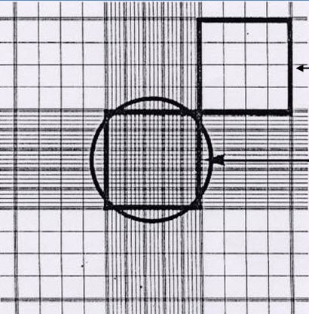
WBC Counting chambers
RBC Counting chambers

Slide 23
Concentration estimation by haemocytometer
Counting 5 chambers
Number of sperms in 1 ml of semen | = N x 10000 x 1000 = N x 10⁷ millions

Slide 24
Estimation of sperm concentration
Cell volume method
The semen is centrifuged immediately after collection.
The sperms will deposit at bottom and the seminal plasma will come to top.
The packed volume of sperms is measured and based on this the concentration is estimated.
This is not an accurate method because the materials other than the sperms will interfere with the result.

Slide 25
Estimation of sperm concentration
Calorimeter
Here the optical density of the semen sample is measured and from which the concentration of the sample is arrived.
The colorimeters are designed to measure the percentage of light transmitted through a light absorbing media can be used.
The percentage of transmission is a function of the concentration of the light absorbing agents in the medium.
This principle is applied to estimate the sperm concentration in a semen sample.

Slide 26
Estimation of sperm concentration
Calorimeter
The percentage of transmission recorded has to be converted as sperm concentration.
Standardization with haemocytometer
Based on this a working chart has to be prepared and it can be used for routine concentration.
The instrument has to be calibrated once in a month.
Diluted semen
Meter reading

Slide 27
Estimation of sperm concentration
Calorimeter
Advantages
Faster than other methods.
Results are reliable
Disadvantage
Initial standardization requires time
Operation requires time and skill.
The media used for suspending the semen should dust free otherwise the results will be wrong.

Slide 28
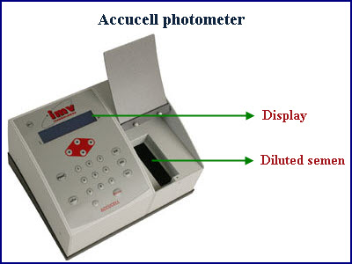
Estimation of sperm concentration
Photometer
It is the advanced form of colorimeter.
Principle - same as colorimeter.
Instrument itself will display the final concentration, dilution rate and number of doses can be made.
It is faster than the colorimeter.
The instrument has to be calibrated once in two weeks with haemocytometer to ensure better working condition.

Slide 29
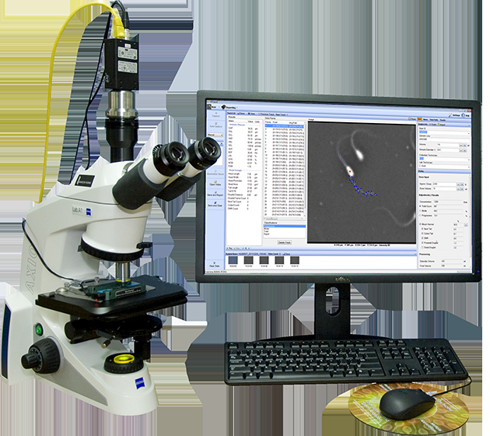
Estimation of sperm concentration
Opacity tubes
Brown’s opacity tubes have been used for estimating sperm concentration.
Opacity increases with increase in concentration of semen.
Computer Assisted Semen Analyzer (CASA)
It is the most advanced method.
Instrument is costly.

Slide 30
Normal sperm concentration in different species
.No. | Species | Concentration
1 | Cattle bull | 1200 (800-1400 millions/ml)
2 | Buffalo bull | 800 (600-1200 millions/ml)
3 | Stallion | 250 (200-600 millions/ml)
4 | Ram and buck | 3000 (2000-4000 millions/ml)
5 | Boar | 250 (200-500 millions/ml)
6 | Dog | 250 (125-500 millions/ml)

Slide 31
Concentration related nomenclature
S.No. | Terminology | Explaination
1 | Normozoospermia | Normal sperm concentration
2 | Oligozoospermia | Reduced sperm concentraion
3 | Polyzoospermia | Increased sperm concentration
4 | Azoospermia | Zero sperm concentration

Slide 32
Viability of spermatozoa
Traditional method – EOSIN NIGROSIN
Principle
The live and dead sperm is assessed by a vital stain - eosin-nigrosin which was found by Hancock during 1951.
The eosin is a vital stain which can only pass through the loosely integrated plasma membrane of dead sperm and stains it as pink color.
The nigrosin is a negative stain which gives background color.
Initially - Mayer (1947) by using eosin (vital stain) and opal blue (background stain).
Later Hancock (1951) used eosin (vital stain) and nigrosin (background)

Slide 33
EOSIN NIGROSIN
Materials required
Semen sample (fresh/frozen)
Glass slides
Eosin stain (5%)
Nigrosin stain (10%)
Immersion oil
Phase contrast microscope
Preparation of 5% eosin stain
Weigh 5 gm eosin powder, put in pestle and mortar.
Prepare 2.9% sodium citrate solution, boil it.
Add the boiling solution to stain and grind it well.
Finally filter and store it at 4 ⁰ C.

Slide 34
EOSIN NIGROSIN
Preparation of 10% nigrosin stain
Nigrosin water soluble powder 10 gm ₊ 100 ml, 2.9% sodium citrate
Store at 4 degree temp
Staining procedure
A drop of eosin, four drops of nigrosin and a small drop of semen are placed on a clean, grease free slide.
Mix the semen first with eosin and then immediately with nigrosin stain.
The mixture is taken on the edge of a slide and pulled across the top of another slide leaving a smear
Allow it to dry in air.
200 spermatozoa are counted under oil immersion at a magnification of 100X

Slide 35
EOSIN NIGROSIN
Calculation

Slide 36
EOSIN NIGROSIN
Interpretation
Unstained - LIVE
Pink stained - DEAD
Partially stained -DEAD
The fresh semen -80% live sperms
The frozen semen -50% live sperms .

Slide 37
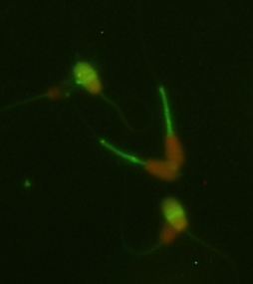
Viability
Fluorescent dye
PI (Propidium iodide)

Slide 38
ACROSOME INTEGRITY
Acrosome a cap like structure on the head of the spermatozoa covers 60% of the anterior portion of the sperm head.
The Mammalian spermatozoon acrosome is golgi derived secratory granule inclosed by outer and inner acrosomal membrane.
The acrosomal matrix, which underlies the outer acrosomal membrane, contains both structural and nonstructural (non-enzymatic and enzymatic) components
A double Trypan blue/Giemsa staining method was first used for sperm evaluation by Kovács and Foote in 1992

Slide 39
ACROSOME INTEGRITY
Other common methods (Fluorescent dye)
Chlortetracycline (CTC).
Fluorescent lectins
Pisum sativum lectin ( PSA) – FITC PSA
Lectin from Arachis hypogaea (peanut)
FITC-PNA

Slide 40
ACROSOME INTEGRITY
Giemsa

Slide 41
- FITC - PSA
ACROSOME INTEGRITY

Slide 42
BIOCHEMICAL TESTS
pH estimation
Methylene blue reduction test (MBRT)
Hypoosmotic swelling test (HOST)
Fructolytic index
Oxygen uptake/ utilization test
Pyruvate utilisation test
Glutamic oxaloacetic transaminase (GOT) activity
Hyaluronidase activity
Resazurin test
Buffering capacity test
Alkaline & acid phosphatase test
Millovanov’s resistance test

Slide 43
pH estimation
Species | pH
Bull | 6.8
Stallion | 7.4
Ram/Buck | 6.8
Boar | 6.8
Dog | 6.7
Cat | 7.4
pH paper
Indicator dyes
Bromothymol blue - 5.2-6.8
Bromo cresole purple – 6.0-7.6
Phenol red – 6.8 – 8.4.
pH of the semen affected during
Inflammatory conditions affecting the accessory sex glands
When bulls are used excessively – Alkaline pH
Incomplete ejaculation – Alkaline pH

Slide 44
METHYLENE BLUE DYE REDUCTION TEST
Principle that the hydrogen ions are liberated during sperm metabolism which will reduce the blue colored methylene blue into colorless leucomethylene blue.
Procedure and interpretaion of reuslt
Materials required
Fresh semen
Egg yolk citrate diluent
5 ml test tube
Incubator

Slide 45
METHYLENE BLUE DYE REDUCTION TEST
Methylene blue solution
(50 mg of methylene blue in 100 ml of 2.9 per cent sodium citrate buffer)
Liquid paraffin
Water bath
Procedure
Take 0.2 ml of fresh semen and 0.8 ml of egg yolk citrate diluent in a sterile 5 ml test tube
Add 0.1 ml methylene blue solution and mix the contents
Place 1 cm layer of liquid paraffin
Keep the test tube in a water bath of 46.5° C
Observe the time taken to change in color from blue to colorless

Slide 46
METHYLENE BLUE DYE REDUCTION TEST
Based on the time taken to change the color, the semen sample is graded as
S.No. | Time interval | Classification
1 | 3 - 5 min | Good
2 | 9 min | Average
3 | > 9 min | Poor

Slide 47
HYPO OSMOTIC SWELLING TEST (HOST)
The integrity of plasma membrane is a pre-requisite for maintaining fertility.
Fluid transport occurs in an intact cell membrane under hypo osmotic conditions until equilibration is reached between inside and outside the cell.
Due to influx of fluid there will be bulging or bending of the tail fibre occurs.
This phenomenon is known as "tail curling" or the sperm with curled tail is known as "swollen sperm".
Spermatozoa with chemically and physically intact membrane will show tail curling under hypo osmotic conditions whereas spermatozoa with an inactive membrane will not.

Slide 48
HYPO OSMOTIC SWELLING TEST (HOST)
Materials required
Fresh/frozen semen
Sugar tube
Distilled water/ HOS media
Water bath
Pipette and tips
Preparation of HOS media
For 75 mosm media
Sodium citrate - 0.367 gm
Fructose- 0.675 gm
Distilled water - 100 ml

Slide 49
HYPO OSMOTIC SWELLING TEST (HOST)
Procedure
Take 0.9 ml of HOS media /distilled water in a sugar tube
Keep the tube in 37 ° C water bath for 5 minutes to bring the temperature of media to 37 ° C
Then add 0.1 ml of semen
Incubate the mixture at 37 ° C water bath for 30 minutes
Place a drop of semen in a clean, grease free glass slide and put a cover slip over it.
Examine under phase contrast microscope to see the tail curling

Slide 50
HYPO OSMOTIC SWELLING TEST (HOST)
The fresh semen - minimum of 70% and above
Post thaw - minimum of 50% reacted sperm.

Slide 51
FRUCTOLYSIS INDEX
Fructose, a glycolysable sugar, present in the semen
Its level in semen is regulated by the male sex hormone testosterone
Fructolysis in the semen is assessed by measuring the disappearance of sugars and accumulation of lactic acid by a constant number of spermatozoa in a specific time and under specified conditions.
Mann (1948) for the first time proposed fructolysis as an index for evaluating the activity of semen.
Fructolytic index is defined as the amount of fructose utilized by 10⁹ spermatozoa in one hour at 37⁰C.

Slide 52
Oxygen uptake/utilization test
Principle – Metabolic activity of sperm is measured in terms of oxygen uptake.
Values represented as R.Q. (Z)
Zo₂ = volume of CO₂ produced by the spermatozoa per unit of time divided by the volume of O₂ consumed in the same unit of time.
The ZO₂ value of bull semen is to be 21
This test indicates activity and live percentage of spermatozoa.

Slide 53
Pyruvate utilisation test
Principle – Based on oxygen utilization in presence of pyruvate and associated compounds
First started by Melrose during 1952.
Oxygen consumption rate after the addition of pyruvate and pyruvate plus 2, 4 di nitrophenol.
Flouride added - reduce the exogenous metaboloism to a low level.
When added with pyruvate the oxygen consumption in high fertile bull semen and low fertile bull semen is increased but on addition of 2,4 di nitrophenol the oxygen uptake is increasing two fold in high fertile bulls but not in low fertile bulls.
The oxygen uptake was measured with the help of monometric equipment.

Slide 54
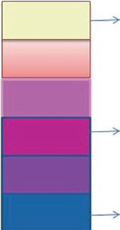
Presence of certain Enzymes and Hormones
GLUTAMIC OXALOACETIC TRANSAMINASE (GOT) ACTIVITY
Indicates the damage to spermatozoa
HYALURONIDASE ACTIVITY - indicate acrosomal damage.
RESAZURIN TEST - indicator of metabolic activity of semen.
Resazurin
Semen +Resazurin (Blue) Dehydrogenase Pink
Resurufin
Dihydroresurufin
CL
1 minute
4 minute
ALKALINE & ACID PHOSPHATASE TEST
Presence indicated - functional state of accessory sex glands and metabolic activity of spermatozoa.

Slide 55
Millovanov’s resistance test
Evaluates ability of spermatozoa to withstand the action of 1 per cent Sodium chloride solution.
Denoted by – R
The milliliter of 1 % Sodium chloride solution required to stop the progressive motility of all spermatozoa in 0.02 ml of semen.
Good quality semen - ‘R’ value to be not less than 5000.

Slide 56
Cold shock resistance test
This test is done to assess the fertilizability/preservability/storage ability (5°C) of the semen of a particular bull.
The spermatozoa are subjected to unfavourable condition such as cold (0°C).
The percentage of resistant live sperm is counted after cold shock.
Procedure
Take one ml of freshly collected in a test tube and place it in a beaker containing crushed ice (0⁰C) for 10 minutes.
Conduct Viability by eosin-nigrosin

Slide 57
BIOLOGICAL TEST
Zona-free hamster ova penetration bioassay - in vitro fertility assessment of spermatozoa.
The hamster egg penetration is a heterologous sperm penetration test.
hamster egg will allow the other species sperms after the zona removal by enzymatic digestion.
ZP - removed by treating the oocytes with freshly prepared 0.1% trypsin in mBWW medium for 30 to 60 seconds.

