Slide 1
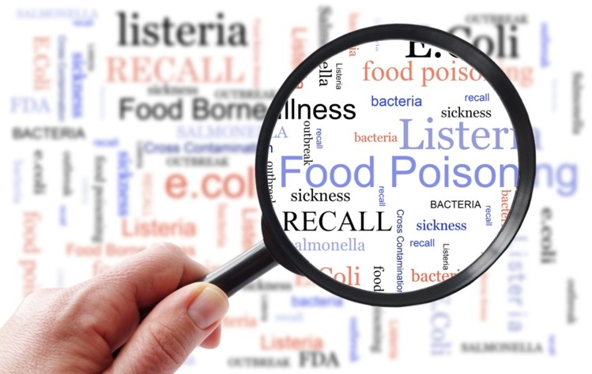
Sources of contamination of meat and carcasses de-contamination

Slide 2
Sources of contamination
Hides & hair: major source of bacteriological contamination
Contents of stomach & gut: major source of bacteriological contamination
Sticking point: bacteria travel to the spleen, lung, bone marrow
Physical contact with structures: mainly in booth dressing
Water: source of pathogens
Operatives: movement should be from clean to dirty part
The slaughter hall environment: ventilation, steam-increases surface moisture, drainage
Utensils & equipment’s: knife, saws & hock cutters
Vermin: fence to keep away dogs & cat
Chemical contamination: contamination by cleaning chemicals

Slide 3
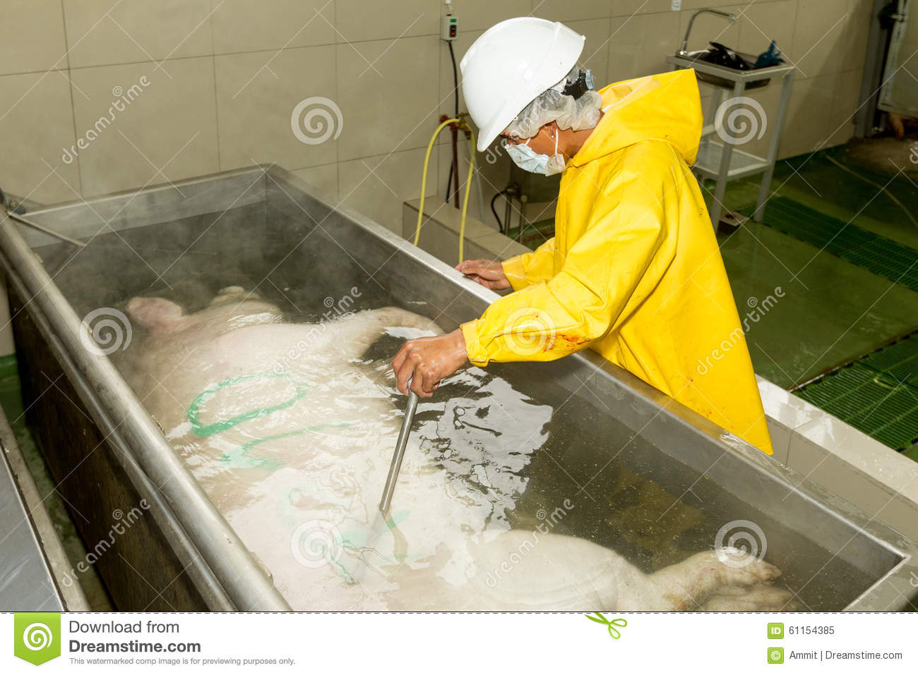
Methods of reducing contamination
Dealing with the dirty animal
Protecting the meat from the worker
Layout & flowlines
Dressing techniques: removal of hide/fleece/hair
Pigs: vertical scalding (61ºC for 7 min.)
Poultry: soft scalding at 50-51ºC for 1 to 3 minutes
Singeing: burn the bristles or down off (the carcass of a pig or fowl)
Preventing contamination from GIT:
The technique used for sealing the rectum is k/as bunging
The oesophagus (weasand) in a cattle is usually sealed by an elastrator ring applied at the oesophgeal-ruminal junction k/as rodding

Slide 4
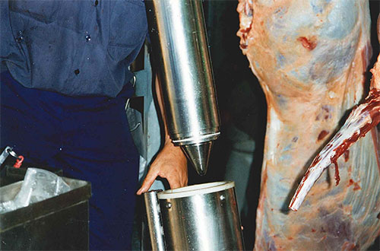
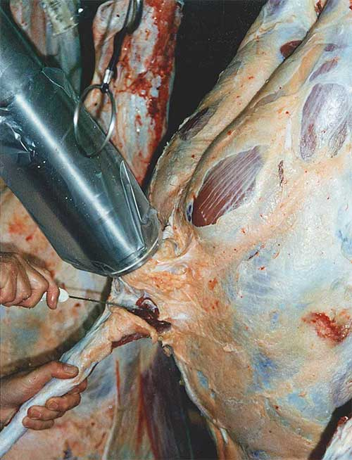
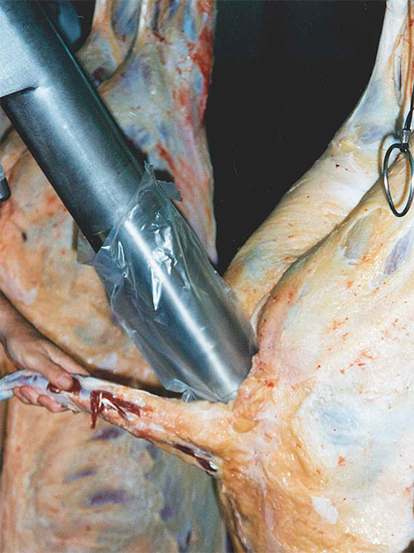
Beef Bunging Machine
https://sesltd.co.nz/beef-bunging-machine.php
Plastic bag in place over extended cone of machine, ready for insertion into rectum
Transferring expanded rubber ring from SafeSeal 502 (the ring loader) to SafeSeal 501 (the machine)
Ring in position on machine
Rectum totally sealed prior to commencement of any knife work
Machine inserted prior to retracting

Slide 5
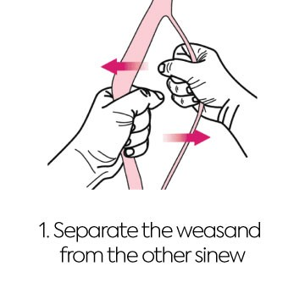
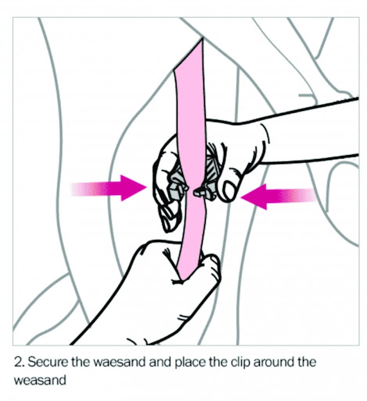
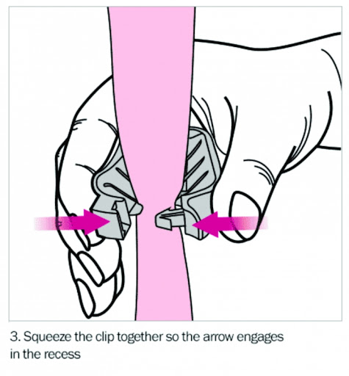
Rodding procedure

Slide 6
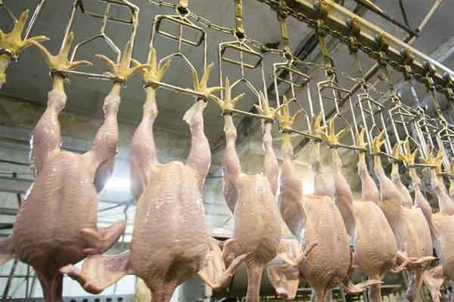
Carcasses decontamination
Water
Steam pasteurization/sterilization
Trimming
Chemical treatments

Slide 7
Carcasses decontamination
water:
With hot & cold water
Hot water gives bloom to the meat
USDA recommendation >74ºC water for 10s
Water with chlorine 15 ppm, temp. 85-90ºC with 100psi pressure
Steam pasteurization/sterilization:
Steam vaccum sterilization process: temp. 88ºC, steam, at 45psi
Steam sterilization: removal of surface water, split carcasses pass through low pressure steam over for 85ºC for 8s & then cooled with a chilled water spray

Slide 8
Carcasses decontamination
Trimming
Removing visible contamination by trimming & then washing was the most practical & effective method for reducing microbial contamination of beef carcasses
Chemical treatment
Chlorine: 20ppm, 16ºC for 10sec & 60sec
Organic acids: acetic acid, lactic acid, citric acid, fumaric acid: reduced the E.coli0157:H7
Hydrogen peroxide
Antimicrobials: Nicin, Bacteriocin
Phosphatase: Trisodium phosphate: reduce the total viable count, Salmonella contamination

