Slide 1
Artificial insemination
Dr Alok Kumar
Asst. Prof cum Jn. Scientist
Dept. Veterinary Gynaecology & Obstetrics
Bihar Veterinary College, (BASU)

Slide 2
Overview
Present scenario
Basics of AI – Our firm footing
Timing of AI – The game changer

Slide 3
Present scenario

Slide 4
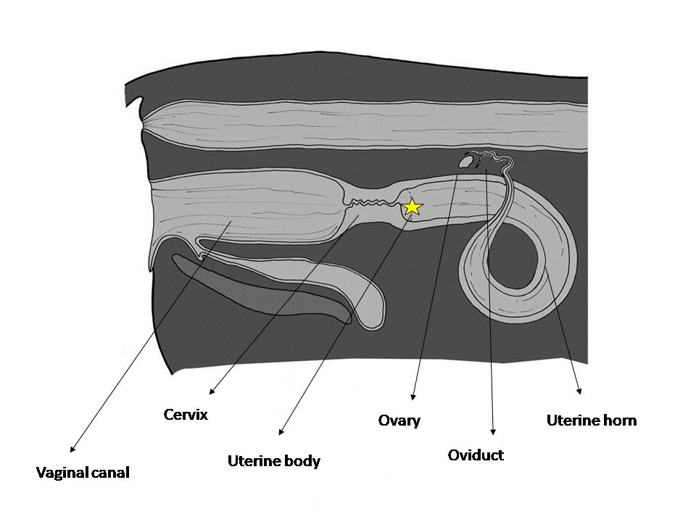
Basics of Artificial insemination
1. Anatomy of female reproductive system
Palpation of organs – structure, consistency etc
Proper place of semen deposition
Structures act as hurdle for AI
Vaginal folds
Urinary bladder
Fornix of vagina

Slide 5
Basics of Artificial insemination
2. Per-rectal palpation
Detection of heat
Palpation of genital structure i.e. cervix/ovary/follicle/CL
Palpation of abnormalities i.e. Endometritis
Rule out gestational heat.
Common malpractices
PRE without proper lubrication
Use of soap as lubricant

Slide 6
Basics of Artificial insemination
3. Preparation for insemination and hygiene
It’s simple to adopt good practices then to break bad ones
Proper restraining of animal
AI equipment must be kept at dry and dust free area
Wash perennial area with antiseptic solution
Protect loaded AI gun from direct sun light
Keep AI sheath in original packet till used

Slide 7
Basics of Artificial insemination
Thawing of straw
Checking water temperature before thawing
Keep the goblet below neck while taking an straw

Slide 8
Basics of Artificial insemination
Thawing of straw
Dipping the straw in warm water (37⁰C) for a period of 45 seconds
Wiping out water droplet by use of tissue paper

Slide 9
Basics of Artificial insemination
Loading of AI gun
Positioning of straw in AI gun
Straw cutting – Lab seal end

Slide 10
Basics of Artificial insemination
Loading of AI gun
Putting plastic sheath over AI gun

Slide 11
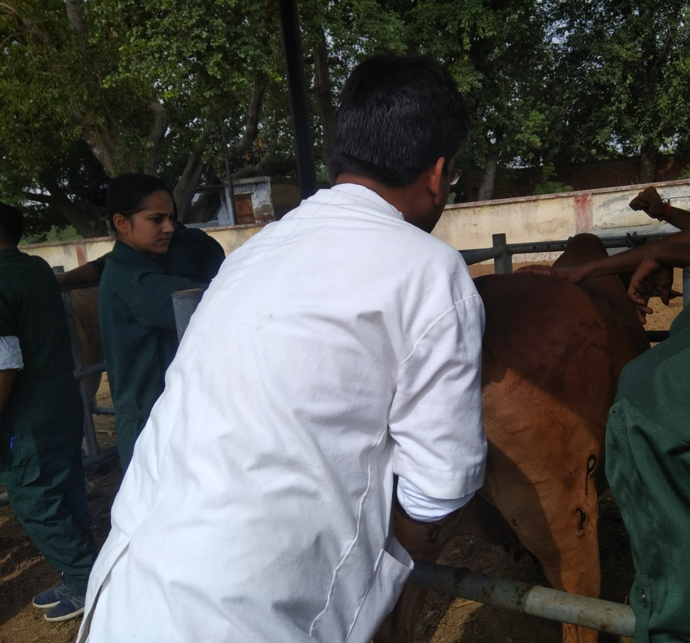
Basics of Artificial insemination
Location & examination of cervix
Retraction of uterus
Examination of the ovaries
Palpation of follicles
Palpation of C.L.

Slide 12
Basics of Artificial insemination

Slide 13
Timing of AI – The game changer

Slide 14
Timing of AI – The game changer

Slide 15
Timing of AI – The game changer

Slide 16
Timing of AI – The game changer
Optimum fertility - insemination at the later half of standing heat
Heat detection mechanism in a farm is optimum – follow AM-PM rule
Heat detection mechanism is not optimum and conception rate is low – insemination soon after heat detection

Slide 17
Standard Method of Insemination
Cows are inseminated at the internal cervical os or just inside the short uterine body.
Recto-Vaginal Method of AI
Restrain the animal
Perform Back racking
Grasp the cervix through the rectum with the left hand.
The vulval lips are opened by downwards pressure from the arm in the rectum
A catheter is then passed into the vagina and manipulated through the cervix by the right hand.

Slide 18
Standard Method of Insemination
The circular folds of vaginal mucosa are obliterated by pushing the cervix forward.
The catheter is initially inserted pointing upwards at an angle of about 30° to avoid entering the urethral meatus or fossa
Catheter is then moved horizontally until it engages in the external os of the cervix.
The left hand squeezes the anterior vagina on to the caudally projecting external os of the cervix, thereby obliterating the fornix of the vagina and facilitating entry of the catheter into the cervix.

Slide 19
Standard Method of Insemination
Entry into the external os is accompanied by a characteristic ‘gritty’ sensation.
The catheter is then introduced through the convoluted cervical canal by manipulation of the cervix through the rectal wall.
One finger is placed over the internal os of the cervix so that the tip of the catheter can be palpated as it emerges from the cervical canal

Slide 20
Alternative Sites for Insemination
Single horn insemination
Technique require palpation of the ovaries to determine the site of ovulation
Careful straightening of the ipsilateral horn to allow the insemination catheter to be inserted to within approximately 2 cm of the uterotubal junction.
Disadvantages
Premature rupture of the follicle, perforation of the uterine wall
Risk of polyspermic fertilisations
Increase in the time required to perform the insemination.

Slide 21
Artificial Insemination in Sheep
Route | Fresh | Liquid | Frozen | Insemination Vol. | Conc. Of Fresh Liquid Frozen Inseminate (x 10⁶/mL)
Vaginal | 300 | 400 |  | 0.3–0.5 mL | 2000
Intracervical | 100 | 150 | 180 | 0.05–0.2 mL | 1000
Transcervical intrauterine |  | 60 |  | 0.1–0.5 mL | 200–400
Laparoscopic intrauterine | 20 | 20 | 20 | 0.05–0.10 mL/ horn | 400–800

Slide 22
Artificial Insemination of Goats
Effects of Seminal Plasma upon Storage
Seminal plasma contain egg yolk–coagulating enzyme (EYCE) that is secreted by the bulbourethral gland.
The toxic interaction with egg yolk and EYCE
EYCE coagulates egg yolk and hydrolyses lecithin to fatty acids and spermicidal lysolecithins (via a phospholipase A)
Bulbourethral gland secretions also have a toxic interaction with milk.
A 55 to 60 kDa glycoprotein lipase, originally named SBUIII now called BUSgp60 releases oleic acid from milk triglyceride

Slide 23
Thanks!
Any questions?
You can find me at:
alok9alright@gmail.com

