Slide 1
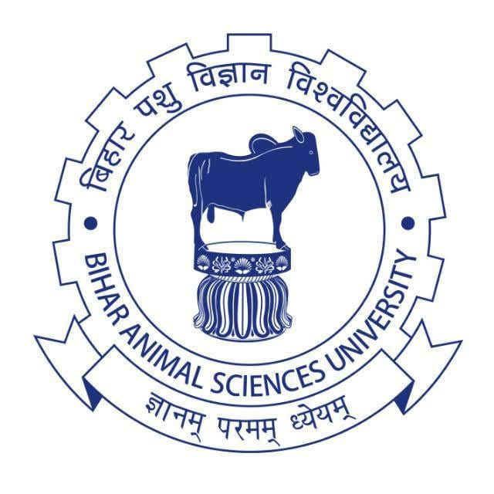
BY - Dr. B. Kumar ASSISTANT PROFESSOR DEPT. OF ANIMAL GENETICS AND BREEDING Bihar Veterinary College, Patna-14 BASU

Slide 2
CELL DIVISION

Slide 3
Two Types of Cell Division 1. Mitosis Mitosis produces two daughter cells that are identical to the parent cell. This type of cell division allows multicellular organisms to grow and repair damaged tissue. 2. Meiosis Meiosis (double cell division) produces daughter cells that have one half the numbers of chromosomes as the parent cell. Meiosis is necessary in sexually-reproducing organisms because the fusion of two gametes (fertilization) doubles the number of chromosomes.

Slide 4
MITOSIS
Mitosis is a process of nuclear and cytoplasmic division (Karyokinesis and cytokinesis respectively) in which two daughter cells are produced that has chromosomal numbers identical to the parental cell.
Mitosis (designated M Phase) is part of the total cell cycle for cells undergoing division.
The initial event in the cell cycle is the growth phase, called Interphase.
In this phase, the cell increases in mass and prepares for DNA replication.
The metabolic rate of the cell will be high.
It takes about 10 hr for a cell requiring 24 hrs for its cell cycle.

Slide 5
Interphase: is divided into three phases, G₁ (first gap), S (synthesis), and G₂ (second gap).
In this phase, the cell increases in mass and prepares for DNA replication.
The metabolic rate of the cell will be high.
It takes about 10 hr for a cell requiring 24 hrs for its cell cycle.
S-PHASE
DNA is replicated.
The centrosome is also duplicated.
Cells will take between 5 and 6 hours to complete S phase.
G2- PHASE
The cell undergoes a period of rapid growth to prepare for mitosis.
G₂ is third, final, shortest subphase, lasting only 3 to 4 hours.
G₂ period is after DNA synthesis has occurred but is prior to the start of prophase.

Slide 6
STAGES OF MITOSIS
Mitosis is divided into,
Prophase
Metaphase
Anaphase and
Telophase
PROPHASE:
The first phase of mitosis within M phase is called prophase.
The nucleolus fades and chromatin (replicated DNA and associated proteins) condenses into chromosomes and each chromosome has two chromatids joined at a centromere.
The mitotic spindle initially appears as structures called asters which surround each centriole pair.
The two pair of centrioles formed from the replication of one pair in Interph away from one another toward opposite ends of the cell and the nuclear envelope breaks up.
Polar fibers, which are microtubules that make up the spindle fibers, reach from each cell pole to the cell's equator.
The kinetochore (protein bundles at the centromere region on the chromosomes where sister chromatids are joined) fibers "interact" with the spindle polar fibers connecting the kinetochores to the polar fibers.
The chromosomes begin to migrate toward the cell center. ase) move

Slide 7
METAPHASE
• The nuclear membrane disappears completely.
• Chromosomes align at the metaphase plate at right angles to the spindle poles.
• Tension applied by the spindle fibers aligns all chromosomes in one plane at the center of the cell.
ANAPHASE
• Spindle fibers shorten; the kinetochores separate and the paired centromeres in each distinct chromosome begin to move apart to the cell poles.
• Once the paired sister chromatids separate from one another, each is considered a "full" chromosome. They are referred to as daughter chromosomes.
• Through the spindle apparatus, the daughter chromosomes move to the poles at opposite ends of the cell.
• At the end of anaphase, each pole contains a complete compilation of chromosomes.

Slide 8
TELOPHASE
• Telophase is technically the final stage of mitosis.
• Its name derives from the Latin word telos which means 'end'.
• The daughter chromosomes arrive at the poles and nuclei (plural form of nucleus) begin to form at opposite poles.
• The nuclear envelopes of these nuclei are re- formed.
• Nucleoli (plural form of nucleolus) also reappear.
• Chromatin fibers of chromosomes uncoil.
• The spindle fibers that have pulled them apart disappear.
• The chromosomes begin to decondense and become more diffuse.
CYTOKINESIS
• Cytokinesis is the division of the cell's cytoplasm and organelles.
• With the two nuclei already at opposite poles of the cell, the cell cytoplasm separates, and the cell pinches in the middle, ultimately leading to cleavage.
• At the end of cytokinesis, there are genetically identical two daughter cells.

Slide 9
Meiosis:- occurs in eukaryotic life cycles involving sexual reproduction.
• During meiosis, the genome of a diploid germ cell undergoes two rounds of division, resulting in four haploid daughter cells.
• Each of the resulting daughter cells has one half of the number of chromosomes as the parent cell.
• This reduction is accomplished by two successive nuclear divisions, as opposed to the one division found in mitosis.
• The two stages of meiosis are Meiosis I and Meiosis II called Reductional Division and Equational Division respectively.
• Before a dividing cell enters meiosis, it undergoes a period of growth called Interphase.
• In animals, meiosis used to produces the gametes: sperms and eggs.

Slide 10
.
INTERPHASE
• The preparatory steps that lead up to meiosis occurs in the same fashion as it does during mitotic interphase of the mitotic cell cycle
MEIOSIS- I
Meiosis I consist of four stages:
Prophase I
Metaphase I
Anaphase I and
Telophase I.
Meiosis I separate homologous chromosomes producing two haploid cells (N), and therefore referred as Reductional Division.
• However, after Meiosis I, although the cell contains 2N chromatids it is only considered as being N, because later in anaphase I the sister chromatids will remain together as the spindle pulls the pair towards the pole of the new cell.

Slide 11
.
DIPLOTENE STAGE
• The diplotene stage, also known as diplonema.
• DNA recombination is complete.
• In this phase, the chromatids continue to shorten and thicken and the four sister chromatids in a group is called a tetrad.
• The synaptonemal complex begins to break down.
• The paired chromatids begin to pull apart, causing the strands to separate longitudinally in some areas to from loops.
• The chiasmata tend to slip toward the ends of the tetrads and then to become terminalised as the meiotic prophase continues.
DIAKINESIS
• Shortening of each tetrad continues through diakinesis, resulting in discrete units.
• Similar to mitosis, the centrioles migrate away from one another and both the nuclear envelope and nucleoli break down.

Slide 12
.
METAPHASE I
• Tetrads align at the metaphase plate.
• One homologue is pulled above the metaphase plate, the other below.
• The centromeres of homologous chromosomes are oriented toward the opposite cell poles.
• The centrioles are at opposite poles of the cell.
• Spindle fibers from one pole of the cell attach to one chromosome of each pair and spindle fibers from the opposite pole attach to the homologous chromosome
ANAPHASE I
• Chromosomes move to the opposite cell poles.
• A key difference between mitosis and meiosis is that sister chromatids remain joined after metaphase in meiosis I, whereas in mitosis they separate.
• During this stage, the original maternal and paternal chromosomes separate, thereby reducing the number of chromosomes from 2N to N number, yet the sister chromatids remain together.

Slide 13
.
TELOPHASE I
• The homologous chromosome pairs complete their migration to the two poles as a result of the action of the spindle.
• Cytokinesis involves the formation of a cleavage furrow, resulting in the pinching of the cell into two cells.
• At the end of Telophase I and Cytokinesis, two daughter cells are produced, each with one half of the number of chromosomes (haploid set of replicated chromosomes) of the original parent cell.
INTERKINESIS
• Interkinesis (Interphase II) is similar to interphase except DNA replication does not occur during this stage.

Slide 14
.
MEIOSIS - II
• Meiosis II is the second part of the meiotic process.The Meiosis II consists of
Prophase II
Each dyad is composed of a pair of sister chromatids attached by a common centromere.
Metaphase II
Centromeres are positioned at the equatorial plane.
Anaphase II and
Centromeres divide and the sister chromatids of each dyad are pulled to opposite poles
Telophase II
Reveals one member of each pair of homologous chromosome present in each pole. Each chromosome is referred as monad (a combination of maternal and paternal genetic information). Nuclei reform around chromosomes at the poles. Following cytokinesis in telophase II, four haploid gametes result from a single meiotic event.

Slide 15
Thank you

