Slide 1
Department of Veterinary Medicine Bihar Veterinary College, Patna – 800 014 (BASU, Patna)
Clinical Examination of GIT of Ruminants(Class -4)
Dr. Ranveer Kumar Sinha Assistant Professor cum Junior Scientist
E-mail: ranveervet@rediffmail.com

Slide 2
Anatomy of GIT of Ruminants

Slide 3
History
Vaccination and anthelmintic record
Recent outbreaks of disease e.g. salmonellosis
Endemic disease like johne’s disease
Recent changes in diet or management
Introductions of new animal
Time of onset, the duration, number affected and the severity and the signs of disease observed

Slide 4
Observations at a distance
Abdominal pain:
Straining in attempts to defecate
Rate of eructation, regurgitation
In chronic:- low body condition score and loss of weight
kicking at the abdomen
Get up and down movements with grunting

Slide 5
Observations at a distance
Dropping of the cud
Ruminal tympany
Sunken eyes
Increased respiratory rate(metabolic acidosis)
Reduction in the quantity and a change in the faces
Jaundice (non-pigmented areas of the skin such as the udder)
Distension and changes in the silhouette of lateral contours of the abdomen.

Slide 6
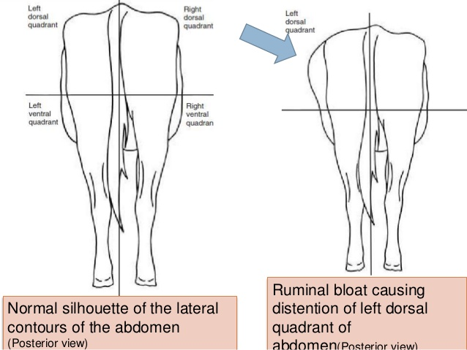

Slide 7
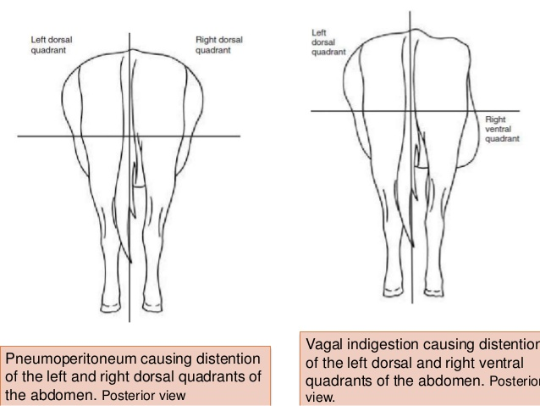

Slide 9
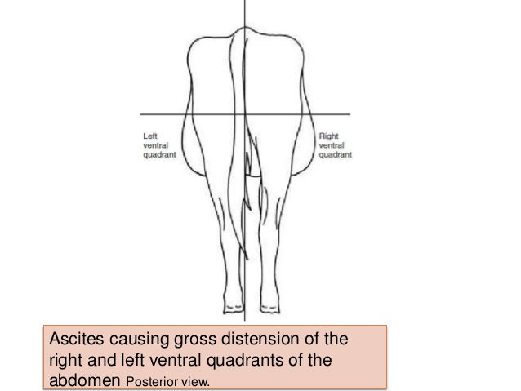

Slide 10
Examination of Mouth
Difficulty in opening mouth
Tetanus & Low Mg level
Damage to the temperomandibular joint
Degenerative changes affecting articular surface of joints
Inability to co-ordinate lip movements : 7th cranial (facial) nerve
Inability to move the tongue :12th cranial (hypoglossal) nerve(alkaloid toxicity, botulism or in listeriosis)
Inability to swallow : 9th cranial (glossopharyngeal) nerve &10th cranial (vagus) nerve (local damage to nerves by abscess or tumour formation)
Buccal mucosa:
diphtheritic membranes which are visible adjacent to the cheek teeth in some cases of calf diphtheria (necrotic stomatitis)
vesicles of foot-and mouth disease
Dental pad:
bovine papular stomatitis,
BVD
FMD
wooden tongue caused by Actinobacillus lignieresii
Paralysis of the tongue is seen in cases of botulism

Slide 12
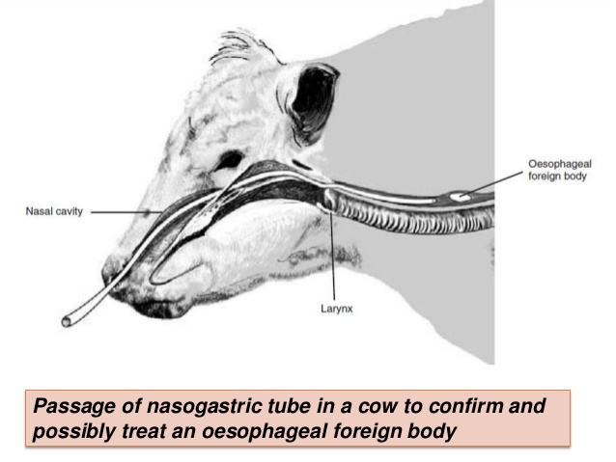

Slide 13
Examination of the left abdomen
Assessment of the rumen and reticulum
To check for evidence of a left displaced abomasum.
Rumen and reticulum
In normal animal digital pressure should not leave a lasting impression once palpation ceases
In vagal indigestion there may be rumen overfill with fibre and an impression of a fist pushed into the sublumbar fossa will remain following withdrawal
Rumen movements
Auscultation by stethoscope (weak contractions can be detected
Rasping or crushing sound or as crackling crescendo–decrescendo rolling thunder (persist for 5 to 8 seconds)
Auscultation of reticular contractions: auscultation over ribs 6 or 7 ventrally on the left side

Slide 14
Changes in rumen motility
Hypomotility (less than one movement every2 minutes)
Rumenostasis may cause a free gas bloat and is associated with a number of conditions including milk fever, carbohydrate engorgement (ruminal acidosis) and painful conditions of the abodmen
Hypermotility (more than five movements every 2 minutes) is less common and conditions
Percussion of the left abdominal wall: Resonance over the gas in the dorsal sac of the rumen

Slide 17
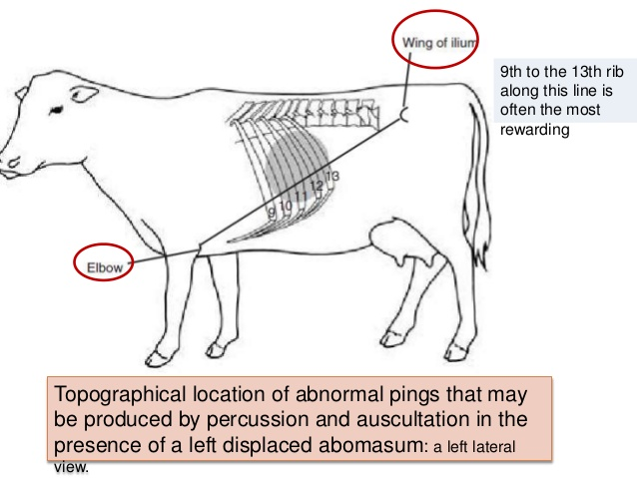

Slide 18
Examination of right side of the abdomen
Gravid uterus
Abomasum
Intestines
Liver
Distension of the right sublumbar fossa
Right-sided abomasal displacement
Caecal dilatation and/or torsion
vagal indigestion
Omasal impaction
Abomasal impaction

Slide 19
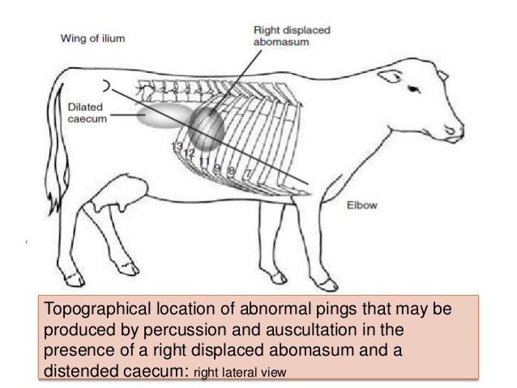

Slide 20
Intestines
Normal intestinal sounds can be heard intermittently in the right ventral quadrant (occur every 15 to 30 seconds)
Repeated peristaltic sounds may indicate intestinal hyper motility
Splashing sounds caused by excessive fluid in the intestines may be detected by ballottement and succession (enteritis, ruminal acidosis or intestinal obstruction)

Slide 21
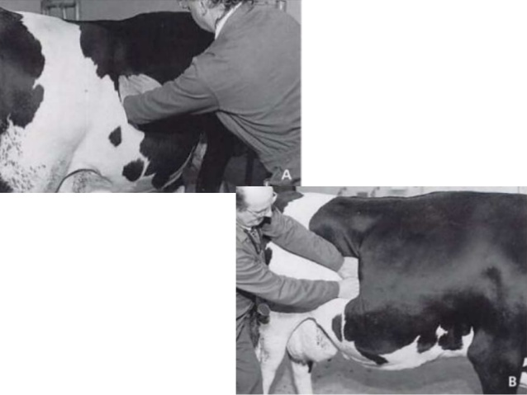
Palpation of liver

Slide 23
Examination of the feces
Amount
Mature cattle generally pass some feces every 1.5-2 hours, amounting to a total of 30- 50 kg/day in 10-24 portions
Reduction in the bulk of feces:
decrease in feed or water intake
a retardation of the passage through the alimentary tract
Diarrhea: the feces are passed more frequently and in greater amounts than normal and contain a higher water content (>90%) than normal

Slide 24
Absence or Scant Feces
Failure to pass any feces for 24 hours or more is abnormal and the continued absence of feces may be due to a physical intestinal obstruction
Paralytic ileus of the intestines due to peritonitis or idiopathic intestinal tympany also result in a marked reduction in feces, sometimes a complete absence, for up to 3 days

Slide 25
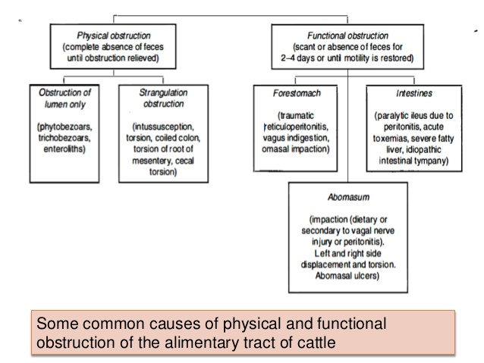

Slide 27
