Slide 1
Death from Drowning, Lightning and Electrocution
Unit-7
Dr. Vivek Kr. Singh
Assistant Professor
Department of Veterinary Clinical Complex

Slide 2
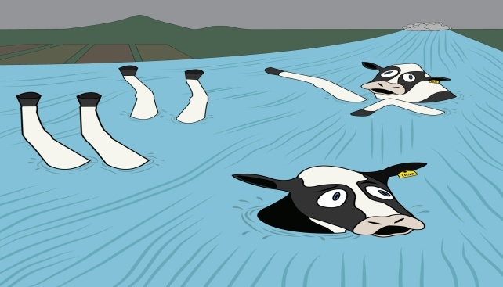
Drowning
Drowning means death from prevention of atmospheric air for entering the lungs caused by the submersion of the body in any fluid medium

Slide 3
Death from drowning results from complex patho-physiological events that differ according to the composition of liquid in which the animal is submerge

Slide 4
Signs of death due drowning
A fine white lathery froth is seen at the mouth and nostrils
The skin shows a corrugated appearance
Early rigor mortis
The lungs are distended like baloons
Oedematous and spongy lungs
White froth in the larynx, trachea and bronchial tubes
Presence of water in lungs
Large amount of water in stomach containing objects present in water at time of immersion
Injuries on the body

Slide 5
Mode of Death in case of drowning
Asphyxia
Shock
Fatal injuries

Slide 6
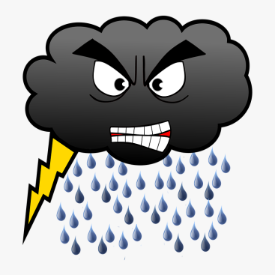
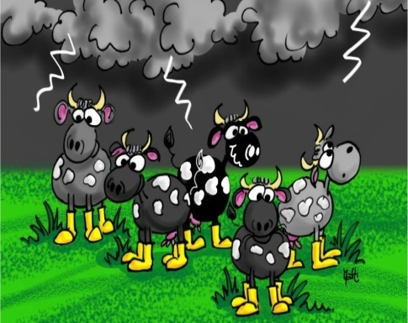
Lighting Stroke and Electrocution
When animal is brought into contact with a flash of lightning, Death is usually immediate and is due to involvement of –
The central nervous system
Paralysis of heart
Paralysis of respiratory system

Slide 7
The cause of death from electric currents is not necessarily the same in all cases
Low intensity current causes ventricular fibrilation
High intensity current causes paralysis of respiratory centre
Lightning is always a DC current and peaks vary from 10,000 to 2,00,000 amperes and voltage upto2,00,00,000 volts
The Current of 110 to 220 volts is sufficient to kill an adult cattle

Slide 8
Symptoms
Varying degrees of shock may occur
Animal may fall dead without struggle
In less severe cases, the animal becomes unconscious and after a few minutes may recover completely
Some animal may show residual nervous symptoms such as depression, paraplagia and cutaneous hyperaesthesia
Animals which have received intermittent shock eat and drink with care

Slide 9
Singeing and burning marks occur in about 90% cases of lightning, mostly on medial side of limbs
Half-chewed food in the mouth is a significant finding in case of a lightning stroke

Slide 10
Causes of death
Severe Nervous shock
Paralysis of respiratory centre
Ventricular fibrilation

Slide 11
Thanks

