Slide 1
Genus : Echinococcus
Instructor:
Dr R. K. Sharma
Assistant Professor
Veterinary Parasitology
Bihar Veterinary College, Patna.

Slide 2
Echinococcus : morphology
Adult E. granulosus worms are small and have a scolex with only three attached segments.
The scolex has four lateral suckers.
The rostellum is non-retractable and armed with a double crown of 28-50 recurved hooks.
The anterior segment is immature, the middle segment is mature with functional testes .
The ovaries, and the posterior segment is gravid with the uterus filled with eggs.
The eggs are typical ,small and rounded , thick-shelled and contain a hexacanth (6-hooked) embryo (oncosphere).
The encysted larval i.e metacestode stage is known as a bladder-worm or hydatid.
E. granulosus forms fluid-filled unilocular cysts with endogenous budding of brood capsules.

Slide 3
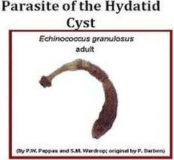
Source -Google
Source: Google. Echinococcus : Adult Dr .R. K. Sharma

Slide 4
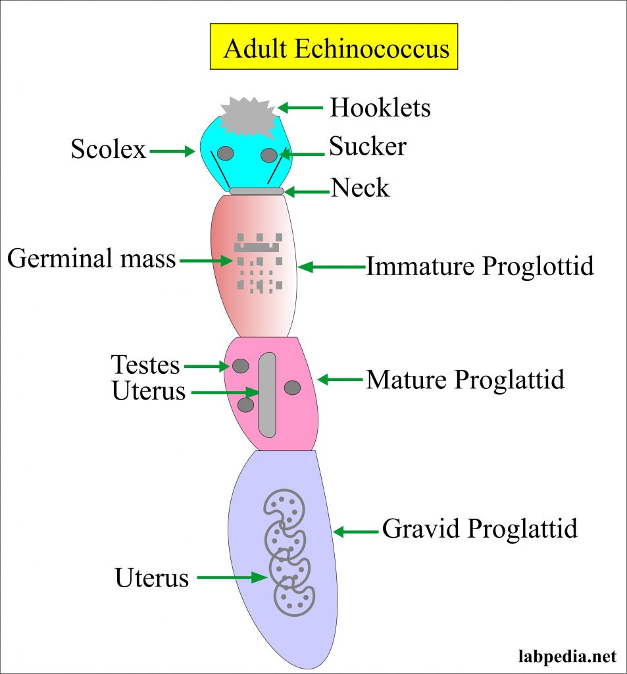
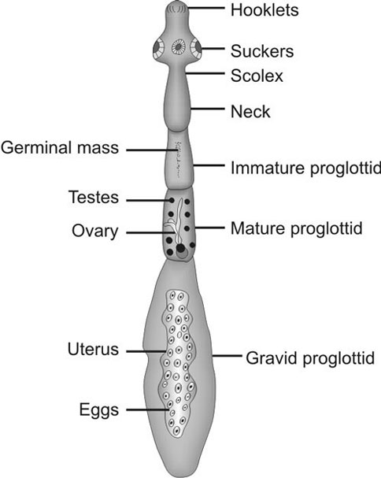
Source -Google
Source- Google Echinococcus :Parts of the body Dr .R. K. Sharma

Slide 5
Echinococcus : life cycle
Life cycle outside the body:
The adult Echinococcus is about 3-6 mm, resides in the bowel of its definite host.
Gravid proglottids release eggs that are passed in the feces.
These eggs are then ingested by a suitable intermediate host, including sheep, goat, swine, cattle, horses and camels.
The eggs then hatch in the bowels and release oncospheres that penetrate the intestinal wall. These oncospheres then migrate through the circulatory system to various organs of the host.
At the organ site, the oncosphere develops into a hydatid cyst. This cyst enlarges gradually, producing protoscolices and daughter cysts that fill the cyst interior.

Slide 6
Life cycle conted…..
These cyst-containing organs are then ingested by the definite host, causing infection. After ingestion, the protoscolices evaginate, producing protoscolexes.
The scolexes of the organisms attach to the intestine of the definite host and develop into adults in 32-80 days.
The life cycle then continues in humans:
Humans can become infected if they ingest substances infected with Echinococcus eggs.
The eggs then release oncospheres in the small intestine.
At these places, oncospheres migrate through the circulatory system and produce hydatid cysts.

Slide 7
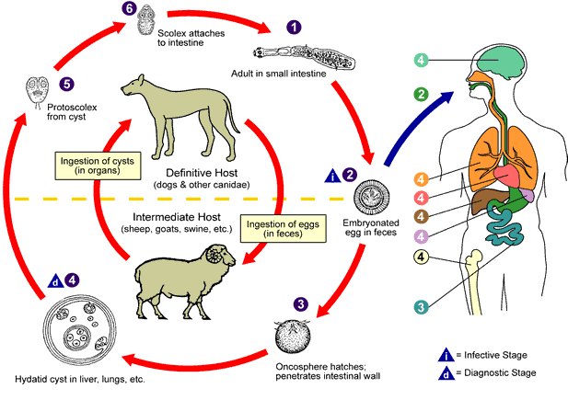
Source -Google
Source: Google Echinococcus : life cycle Dr .R. K. Sharma

Slide 8
Echinococcus : mode of transmission
The cysts develop into adult tapeworms in the dog.
Infected dogs shed tapeworm eggs in their feces which contaminate the ground.
Echinococcus eggs deposited in soil can stay viable for up to a year.
Sheep, cattle, goats, and pigs ingest tapeworm eggs in the contaminated ground.
After hatching the eggs develop into cysts in the internal organs.
The most common mode of transmission to humans is by the accidental consumption of soil, water, or food that has been contaminated by the fecal matter of an infected dog.
The disease is most commonly in people involved in raising sheep.

Slide 9
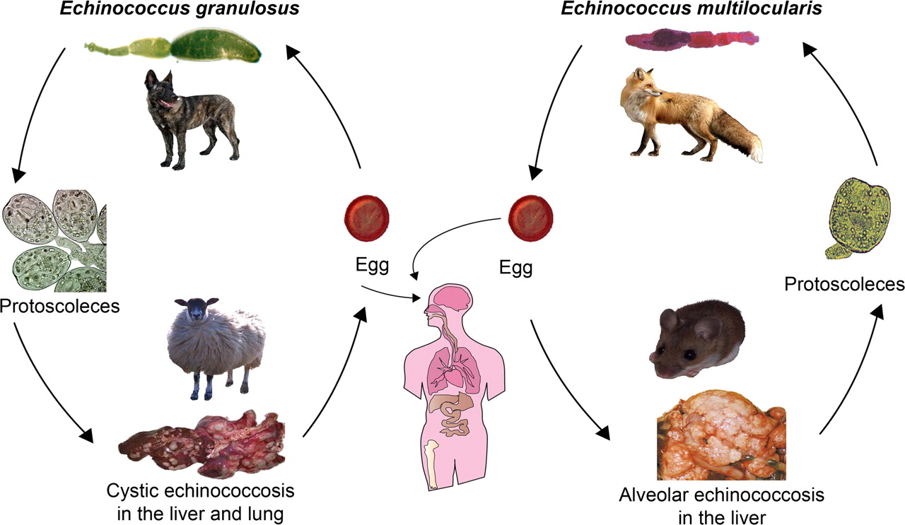
Source -Google
Source: Google Echinococcus : mode of transmission Dr .R. K. Sharma

Slide 10
Echinococcus : pathogenesis
Mainly infections are acquired during childhood
Clinical signs and pathogenesis of echinococcosis may not appear for years, except when cysts are in vital organs.
Liver cysts may eventually cause abdominal pain or a palpable mass.
Jaundice may occur if the bile duct is obstructed.
Rupture into the bile duct, peritoneal cavity, or lung may cause fever, urticaria, or a serious anaphylactic reaction.
Pulmonary cysts can rupture, causing cough, chest pain, and hemoptysis.

Slide 11
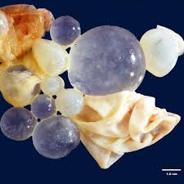
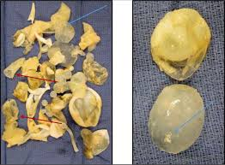
Source - google
Hydatid cyst of liver Dr .R .K. Sharma

Slide 12
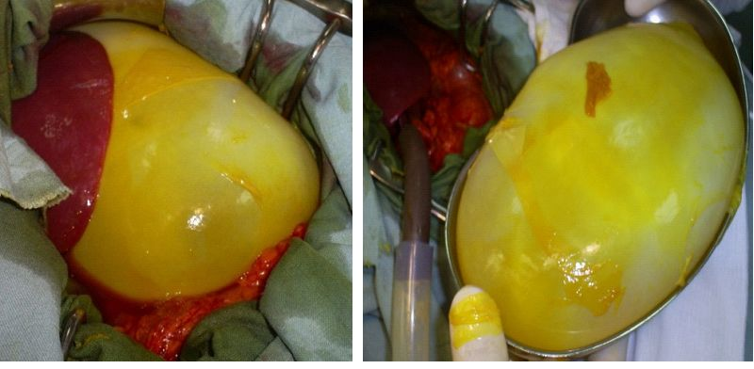
Source - google
Hydatid cyst of the liver with spontaneous rupture in peritoneum
Dr.R.K.Sharma

Slide 13
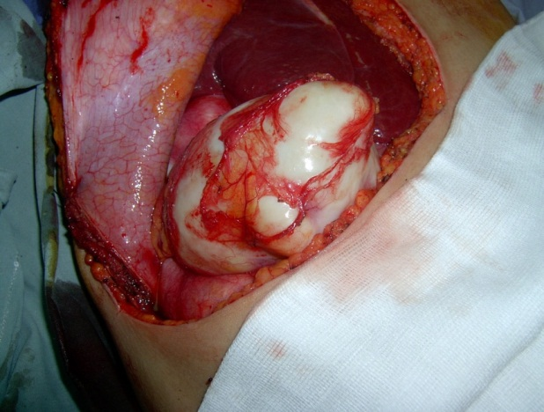
Source - google
Hydatid cyst of the peritoneum Dr.R.K.Sharma

Slide 14
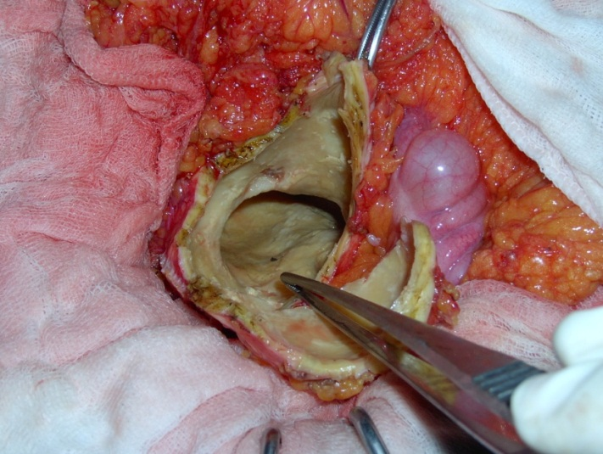
Source - google
Peritoneal Echinococcosis Dr. R.K.Sharma

Slide 15
Echinococcus : Diagnosis
Early detection of E. granulosus and E. multilocularis infections is based on clinical signs and symptoms.
Ultrasonography imaging is another technique for the diagnosis of both cystic and alveolar echinococcosis in human beings. This technique is usually validated by computed tomography (CT) and/or magnetic resonance imaging (MRI) scans.
Cysts can be also diagnosed by radiography and different serological tests .

Slide 16
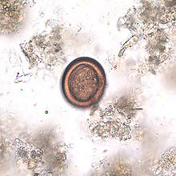
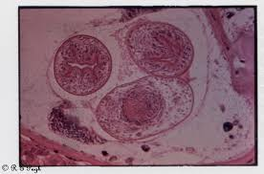
Source - google
Echinococcus : eggs Dr. R.K.Sharma

Slide 17
Echinococcus : management
Chemotherapy.
Cyst puncture.
PAIR (percutaneous aspiration, injection of chemicals and reaspiration) have been used to replace surgery as effective treatments for cystic echinococcosis.
The treatment of alveolar echinococcosis is more difficult than cystic echinoccosis.

