Slide 1
Family : Taeniidae Genus : Taenia
Instructor:
Dr R. K. Sharma
Assistant Professor
Veterinary Parasitology
Bihar Veterinary College, Patna.

Slide 2
Taenia :morphology
The adult Taenia spp. has a head (scolex) that consists of four suckers and a rostellum.
The rostellum is with a double crown of hooks, and unsegmented narrow neck.
They have a large body formed by several hundred proglottids.
The entire body is called a strobila and may range in size from two to eight meters long.
Each proglottid of Taenia has reproductive organs from both sexes and a complex absorption and reproduction system.
Proglottids that are closer to the scolex do not have sexual organs where as the further from the scolex, are more sexually matured proglottid.
Mature proglottids contain more than 50,000 fertile eggs which are accumulated with a long and profusely branched central uterus.

Slide 3
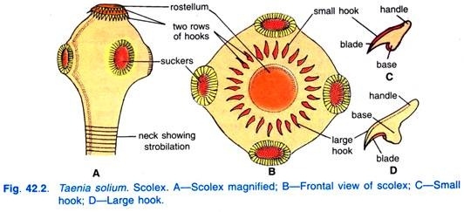
SOURCE-GOOGLE
Taenia : Parts of body. DR.R.K.SHARMA

Slide 4
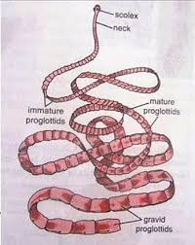
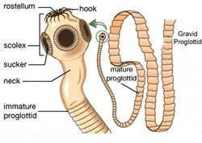
SOURCE-GOOGLE
Taenia : Parts of body. DR.R.K.SHARMA

Slide 5
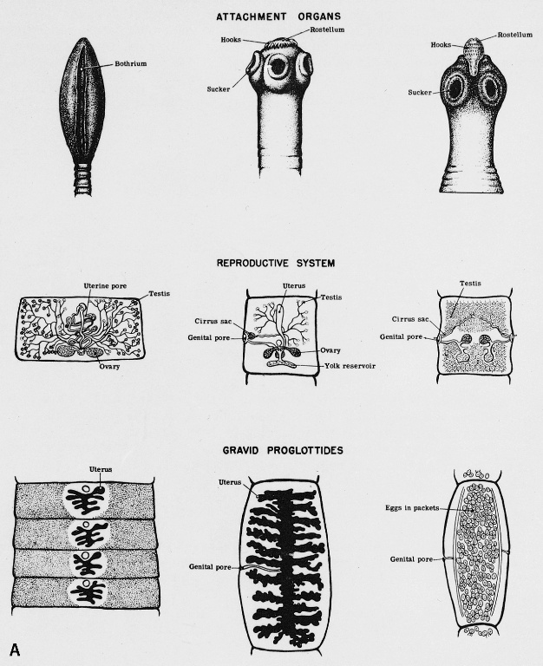
SOURCE-GOOGLE
Taenia : Parts of body. DR.R.K.SHARMA

Slide 6
Taenia : life cycle
Taenia life cycle completed through 3 stage i.e eggs, larvae, and adults.
Adults inhabit the intestines of definitive hosts, mammalian carnivores.
Eggs laid by adult tapeworms living in the intestines of definitive hosts are excreted with faeces into the environment .
These eggs are ingested by an intermediate host, in which the eggs hatch into larvae.
These larva develop, enter the circulation, and encyst in the musculature or other organs. When the intermediate host is eaten raw or undercooked meat, the parasites are released from the ingested cysts in the intestines and develop into adult tapeworms in the definitive host, restarting the cycle.

Slide 7
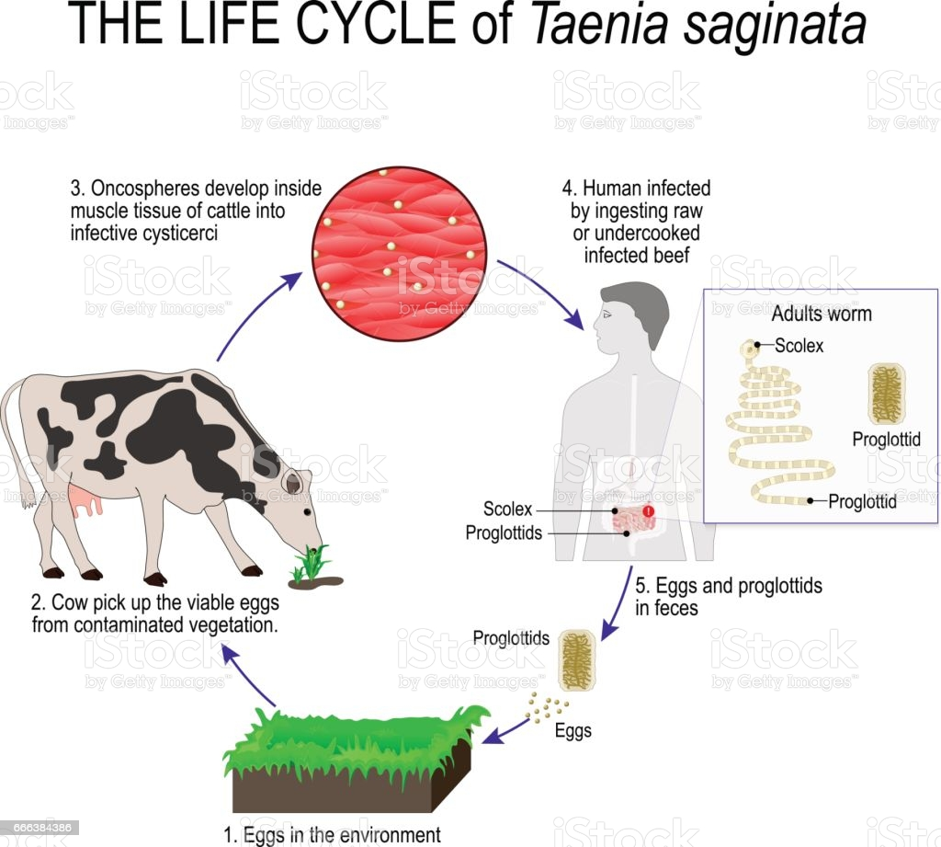
SOURCE-GOOGLE
Taenia : life cycle DR.R.K.SHARMA

Slide 8
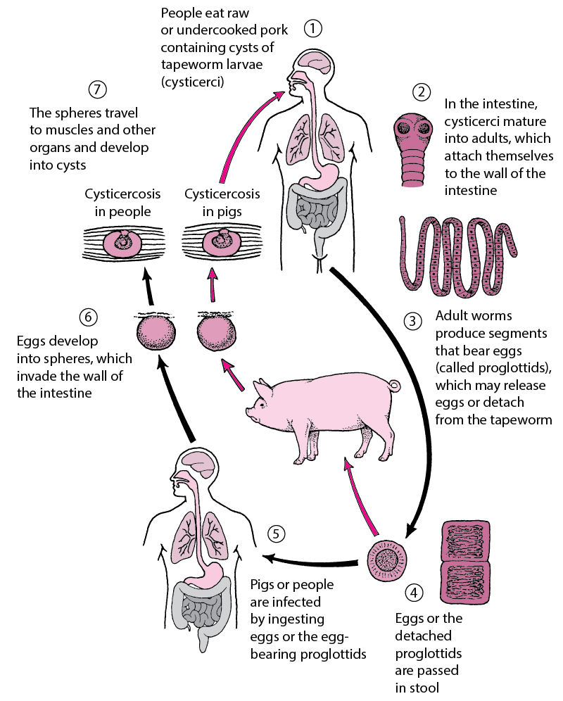
SOURCE-GOOGLE
Taenia : life cycle DR.R.K.SHARMA

Slide 9
Taenia : mode of transmission
Taeniasis and cysticercosis are common in areas where animal husbandry practices are such that pigs come into contact with human faeces.
Taeniasis is acquired by humans through the ingestion of cysticerci in undercooked or uncooked pork.
Once in the human body, cysticerci develop into adult worms that live in the intestine and release egg-bearing gravid proglottids (segments) which are passed in the faeces.
Cysticercosis is acquired when proglottids or eggs are ingested.
Cysticercosis is a natural infection of pigs, but it can also affect humans, usually when they swallow T. solium egg-contaminated soil, water or food.

Slide 10
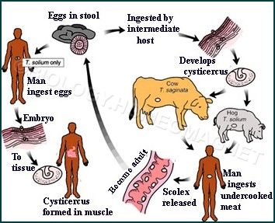
SOURCE-GOOGLE
Taenia : mode of transmission DR.R.K.SHARMA

Slide 11
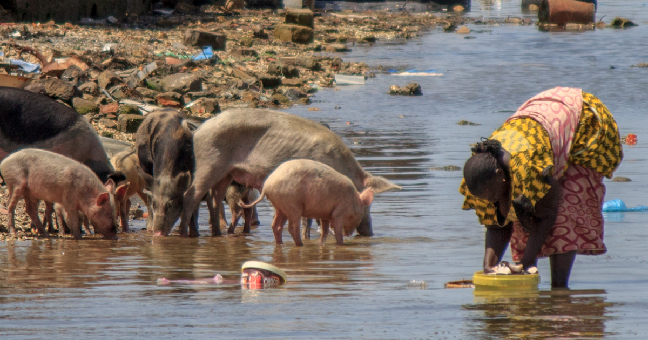
SOURCE-GOOGLE
Taenia : mode of transmission DR.R.K.SHARMA

Slide 12
Taenia : Pathogenesis
Viable cysticerci (larval form) in most organs cause minimal or no tissue reaction.
But dying cysts in the central nervous system, eye, or spinal cord can release antigens that cause an intense tissue response. Thus, symptoms often do not appear for years after infection.
Infection in the brain (neurocysticercosis) may result in severe symptoms due to mass effect and inflammation induced by degeneration of cysticerci and release of antigens.
Depending on the location and number of cysticerci, patients with neurocysticercosis may present with seizures, signs of increased intracranial pressure, hydrocephalus, focal neurologic signs, altered mental status, or aseptic meningitis.
Cysticerci may also infect the spinal cord, muscles, subcutaneous tissues, and eyes.

Slide 13
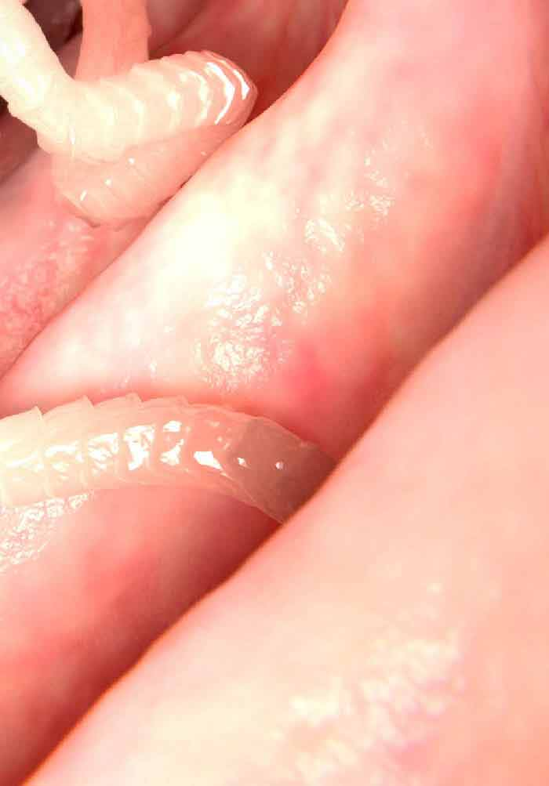
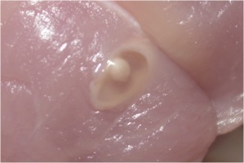
SOURCE-GOOGLE
Taenia : Pahogenesis DR.R.K.SHARMA

Slide 14
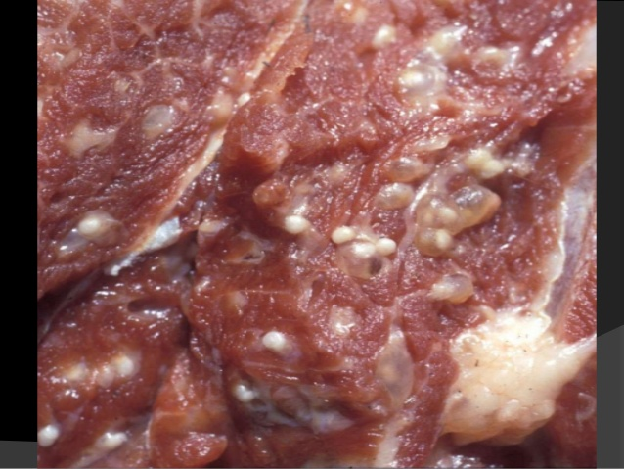
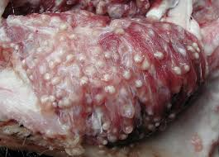
SOURCE-GOOGLE
Taenia : pathogenesis DR.R.K.SHARMA

Slide 15
Taenia : diagnosis
Diagnosis of Taenia tapeworm infections is made by examination of faecal samples for detection of tapeworm segments.
Faecal specimens should be collected on three different days and examined in the lab for Taenia eggs using a microscope.
Tapeworm eggs can be detected in the faeces 2 to 3 months after the tapeworm infection is established.

Slide 16
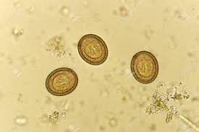
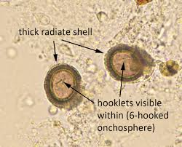
SOURCE-GOOGLE
Taenia : Eggs DR.R.K.SHARMA

Slide 17
Taenia : management
Management involve the following:
Thorough cooking of pork, beef , fish and other types of meat .
Prolonged freezing of meat for some tapeworms (e.g., fish tapeworm).
Regular deworming of dogs and cats.
Prevention of recycling through hosts (eg, dogs eating dead game or livestock).
Reduction and avoidance of intermediate hosts such as rodents, fleas, and grain beetles
Meat inspection.
Sanitary treatment of human waste.
Smoking and drying meat are ineffective in preventing infection

Slide 18
SOURCE-GOOGLE
Taenia : Management DR.R.K.SHARMA

Slide 19
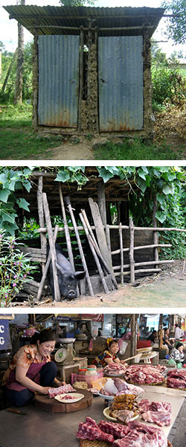
SOURCE-GOOGLE
Taenia : management DR.R.K.SHARMA

