Slide 1
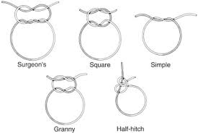
SUTURE MATERIAL AND SUTURING TECHNIQUES -III
Dr. Archana Kumari
Asstt. Professor cum Junior Scientist
Veterinary Surgery and Radiology
BVC, BASU, Patna

Slide 2
SUTURE MATERIAL

Slide 3
Ideal properties:
Easy to handle.
Predictable behaviour in tissues.
Predictable tensile strength.
Sterile.
Secure knotting ability.
Minimal tissue reaction.
Non-alergenic,non-carcinogenic,non-shrinkage

Slide 4
CLASSIFICATIONS OF SUTURE MATERIALS
According to source:
1.Natural
2.Synthetic
3.Metallic
According to structure:
1.Monofilament
2.Multifilament

Slide 5
CLASSIFICATIONS OF SUTURE MATERIALS
According to fate:
1.Absorbable
2.Non-absorbable
Organic
Inorganic
Synthetic
According to coating:
1.Coated
2.Uncoated

Slide 6
Non absorbable
Organic | Inorganic | Synthetic
Cotton | Mettalic suture | Nylon
Silk | Suture wire | Terelene
Horse hair | Stainless steel wire | Vetafil
Linen | Tantalum Wire | Polyester
Umblical tape | Wound Clips | Synthetic Mesh
Dermal suture | Pin suture | Surgilene
Silk worm gut | Mettalic Mesh | Polybutester

Slide 7
Absorbable
Catgut:
It is obtained from the from the submucosa of small intestine of a sheep .
Serosal layer of bovine intestine .
Initially it was reffered to as “kitgut” meaning the cord or string on fiddle.
It is composed of formaldehyde treated collagen fibres.
Sterlised by ionising radiation or by ethylene oxide.
Available in presterlised aluminium foils containing 85% ethyl alcohol, it cannot be autoclaved.
Heat denature the protein and tensile strength is reduced.
The absorption time can be delayed by treatment with chromic acid ,iodine , tannin , formalin,or other chemicals.
The catgut is also avialable as plain catgut, mild chromic catgut,mdium chromic catgut and extra chromic catgut based on the degree of treatment with chromic acid.
Plain Catgut Type A: Absorbed in about 5 days
Mild chromic catgut Type B : Absorbed in about 10 days
Medium Chromic Type C : Absorbed in about 20 days
Extra Chromic Type D : Absorbed in about 40 days

Slide 8
The material is available in sizes varying from no.
7/0 (Finest )
6/0
5/0
4/0
3/0
2/0
1/0
1
2
3 (Thickest )

Slide 9
In routine surgerical procedures, mild to medium chromic catgut is used.
It is absorbed and digested by macrophages and lysosomal enzymes.
Catguts weakens swell in vivo and henc result in poor knot security.

Slide 10
2. Kangaroo tendon :
It is obtained from the tendon of tail of the kankaroo
It is used for suturing joint capsule, hernial ring and places where more strength is required.
3. Fascia lata :
It is obtained from bovine fascia lata and it is available in tape like pieces preserved in glass tube.
4. Cargile membrane:
It is obtained ffom bovine caecum in the form of thin sheet
It is used to cover surfaces from which peritoneum has been removed. It is not gnerally used.
5. Collagen:
It is prepared from bovine flexor tendon fillament.
It is a multi-fillament absorbable suture and it is obserbed within 60 days.
It is treated with formaldehyde and chromic acid or both.
Less tissue reaction than catgut.
It is used in ophtalmic surgery.

Slide 11
. Polyglactin 910 (vicryl):
It is synthetic braided absorbable suture material consist of glycolic acid and lactic acid in the ratio of 9:1.
Sterlised by ethylene oxide.Absorbed by hydrolysis in 40 to 90 days .
Used in occular surgery and closing of muscles after laprotomy.
It is inert , non-pyrogenic and produces mild tissue reaction. It remains stable in contaminated wound.
7. Polyglycolic acid (dexon):
It is synthetic suture material prepared from glycolic acid.
It is smooth, strong and absorbable.
Absorbed in 100 to 200 days by hydrolysis.
Used in closure of clean wound .
size varies from 6/0 to 1.

Slide 12
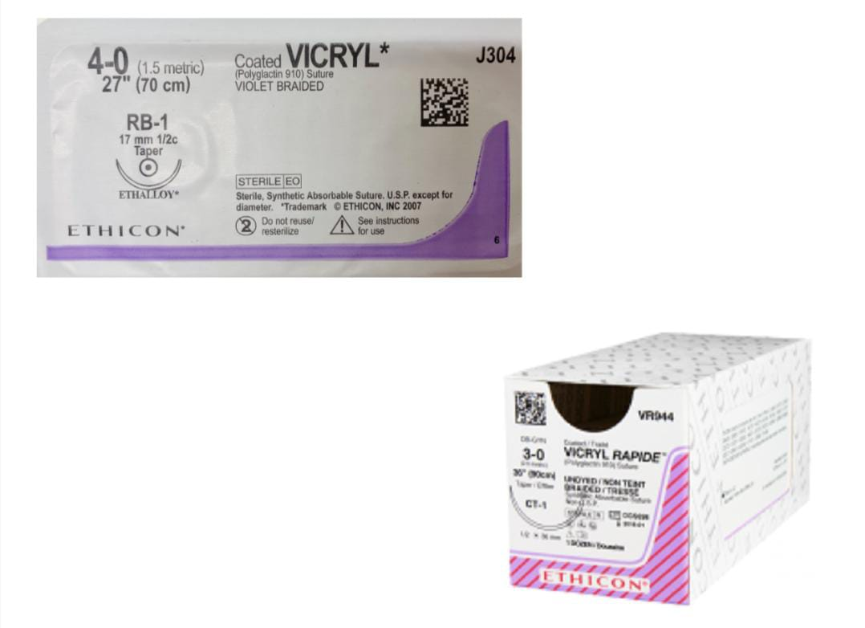
Vicryl

Slide 13
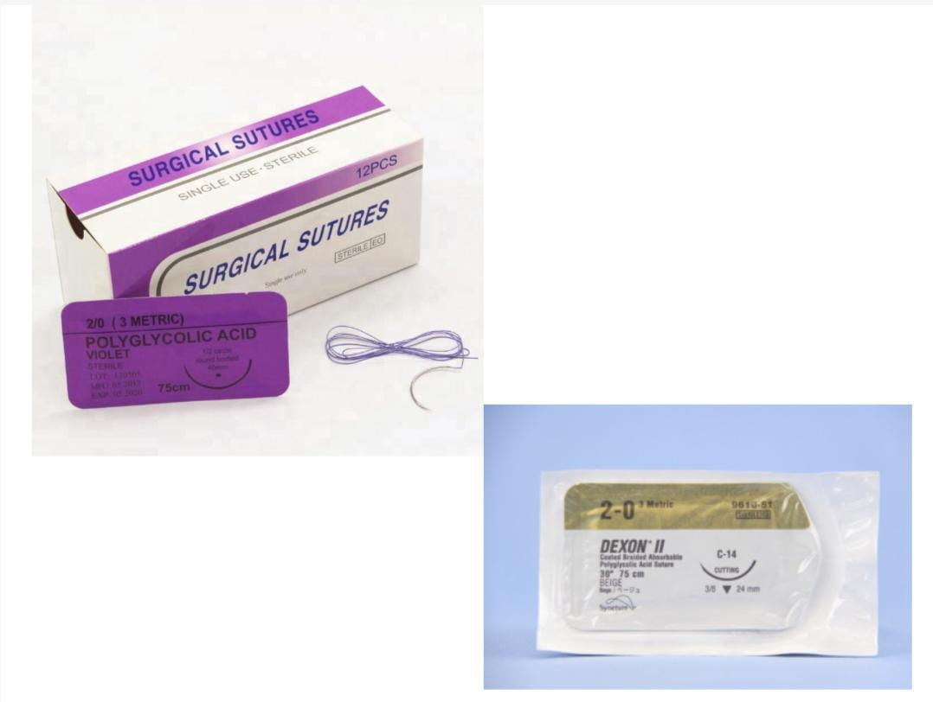
Dexon

