Slide 1
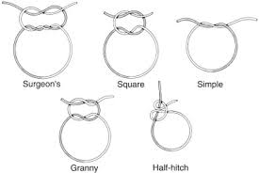
SUTURE MATERIAL AND SUTURING TECHNIQUES -IV
Dr. Archana Kumari
Asstt. Professor cum Junior Scientist
Veterinary Surgery and Radiology
BVC, BASU, Patna

Slide 2
SUTURE MATERIAL

Slide 3
Polydioxanone
It is synthetic monofilament polymer of paradioxanone.
It is sterlised by by ethylene polyglactin 910.
It is absorbed by hydrolysis
Absorption time 91 to 182 days.
On relative basis catgut loses its strength on 7 day, polyglactin at 10-19th day and polydioxanone at 20th day.

Slide 4
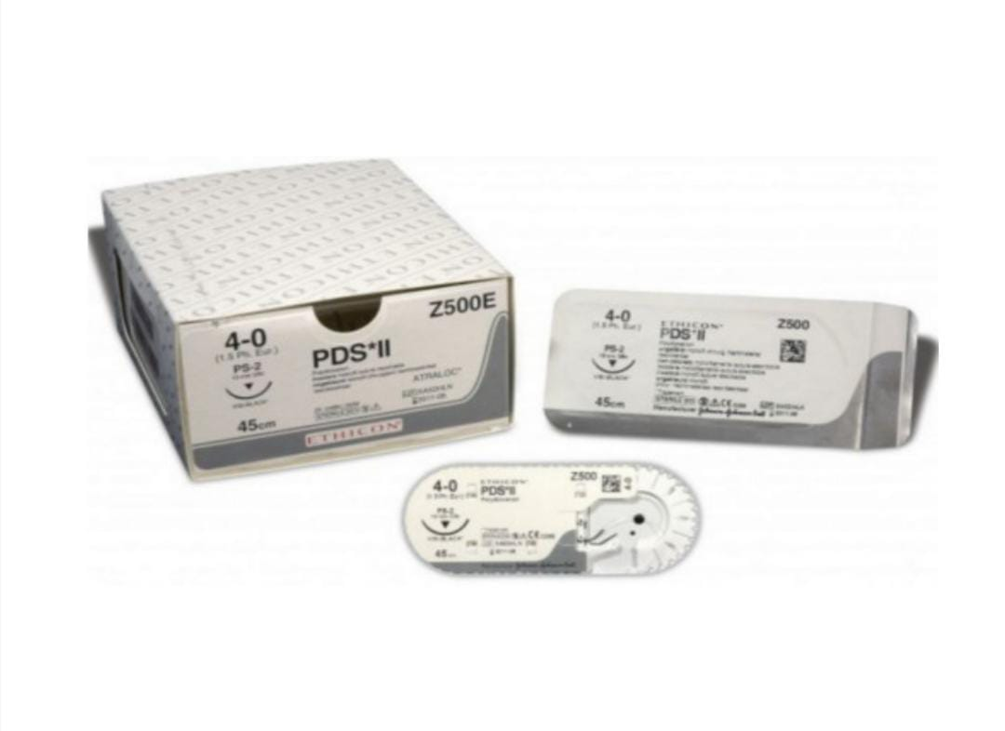
Polydioxanone

Slide 5
Non absorbable (Organic suture material)
Silk:
Obatined from the cocoon of the silk worm.
Dyed with the vegetable dye .
Its natural capillarity is decreased by treating it with oil, waxor silicone
And it is available as monofilament and braided multifilament.
Sterlised by autoclaving, binds with gammaglobulin leads to acute inflammation may cause ulceration in the GIT.
May act as nidus for calculus formation in the urinary bladder and gall bladder.
Cotton:
Less tissue reaction than silk.
Capillary in action
Silk worm gut:
It is smooth ,strong , non capillary and useful for cutaneous suture.
It is available in fine , medium, and coarse size 30 to 40 cm length

Slide 6
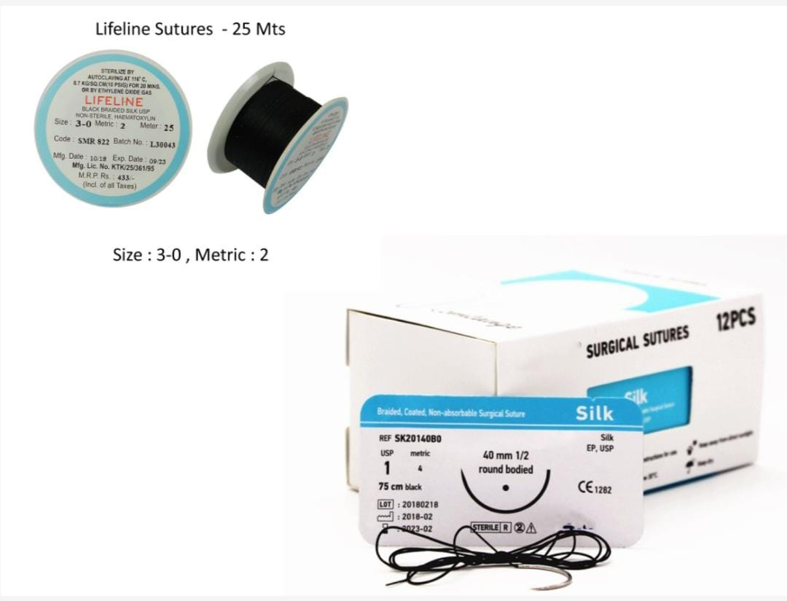
Silk

Slide 7
Horse hair :
It is cheap , non-capillary ,flexible and is easily sterlised .
It causes little tissue reaction.
Linen:
It is capillary in nature and produces more tissue reaction than cotton and silk.
Umblical Tape:
Cotton tape suture is about 1/4 cm wide and most often used to tie the umblical cord of the new born or as vulvar suture in cases of prolpse of vagina or uterus.
Dermal suture :
Non absorbable silk coated with tanned gelatin or other protein substances.

Slide 8
Inorganic suture material
Mettalic suture :
Wire of different metals like tatntalum ,silver ,copper, aluminium, vitallium(stainless steel).
Metal clips (wound clips):
They hold the skin in opposition over flat surfaces.
They causes less scarring.
Pin suture :
Ordinary pins can be used for keeping the skin edges together.
Wire mesh:
Tantalum and srainless steel mesh are used to cover defects in the abdominal wall in cases of hernia or injury.

Slide 9
Mettalic suture

Slide 10
Synthetic suture material
Nylon:
Obtained from hexamethylene diamine and adipic acid.
It is biologically inert and may be monofilament or mulifilament, and former is non-capillary.
It stimulates minimal tissue reaction .
It is not used within serous or synovial cavity because cut sharp ends can cause trauma due to friction .
It has poor handling characteristics and knot security.
Polyster Fiber
Synthetic mesh
Terelene
Synthetic mesh
Polybutester
Surgilene
Vetafil

Slide 11
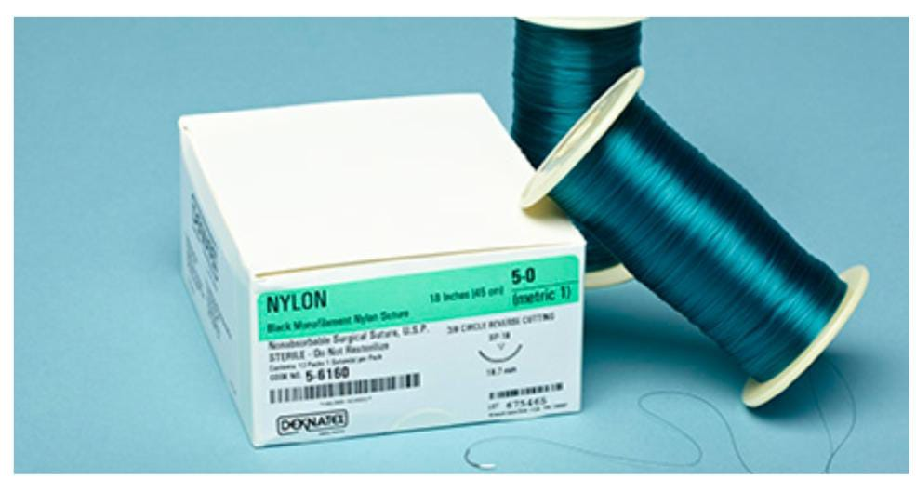
Nylon

Slide 12
Natural
Absorbable Non absorbable
catgut • Silk worm gut
Chromic • Silk
catgut Cotton
Collagen
Fascia lata
Beef tendon

Slide 13
Synthetic
Absorbable Non Absorbable
Polyglycolic acid Nylone
Polyglactic acid Polypropyline
Polyglactin(vicryl) Polysters
Polydioxanone(PDS Polyethelene

Slide 14
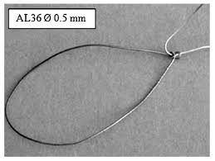
Metallic
SS(stainless steel)
Tantalum
Silver
Gold
Aluminium

Slide 15
Monofilament
Absorbable
Catgut
Chromic catgut
Vicryl
PDS
Non-absorbable
Polyoropylene
Polyester
Nylone
Polyvenyleidenefluoride /PVDF
suture

Slide 16
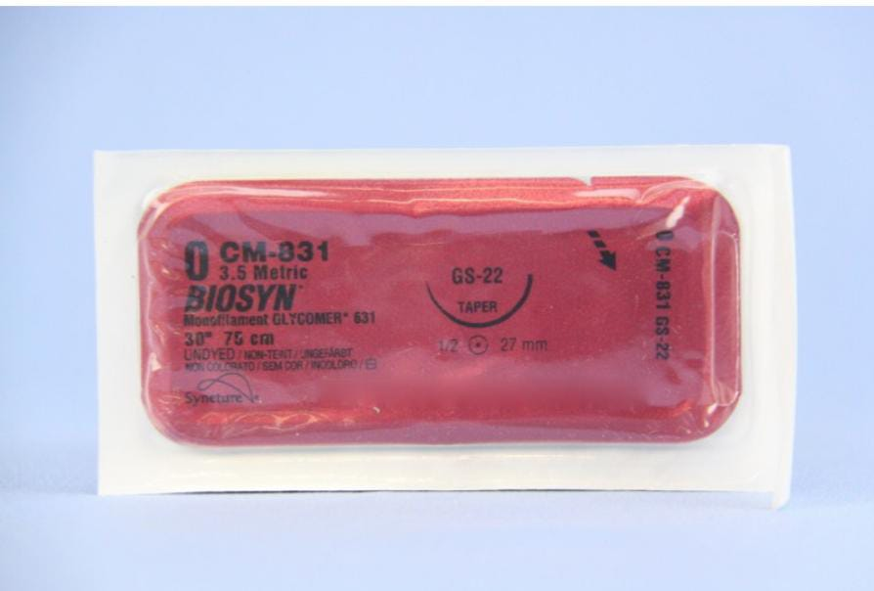
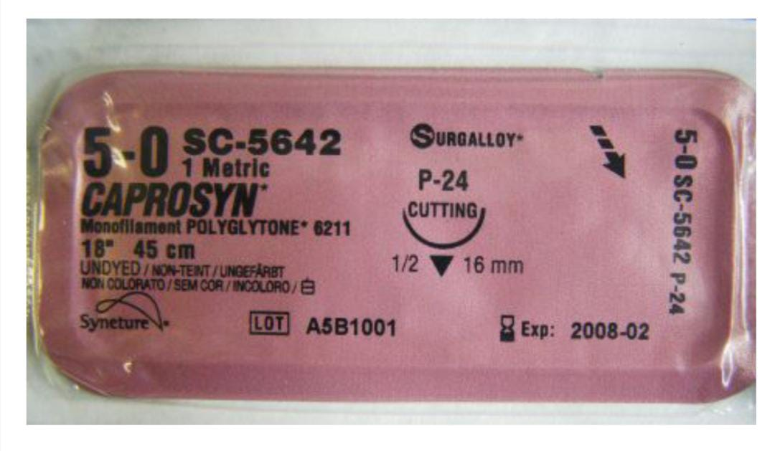
Monofilament

Slide 17
Monofilament vs multifilment
Monofilament
Has no capillary action
Less infection risk
Smooth tissue passage
Higher tensile strength
More throws required
Multifilament
Has capillary action
Increased infection risk
Less smooth passage
Less tensile strength
Better knot security

Slide 18
Absorbable vs Non absorbable
Absorbable
Degraded by enzymes ,hydrolysis or phagocytosis
Used to hold the edges in
approximation temporarily until the wound is heal
Non absorbable
Encapsulated or walled off by fibrosis
Used to suture at sites
where tensile strength need to be maintained

Slide 19
Selection of suture materials
Condition of the wound.
Tissues to be repaired.
Tensile strength.
Knot holding characteristics.
Reaction of surrounding tissues.

