Slide 1


Factors Affecting the Length of Estrus Cycle
Dr. D. Sengupta
Assistant Professor
Department of Veterinary Gynaecology & Obstetrics
Bihar Veterinary College, Patna- 14

Slide 2
Estrus Cyclicity: Following ovulation, the corpus luteum which forms subsequently in the ovary is “removed” to permit a new ovarian cycle to begin.
In this way, after a relatively short interval of time, a further opportunity is provided for the female to conceive. Exception- Dog

Slide 3
Factors Governing the Length of Estrus Cyclicity
Luteolysis and its Endocrine Control
Length of Follicular Phase
Endocrine Control of Tonic Center of Hypothalamus for GnRH Release
Pregnancy and Conception Failure

Slide 4
Luteolysis and its Endocrine Control
Luteolysis is the physiological apoptosis of the corpus luteum
In ruminants and swine this is mediated by Prostaglandin F_{2α} (PGF_{2α})

Slide 5
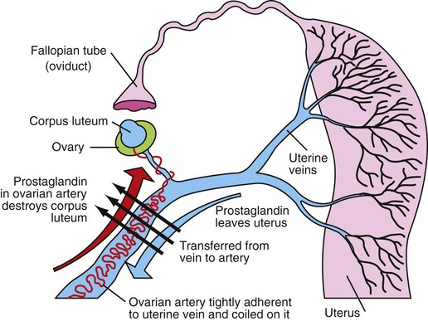
Pulsatile release of PGF_{2α} from the endometrium reaches the ovary by Utero-Ovarian Counter-Current Mechanism
Exception Mare! In mares the uterine PGF_{2α} is released in the blood and travels to the corpus luteum through general circulation i.e. endocrine manner. But the CL is much more efficient in capturing the PGF_{2α}.

Slide 6
Endocrine Control of PGF_{2α} Release
Oxytocin binds to its receptors in the plasma membrane and releases PGF_{2α}
Estradiol up-regulates OTRs and PRs
Progesterone down-regulates ERs and OTRs and PRs after a length of ten days exposure
PRs progressively decrease along the length of di-estrus
IFN tau down-regulates ERs, PRs and OTRs thus blocks PGF_{2α} release and abrogates luteolysis

Slide 7
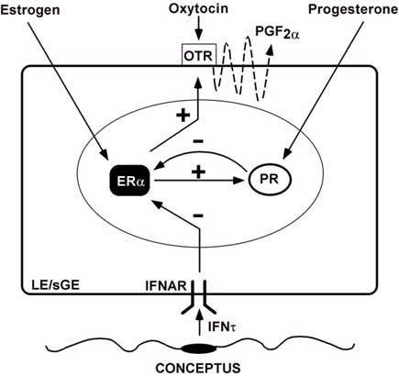
Endocrine Control of PGF_{2α} Release

Slide 8
Endocrine Control of PGF_{2α} Release
Length of diestrus
Length of Progesterone Exposure
Up-regulations of hypothalamic and endometrial ERs
Down-regulation of PRs
Up-regulation of endometrial OTRs and increased release of oxytocin from hypothalamic nuclei
Pulsatile Release of PGF_{2α}
Progression of folliculogenesis to Graafian Follicle
Luteolysis
ESTRUS

Slide 9
Timing of Onset of Pulsatile PGF_{2α} release in farm animals
Species | Day of Onset of Pulsatile Release of Endometrial PGF_{2α}
Cattle | 17
Sheep | 13
Goat | 18
Pig | 14-15
Mare | 15

Slide 10
Length of Follicular Phase
Species Variation: Length of follicular phase is only 2 to 3 days in ewes but 3 to 5 days in bovines
Individual Variation:
Over-Sensitivity of Tonic Hypothalamic GnRH release center- Prolonged Follicular Phase
Estradiol from the growing follicles reduces the LH pulse frequency and delays folliculogenesis

Slide 11
Endocrine Control of Tonic Center of Hypothalamus for GnRH Release
High Cortisol Level (Heat Stress)- Decreases LH pulse frequency and delays ovulation
High Melatonin Level (Photoperiodism)- Dark Hormone Melatonin increases/decreases GnRH release

Slide 12
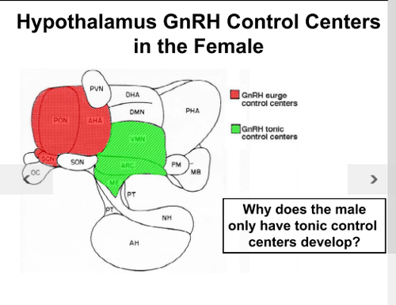

Slide 13
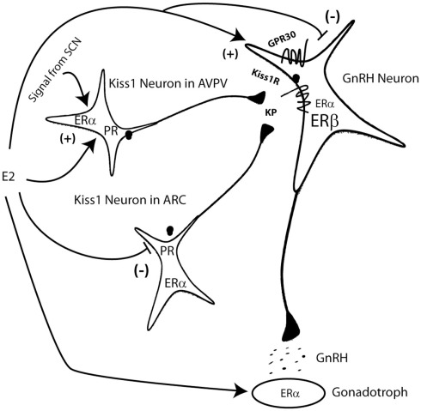
Action of Estrogen is Mediated by Kisspeptin Neurons

Slide 14
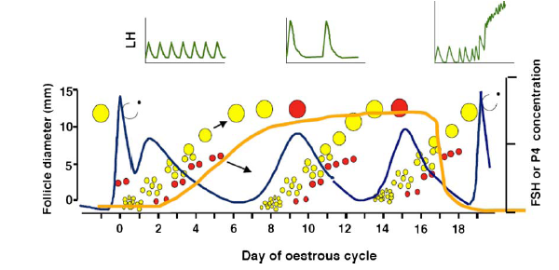
Schematic depiction of the pattern of secretion of follicle-stimulating hormone (FSH; blue line), luteinizing hormone (LH; green lines), and progesterone (P4; orange line); and the pattern of growth of ovarian follicles during the estrous cycle in cattle. Each wave of follicular growth is preceded by a transient rise in FSH concentrations. Healthy growing follicles are shaded in yellow, atretic follicles are shaded red. A surge in LH and FSH concentrations occurs at the onset of estrus and induces ovulation. The pattern of secretion of LH pulses during an 8-h window early in the luteal phase (greater frequency, lesser amplitude), the mid-luteal phase (lesser frequency, lesser amplitude) and the follicular phase (high frequency, building to the surge) is indicated in the inserts in the top panel.

Slide 15
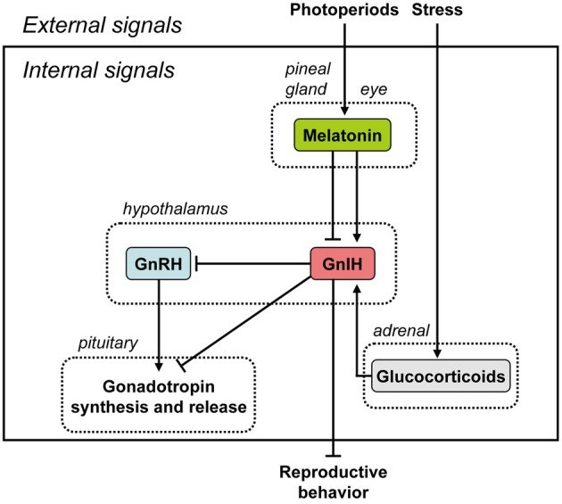
Seasonality/Photoperiod:
Summary of the neuroendocrine integration of environmental signals and internal signals to control reproduction. The neuroendocrine integration of environmental signals, such as photoperiods and stress, and internal signals, such as GnIH, melatonin, and glucocorticoids, is important for the control of avian and mammalian reproduction. GnIH inhibits gonadotropin synthesis and release by directly acting on the pituitary or by inhibiting the activity of GnRH neurons in birds and mammals. GnIH can also inhibit reproductive behavior by possibly acting within the brain. GnIH expression is photoperiodically modulated via a melatonin-dependent process. Melatonin induces the expression of GnIH in quail and rats, whereas melatonin inhibits the expression of GnIH in hamsters and sheep. Stress induces the expression of GnIH in birds and mammals. GnIH may therefore be a mediator of stress-induced reproductive disruption.

Slide 16
Early Embryonic Death/Conception Failure
Embryonic death before MRP does not affect the cycle length
Embryonic death after MRP often leads to extension of cycle length
This is mediated by Interferon tau released by the trophoblast that extends the luteal lifespan

Slide 17
Thank You!

